Slide 2
Gaining Clarity Around the KAS for Mathematics Through PLCs
Erin Chavez
Maggie Doyle

Slide 3
Today, we will...
Explore the Breaking Down a Standard resource through the lens of how this resource can strengthen the connection between the components of the KAS and how those components support teachers in designing standards-aligned instruction
Experience how the changes in the KAS can and will be reflected in student experiences within Kentucky classrooms, specifically how this resource can help ensure students have access to grade-level assignments.
Notes:
Description:
You know that moment in most Hallmark movies when the main characters have an experience that leads them to see one another in a whole new light? Not to oversell it, but this session will likely be just like that, only with the roles of the main characters being played by you and the KAS for Mathematics. Together we will look beyond the surface of a standard you may be familiar with (it might even be one you are currently teaching) and use a series of guiding questions to see that standard with a clarity that may have been missing before. During the session, we'll apply that clarity to a process teachers can use to reflect on an assignment. You'll leave with experience using (FREE) tools available on kystandards.org to see a standard with #nofilter. You'll also have valuable insight that will be really useful in your personal planning and in collaborations with your PLC moving forward.

Slide 4
All the resources we will use today are available on kystandards.org

Slide 5
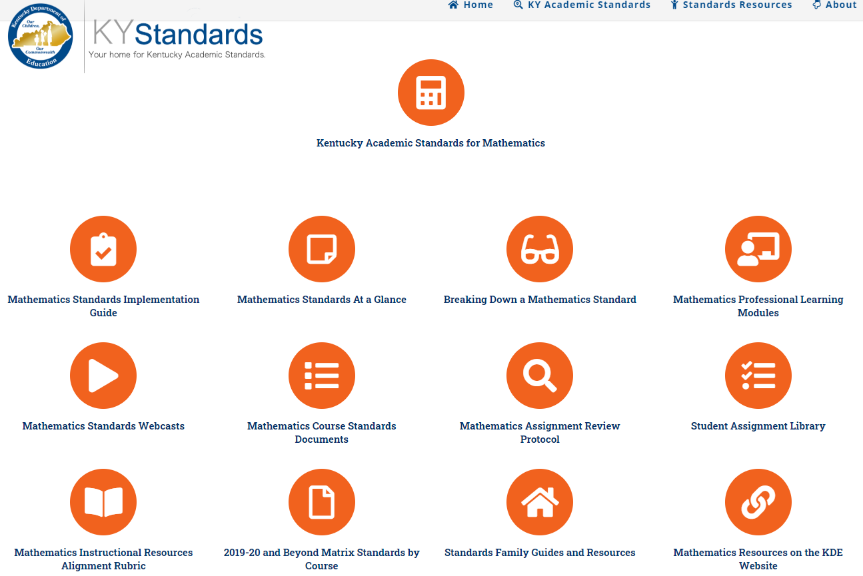
All the resources we will use today are available on kystandards.org

Slide 6
Breaking Down a Standard Protocol
Highlights the role each component within the KAS for Mathematics plays in answering the question, “What do we expect our students to learn?”
If teachers/teacher teams/instructional leaders are struggling with understanding the depth of a standard this is a resource that will help provide clarity around the standard.
Notes:
From Implementation Guidance Document: This protocol guides participants through taking a deeper look at a specific standard in order to better understand the instructional implications and how those will impact student learning. If teachers/teacher teams/instructional leaders are struggling with understanding the depth of a standard this is a resource that will help provide clarity around the standard.

Slide 7
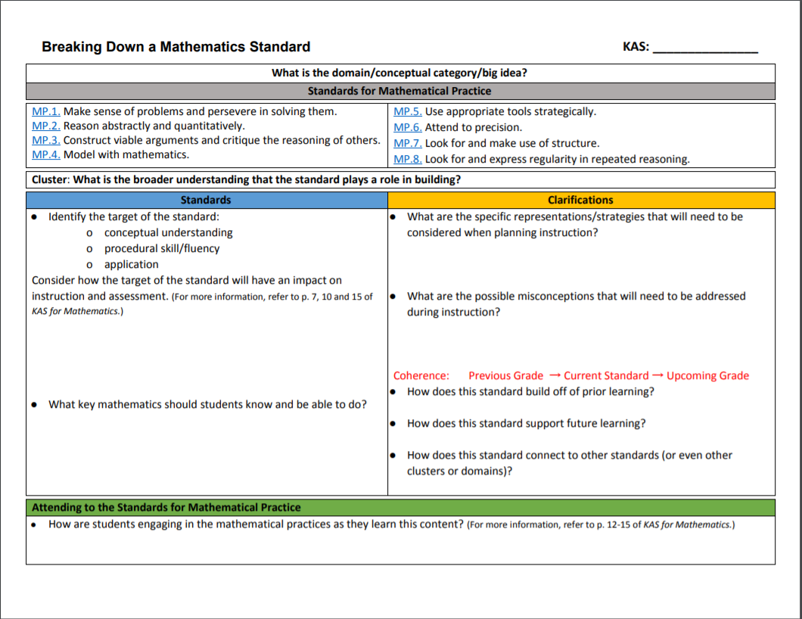
Breaking Down a Standard p. 1
Notes:
Something to note that was very intentional was how much this tool mirrors the actual standards page. The revision team of the standards worked really hard to embed within the standards page itself. This tool will really guide teachers through how they can utilize the information within the KAS document to create a well rounded understanding of the standards.

Slide 8
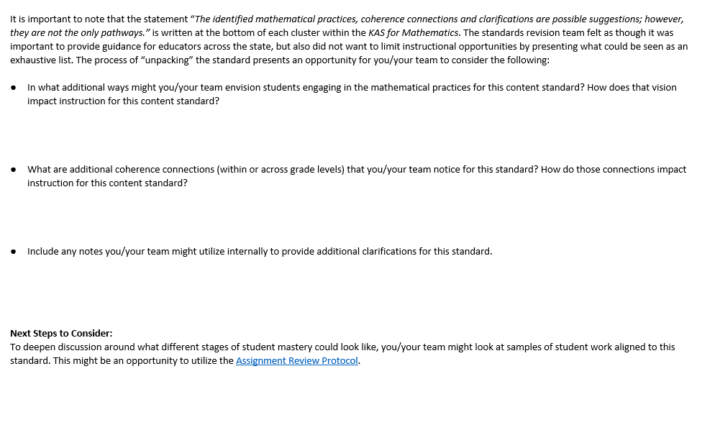
Breaking Down a Standard p. 2
Notes:
Zoom past this really quickly since the questions are on another slide later.

Slide 9
Initial Overview
Use the KAS for Mathematics to identify:
What is the domain/conceptual category/big idea?
What is the broader understanding the standard plays a role in building (cluster)?
Notes:
Give participants time to read and answer

Slide 10
Standards

Slide 11
A Closer Look at the Standards for Mathematical Content
The Standards for Mathematical Content are a balanced combination of conceptual understanding, procedural skill/fluency and application.
Conceptual understanding-refers to understanding mathematical concepts, operations and relations. Conceptual understanding is more than knowing isolated facts and methods; students should be able to make sense of why a mathematical idea is important and the kinds of contexts in which it is useful. Conceptual understanding allows students to connect prior knowledge to new ideas and concepts.
Notes:
Talking points:
When participants are reading what conceptual understanding means, have them choose a word that resonates with them and have them write them on their whiteboards.. Can they also name a conceptual understanding standard that they teach in mathematics?

Slide 12
A Closer Look at the Standards for Mathematical Content
The Standards for Mathematical Content are a balanced combination of conceptual understanding, procedural skill/fluency and application.
Procedural skill/fluency-is the ability to apply procedures accurately, efficiently, flexibly and appropriately. It requires speed and accuracy in calculation while giving students opportunities to practice basic skills. Students’ ability to solve more complex application and modeling tasks is dependent on procedural skill and fluency.
Notes:
Talking points:
When participants are reading what procedural skill and fluency means, have them choose a word that resonates with them and have them write them on their whiteboards. Can they also name a procedural skill or fluency standard they teach in mathematics?

Slide 13
A Closer Look at the Standards for Mathematical Content
The Standards for Mathematical Content are a balanced combination of conceptual understanding, procedural skill/fluency and application.
application-provides a valuable context for learning and the opportunity to solve problems in a relevant and a meaningful way. It is through real-world application that students learn to select an efficient method to find a solution, determine whether the solution(s) makes sense by reasoning and develop critical thinking skills.
Notes:
Talking points:
When participants are reading what application means, have them choose a word that resonates with them and have them write them on their whiteboards.Can they also think of an application standard they teach or have recently taught.

Slide 14
Clarifications

Slide 15
Coherence
Reading the Coherence/Vertical Alignment: Within Grade Levels
Reading the Coherence/Vertical Alignment: Across Grade Levels

Slide 16
A Closer Look at the Standards for Mathematical Practice
MP.1: Make sense of problems & persevere in solving them.
MP.2: Reason abstractly and quantitatively.
MP.3: Construct viable arguments and critique the reasoning of
others.
MP.4: Model with mathematics.
MP.5: Use appropriate tools strategically.
MP.6: Attend to precision.
MP.7: Look for and make use of structure.
MP.8: Look for and express regularity in repeated reasoning.

Slide 17
Attending to the SMPs:
Refer to p 12-15 of the KAS for Mathematics.
Engaging the SMPs: Look fors and Question Stems
Provides guidance on ways teachers can design instruction to allow students to engage in the standards for mathematical practices (SMP). Intentionally integrating opportunities for students to engage with the SMPs is critical to facilitating student growth in mathematical maturity and expertise throughout the elementary, middle and high school years. Resource includes Student Look-fors, Teacher Look-fors and potential Question Stems for each of the eight mathematical practices.
Notes:
Address misconception with MPs tagged to content standards.

Slide 18
The process of “breaking down” a standard presents an opportunity for you/your team to consider the following:
In what additional ways might you/your team envision students engaging in the mathematical practices for this content standard? How does that vision impact instruction for this content standard?
What are additional coherence connections (within or across grade levels) that you/your team notice for this standard? How do those connections impact instruction for this content standard?
Include any notes you/your team might utilize internally to provide additional clarifications for this standard.
Notes:
Notes:It is important to note that the statement “The identified mathematical practices, coherence connections and clarifications are possible suggestions; however, they are not the only pathways.” is written at the bottom of each cluster within the KAS for Mathematics. The standards revision team felt as though it was important to provide guidance for educators across the state, but also did not want to limit instructional opportunities by presenting what could be seen as an exhaustive list.

Slide 19
Next Steps to Consider:
To deepen discussion around what different stages of student mastery could look like, you/your team might look at samples of student work intended to align to this standard. This might be an opportunity to utilize the Assignment Review Protocol.

Slide 20
Assignment Review Protocol: Mathematics
Intended to help teachers, leaders and other stakeholders answer the question, “Does this task give students the opportunity to meaningfully engage in worthwhile grade-appropriate content?” This protocol is designed to guide participants through the process of reviewing a single task/assignment.
PART ONE: Mathematical Content
Section 1: Target of the Standard
Section 2: Coherence
Section 3: Cognitive Complexity
PART TWO: Mathematical Practices
PART THREE: Relevance
PART FOUR: Student Performance (if applicable)
Notes:
Provide participants with the sample tasks and allow them to work/discuss at their table.

Slide 21
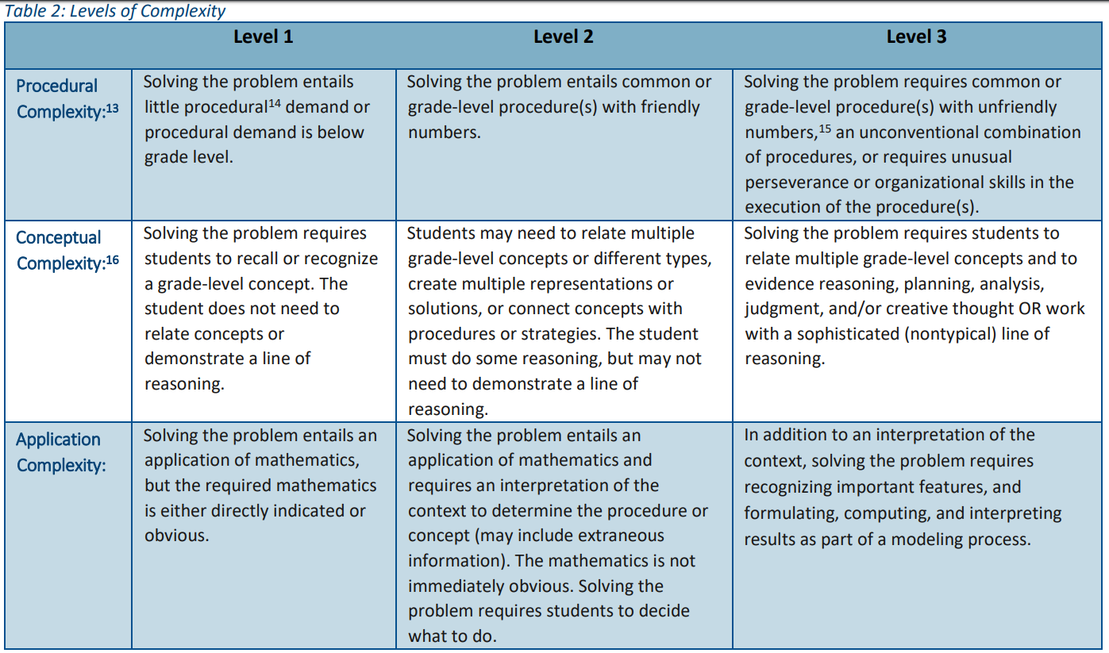
Cognitive Complexity

Slide 22
Consider what’s next for this assignment
Is it already strongly aligned to the standard?
If not
Could minor revisions improve the alignment?
Could another assignment fill the gaps that showed up when examining this assignment?
Is instruction balanced when considered collectively?

Slide 23
5 Things to Know Before you Go
Subscribe to www.kystandards.org
Upcoming April Professional Learning
Digital Professional Learning: April 23
Grade Level Samples: Unpacking the Standards & Assignment Review Protocol
Utilize the Standards Family Guides
Be on the lookout for summer PD opportunities

