Slide 2
KAS for Reading & Writing:
Breaking Down a Standard Protocol

Slide 3
Academic Program Consultants
Kelly Philbeck
kelly.philbeck@education.ky.gov
Whitney Hamilton
whitney.hamilton@education.ky.gov

Slide 4
Kystandards.org page

Slide 5
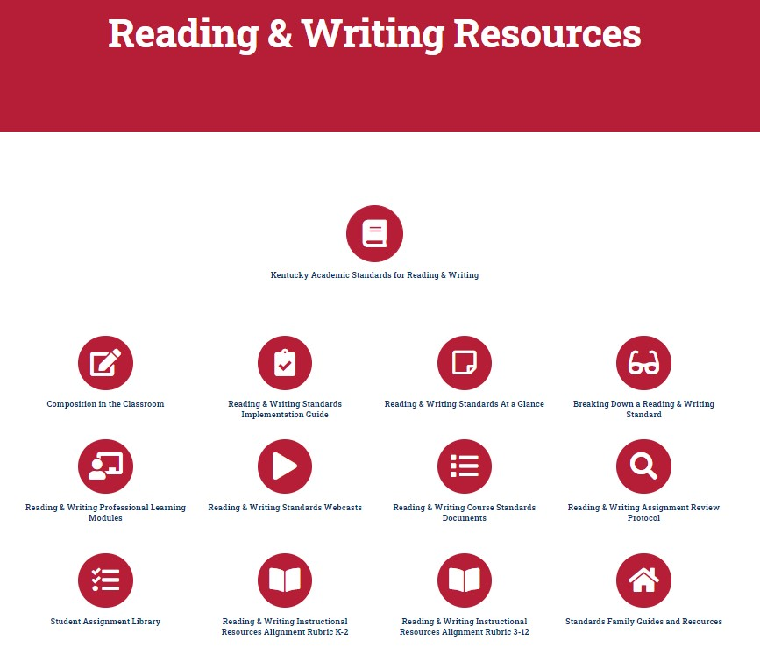
Reading and Writing Resources

Slide 6
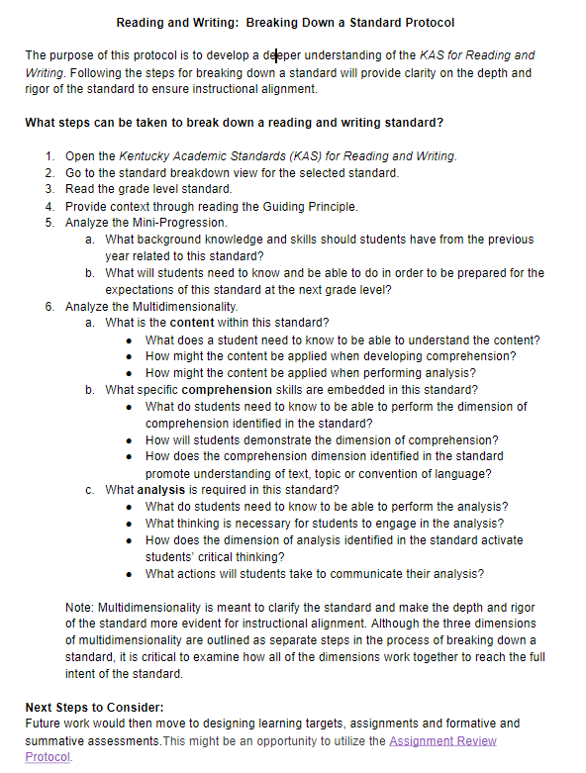
Protocol

Slide 7
Essential Questions:
What are the critical components of breaking down a KAS for Reading and Writing grade level standard?
How can the KAS for Reading & Writing Breaking Down a Standard Protocol support teachers in identifying what students need to learn at a particular grade level?

Slide 8
Step One:
Open the Kentucky Academic Standards (KAS) for Reading and Writing

Slide 9
KAS for Reading & Writing

Slide 10
Step Two:
Go to the Standard Breakdown View for the Selected Standard

Slide 11
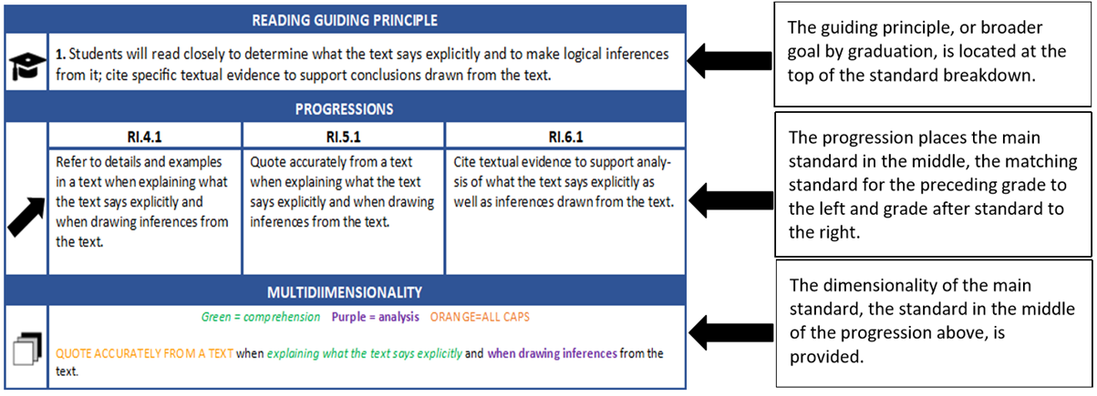
Kentucky Academic Standards for Reading and Writing

Slide 12
Step Three:
Read the grade level standard

Slide 13
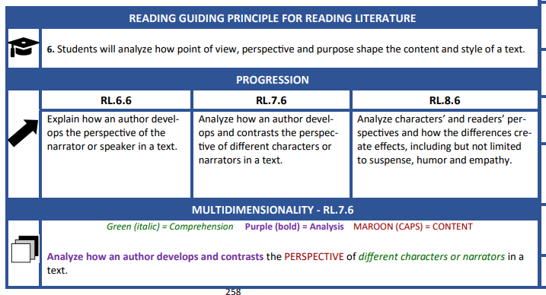
Standard Breakdown View

Slide 14
Step Four:
Provide context through reading the Guiding Principle

Slide 15
Guiding Principles
Define general, interdisciplinary literacy expectations
Set broader literacy goals for students to be transition ready
Each grade level is responsible for a grade-specific standard that progresses toward the guiding principle.
Grade-specific standards are expected to be retained or further developed each year as students work toward the guiding principle.

Slide 16
Guiding Principle

Slide 17
Point of View vs. Perspective vs. Purpose
Point of View vs. Perspective vs. Purpose
Point of View | Perspective | Purpose
the type of narrator (1st, 2nd, 3rd, 3rd omniscient) Who is telling the story? Who is speaking? | how the narrator or characters perceive what is happening in the story | the author’s reason for writing

Slide 18
Step Five:
Analyze the Mini-Progression

Slide 19
Mini-Progression
Shows year to year progression
Main standard in the middle
Previous grade to the left
Following grade to the right

Slide 20
Mini-Progression

Slide 21
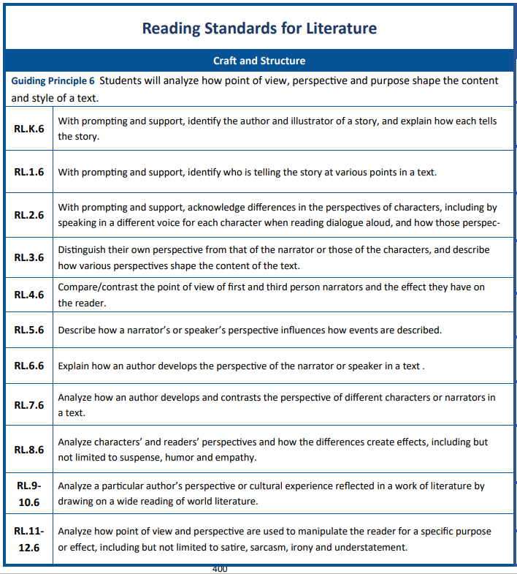
Standard 6 Full Progression View

Slide 22
Step Six:
Analyze the Multidimensionality

Slide 23
Multidimensionality
The standards consist of multiple dimensions or layers. Multidimensionality is coded on the grade level standard to reflect the CONTENT, the comprehension and the analysis components within the standard.

Slide 24
Multidimensionality
In planning and instruction, teachers will need to know when to utilize the interdependence of a standard’s CONTENT, comprehension and analysis to develop the students’ skills and knowledge to become independent and proficient thinkers.

Slide 25
Multidimensionality

Slide 26
Multidimensionality
Analyze...
What is the content within this standard?
What specific comprehension skills are embedded in this standard?
What analysis is required in this standard?

Slide 27
Multidimensionality: Content
What is the content within this standard?
What does a student need to know to be able to understand the content?
How might the content be applied when developing comprehension?
How might the content be applied when performing analysis?

Slide 28
Multidimensionality: Comprehension
b. What specific comprehension skills are embedded in this standard?
What do students need to know to be able to perform the dimension of comprehension identified in the standard?
How will students demonstrate the dimension of comprehension?
How does the comprehension dimension identified in the standard promote understanding of text, topic or convention of language?

Slide 29
Multidimensionality: Analysis
c. What analysis is required in this standard?
What do students need to know to be able to perform the analysis?
What thinking is necessary for students to engage in the analysis?
How does the dimension of analysis identified in the standard activate students’ critical thinking?
What actions will students take to communicate their analysis?
Notes:
Whitney’s last slide

Slide 30
RL.7.6
Analyze how an author develops and contrasts the PERSPECTIVE of different characters or narrators in a text.
CONTENT = MAROON (CAPS) Analysis = Purple (bold) Comprehension = Green (Italic)

Slide 31
Critical Note:
Multidimensionality is meant to clarify the standard and make the depth and rigor of the standard more evident for instructional alignment.
Although the three dimensions of multidimensionality are outlined as separate steps in the process of breaking down a standard, it is critical to examine how all of the dimensions work together to reach the full intent of the standard.

Slide 32
RL.7.6
Analyze how an author develops and contrasts the PERSPECTIVE of different characters or narrators in a text.
CONTENT = MAROON (CAPS) Analysis = Purple (bold) Comprehension = Green (Italic)

Slide 33
Recap
Read your grade level standard.
Provide context through the guiding principle.
Analyze the mini-progression.
Analyze the multidimensionality.
Examine the interdependence of the dimensions to reach the full intent of the standard.

Slide 34
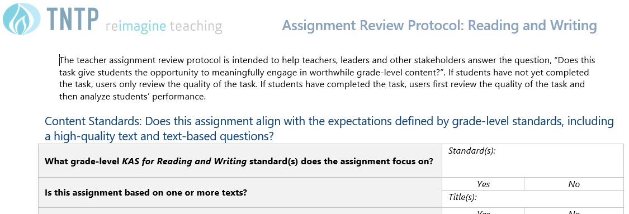
Next Steps to Consider:
Future work would then move to designing learning targets, assignments and formative and summative assessments.This would be an opportunity to utilize the Assignment Review Protocol.

Slide 35
Questions? Contact Us:
ELA Team
elateam@education.ky.gov

Slide 36
Certificate of Completion
Thank you for completing this asynchronous module provided by the KDE.
Please use the link below to obtain your certificate of completion.
Kentucky Department of Education Professional Learning Modules
Educators can use the PLBB to find learning sessions, and it is the local school district who determines if they are acceptable for credit based on their district policies. See 704 KAR 3:035 for more details.

