Slide 2
Fall Wrap Up and Spring Preview
Webcast
December 5, 2019
Notes:
Jackie
GoSoapbox KAS

Slide 3
Essential Questions:
What resources are available to Kentucky educators for implementing the KY Academic Standards (KAS)?
How might schools and districts utilize these tools in their implementation plans?
Notes:
Misty

Slide 4
KAS 3 Year Implementation
Notes:
Misty:
Discuss the plan this year and 2 out: Goal this year is getting to know the standards. kystandards.org; modules starting point. Start with a deep understanding of the standards

Slide 5
KAS 3 Year Implementation Plan Snapshot
Year 1 - Systems/Structures to Support Standards Implementation
2019-2020
Year 2 - Balanced Assessment
2020-2021
Year 3 - Instructional Best Practice
2021-2022
Notes:
Misty

Slide 6
Fall 2019 Resources
Professional Learning Modules
Assignment Review & Alignment Professional Learning for Reading and Writing and Mathematics
Effective Literacy Instruction: Understand Text-Dependent Questions
Social Studies: Minding the Gap
Social Studies: Inquiry Ready
Science: Getting to Know Your KAS

Slide 7
Your Standards Resources
Notes:
Subscribe, then click to circle “Your Standards Resources”

Slide 8
Standards Resources

Slide 9
Fall 2019 Resources
Other Resources
Standards Webcasts
Student Assignment Library
Reading and Writing
Mathematics
Standards Family Guides & Resources
Social Studies Resources
Glossary of Terms
Student Work Review Protocol

Slide 10
Your Standards Resources
Notes:
Subscribe, then click to circle “Your Standards Resources”

Slide 11
Standards Resources

Slide 12
Fall 2019 Resources
Other Resources
Standards Webcasts
Student Assignment Library
Reading and Writing
Mathematics
Standards Family Guides & Resources
Social Studies Resources
Glossary of Terms
Student Work Review Protocol

Slide 13
Student Assignment Library

Slide 14
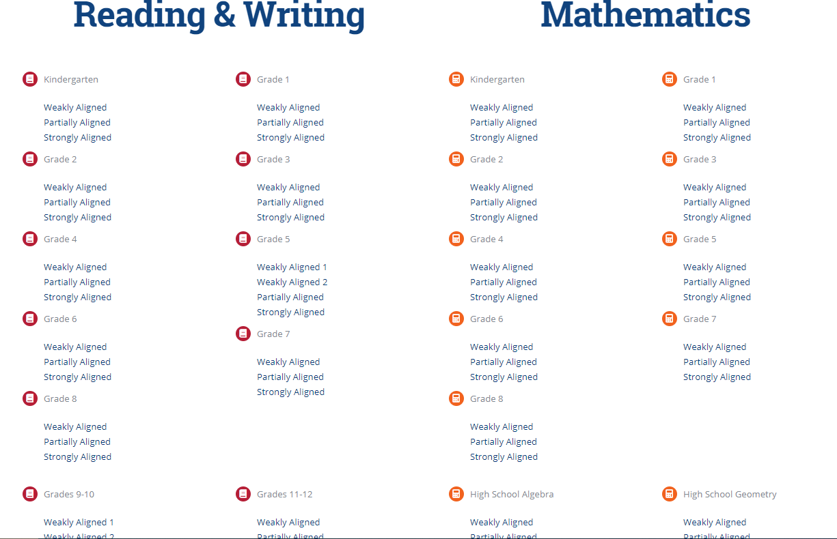
Student Assignment Library

Slide 15
Fall 2019 Resources
Other Resources
Standards Webcasts
Student Assignment Library
Reading and Writing
Mathematics
Standards Family Guides & Resources
Social Studies Resources
Glossary of Terms
Student Work Review Protocol

Slide 16
Standards Family Guides and Resources

Slide 17
Standards Family Guide and Resources

Slide 18
Fall 2019 Resources
Other Resources
Standards Webcasts
Student Assignment Library
Reading and Writing
Mathematics
Standards Family Guides & Resources
Social Studies Resources
Glossary of Terms
Student Work Review Protocol

Slide 19
Social Studies Resources

Slide 20
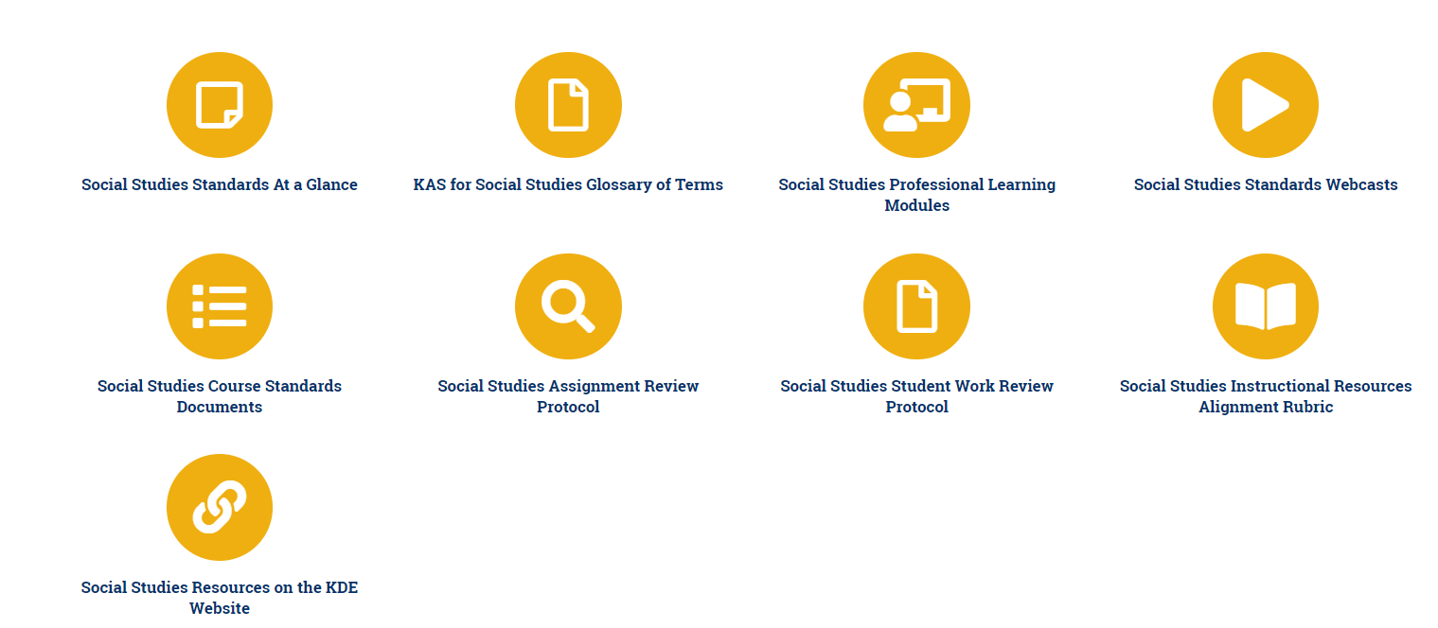
New Social Studies Resources

Slide 21
Spring 2020
Professional Learning Series
Webcasts
1st & 3rd Thursday at 9 am ET
Digital Professional Learning Opportunity
4th Thursday on kystandards.org
Topic Study
Building a Culture of Learning: Focus on PLCs
Notes:
Misty

Slide 22
Content Area Focus
January - Science
February - Social Studies
March - Reading and Writing
April - Mathematics
May - Preview Summer PL Opportunities
Notes:
Misty

Slide 23
Your Standards Resources
Notes:
Misty

Slide 24
Professional Learning Opportunities
Notes:
Misty

Slide 25
Professional Learning Opportunities
Notes:
Misty

Slide 26
Things to Know Before you Go
Subscribe to www.kystandards.org
Next Webcast: January 9 at 9:00 am ET
Coming in January: Implementation Guidance Documents
Spring Topic Study
Building a Culture of Learning: A Focus on PLCs
1/13/20-4/17/20
Registration Closes 1/10/20
Notes:
Misty

