Slide 1
Improving Student Engagement in the Science Classroom Using a Driving Question Board (DQB)
Modified from Casandra Gonzalez, Ryan King and Missy Weatherly (2023). [What is a “Driving Question Board” and how can it improve student engagement in class? from the Advancing Coherent and Equitable Systems of Science Education (ACESSE) Project. This work is licensed under a Creative Commons Attribution-ShareAlike 4.0 Unported License. Educators and others may use or adapt. If modified, please attribute and re-title. CC BY-SA license details are at https://creativecommons.org/licenses/by-sa/4.0/.

Slide 2
Module Goals
Explain what a driving question board is and understand its purpose in the science classroom.
Identify ways that the driving question board can build a community of learners.
Analyze how a cohesive storyline can be built around an anchoring phenomenon.
Generate ideas for how a driving question can be used as a formative assessment tool.

Slide 3
Group Norms
Presume positive intentions.
Listen carefully to one another.
Be open to new ideas.
Be open to productive struggle.
Ask questions.
Allow a chance for everyone to participate.

Slide 4
Sessions in this Module
Session A:
What is a driving question board and what is its purpose in the science classroom?
Session B:
How does the use of a driving question board foster a community of learners in terms of student engagement and motivation?
Session C:
How can a driving question board anchored in a phenomenon be used to build a cohesive storyline?
Session D:
Why should the driving question board be used as a formative assessment tool to foster an equitable learning community?

Slide 5
Session A
Focus Question:
What is a driving question board and what is its purpose in the science classroom?

Slide 6
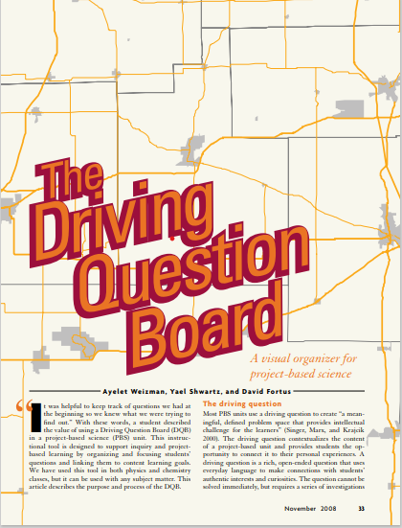
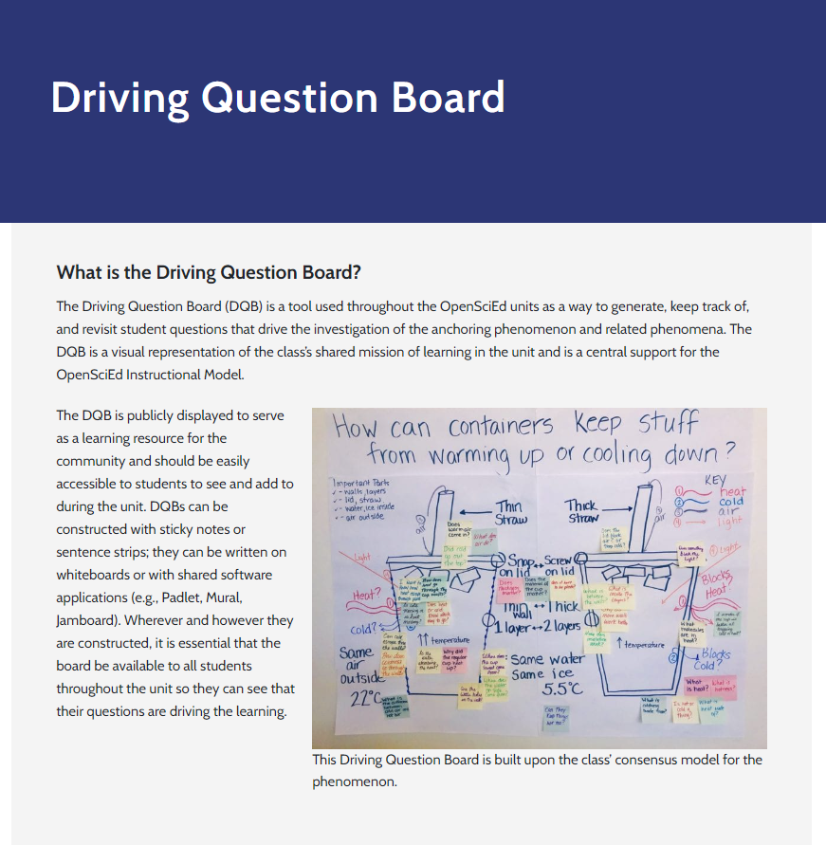
Articles to Read
Read the following two articles about a
driving question board. As you read, jot your responses to the following questions in the Session A: Notes section of your participant packet.
Focus Questions:
What is the driving question board?
What is the purpose of the driving question board in the science classroom?
How does the driving question board support equitable science classrooms?
What resonates with you in how this can be impactful in the classroom?
Article 1:
The Driving Question Board
[Used with permission from National Science Teaching Association (NSTA)]
Article 2:
Driving Question Board (OpenSciEd)
Notes:
Weizman, A., Shwartz, Y. & Fortus, D., (2008, November).The Driving Question Board. The Science Teacher, 33-37.
OpenSciEd. (n.d.). On Demand Teacher Support: Driving Question Board. OpenSciEd Professional Learning. https://www.openscied.org/professional-learning/on-demand-teacher-support/driving-question-board/.

Slide 7
Stop and Discuss
Discuss each question with a colleague(s):
What is the driving question board?
What is the purpose of the driving question board in the science classroom?
How does the driving question board support equitable science classrooms?
What resonates with you in how this can be impactful in the classroom?
Group Synthesis
What common themes arose in your discussion?
What wonderings does your group have?

Slide 8
Shared Definition for Consideration
The driving question board is a jointly constructed visual representation of a class’s shared mission of learning, a place for ALL students to record their questions about the anchoring phenomenon or problem used to drive the classroom instruction.

Slide 9
Session A Shared Understandings
The purpose of the driving question board is to:
Build a classroom culture of appreciation and values diverse ideas.
Provide students with a sense of ownership and shifts the focus of learning from an individual experience to a collective one that moves thinking forward.
Capture students' wonderings about a phenomenon that is categorized to lead investigations to help students figure out the phenomenon.
Serve as a “road map” for student learning - shows where students have been, what they have learned and done along the way, and where they will be going since it is revisited throughout the learning.

Slide 10
After completing session A, you should be able to answer the following questions.
What is a driving question board?
What is its purpose in the science
classroom?

Slide 11
Session A Overall Reflection
Take some time to record your responses to the following prompts in Session A: Overall Reflection of the participant packet.
What are your takeaways from this session?
What questions might you have as a result of your learning from this session?

Slide 12
Session A Next Steps - Considerations for Implementation
Record in Session A: Next Steps- Considerations for Implementation in the participant packet.
How do you envision incorporating the
driving question board into your classroom routine?

Slide 13
Session B
Focus Question:
How does the use of a driving question board foster a community of learners in terms of student engagement and motivation?

Slide 14
In Session A, we learned...
The driving question board is
AND
serves these purposes
A visual representation
Builds a culture of appreciation and values diverse ideas
Functions as a collective approach to move thinking forward for all
Jointly constructed
A class’s shared mission of learning
Captures students' wonderings and ideas to figure out a phenomenon
Serves as a “road map” for student learning
A record of questions from ALL students
A driving force throughout instruction

Slide 15
Teacher Hat Versus Adult Learner Hat (1)
Teacher Hat
Adult Learner Hat
While in teacher hat, we will:
grow our understanding of phenomena.
analyze Kentucky Academic Standards for Science.
reflect on our teaching and consider new shifts in our teaching practice.
While in adult learner hat, we will:
build and deepen our own science content knowledge.
engage in a learning opportunity that is symmetrical to the student experience.

Slide 16
Content Deepening
Respond to the following prompts in Session B: Notes- Teacher Hat in your participant packet.
How do you usually teach water, earth systems and structure and properties of matter?
What do you want students to learn?
How might you sequence the learning experiences?
What ideas do students struggle with?

Slide 17
Adult Learner Hat (1)
While in adult learner hat, we will:
Build and deepen our own science content knowledge; and
Engage in a learning opportunity that is symmetrical to the student experience.

Slide 18
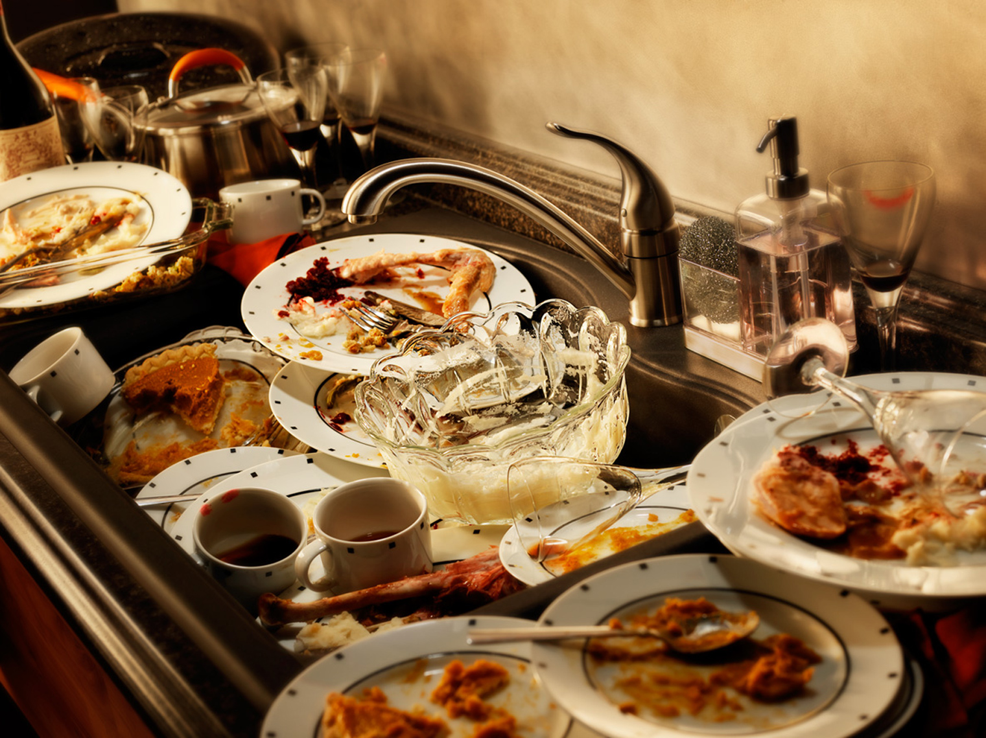
Anchoring Phenomenon
Think about the pile of dirty dishes sitting in your kitchen after you have finished eating a meal. Use the Session B: Adult Learner Notebook in the participant packet to record your thinking.
What do you notice and wonder from the picture?
What can you do to get the items clean?
What would happen to the dirty stuff on/in the items?
Notes:
Brinza, G., Larson, K., McGreal, A. & Novak, M. (n.d). Where Does Our Clean Water Come From and Where Does It Go After We Make It Dirty? NextGenStorylines. ​Where Does Our Clean Water Come from and Where Does it Go After We Make it Dirty?​ — Next Generation Science Storylines (nextgenstorylines.org).

Slide 19
Developing a Plan
In a group develop a plan to get the dishes clean.
Share out each in whole group.
Look for similarities and differences within plans.
Notes:
Brinza, G., Larson, K., McGreal, A. & Novak, M. (n.d). Where Does Our Clean Water Come From and Where Does It Go After We Make It Dirty? NextGenStorylines. ​Where Does Our Clean Water Come from and Where Does it Go After We Make it Dirty?​ — Next Generation Science Storylines (nextgenstorylines.org).

Slide 20
Identify Related Phenomena
We decided getting clean water and getting rid of it when it was dirty was important for us when cleaning our dishes. Record your thoughts in Session B: Adult Learner Notebook.
Stop and Think
Where else might we use clean water
and make it dirty?
Notes:
Brinza, G., Larson, K., McGreal, A. & Novak, M. (n.d). Where Does Our Clean Water Come From and Where Does It Go After We Make It Dirty? NextGenStorylines. ​Where Does Our Clean Water Come from and Where Does it Go After We Make it Dirty?​ — Next Generation Science Storylines (nextgenstorylines.org).

Slide 21
Driving Question
Where does our clean water come
from and where does it go after
we make it dirty?
Notes:
Brinza, G., Larson, K., McGreal, A. & Novak, M. (n.d). Where Does Our Clean Water Come From and Where Does It Go After We Make It Dirty? NextGenStorylines. ​Where Does Our Clean Water Come from and Where Does it Go After We Make it Dirty?​ — Next Generation Science Storylines (nextgenstorylines.org).

Slide 22
Initial Model
Create an initial model on a separate piece of paper showing where you think the clean water comes from and where the water goes after we make it dirty.
Things to keep in mind:
When engaging in modeling, the key should be on explaining the “how” (and why) of a phenomenon.
Focus on explaining where the water comes from before the faucet and where you think water goes to after the drain.
Notes:
Brinza, G., Larson, K., McGreal, A. & Novak, M. (n.d). Where Does Our Clean Water Come From and Where Does It Go After We Make It Dirty? NextGenStorylines. ​Where Does Our Clean Water Come from and Where Does it Go After We Make it Dirty?​ — Next Generation Science Storylines (nextgenstorylines.org).

Slide 23
Comparing Models
Use a gallery walk to view the other models that were created.
As you explore other models, note the following in the
Session B: Adult Learner Notebook in your participant packet.
What was similar and different in the ideas that you saw represented in your model compared to the other models?
What did you notice was similar and different across all the models?
Notes:
Brinza, G., Larson, K., McGreal, A. & Novak, M. (n.d). Where Does Our Clean Water Come From and Where Does It Go After We Make It Dirty? NextGenStorylines. ​Where Does Our Clean Water Come from and Where Does it Go After We Make it Dirty?​ — Next Generation Science Storylines (nextgenstorylines.org).

Slide 24
Consensus Building Discussion
Form a scientists’ circle to have a consensus building discussion.
What ideas do you all agree on?
What ideas were different across the models?
Notes:
Brinza, G., Larson, K., McGreal, A. & Novak, M. (n.d). Where Does Our Clean Water Come From and Where Does It Go After We Make It Dirty? NextGenStorylines. ​Where Does Our Clean Water Come from and Where Does it Go After We Make it Dirty?​ — Next Generation Science Storylines (nextgenstorylines.org).

Slide 25
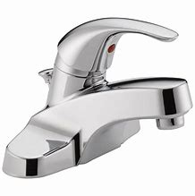
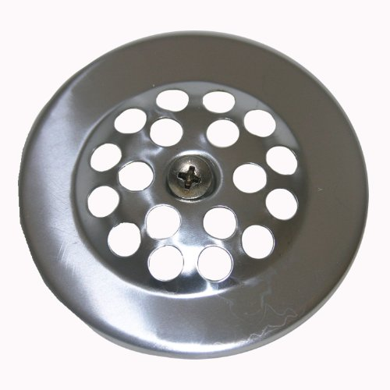
Making Sense of the Phenomenon
Where does our clean water come from? | Where does water go once we make it dirty?
Notes:
Brinza, G., Larson, K., McGreal, A. & Novak, M. (n.d). Where Does Our Clean Water Come From and Where Does It Go After We Make It Dirty? NextGenStorylines. ​Where Does Our Clean Water Come from and Where Does it Go After We Make it Dirty?​ — Next Generation Science Storylines (nextgenstorylines.org).

Slide 26
Consensus Building
Develop a consensus model as a whole group that represents everything we agreed upon.
Include question marks on the areas where there were different ideas.
Notes:
Brinza, G., Larson, K., McGreal, A. & Novak, M. (n.d). Where Does Our Clean Water Come From and Where Does It Go After We Make It Dirty? NextGenStorylines. ​Where Does Our Clean Water Come from and Where Does it Go After We Make it Dirty?​ — Next Generation Science Storylines (nextgenstorylines.org).

Slide 27
Asking Questions
Where does our clean water come from and where does it go after we make it dirty?
Write at least two phenomena-related questions, one per sticky note that you are curious about.
One person will share their question. If anyone has a question that is related or similar, they will speak up and share their question and explain why/how it is related.
Notes:
Brinza, G., Larson, K., McGreal, A. & Novak, M. (n.d). Where Does Our Clean Water Come From and Where Does It Go After We Make It Dirty? NextGenStorylines. ​Where Does Our Clean Water Come from and Where Does it Go After We Make it Dirty?​ — Next Generation Science Storylines (nextgenstorylines.org).

Slide 28
Teacher Hat(1)
While in teacher hat, we will:
grow our understanding of phenomena.
analyze Kentucky Academic Standards for Science.
reflect on our teaching and consider new shifts in our teaching practice.

Slide 29
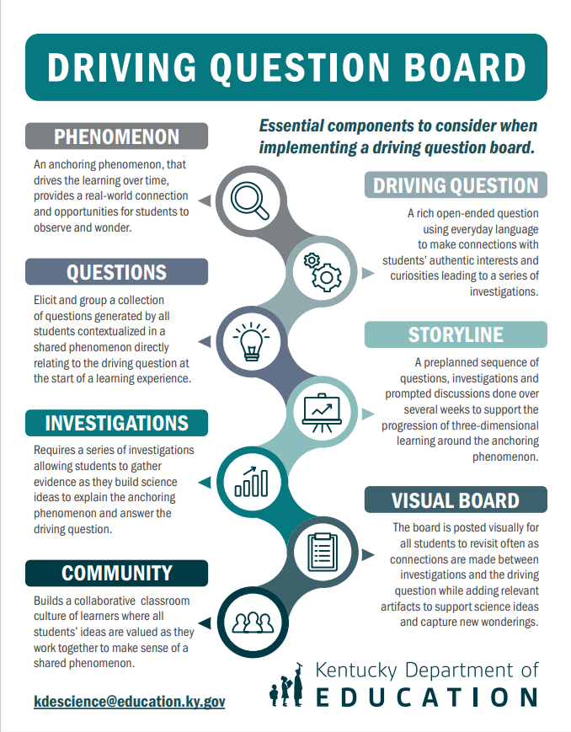
Stop and Reflect
Record your thinking in the Session B: Notes – Teacher Hat in your participant packet. You may use the Driving Question Board Poster to add to your thinking.
What did you learn from this experience?
How did the use of a driving question board impact your experience in terms of engagement and/or motivation for learning?

Slide 30
Session B Shared Understandings
The driving question board…
Connects to students’ experiences or the world around them
Encourages everyone to participate and share their voice
Focuses on the students’ curiosities
Allows students to build on each other’s ideas
Promotes collaboration among students
Builds a classroom community of learners as they work toward explaining the phenomenon.

Slide 31
After completing session B, you should be able to answer the following questions.
How does the use of a driving question board foster a community of learners?
How does the driving question board increase student engagement?
How does the driving question board motivate students to learn?

Slide 32
Session B Overall Reflection
Take some time to record your thoughts from today’s session by responding to the following prompts in Session B: Overall Reflection of the participant packet.
What?
So What?
Now What?
What inspired you during this session?
Why did that inspire you?
What are your goals as a result of this experience?

Slide 33
Session B Next Steps - Considerations for Implementation
Examine your current science resource, how does the resource support the implementation of the DQB? If it does not, how might you incorporate a DQB within the learning experience? Record your ideas in Session B: Next Steps- Considerations for Implementation section of your participant packet.
Consider the following:
What standards are being addressed during the instruction?
What anchoring phenomenon might you use to frame the learning around?
What might be your driving question?
DRIVING QUESTIONS
Are a rich open-ended question that cannot be solved immediately
Use everyday language to connect with student’s authentic curiosities
Require a series of investigations that can be done over several weeks

Slide 34
Session C
Focus Question:
How can a driving question board anchored in a phenomenon be used to build a cohesive storyline?

Slide 35
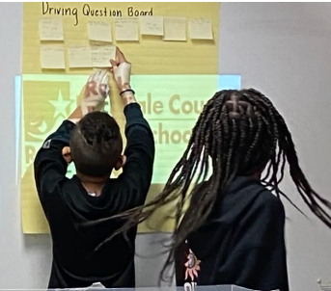
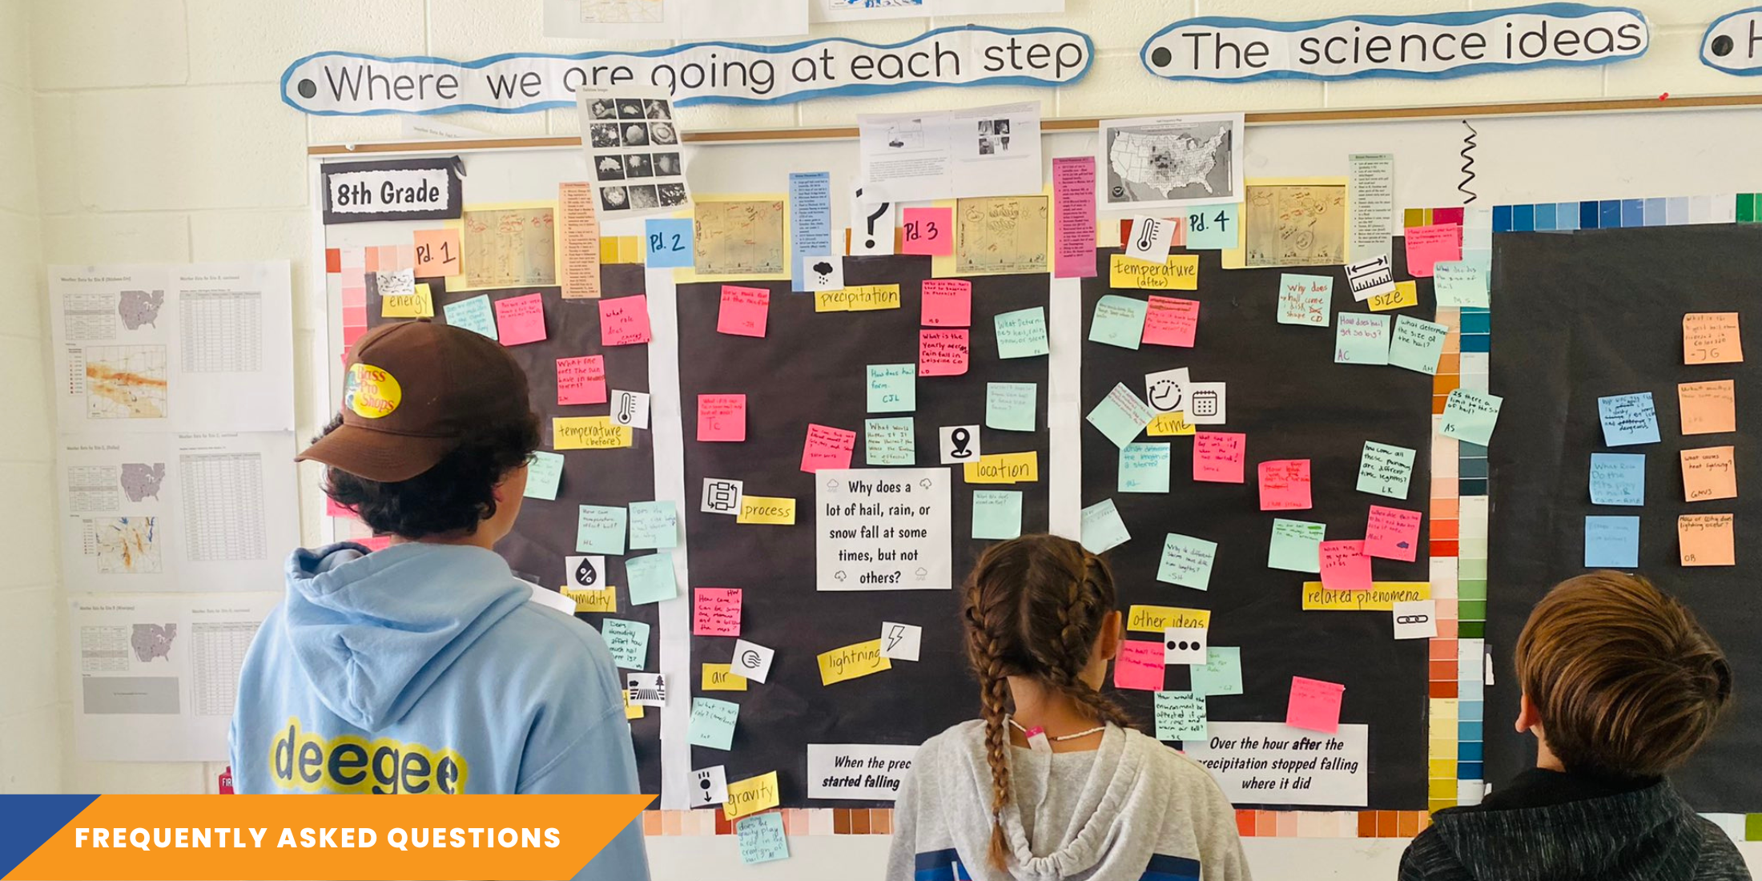
In the previous sessions, we learned…
The driving question board is an effective strategy for fostering student engagement and empowering them in their learning journey, fueling a strong motivation for learning.
What the student experience feels like when using a driving question board to engage in a learning experience that is symmetrical to the classroom.

Slide 36
Teacher Hat Versus Adult Learner Hat (2)
Teacher Hat
Adult Learner Hat
While in teacher hat, we will:
grow our understanding of phenomena.
analyze Kentucky Academic Standards for Science.
reflect on our teaching and consider new shifts in our teaching practice.
While in adult learner hat, we will:
build and deepen our own science content knowledge.
engage in a learning opportunity that is symmetrical to the student experience.

Slide 37
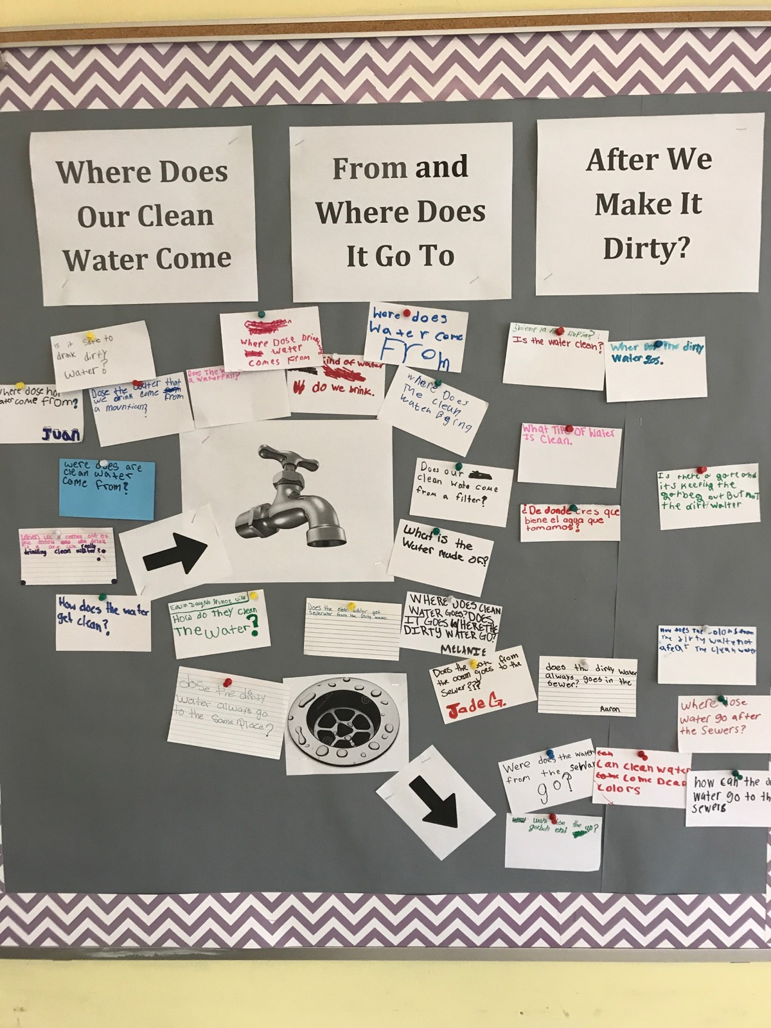
Questions on the DQB
Revisit and familiarize yourself with the questions on the DQB from session B.
Consider and discuss within small groups:
Which questions are testable?
Which questions might help us understand more about the driving question?
Which questions give us information “in addition to” the driving question?

Slide 38
Big Ideas on Grouping Questions on the DQB
Categorizing in the moment with students is more powerful for the student learning because the students get to see how their questions connect and relate to other’s questions.
This process puts the student at the center of their learning experience, while the teacher acts as a facilitator who is learning along with the student.
This also helps with teacher management of the DQB. If the teacher has worked with students to categorize, they will not have to come back and do it later after class.
Students have the ownership to continue adding to groups, creating new groups, and checking groups of questions that are answered.

Slide 39
Adult Learner Hat (2)
While in adult learner hat, we will:
Build and deepen our own science content knowledge; and
Engage in a learning opportunity that is symmetrical to the student experience.

Slide 40
Your Ideas for Investigation
Reflect back to session B.
Identify the anchoring phenomenon
Review the driving question
View the driving question board
Jot down ideas for two to three in-class activities or investigations that could help answer some of the questions on the driving question board.
Share these ideas out and post them beside the questions they would address on the driving question board.

Slide 41
Teacher Hat (2)
While in teacher hat, we will:
Grow our understanding of phenomena;
Analyze Kentucky Academic Standards for Science; and
Reflect on our teaching and consider new shifts in our teaching practice.

Slide 42
Kentucky Academic Standards for Science
When looking at the grade 5 standards, what standards do you think are addressed with this learning experience?
Kentucky Academic Standards for Science

Slide 43
Kentucky Academic Standards for Science Addressed in this Resource (1)
5-PS1-1: Develop a model to describe that matter is made of particles too small to be seen.
5-PS1-2: Measure and graph quantities to provide evidence that regardless of the type of change that occurs when heating, cooling or mixing substances, the total weight of matter is conserved.
5-PS1-3: Make observations and measurements to identify materials based on their properties.
5-PS1-4: Conduct an investigation to determine whether the mixing of two or more substances results in new substances.
5-ESS2-1: Develop a model using an example to describe ways the geosphere, biosphere, hydrosphere and/or atmosphere interact.
5-ESS2-2: Describe and graph the amounts and percentages of salt water and fresh water in various reservoirs to provide evidence about the distribution of water on Earth.
5-ESS3-1: Obtain and combine information about solutions individual communities use to protect the Earth’s resources and environment.*
3-5-ETS1-1: Define a simple design problem reflecting a need or a want that includes specified criteria for success and constraints on materials, time or cost. *
3-5ETS1-2: Generate and compare multiple possible solutions to a problem based on how well each is likely to meet the criteria and constraints of the problem. *
3-5ETS1-3: Plan and carry out fair tests in which variables are controlled and failure points are considered to identify aspects of a model or prototype that can be improved. *
Kentucky Academic Standards for Science

Slide 44
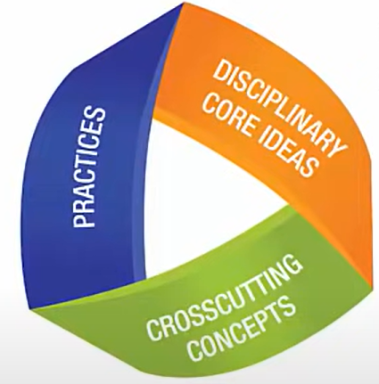
Three-Dimensional Standards (1)
Practices describe
behaviors scientists and engineers engage in
“What students DO”
Disciplinary core ideas describe the core ideas in the science disciplines
“What the students KNOW”
The crosscutting concepts describe concepts linking the different domains of science
“How the students think”

Slide 45
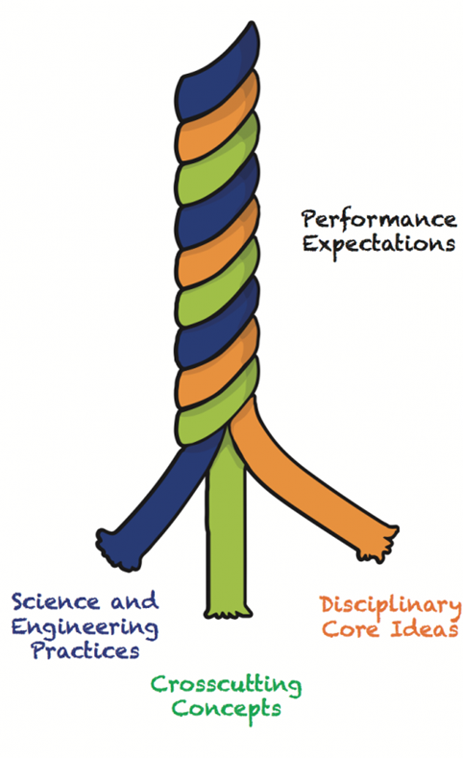
Three-Dimensional Standards (2)
Science and Engineering Practices | Disciplinary Core Ideas | Cross Cutting Concepts
Asking questions or defining problems Developing and using models Planning and carrying out investigations Analyzing and interpreting data Using mathematics and computational thinking Constructing explanations and designing solutions Engaging in argument from evidence Obtaining, evaluating and communicating information | Physical Sciences: (PS1) Matter and Its Interactions (PS2) Motion and Stability: Forces and Interactions (PS3) Energy (PS4) Waves Life Sciences: (LS1) Molecules to Organisms (LS2) Ecosystems (LS3) Heredity (LS4) Biological Evolution Earth and Space Sciences: (ESS1) Earth’s Place in the Universe (ESS2) Earth’s Systems (ESS3) Earth and Human Activity Engineering Design: (ETS1.A) Defining and Delimiting an Engineering Problem (ETS1.B) Developing Possible Solutions (ETS1.B) Optimizing the Design Solution | Patterns Cause and effect mechanisms and explanation Scale, proportion and quantity Systems and system models Energy and matter flows, cycles and conservation Structure and function Stability and change

Slide 46
Kentucky Academic Standards for Science Addressed in this Resource (2)
5-PS1-1: Develop a model to describe that matter is made of particles too small to be seen.
Science and Engineering Practice: Develop a model
Disciplinary Core Idea: Matter is made of particle
Cross Cutting Concept: too small to be seen (Scale, proportion, and quantity)
5-PS1-2: Measure and graph quantities to provide evidence that regardless of the type of change that occurs when heating, cooling or mixing substances, the total weight of matter is conserved.
Science and Engineering Practice: Measure and graph quantities to provide evidence
Disciplinary Core Idea: type of change that occurs when heating, cooling or mixing substances, conservation of matter
Cross Cutting Concept: total weight of matter (Energy and Matter)
Kentucky Academic Standards for Science

Slide 47
Compare Your Investigations to the Performance Expectations
Refer back to the investigations posted by our group on the driving question board. Record your ideas in the Session C: Notes
section of the participant packet.
What science and engineering practices, disciplinary core ideas and cross cutting concepts will students be engaged in to figure out the anchoring phenomenon through the investigations identified?

Slide 48
Storyline
Compare your thinking to the developers thinking of the three dimensions by examining the storyline for this unit.
Identify evidence of how the storyline connects back to our driving question board.
Notes:
Brinza, G., Larson, K., McGreal, A. & Novak, M. (n.d). Where Does Our Clean Water Come From and Where Does It Go After We Make It Dirty? NextGenStorylines. ​Where Does Our Clean Water Come from and Where Does it Go After We Make it Dirty?​ — Next Generation Science Storylines (nextgenstorylines.org).

Slide 49
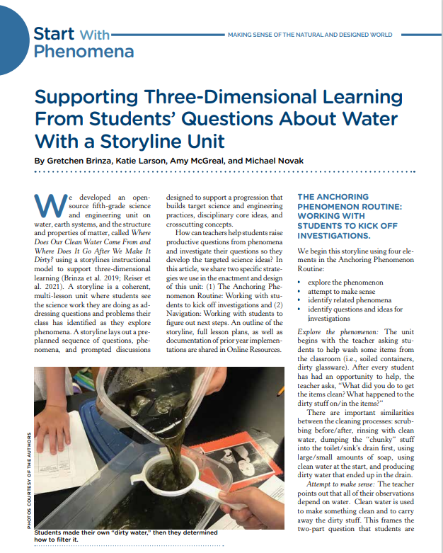
Article
Supporting Three-Dimensional Learning From Students’ Questions About Water With a Storyline Unit
As you read, jot your responses to the following questions in the Session C: Notes section of your participant packet.
How was the driving question board used throughout this learning experience as described in the article?
As the students were navigating through the learning experience, what were the actions of both the teacher and the students?
Notes:
Brinza, G., Larson, K., McGreal, A. & Novak, M. (2022, March 1). Supporting Three-Dimensional Learning From Students’ Questions About Water With a Storyline Unit. Science and Children. (75-79).

Slide 50
Session C Stop and Think
In the Session C: Notes section of the participant packet, respond to the prompt on the right and be ready to share out with your colleague or table group.
How can the driving question board anchored in a phenomenon be used to build a cohesive storyline?

Slide 51
Session C Shared Understandings
Allows students to see the science work they are doing as addressing questions and problems their class has identified as they explore phenomenon.
Lays out pre-planned sequence of questions, investigations and prompted discussion designed to support a progression that builds targeted three-dimensional learning.
Involves students as partners in identifying questions and problems, figuring out how to address them, and making sense of what they find.
Provides real world connections and opportunities for students to observe, wonder and identify problems that they want to figure out how to solve.

Slide 52
After completing session C, you should be able to answer the following questions.
How can the anchoring phenomenon kick off the investigations and help to navigate the learning sequence?
How can the driving question board elicit student ideas that connect to investigations students will engage in to make sense of the phenomenon?
How can the driving question board be used to build a cohesive storyline?

Slide 53
Session C Overall Reflection
Take some time to record your thoughts from today’s session by responding to the following prompts in Session C: Overall Reflection of the participant packet.
What might be one thing you STOP based on today’s session?
What might be one thing you will CONTINUE based on today’s session?
What might be one thing you START based on today’s session?

Slide 54
Session C Next Steps - Considerations for Implementation
Use the driving question board you planned for the last session with your students. Record your ideas in Session C: Next Steps- Considerations for Implementation section of your participant packet.
Consider how you might:
Facilitate the grouping of questions during the development of the driving question board.
Have students identify some investigations that may help them answer their questions.
Consider other investigations needed to answer their questions.
Organize questions/investigations in a logical order (Storyline) to help students make sense of the phenomenon.

Slide 55
Session D
Focus Question:
How can the driving question board be used as a formative assessment tool to foster an equitable learning community?

Slide 56
Builds a culture of appreciation and values diverse ideas
Requires a series of investigations that is done over a period of time
Class's shared mission of learning: the road map for student learning
What we’ve learned about the DQB
Engages and motivates students to want to learn
Captures student’s wonderings/ ideas to figure out a phenomenon
Provides an anchor to build a cohesive storyline

Slide 57
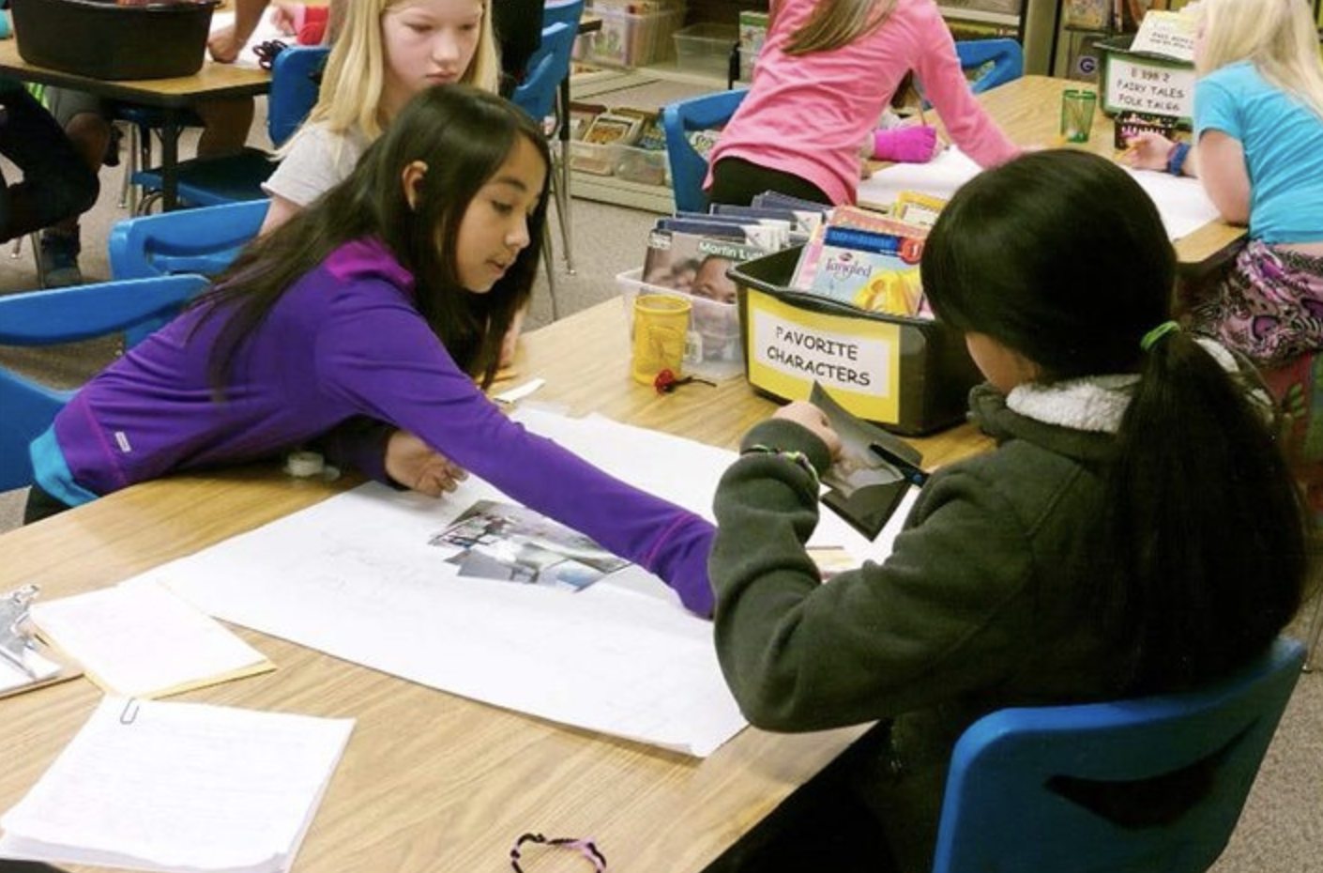
Shifting to a collectivist approach and positioning every student as a “knower” in the science classroom.
“Turns out our brains are wired to favor a communal view of the world. Humans have always sought to be in community with each other…Collectivist societies emphasize relationships, interdependence within a community, and cooperative learning.” (Zaretta Hammond, Culturally Responsive Teaching and the Brain)
STEM Tool #47
STEM Tool #54
Notes:
Miller, E., Simani, M. & Debarger, A. (2017, March). Practice Brief 47: How Can I Promote Equitable Sensemaking by Setting Expectations for Multiple Perspectives?. Stem Teaching Tools. https://stemteachingtools.org/brief/47.
Morrison, Deb & Bell, Phillip. (2018, May). Practice Brief 54: How to Build an Equitable Learning Community in Your Science Classroom. Stem Teaching Tools. https://stemteachingtools.org/brief/54.

Slide 58
Equitable Learning Community Discussion
As you read, consider jotting your thinking on these questions in the Session D: Notes section of the participant packet.
How might the driving question board help ensure all student ideas/questions/perspectives are shared, heard and considered?
Why is an equitable classroom community essential while using a driving question board?
How might you use the driving question board as an opportunity to build areas of agreement and disagreement?
How might you differentiate the driving question board to meet the needs of all students in your classroom?

Slide 59
What is formative assessment?
In your own words, how would you describe formative assessment?
Take a moment and jot your initial ideas in the Session D: Notes section of your participant packet.
Share out in whole group

Slide 60
Shared Understanding of Formative Assessment
"Formative assessment is a planned, ongoing process used by all students and teachers during learning and teaching to elicit and use evidence of student learning to improve student understanding of intended disciplinary learning outcomes and support students to become self-directed learners."
[Council of Chief State School Officers (CCSSO), 2018]
Questions to Consider:
What key words jump out at you in this definition?
Does anything in the definition surprise you?
How does this definition align to your current schema for formative assessment?

Slide 61
Informal Formative Assessment Cycle
As you read, jot your responses to the following questions in the Session D: Notes section of your participant packet.
STEM Teaching Tool #16
How might the driving question board be used to give voice to all students in an informal assessment?
What supports do teachers need to enact robust informal formative assessment in their classrooms?
Notes:
De Leo’n, Vanessa & Allen, Annie. (2015, May). Practice Brief 16: The Informal Formative Assessment Cycle as a Model for Teacher Practice. Stem Teaching Tools. https://stemteachingtools.org/assets/landscapes/STEM-Teaching-Tool-16-Informal-formative-assessment.pdf.

Slide 62
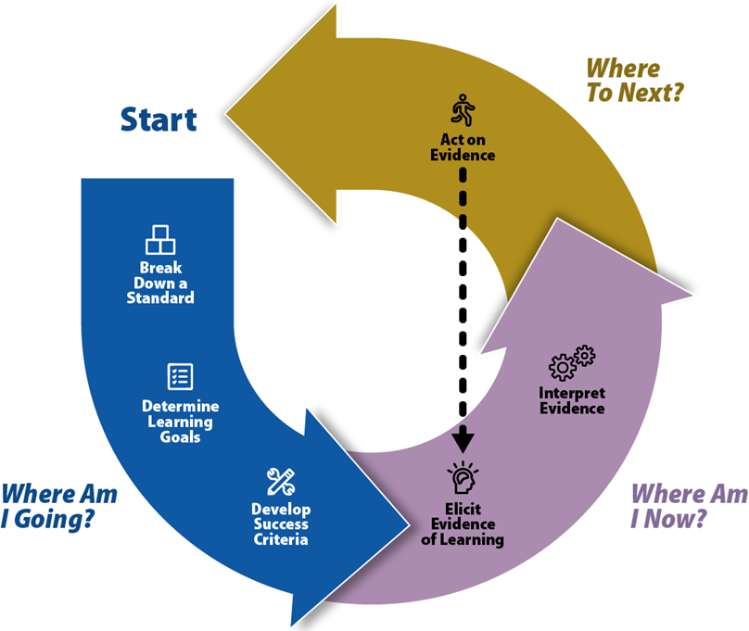
The Formative Assessment Process
As you examine this formative assessment graphic, respond to the prompt in the Session D: Notes section of your participant packet.
How might the driving question board support the formative assessment process as described in the graphic?
Graphic is from the Kentucky Department of Education Balanced Assessment Professional Learning Module.

Slide 63
Based on this DQB poster, in what ways could the driving question board be used as a formative assessment?

Slide 64
Session D Stop and Think
In the Session D: Notes section of the participant packet, respond to the prompt to the right and be ready to share out with your colleague or table group.
How can the driving question board be used as a formative assessment tool to foster an equitable learning community?

Slide 65
Barriers and Ways to Overcome (1)
Complete your grouping of questions within the class with students.
Be intentional with times you revisit the DQB to complete a quick check of student learning.
Capture science ideas throughout the storyline as students gain understanding.
Management of time
Management of space
Use one driving question board that includes ideas and questions from all class periods: Use different color post its for each class.
Use technology to create a digital driving question board.
Use a tri-fold board for each class.
Use a flip chart stand and flip page for each class.

Slide 66
Barriers and Ways to Overcome (2)
Allow students to research or investigate those in free time.
Encourage students to capture these questions in their notebooks.
Encourage students to take questions home and discuss with their families.
Collaborate with other colleagues such as a librarian.
Consider other learning opportunities the question may fit in.
Questions not addressed
Help students reformulate questions so they can lead to grade-appropriate investigations of important science ideas.
Think about ways to use these questions to differentiate instruction to meet the diverse needs of all learners.
Questions not grade appropriate

Slide 67
Session D Shared Understandings
The driving question board can…
Serve as an informal formative assessment in the classroom when a teacher elicits student thinking and makes immediate use.
Provide students an opportunity to get meaningful feedback in a low-stakes environment, which supports their learning and helps them develop confidence in their ability to express their understanding.
Give voice to all students in order to fully engage students in inquiry-based lessons and effectively implement informal formative assessment practices with them.
Promote deep and equitable learning when planned purposefully to ensure the various perspectives that students bring to making sense of phenomenon are solicited, clarified and considered.

Slide 68
After completing session D, you should be able to answer the following questions.
How can the driving question board be used as a formative assessment tool?
How can the driving question board be used to foster an equitable learning community?

Slide 69
Session D Next Steps - Considerations for Implementation
Use the driving question board you planned for the last session with your students. Record your ideas in Session D: Next Steps- Considerations for Implementation section of your participant packet.
Use the driving question board you planned for the last session with your students.
Consider how you might:
Identify the science ideas or lack of ideas the driving question board revealed.
Revisit the driving question board throughout the unit.
Formatively assess the students using the driving question board process.
Elicit evidence that students were engaged in “making sense” of the science in the unit.

Slide 70
Reflect on Your Experience
It's all in a Social
Media Post!
Think about the learning from this module. Compose a social media post consisting of a summary and your take aways to share. Consider sharing it on social media along with the link to the resource!

Slide 71
Certificate of Completion
Thank you for completing this module provided by the KDE.
Please use the link below to obtain your certificate of completion.
Kentucky Department of Education Professional Learning Modules
Educators can use the PLBB to find learning sessions, and it is the local school district who determines if they are acceptable for credit based on their district policies. See 704 KAR 3:035 for more details.

