Slide 1
Teacher Collaboration Activity
Module 4: Eliciting Evidence of Student Learning
Kentucky Department of Education
Notes:
This Teacher Collaboration Activity is a designed as a follow-up to the professional learning in Parts I and II of Module 4: Eliciting Evidence of Student Learning

Slide 2
Teacher Collaboration Success Criteria
Participants will be able to:
Evaluate and improve evidence gathering strategies to ensure that they provide meaningful evidence of student learning
Plan meaningful evidence gathering opportunities that can support the formative assessment process
Notes:
Introduce the content on the slide by providing the following information.
At the end of this learning sequence, you should be able to:
Evaluate and improve evidence gathering strategies to ensure that they provide meaningful evidence of student learning.
Plan meaningful evidence gathering opportunities that can support the formative assessment process.

Slide 3
Agenda
Time | Agenda
5 minutes | Welcome
5 minutes | Eliciting Evidence Refresher
40 minutes | Eliciting Evidence Lesson Tune-Up
5 minutes | Activity Debrief and Reflection
Notes:
This is a proposed agenda for this activity.
Keep in mind that factors such as group size, facilitation style, and focus will impact timing.
Facilitators are encouraged to adjust this agenda to meet their local needs.

Slide 4
Learning Goals and Success Criteria Refresher
Notes:
Slides 5-9 offer a refresher on the content from Parts I and II of this module. They are presented as an optional scaffold for participants.
Facilitators should decide if the group would benefit from a quick walk through of the content or a more detailed discussion. Some groups may be ready to move forward without the refresher.
The level of depth of discussion of these slides may impact the overall timing of the teacher collaboration session.

Slide 5
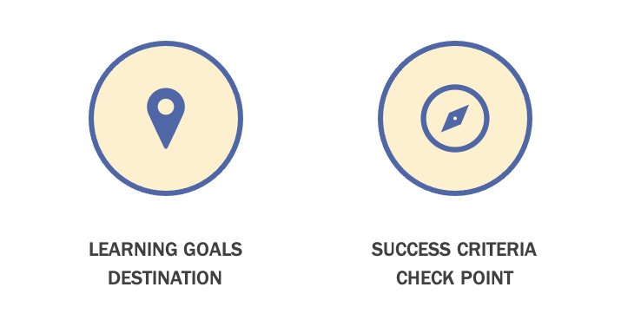
Mapping Student Learning
Notes:
Introduce the content on the slide by providing the following information.
Self-directed learners need to understand what they are learning and how to get there. Learning Goals and Success Criteria work in tandem to help students understand where they are going with their learning so that they can actively manage their own learning.
If a lesson is a journey that students and teachers take together, Learning Goals represent to students the destination of their journey, signaling clearly what they are learning and why it is important.
Success Criteria demonstrate to students what it looks like to be successful in achieving the Learning Goals. Success Criteria represent the check points along the route, giving students a specific information to understand their progress and make adjustments to move their learning forward.
Learning Goals and Success Criteria are essential tools for students to understand where they are in their learning so that they can become self-directed learners.
More information about Learning Goals and Success Criteria can be found in Module 3.

Slide 6
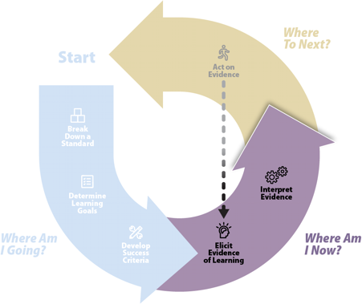
Where am I now?
Adapted from Formative Assessment Insights (WestEd)
Notes:
Introduce the content on the slide by providing the following information.
In Module 4, we focused on Eliciting Evidence of Student Learning, which answers the question, “Where Am I Now?”
Once a shared answer to the question,, “Where Am I Going?” has been established by clarifying and sharing Learning Goals and Success Criteria, students and teachers need to understand their current status so that they can make decisions to move learning forward. This starts with eliciting meaningful evidence that can be used to reason about student learning and inform next steps.
Facilitators may want to remind participants that for the purposes of this presentation, the word “lesson” may refer to the learning plan for a single class period or could reflect a learning plan that covers several days. It’s a coherent set of learning opportunities focused on the same content and goals.
.

Slide 7




Key Considerations for Evidence of Student Learning
Intentionally design and implement
Make student learning visible
Inform students and teachers about next steps
Integrate into learning
Notes:
Introduce the content on the slide by providing the following information.
You may remember this slide from Part I of Module 4. In the formative assessment process, evidence of student learning is central to inform student and teacher decisions about next steps to move students toward their Learning Goals. A critical element of lesson planning is integrating strategies to gather evidence of student learning during the learning.
First, keep in mind that eliciting evidence of student learning is intentional and planned. It should be a key aspect of the lesson design process, implemented when a lesson is enacted. Just like with other aspects of lesson design, teachers may use their professional judgement to make adjustments to evidence gathering strategies while they are teaching. But eliciting evidence of student learning shouldn’t be on-the-fly, but part of a strategic plan to support students to achieve their intended learning.
Another central purpose behind gathering evidence of student learning is to make student learning visible. This means that evidence is elicited as students engage in a performance that makes their thinking tangible. Such opportunities may arise during teacher-student interactions, during peer interactions, and from examining student work products. Later in this module, we will explore different strategies for eliciting evidence of student learning.
The whole point of eliciting evidence of student learning is to allow students to manage their own learning and teachers to reflect on and adjust their instruction. So, evidence gathered must provide information that goes deeper than “got it” or “didn’t get it” to provide a more complex understanding of where students are in their learning to inform forward-looking decisions about next steps in learning.
Finally, the process of eliciting evidence for the formative assessment process is not separate from teaching and learning. It should take place while the learning is happening so that the information can inform immediate next steps and ensure students are making progress.

Slide 8
Ensuring Evidence is Meaningful
Meaningful evidence
  Aligned to Learning Goals and Success Criteria
  Multiple sources
  Anchored in disciplinary discourse and practices
Fairness and equity
  Culturally responsive
  Accessible
  Promotes student choice and autonomy
Notes:
Introduce the content on the slide by providing the following information.
In Part I of Module 4, we explored the elements necessary for meaningful evidence of student learning that can help students and teachers understand where students are in their learning and inform next steps to move learning forward toward the Learning Goals.
This is a high-level reminder of some of the key content considered in that presentation.
Walk participants through this to activate prior knowledge, elaborating as necessary and pacing the discussion based on how familiar the group is with the content. Ask participants to keep these ideas in mind during the remainder of the module, as they consider a lesson shared by a peer in the tune-up activity.
For more details on each of these elements, consult Module 4, Part I.

Slide 9
Evidence Gathering Routines
Elicit evidence through:
Prior knowledge
Academic dialogue
Questioning
Observation and analysis of student work
Peer- and self-assessment
Notes:
In Part II of this Module, we considered different routines that you are probably already using with your students and how they can be used to elicit meaningful evidence of student learning.
Walk participants through these evidence gathering routines to activate prior knowledge, elaborating as necessary and pacing the discussion based on how familiar the group is with the content.
Ask participants to keep these ideas in mind during the remainder of the module, as they consider a lesson shared by a peer in the tune-up activity.
For more details on each of these elements, consult Module 4, Part I.

Slide 10
Lesson Tune-Up
Notes:
As in the Teacher Collaboration Activity in Module 3, this activity will rely on a volunteer who will share a lesson for discussion and feedback from their peers.
Facilitators will need to do pre-work with their participants to lead the tune-up activity. Primarily, facilitators will need to identify a participant volunteer to share a lesson. As with the previous tune-up activity, criteria the lesson should be one that the volunteer is comfortable sharing and believes has room for improvement in terms of eliciting evidence of student learning formative assessment process. It does not need to be a model lesson and can be a work in progress. However, the facilitator will need to make some decisions in advance based on the specific lesson.
This activity presumes a degree of familiarity with the Kentucky Academic Standards. The Kentucky Department of Education has created educator resources for Reading and Writing, Mathematics, Social Studies and Science that build knowledge about the standards and help educators break down standards to support teaching and learning. These resources can support educators to consider the prior knowledge and progression of learning for each standard in order to guide instruction and formative assessment.
The KDE Breaking Down a Standard resources can be found here: https://kystandards.org/standards-resources/break-down-stand-res/.
The Kentucky Department of Education has also developed a series of modules called, Getting to Know the KAS: https://kystandards.org/standards-resources/pl-mods/getting-to-know-your-kas-modules/.
If participants need a stronger grounding in the Kentucky Academic Standards, facilitators should consider facilitating one of these modules before engaging in this activity.

Slide 11
Lesson Tune-Up Purpose
Apply learning about strategies to elicit meaningful evidence of student learning
Collaboratively build ideas about ways to plan for evidence to support the formative assessment process
Work together to improve upcoming instruction
Notes:
Introduce the content on the slide by providing the following information.
We are going to look at a lesson together and apply what we’ve been discussing about eliciting evidence of student learning.
We will use a protocol to structure out time and to support collaboration.
Our goal is to build our shared capacity to plan to elicit evidence of student learning to support the formative assessment process.

Slide 12
Lesson Tune-Up Norms
In our group we:
Are supportive
Ask questions
Use evidence to support our opinions
Are open to ideas
Listen
Presume positive intent
Watch airtime
Notes:
Introduce the content on the slide by providing the following information.
Facilitators may want to edit this slide to reflect personal preferences or norms already in place among participants. Key to success is making sure that the group works together in a way that is productive, supportive, and safe, particularly for the person who volunteered to share their work. It can be intimidating to share work and get critical feedback and the facilitator should work with the group to make sure that this is a positive experience for the person sharing.

Slide 13
Lesson Tune-Up Protocol
Learning Goals and Success Criteria
Time | Protocol
3 minutes | Introduction (Facilitator)
7 minutes | Lesson Presentation (Volunteer)
5 minutes | Clarifying and Probing Questions (Group and Volunteer)
20 minutes | Evidence Gathering Tune-Up Discussion (Group)
5 minutes | Reflection and Next Steps (Volunteer)
Notes:
This information corresponds to the more detailed information in the handout, Planning for Evidence of Student Learning Tune-up Protocol, available in the facilitator guide for this teacher collaboration activity.
To introduce this activity, direct participants to the handout and walk them through the process. This slide can be kept up during the activity to help keep time and focus and the protocol document will be the primary guide. Additionally, participants can review to the Meaningful Evidence reference sheet, also available at the end of the Teacher Collaboration Facilitator Guide.
Facilitators should make clear specific roles and responsibilities for each section of the protocol.
During the presentation, only the volunteer speaks, the group listens.
During the clarifying and probing questions section, the group asks questions and the volunteer responds. Clarifying questions can be answered with factual information and probing questions can be answered with thoughts, reflections, opinions and ideas. Probing questions are designed to push thinking and generate ideas.
During the tune-up discussion, the group discusses and the volunteer listens and takes notes.
Finally, during the reflection and next steps, the volunteer will discuss their takeaways from the discussion and identify next steps they will take with the lesson.

Slide 14



Debrief
What is one big takeaway for your own practice?
How can your students be more engaged in the process of making evidence their learning visible?
What is at least one thing you will do differently based on what you learned?
Notes:
This is an opportunity for participants to reflect on how the tune-up activity worked for them and provide suggestions about how it could be more productive.
It is also a change for them to reflect on their learning and ensure that they are prepared to apply what they learned to their own practice.
Because most participants focused on a colleague’s lesson in this activity, it will be important to make sure that they are able to apply that learning to their own lesson design practice.
This debrief could be structured as a whole group share out, a partner discussion, or an exit ticket activity. In a digital setting, participants can add their ideas to a shared document, like a Google Doc.

