Slide 1
Inquiry Practices of the KAS for Social Studies
The Kentucky Academic Standards (KAS) for the Social Studies
Notes:
Module Overview:
The Inquiry Practices Module supports the successful implementation of the Inquiry Practices in the Kentucky Academic Standards (KAS) for Social Studies in classrooms across the state.
Materials needed:
Kentucky Academic Standards (KAS) for Social Studies: https://education.ky.gov/curriculum/standards/kyacadstand/Documents/Kentucky_Academic_Standards_for_Social_Studies.pdf
Goals:
The goals of the Inquiry Practices Module are for districts and schools to:
Understand the inquiry practices as outlined in the KAS for Social Studies.
Define inquiry as outlined in the KAS for Social Studies.
Understand the characteristics of compelling and supporting questions.
Acquire ways to get students to engage with and create compelling and supporting questions when required.
Understand the skills and progressions found within the Using Evidence standards.
Understand the four components of the Communicating Conclusions standards and find examples and strategies to implement these components.
Intended Audiences:
Module participants may include, but are not limited to, district leadership, school administrators, instructional specialists/coaches, intervention specialists, department chairs, special educators and classroom teachers. In addition, districts may choose to have anyone planning to conduct observations or walkthroughs participate in this session in order to develop an understanding of the KAS for Social Studies that should be guiding the instruction witnessed in the classroom.
Facilitators:
While this module series is designed for a teacher to engage with individually, it may be implemented with a group of educators led by a facilitator. If this module is being completed as a group, facilitators may include, but are not limited to, district leaders, school administrators, instructional specialists/coaches, intervention specialists, department chairs, special educators, and classroom teachers. Facilitators may need to revise specific tasks in order to meet the needs of the participants or to be respectful of the time planned within the work session.
Helpful Hint for Facilitators:
The learning that will take place in this module may cause Kentucky educators to face changes in instructional practices amidst this transition. It is important to realize that while you are the facilitator of these work sessions, you may not have all the answers to the questions asked by participants, and that is okay. Throughout the module, participants may have questions that will be addressed in future work sessions. When that happens, reflect on this quote from Graham Fletcher, “Every teachable moment doesn’t need to be a teachable moment in that moment.” Use these moments to encourage participants to attend future work sessions where those questions will be addressed. If participants ask questions you are not prepared to answer, offer to follow up on that during the next work session.
Planning Ahead for Facilitators:
• Determine which stakeholders to invite as participants. In the invitation, describe how the work sessions will benefit them.
• A few days before the meeting, you may want to remind participants to bring their documents to the meeting. (See below for Participant Documents Needed.)
• Reserve adequate space and equipment. Tables or desks should be set up to support small-group discussion.
• Access to the Internet for participants is helpful but may not be necessary depending on how participants plan to engage with the KAS for Social Studies.
• Consider how you might handle participants who may not be in attendance at all work sessions. It might be worthwhile to consider how those participants might access missed sections of the module between work sessions in order to feel as prepared as the other participants.
Guiding Notes
Guiding notes are provided in the Notes section of the PowerPoint to support your learning. The information provided in the Notes section includes additional information, directions for the activities on the slide, and citations of used resources, where appropriate. It is critical that you read the material presented in the Notes section to ensure that you are acquiring the important knowledge, skills and understanding required when engaging with this module.
Building a Community:
If completing collaboratively, building a community is important, especially if participants have not worked together before. The concept is the same as building a safe, respectful, productive classroom climate. Incorporating community-building into each session builds trust, shows participants that they are valuable as individuals and engages them in the learning process. It is also useful for creating a professional learning network where participants can be supported in their work. Community-building can be as simple as allowing participants to introduce themselves and their role in the school/district, developing or refining group norms, allowing for questions, and/or the sharing of answers to reflection questions or individual discovery task items that are included in each section. Again, time allotted for community-building will allow participants to have a voice and be engaged as active contributors and learners in the sessions.

Slide 2
Inquiry Practices of the KAS for Social Studies
Section A: An Introduction
Notes:
Guiding Notes:
This is where section A begins.

Slide 3
Module Overview
Section A: Introduction - What is inquiry?
Section B: What are Compelling Questions, and how do students ask them?
Section C: What are Supporting Questions, and how do students ask them?
Section D: How do students investigate through the disciplinary strand standards?
Section E: How do students use the Using Evidence standards to analyze sources and apply relevant information to make evidence-based claims?
Section F: How do the Communicating Conclusions standards support students in synthesizing knowledge to support civic engagement?
Section G: Reflection
Notes:
Guiding Notes:
This slide provides an overview of the module.

Slide 4
Module Objectives
Understand the inquiry practices as outlined in the KAS for Social Studies.
Define inquiry as outlined in the KAS for Social Studies.
Understand the characteristics of compelling and supporting questions.
Acquire ways to get students to engage with and create compelling and supporting questions when required.
Understand the skills and progressions found within the Using Evidence standards.
Understand the four components of the Communicating Conclusions standards and find examples and strategies to implement these components.
Notes:
Guiding Notes:
This slide includes the objectives of this module.

Slide 5
What is inquiry?
Individually, with a partner, grade-level team or Professional Learning Community, complete the following:
Define inquiry.
How is inquiry connected to something you know about?
Notes:
Guiding Notes:
Read the slide and answer the questions.

Slide 6
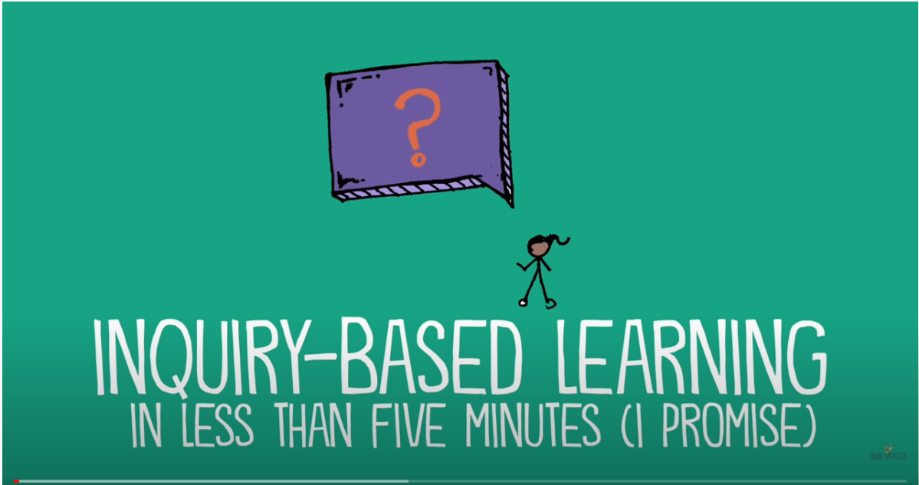
What is inquiry?
Inquiry, as a term, is sometimes misunderstood, considered very broad or even politicized. Prior to engaging with how the teacher writers from across Kentucky operationalized inquiry in the KAS for Social Studies, let us take a moment and develop a foundational understanding of inquiry.
As you watch What is Inquiry-Based Learning?, what new ideas or impressions do you have that extended your thinking in new directions about inquiry?
Notes:
Guiding Notes:
Read the slide, and watch the video entitled, What is Inquiry Based Learning. Identify the ways in which your understanding of inquiry has been extended.
Resources:
Spencer, John. (2017, December 5). What is Inquiry Based Learning? https://www.youtube.com/watch?v=QlwkerwaV2E
Project Zero. (2019). Connect, Extend, Challenge. Harvard Graduate School of Education. https://pz.harvard.edu/sites/default/files/Connect%20Extend%20Challenge_0.pdf

Slide 7
What is inquiry?
Individually, with a partner, grade-level team or Professional Learning Community, answer the following question:
What is challenging or confusing about inquiry? What do you wonder about?
Notes:
Guiding Notes:
Read the slide and engage in the activity.

Slide 8
Inquiry in the KAS for Social Studies
In order to prepare young people in the 21st century to carry on the ideals of the founders, social studies education must aim to develop students' knowledge of important social studies concepts and their use of disciplinary thinking skills. Achieving this aim is the mission of social studies education in Kentucky.
The KAS for Social Studies is designed to promote the development of knowledge and skills that will produce Kentucky graduates who are civically engaged, socially responsible and culturally aware.
These standards guide student exploration of the relationships and interactions among individuals and groups at local, state, national and international levels through the disciplines of civics, economics, geography and history and the inquiry practices of questioning, investigating, using evidence and communicating conclusions.
Notes:
Guiding Notes:
Read this slide.

Slide 9
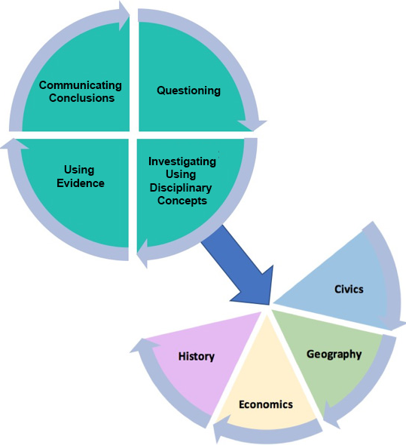
Organization of the Standards
Notes:
Guiding Notes:
The KAS for Social Studies is organized around the inquiry practices of questioning, investigating, using evidence and communicating conclusions. Students will consider or pose questions and then investigate those questions through the disciplinary lenses of civics, economics, geography and history. Students complete the inquiry process by communicating evidence-based conclusions.
The inquiry process is critical for effective student understanding of civics, economics, geography and history. Inquiry instruction requires teachers and students to ask questions that drive student investigation of the subject matter and eliminates the “skills vs. content” dilemma in social studies as both are needed to successfully engage in inquiry. Students will engage in inquiry using the tools, conceptual understandings and the language of political scientists, economists, geographers and historians at a developmentally appropriate level. Students will craft arguments, apply reasoning, make comparisons, corroborate their sources and interpret and synthesize evidence as political scientists, economists, geographers and historians.

Slide 10
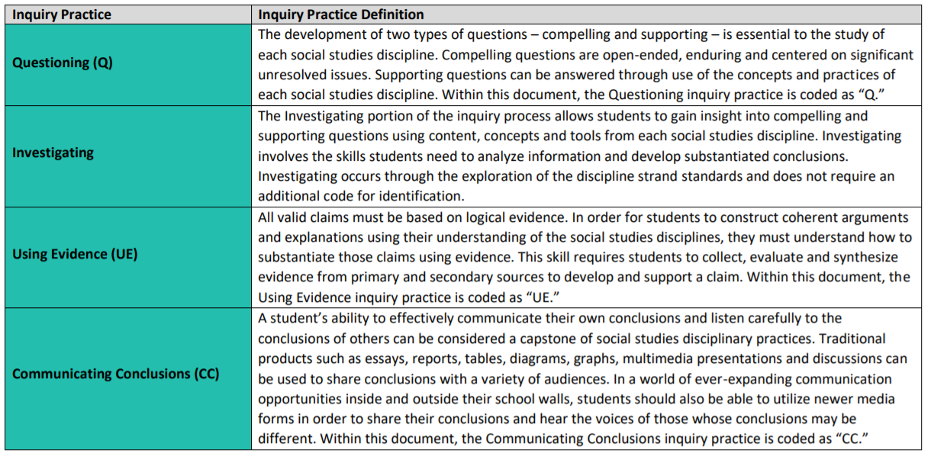
What are the inquiry practices outlined in the KAS for Social Studies?
Notes:
Guiding Notes:
Review this chart on pages 10-11 of the KAS for Social Studies and annotate it using the Color, Symbol, Image thinking strategy, linked below.
As you read, note things that you find interesting, important or insightful. Then, complete the thinking strategy:
• Choose a color that you feel best represents or captures the essence of a key idea.
• Choose a symbol that you feel best represents or captures the essence of a key idea.
• Choose an image that you feel best represents or captures the essence of a key idea.
If working with a partner or group, share your color and then share the item from the reading that it represents. Tell why you chose that color as a representation of that idea. Repeat the sharing process until every member of the group has shared his or her Color, Symbol, and Image.
Resources:
Project Zero. (2019). Color, Symbol, Image. Harvard Graduate School of Education. https://pz.harvard.edu/sites/default/files/Color%20Symbol%20Image_1.pdf

Slide 11
What is a culture of inquiry?
The writing team envisioned standards that would afford students an opportunity to provide social studies learning experiences that will prepare all K-12 students in Kentucky to be productive and involved members of society.
Under this framework, Kentucky students actively will engage with the social studies concepts, ideas and practices needed to participate in and navigate the community, state, nation and world in which they live. In an ever-changing and increasingly interconnected world, students must be lifelong critical thinkers and questioners who can undertake multidimensional, complex reasoning.
Thus, students must be active participants in classrooms that foster and support a culture of inquiry.
Notes:
Guiding Notes:
Read this slide.

Slide 12
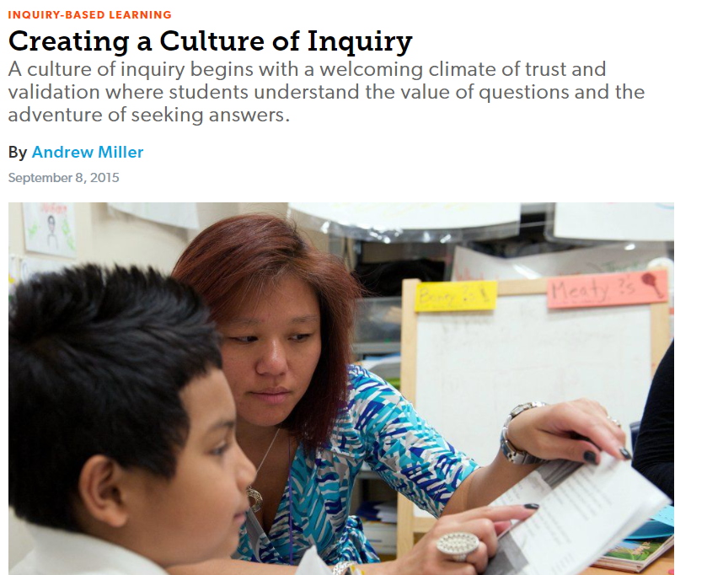
What is a culture of inquiry? (continued)
Read the following article entitled
Creating a Culture of Inquiry.
As you read this article, annotate it.
Visit Making Annotations: A User’s Guide for more information on how to annotate an article.
Creating a Culture of Inquiry. Edutopia.
Notes:
Guiding Notes:
Read the slide. Annotate the article using the Making Annotations: A User’s Guide as guidance for how to annotate an article.
Note: This article discusses Essential Questions as important to learning. It is important to note that the KAS for Social Studies requires that students engage in Compelling and Supporting questions as a part of the inquiry practice of Questioning.
Resources:
Miller, Andrew. (2015, September 8). Creating a Culture of Inquiry. Edutopia. https://www.edutopia.org/blog/creating-a-culture-of-inquiry-andrew-miller#:~:text=It%20can%20create%20student%20ownership,it%20vital%20throughout%20the%20year
Read, Write Think. (2008). Making Annotations: A User’s Guide. National Council Teachers of English. http://www.readwritethink.org/files/resources/lesson_images/lesson1132/AnnotationGuide.pdf

Slide 13
Reflection
After completing this introduction to the Inquiry Practices of the KAS for Social Studies, consider the following questions:
Why should you invest in creating a classroom culture that includes inquiry?
In what way(s) are you ready to engage in this work?
What are you excited to learn? What concern(s) do you have, if any?
Notes:
Guiding Notes:
Individually, with a partner or in a small grade-banded group, discuss the questions on the slide after engaging with this introduction.

Slide 14
Coming Up
Section B: What are Compelling Questions, and how do students ask them?
Section C: What are Supporting Questions, and how do students ask them?
Section D: How do students investigate through the disciplinary strand standards?
Section E: How do students use the Using Evidence standards to analyze sources and apply relevant information to make evidence-based claims?
Section F: How do the Communicating Conclusions standards support students in synthesizing knowledge to support civic engagement?
Section G: Reflection
Notes:
Guiding Notes:
This slide previews the upcoming sections.
The KDE needs your feedback on the effectiveness of this module, the learning platform and how the consultants may best support you as you take the next steps in the implementation process. Complete a short survey to share our thinking and provide them with feedback on how the KDE can best meet our needs. Feedback from our surveys will be used by the KDE to plan and prepare future professional learning.
Post-survey: https://docs.google.com/forms/d/e/1FAIpQLSffTPNRAlm0EpnD7VfhUlfV-WtFTE7xVEyq4zjb5TYu9mSNxw/viewform

Slide 15
Inquiry Practices of the KAS for Social Studies
Section B: Compelling Questions
Notes:
Guiding Notes:
Section A: Compelling Questions begins here.

Slide 16
Module Overview
Section A: Introduction- What is inquiry?
Section B: What are Compelling Questions, and how do students ask them?
Section C: What are Supporting Questions, and how do students ask them?
Section D: How do students investigate through the disciplinary strand standards?
Section E: How do students use the Using Evidence standards to analyze sources and apply relevant information to make evidence-based claims?
Section F: How do the Communicating Conclusions standards support students in synthesizing knowledge to support civic engagement?
Section G: Reflection
Notes:
Guiding Notes:
This slide provides an overview of the module.

Slide 17
Module Objectives
Understand the inquiry practices as outlined in the KAS for Social Studies.
Define inquiry as outlined in the KAS for Social Studies.
Understand the characteristics of compelling and supporting questions.
Acquire ways to get students to engage with and create compelling and supporting questions when required.
Understand the skills and progressions found within the Using Evidence standards.
Understand the four components of the Communicating Conclusions standards and find examples and strategies to implement these components.
Notes:
Guiding Notes:
This slide includes the objectives of this module.

Slide 18
Questioning
The development of two types of questions – compelling and supporting – is essential to the study of each social studies discipline.
Compelling questions are open-ended, enduring and centered on significant unresolved issues.
Supporting questions can be answered through use of the concepts and practices of each social studies discipline.
Notes:
Guiding Notes:
Read the slide.

Slide 19
Compelling Questions
Compelling questions are open-ended, enduring and center on significant unresolved issues. They:
Focus on “big ideas”;
Are intellectually challenging;
Generate interest;
Allow for multiple perspectives;
Can be answered in a variety of ways; and
Inspire investigation through the discipline strands.
Notes:
Guiding Notes:
Read the slide.

Slide 20
Why is this a compelling question?
Topic: The American Revolution
Standards: 5.I.Q.1, 5.I.Q.3, 5.E.MA.1, 5.H.CE.1, 5.I.UE.1, 5.I.CC.4
Compelling Question: What unites Americans?
Notes:
Guiding Notes:
Evaluate the compelling question on this slide to determine why it is a compelling question for grade 5. This compelling question can be found on page 82 of the KAS for Social Studies. In the example on Grade 5, this question aligns with the following standards:
5.I.Q.1
5.I.Q.3
5.E.MA.1
5.H.CE.1
5.I.UE.1
5.I.CC.4
In order to evaluate the compelling question on the screen, ask the following questions:
Is this question open-ended?
Is it enduring?
In other words, is this a question students might engage with again in the future? Is the focus of this question about an issue that students will encounter multiple times throughout their social studies education?
Does it center on significant unresolved issues?
Does this question focus on a “big idea?”
Is this question intellectually challenging?
Does it generate interest?
Does it allow for multiple perspectives?
Can it be answered in a variety of ways?
Does it inspire investigation through the discipline strands?
Work individually, with a small group, grade level team or PLC to evaluate this question. Once you have evaluated the answer, listen to the audio clip embedded in the slide. A transcript of the audio follows below:
Designing a compelling question is multifaceted. As with all instruction, a compelling question starts with the standards. Inquiry instruction requires teachers and students to ask questions that drive student investigation of the subject matter and eliminates the “skills vs. content” dilemma in social studies as both are needed to successfully engage in inquiry. Thus, a compelling question was crafted using the standard on the screen.
When designing and crafting a compelling question, it is important to look at the structure of the sentence to inform whether or not you are meeting the requirements of a compelling question. For example, sometimes starting a sentence with “how” is the best way to craft a question that can be answered in a variety of ways. Examples such as “How does the desire for inexpensive goods lead to unintended consequences?” or “How does culture shape modern communities?” show that “how” can be a great sentence starter to questions that allow students to craft a variety of explanations and/or arguments to one question.
Some sentence starters, like “what”, may be appropriate if the second part of the sentence meets the qualifications of a compelling question (focus on “big ideas”, are intellectually challenging, generate interest, allow for multiple perspectives, can be answered in a variety of ways, and inspire investigation through the discipline strands). For example, a question such as “What is the relationship between supply and demand?” is too narrow as it is does not meet the qualifications of a compelling questions (it is too specific, doesn’t allow for multiple perspectives, cannot be answered in a variety of ways, etc.). However, a question such as “What unites Americans?” is compelling because it is focuses on a “big idea,” is intellectually challenging, allows for multiple perspectives, etc.
As the compelling question is being designed, it is important to ask the following questions:
Is this question open-ended?
Is it enduring?
Does it center on significant unresolved issues?
Does this question focus on a “big idea?”
Is this question intellectually challenging?
Does it generate interest?
Does it allow for multiple perspectives?
Can it be answered in a variety of ways?
Does it inspire investigation through the discipline strands?
Once you have the compelling question crafted, it is important to determine if there is any bias in the question. Is the question written in a way that would influence individuals to respond a certain way?

Slide 21
How is a compelling question
designed?
Notes:
Guiding Notes:
Access the audio clip provided. A transcript of the audio clip is below:
On the next slide, you will watch as two educators design a compelling question. It is important to note that the video presented here is used solely for the purpose of modeling how to design a compelling question; it does not provide additional information on how to scaffold student investigation of the compelling question. Thus, it is important to focus your observation on how the educators designed the question. Some questions that may guide your observations include:
How did they start designing a compelling question?
How did they determine the focus of the compelling questions?
What resources did they use in their discussion?
Did they model academic discourse? If so, how?
How did they evaluate their compelling question once they had crafted it?
In the video that follows, the educators reference the KAS for Social Studies for kindergarten in their discussion. To access the kindergarten standards found in the KAS for Social Studies, access page 25 of the KAS for Social Studies.
Note:
The compelling question designed here is aligned to the KAS for Social Studies for kindergarten. If you are a kindergarten teacher who would like more information on kindergarten as outlined in the KAS for Social Studies, access the following resources:
The kindergarten standards start on page 25. Additional resources that may be useful to add additional context to developing a compelling question for kindergarten include the following:
Grade-Level Overviews in the KAS for Social Studies: See pages 26-28 for the kindergarten grade-level overview
Disciplinary Clarifications and Instructional Support in the KAS for Social Studies: See pages 31-35 for the kindergarten disciplinary clarifications and instructional support.
Glossary of Terms: The term “culture” is defined on page 3: https://education.ky.gov/curriculum/standards/kyacadstand/Documents/KAS_for_Social_Studies_Glossary_of_Terms.pdf
The Social Studies Student Assignment Library: https://kystandards.org/standards-resources/sal/ss_sal/
Strongly Aligned Assignments and Strongly Aligned Assignments with Teacher Notes are provided for Kindergarten. It is important to note that these examples are aligned to different standards than are used in the video clip that follows.
The Social Studies Student Assignment Library provides examples of student assignments that are weakly, partially and strongly aligned to standards. Strongly aligned assignments are provided for each grade Kindergarten through Grade 8 and one assignment is provided for the high school grade band. Weak and/or partially aligned assignments are provided for each grade band (elementary, middle and high). The assignments can be used with the Assignment Review Protocol to develop a better understanding of the tool and how it can be applied to a teacher’s own work. Teacher Notes are designed to support educators in implementing assignments that are strongly aligned to the Kentucky Academic Standards (KAS) for Social Studies. Teacher Notes, which are available for kindergarten – high school, contain guidance on how to scaffold student understanding of the inquiry practices and the disciplinary strands referenced in the strongly aligned assignments to the KAS for Social Studies.
Access the Assignment Review Protocol here: https://education.ky.gov/curriculum/standards/kyacadstand/Documents/Social_Studies_Assignment_Review_Protocol.docx

Slide 22
How is a compelling question
designed? (continued)
Notes:
Guiding Notes:
In this video you will hear two educators collaborating to develop a compelling question for kindergarten. The intent of this video clip is to support educators in designing a compelling question. While this video focuses on designing a compelling question that aligns to the KAS for Social Studies for kindergarten, the modeling presented is valuable for all educators, K-12, as it provides an example of how to design a standard-aligned compelling question. Participants should listen intently to learn how the two featured educators think through common issues teachers experience, such as when it may be better to craft “how” questions over “what” questions and the importance of embedding the grade level theme into the compelling question. It is important to note that as the educators discuss designing a compelling question, they craft and discuss the following question: “How does culture impact my community?”
Culture was chosen as the topic of this compelling question because culture is something that students are supposed to investigate in kindergarten according to the KAS for Social Studies as it is explicitly stated in the standards, and it is implicitly a part of investigating a community. The focus of kindergarten is to provide students with rich explorations of topics that affect them and their personal environment. They engage in learning about themselves, their school, city and local communities, and culture impacts the composition of their communities.
Next, click on the video to see how two educators design a compelling question about culture that is aligned to the KAS for Social Studies for kindergarten. The kindergarten standards start on page 22.
As you view this clip, reflect on the following questions:
How did they start designing a compelling question?
How did they determine the focus of the compelling question?
What resources did they use in their discussion?
Did they model academic discourse? If so, how?
How did they evaluate their compelling question once they had crafted it?
Note:
As previously noted, the compelling question designed here is aligned to the KAS for Social Studies for kindergarten. If you are a kindergarten teacher who would like more information on kindergarten as outlined in the KAS for Social Studies, access the following resources:
Grade-Level Overviews in the KAS for Social Studies: See page 22 for the kindergarten grade-level overview
Disciplinary Clarifications and Instructional Support in the KAS for Social Studies: See the kindergarten disciplinary clarifications and instructional support beginning on page 27.
Glossary of Terms: The term “culture” is defined on page 3. Access this document here: https://education.ky.gov/curriculum/standards/kyacadstand/Documents/KAS_for_Social_Studies_Glossary_of_Terms.pdf
It is important to note that as participants design a unit, lesson, etc., using a compelling question, the question may need to be revised to ensure alignment between the inquiry practices and the disciplinary strand standards in the work.
A transcript of this video follows below:
Teacher one: So I want to design a compelling question about the topic of culture. And I want to do that for kindergarten. Now, if you were to look at the KAS for Social Studies, the whole idea and the theme is like kindergarten. Myself in my community and culture is one of the things that kids really start to learn about in kindergarten. So I was trying to design this question. I was trying to figure out what might be a good, compelling question about culture. So first I thought of this question… What is culture? In thinking about this as a compelling question, like I know, one of the things we like to do is we like to use the word “how”, right? Because that leads kids more to…
Teacher two: Being more open ended…
Teacher one: Right! Being more open ended. Even in kindergarten [students] can have a more complex way of understanding it, right? It’s not just yes… it’s not just no… whatever. Culture, in itself, is kind of a difficult term because it’s very broad. So, when I was thinking about this, I was like, ok… well, what is an appropriate starter here, because culture is big, right?
Teacher two: Sure.
Teacher one: So, does it work to have “What is culture?” Now, the only question I have is when I think about it and so what I've done is I've copied those questions about like how do you evaluate your compelling question, right? So in evaluating this, I think it is open ended because (by) definition… it is large. Is it enduring? I don’t know. I think kids would always come back to it, but I think at some point it’s… I don’t know. I wonder if it is enduring. The thing that I really … one of the things that doesn’t feel right about this question is that I wonder if it allows for multiple perspectives. So, like, because I look at the standards and I say, “Ok, the geography (standard) with culture actually says “identify and describe…” So then, in that case, I almost wonder if “what is culture?” is too narrow. Because I wonder if… like the whole idea of compelling question is that you should be able to look at it through multiple disciplines, right?
Teacher two: Sure.
Teacher one: I wonder, then, in that case, does that then make “what is culture” too narrow? Does that make sense?
Teacher two: It does and students at kindergarten may… they certainly would not necessarily have the nuance to look at the word “what” and know that it is allowing for description, perhaps in the way that you would want them to see it as an open ended question, right?
Teacher one: So then I am wondering about incorporating more of the theme and see if that helps because the whole theme for kindergarten is myself and my community. So, I am wondering if we incorporate that theme if that allows for multiple disciplines to come into that conversation.
Teacher two: Ok.
Teacher one: So I am wondering … so if we go back up to our question “What is culture?” Let's talk about it with “how”. What about something like “How does culture impact my community?” What do we think about that?
Teacher two: So it’s stating myself and my community.
Teacher one: And community here in kindergarten means classroom, school, immediate local community.
Teacher two: That is certainly… that allows for multiple answers, it is open ended… Do we feel like… and obviously there is instruction scaffolded to that question…
Teacher one: Yeah, so what I was thinking was how does culture… and I don’t know if this is right… we’ll go through the checklist again. We’ll keep thinking about it… but I think about… if we go back to the question “How does culture impact my community?” Ok. Are there ways we can pull in a civics standard? Something like… “Examine the ways people would together effectively to make decisions”... Is culture a part of that?
Teacher two: Or even the identify local and Kentucky state symbols and events. Like things that are happening in their local community that they could utilize when responding.
Teacher one: And that’s even probably better, right? So then a supporting question might be, if we are going to think about this through a disciplinary approach… And again, we can make the supporting questions a little tighter later but this is just being used to identify the multiple perspectives component of it, but to your point, how does culture influence the events in my community?
Teacher two: Yes.
Teacher one: Ok, so think about economics… can we pull economics into that? This question of “How does culture impact my community?”
Teacher two: I was just going to say you have the various jobs… I think even their analysis of needs and wants within a community would give clues as to how it’s being impacted and shaped by culture.
Teacher one: Yes, and then I even think about it being influenced by this one: “Identify places in the community that provide goods and services.”
Teacher two: Oh, that is a good one.
Teacher one: Think about the diversity in your communities that is a result of the culture and just then look at the places that are there in your community that provide goods and services. I think “Identify and describe the culture of your communities” applies pretty well, right? That’s something we have already talked about. And then if we look at… “Identify and describe how communities change over time.”
Teacher two: Oh, that one applies.
Teacher one: Is that something where they can see how culture impacts their community? Ok, so we think we have the discipline specific part of it?
Teacher two: Yep, pretty easily.
Teacher one: And then, of course, we can consider revising that as we implement. Let’s evaluate the question and then we can address the supporting questions later. The supporting question discussion is important in allowing the question to be evaluated for addressing multiple perspectives. Later, we can really focus on the supporting questions to ensure they are appropriate for a kindergartener. Let’s evaluate the question: Is the question open ended?
Teacher two: Definitely.
Teacher one: Is it enduring?
Teacher two: Yes
Teacher one: Does is center around significant unresolved issues? I think so.
Teacher two: It is certainly significant.
Teacher one: Yes, it’s technically not an unresolved issue but I do think it is something that is important for kids to see maybe if you are looking at change over time, how does culture impact that? And this is the foundation for that. Is it a big idea? I think culture is a huge idea.
Teacher two: Yes, for sure.
Teacher one: Is it intellectually challenging? Yes.
Teacher two: Yes.
Teacher one: Does it generate interest?
Teacher two: I think so. I think students would because, again, it is their home, their community… it is something they are invested in.
Teacher one: And it really makes that connection between culture and the world, the immediate world, they live in kindergarten: what is their classroom…
Teacher two: Which is really opening up for them as they are in school for the first time.
Teacher one: Yes, that’s true. And then… so we have done the multiple perspectives… Can it be answered in a variety of ways? I think so.
Teacher two: Yes
Teacher one: And I think you get at that with the multiple disciplines and the different perspectives you can use to answer the question. It does inspire investigation through the disciplinary strands. I think so… how do you feel? Teacher two: I will say initially I wasn’t sure, but when we went back to the standards and the links that we could make, it was obvious that it was even though my initial instinct was that I didn’t know.
Teacher one: Right, and then I think this is something to when we think about and I love aligning it to the standards. Also think about how when we talk about and in during you know, is it in an enduring question. This is something that kids can constantly repeat as their understanding of communities expand.
Teacher two: Yes.
Teacher one: Throughout their social studies education…
Teacher two: And moves beyond their local community to the much larger world. I mean, that’s something we would want a student in grade 12 to be able to process.
Teacher one: Yes. Ok. Sounds like we have our compelling question.
Teacher two: I like it.

Slide 23
Discovery Task:
Which of the following are compelling questions?
Can technology transform civilizations?
How does culture shape modern communities?
How did the technology of advanced civilizations influence Europeans as they attempted to enter world economic markets during the period of exploration?
What makes a community healthy?
What unites Americans?
How did cultural groups connect and interact in the past and today to shape the culture of modern Mexico?
Why did the colonists demand no taxation without representation?
How does the desire for inexpensive goods lead to unintended consequences?
Notes:
Guiding Notes:
Read the slide and identify the compelling questions on the screen.

Slide 24
Discovery Task: Which of the following are compelling questions? (answers)
Can technology transform civilizations?
How does culture shape modern communities?
How did the technology of advanced civilizations influence Europeans as they attempted to enter world economic markets during the period of exploration?
What makes a community healthy?
What unites Americans?
How did cultural groups connect and interact in the past and today to shape the culture of modern Mexico?
Why did the colonists demand no taxation without representation?
How does the desire for inexpensive goods lead to unintended consequences?
Notes:
Guiding Notes:
Consider why the highlighted questions are compelling. Remember, when evaluating the questions presented here, it may be helpful to ask the following questions:
Is this question open-ended?
Is it enduring?
Does it center on significant unresolved issues?
Does this question focus on a “big idea?”
Is this question intellectually challenging?
Does it generate interest?
Does it allow for multiple perspectives?
Can it be answered in a variety of ways?
Does it inspire investigation through the discipline strands?

Slide 25
Deeper Dive:
Why is a compelling question compelling?
Access the Teacher Notes document for your grade level in the Student Assignment Library on www.kystandards.org. Once you have accessed this document, identify the compelling question.
After you have identified the compelling question, evaluate it by asking the following questions:
Is this question open-ended?
Is it enduring?
Does it center on significant unresolved issues?
Does this question focus on a “big idea?”
Is this question intellectually challenging?
Does it generate interest?
Does it allow for multiple perspectives?
Can it be answered in a variety of ways?
Does it inspire investigation through the discipline strands?
Notes:
Guiding Notes:
Individually, with a partner or in a small grade-banded group, discuss the question on the slide after engaging with this introduction.
Note: Teacher Notes are designed to support educators in implementing assignments that are strongly aligned to the Kentucky Academic Standards (KAS) for Social Studies. Teacher Notes, which are available for kindergarten through high school, contain guidance on how to scaffold student understanding of the inquiry practices and the disciplinary strands referenced in the strongly aligned assignments to the KAS for Social Studies.

Slide 26
What role does a student take in asking compelling questions?
Whether or not a student is required to generate their own compelling question varies depending on the student’s grade level in the KAS for Social Studies.
For example:
In Kindergarten through Grade 5, students are not required to ask compelling questions without teacher support as it is not the expectation of the standard that students develop the compelling questions on their own.
In Grades 6 through 8, teachers should provide opportunities for students to develop their own compelling questions, with teacher support, to address the grade level theme.
In high school, teachers should provide opportunities for students to generate their own compelling questions to frame thinking, inquiry and/or understanding of key concepts in civics, economics, geography, U.S. history and world history.
Notes:
Guiding Notes:
Read this slide.
For more information on how the skill of questioning progresses through a student’s social studies education, review Appendix A: Kindergarten through High School Progressions in the KAS for Social Studies. Appendix A starts on page 193.

Slide 27
What role does a student take
in asking compelling questions? (continued)
It is important to note that a standard is the floor, not a ceiling. These standards are not a set of instructional or assessment tasks, but rather statements of what students should know and be able to do after instruction. Decisions on how best to help students meet these program goals are left to local school districts and teachers.
Thus, if you are a grade 3 teacher, and you would like your students to generate their own compelling questions, go for it! Local school districts, schools and teachers may go beyond the minimum requirements outlined in the KAS for Social Studies. Teachers can have students develop their own compelling questions with support, but it is not the requirement of the standard.
Notes:
Guiding Notes:
Read this slide.

Slide 28
Deeper Dive: What strategies are available to get students engaged with compelling questions?
Revisit the Teacher Notes document for your grade level in the Student Assignment Library on www.kystandards.org.
Once you have accessed this document, read the section about compelling questions. Next, identify the strategy cited to support students in engaging with compelling question. As you identify this strategy, reflect on the following questions with a partner, small group or your PLC.
How would your classroom culture support the use of this strategy to develop compelling questions?
How would you implement this strategy in your classroom?
What concern(s) do you have, if any?
If you are an elementary teacher who is interested in having your students create their own compelling question, complete the process above, but access the Teacher Notes documents for Grades 6 through high school and select one strategy to use for this task.
Notes:
Guiding Notes:
Read the slide, and engage with the activity.

Slide 29
Scavenger Hunt:
Compelling Question development strategy list
If you are interested in learning more strategies that could help students develop their own compelling questions, access the Teacher Notes documents in the Student Assignment Library on www.kystandards.org for Grades 6 through High School.
Find the section that discusses the compelling question and make a list of the different strategies suggested at each grade level.
Notes:
Guiding Notes:
Individually, with a partner, small group or PLC, have participants make a list of all of the strategies used in the Teacher Notes to support students developing their own compelling questions.
If working in groups and you would like to explore the strategies presented that will support students in developing their own compelling questions further, record the strategies you found on a large poster board or Google sheet. If using poster paper, have one strategy per posterboard. If using a google document, have clear sections where everyone can populate their ideas. Once the poster board or Google sheet is set up, engage in a Gallery Walk. For more information, visit this webpage: https://www.theteachertoolkit.com/index.php/tool/gallery-walk
.As you view the poster or Google sheet, ask questions of the strategies presented and take notes, such as Cornell Notes on each poster/Google Sheet. For more information on Cornell Notes, visit this webpage: https://lsc.cornell.edu/how-to-study/taking-notes/cornell-note-taking-system/
At the conclusion of the Gallery Walk, reflect on what you learned about the strategies to develop compelling questions.

Slide 30
Questioning Caveats
When designing compelling questions, it is important to ensure that your questions meet the following criteria:
Consider what you are asking students to explain/argue.
Consider the consequences of the variety of student responses when they have opportunities for constructing explanations and/or arguments. Questions such as “Was Hitler a good leader?” is not an appropriate question for students to engage with as students should not argue that Hitler was a good leader.
Notes:
Guiding Notes:
Read the slide.
It is important to note that this caveat does not mean that students shouldn’t engage with current and controversial issue discussions. For more information on how to support students in engaging in the proven practice of current and controversial issue discussions, access the Creating Collaborative Civic Spaces module: https://education.ky.gov/curriculum/standards/kyacadstand/Documents/Collaborative_Civic_Spaces_PowerPoint.pptx

Slide 31
Questioning Caveats (2)
Avoid hypotheticals.
In order to meet the requirements of the KAS for Social Studies, evidence must be used to support explanations and/or arguments. Thus, students must be required to engage with questions that ask them to consider real situations. For example, “What would happen if Germany won World War One?” isn’t appropriate because there is no evidence to support a student’s explanation and/or argument to this question.
Notes:
Guiding Notes:
Read the slide.

Slide 32
Questioning Caveats (3)
Questions should not be biased.
An essential component of a compelling question is that it can be argued in a variety of ways. If the question directs students to answering one way, the question needs to be revised. A question such as “How can the U.S. minimize social inequality” is biased because while students could provide a variety of ways that the U.S. could minimize social inequality, the question is not truly open-ended because it is limiting students to one perspective.
Notes:
Guiding Notes:
Read the slide.

Slide 33
Application
Individually, with a partner, a grade level group or PLC, write a compelling question that you would use in your classroom.
In order to write a compelling question, consider the following:
Identify the questioning and disciplinary strand standards that will be the focus of this question.
What is the topic of study?
What do you want students to know and be able to do when they are done answering this question?
Notes:
Guiding Notes:
Read the slide. Write a compelling question.

Slide 34
Reflection
What is the definition of a compelling question?
What are some questions that you can ask to evaluate a compelling question?
When creating a compelling question, what must you consider?
According to the KAS for Social Studies, when are students expected to ask their own compelling questions?
What questions do you have?
Notes:
Guiding Notes:
Consider the questions on the screen individually, in partners, or with grade-banded groups.

Slide 35
Coming Up
Section C: What are Supporting Questions, and how do students ask them?
Section D: How do students investigate through the disciplinary strand standards?
Section E: How do students use the Using Evidence standards to analyze sources and apply relevant information to make evidence-based claims?
Section F: How do the Communicating Conclusions standards support students in synthesizing knowledge to support civic engagement?
Section G: Reflection
Notes:
Guiding Notes:
This slide previews the upcoming sections.
The KDE needs your feedback on the effectiveness of this module, the learning platform and how the consultants may best support you as you take the next steps in the implementation process. Complete a short survey to share our thinking and provide them with feedback on how the KDE can best meet our needs. Feedback from our surveys will be used by the KDE to plan and prepare future professional learning.
Post-survey: https://docs.google.com/forms/d/e/1FAIpQLSffTPNRAlm0EpnD7VfhUlfV-WtFTE7xVEyq4zjb5TYu9mSNxw/viewform

Slide 36
Inquiry Practices of the KAS for Social Studies
Section C: Supporting Questions
Notes:
Guiding Notes:
This slide begins section C: Supporting Questions.

Slide 37
Module Overview
Section A: Introduction- What is inquiry?
Section B: What are Compelling Questions, and how do students ask them?
Section C: What are Supporting Questions, and how do students ask them?
Section D: How do students investigate through the disciplinary strand standards?
Section E: How do students use the Using Evidence standards to analyze sources and apply relevant information to make evidence-based claims?
Section F: How do the Communicating Conclusions standards support students in synthesizing knowledge to support civic engagement?
Section G: Reflection
Notes:
Guiding Notes:
This slide shows an overview of the module.

Slide 38
Module Objectives
Understand the inquiry practices as outlined in the KAS for Social Studies.
Define inquiry as outlined in the KAS for Social Studies.
Understand the characteristics of compelling and supporting questions.
Acquire ways to get students to engage with and create compelling and supporting questions when required.
Understand the skills and progressions found within the Using Evidence standards.
Understand the four components of the Communicating Conclusions standards and find examples and strategies to implement these components.
Notes:
Guiding Notes:
This slide includes the module objectives.

Slide 39
Questioning
The development of two types of questions – compelling and supporting – is essential to the study of each social studies discipline.
Compelling questions are open-ended, enduring and centered on significant unresolved issues.
Supporting questions can be answered through use of the concepts and practices of each social studies discipline.
Notes:
Guiding Notes:
Read the slide.

Slide 40
Supporting Questions
These questions support the compelling question by asking more focused questions.
Investigating supporting questions should provide students with knowledge that they can synthesize to answer the larger compelling question.
These can be answered through use of the concepts and practices of each social studies discipline.
Supporting questions may be discipline specific.
Notes:
Guiding Notes:
Read the slide.

Slide 41
What are some examples of supporting questions?
Civics
How do public services impact a community? (Grade 1)
What roles did subjects of various empires play within their societies and governments? (Grade 7)
What are civic responsibilities of individuals within a society? (high school)
Economics
Why did the British Parliament raise taxes on the colonists? (Grade 5)
Why did economic interdependence exist between the regions of the United States between 1783-1877? (Grade 8)
How do interest rates influence borrowing and investing? (high school)
Geography
How does our community recognize other cultures? (Grade 1)
What characteristics do River Valley Civilizations have in common? (Grade 6)
How does the geography of Kentucky influence the development of the state? (high school)
History
How do communities change over time? (Kindergarten)
What was Kentucky’s role in early American history from the earliest colonial settlement to 1877? (Grade 8)
How did advancements in communication, technology and trade impact global interactions from 1900-present? (high school)
Notes:
Guiding Notes:
As you review this slide, consider why these questions meet the characteristics of supporting questions (discipline specific, etc.).
Some of these questions can be found in the Strongly Aligned Assignments for the grade level indicated. For more information on the Strongly Aligned Assignments, visit the Social Studies Student Assignment Library: https://kystandards.org/standards-resources/sal/ss_sal/

Slide 42
Why is this a supporting question?
How do public services impact a community?
Notes:
Guiding Notes:
As you review this slide, consider why this question meets the characteristics of supporting questions (discipline specific, etc.). When evaluating supporting questions, ask the supporting questions the following:
Does it align to and inspire investigation of the compelling question?
Does it provide students with knowledge that they can synthesize to answer the compelling question?
Can it be answered through use of the concepts and practices of each social studies discipline?
Does it use discipline specific terminology?
This question is supporting because it is discipline specific to Civics and is aligned to the Civics standards for Grade 1. It also inspires investigation of the compelling question, “What makes a community healthy?” This supporting question, along with the compelling question, are from the KAS for Social Studies. For more information on the standards alignment for this supporting and compelling question, access page 33 of the KAS for Social Studies.
When distinguishing between compelling and supporting questions, it may be helpful to consider why a question listed is an example of a supporting question and is not an example of a compelling question. For example, you may identify the question “How do public services impact a community?” as a compelling question; however, it is a supporting question. This question is more focused as it asks students to use their knowledge of public services and how those public services impact a community. Thus, students are required to identify how libraries, fire departments, police departments and/or schools impact a community. This supporting question builds knowledge for students to engage with the compelling question, “What makes a community healthy?” Supporting questions should provide students with knowledge that they can synthesize to answer the larger compelling question. In this example, students are required to identify public services and how they impact the community to determine how public services make a community healthy.

Slide 43
How is a supporting question
designed?
Notes:
Guiding Notes:
In this video you will hear two teachers collaborating to develop supporting questions. While this video focuses on designing supporting questions that align to the KAS for Social Studies for kindergarten, the intent of this video clip is to support educators in understanding the process involved in designing supporting questions. The modeling presented is valuable for all educators, K-12, as it provides an example of how to design standards aligned, discipline specific supporting questions. Participants should listen intently to learn how the two featured educators think through common issues teachers experience when crafting supporting questions. It is important to note that this video builds on work previously shown about how to craft a compelling question. The supporting questions written here align to the compelling question “How does culture impact my community?”. In addition, these supporting questions align to the Grade Level theme of kindergarten: Me, Myself and My Community.
Culture was chosen as the topic of the compelling question and the accompanying investigation because culture is something that students are supposed to investigate in kindergarten according to the KAS for Social Studies as it is explicitly stated in the standards and it is implicitly a part of investigating a community. The focus of kindergarten is to provide students with rich explorations of topics that affect them and their personal environment. They engage in learning about themselves, their school, city and local communities and culture impacts the composition of their communities. It is also important to understand that culture is defined in the Glossary of Terms as follows:
Culture - a social institution created within the learned behavior of people, including but not limited to their specific norms, values, belief systems, language(s), knowledge, social relations, technologies, institutions and organizations.
Glossary of Terms: https://education.ky.gov/curriculum/standards/kyacadstand/Documents/KAS_for_Social_Studies_Glossary_of_Terms.pdf
The educators featured in this video use this knowledge to craft the supporting questions.
As you watch the video, they will notice that the educators featured use several components of the KAS for Social Studies for kindergarten to design the supporting questions. When the teachers are engaging with the KAS for Social Studies for kindergarten, they explore the civics, economics, geography and history standards found within. As a reminder, the standards are identified as follows:
Civics: Denoted with the letter “C” and are blue within the architecture.
Economics: Denoted with the letter “E” and are yellow within the architecture.
Geography: Denoted with the letter “G” and are green within the architecture.
History: Denoted with the letter “H” and are purple within the architecture.
For more information on the architecture of the KAS for Social Studies. Organization of the Standards starts on page 10 of the KAS for Social Studies. Additionally, the Getting to Know the KAS for Social Studies module provides guidance and support for participants in understanding the architecture of the standards. Access the module here: https://education.ky.gov/curriculum/standards/kyacadstand/Documents/Getting_to_Know_the_KAS_for_Social_Studies.pptx
Additionally, the educators featured use the Disciplinary Clarifications and Instructional Support in the KAS for Social Studies when designing the supporting questions. See the kindergarten disciplinary clarifications and instructional support beginning on page 27.
Next, click on the video to see how two educators design supporting questions about culture that are aligned to the KAS for Social Studies for kindergarten and the compelling question “How does culture impact my community?”. The kindergarten standards start on page 22.
As you view this clip, reflect on the following questions:
How did they start designing the supporting questions?
How did they determine the focus of the supporting questions?
What resources did they use in their discussion?
Did they model academic discourse? If so, how?
How did they evaluate their supporting questions once they were crafted?
Note: If you are a kindergarten teacher and would like more information about kindergarten in the KAS for Social Studies, access the additional resources below:
Grade-Level Overviews in the KAS for Social Studies: See the kindergarten grade-level overview beginning on page 22.
Disciplinary Clarifications and Instructional Support in the KAS for Social Studies: See the kindergarten disciplinary clarifications and instructional support beginning on page 27.
Glossary of Terms: The term “culture” is defined on page 3. Access this document here: https://education.ky.gov/curriculum/standards/kyacadstand/Documents/KAS_for_Social_Studies_Glossary_of_Terms.pdf
It is important to note that as you design a unit, lesson, etc. using a compelling question and aligned supporting questions, the questions may need to revised to ensure alignment between the inquiry practices and the disciplinary strand standards in the work.
A transcript of this video follows below:
Teacher one: OK, so now what we need to do is we need to design supporting questions that align with our compelling questions. So, our compelling question that we had come up with when we were we were looking at the kindergarten standards and the theme of kindergarten is Me, Myself and My Community. We really want to look more in depth at this term of culture. Just because we know it's in the standards and we know that culture… We want kids to explore the culture that's found in their community. And in kindergarten it's about their classroom community, their school community, their immediate local community. And so now that we have our compelling question of “How does culture impact my community?”, we now need to look at it and say, “OK, what are going to be the supporting questions that are going to drive a students’ investigation or their understanding of this compelling question?” And so when we looked at the compelling question, you know, part of the characteristics in determining and evaluating your compelling question is whether or not it can be answered through multiple perspectives. So I think a good place to start would be to look at the standards, the ones for kindergarten and say, “OK, How do you know? What are the various standards-aligned, discipline-specific ways that we can drive student investigation of the compelling question? So what are some discipline-specific supporting questions?” And then as we kind of design those, we will go back and evaluate each one using the four questions on the screen. Does that work for you?
Teacher two: That works perfect.
Teacher one: Alright, so we'll start off with Civics just because civics is first in the document. It's easiest to look at first. OK, so our compelling question is how does culture impact my community? OK, so let's take a second look at the standards. What do we think? I mean, I kind of think that if we're really looking at you know how does culture impact my community? What about this one? (Teacher one points to the standard K.C.KG0.2 Identify local and Kentucky state symbols and events)
Teacher two: Yeah, I think I think that one is the best. There are others that could work, of course, but I like them thinking about local symbols, local events, and how that contributes to their culture. .
Teacher one: Alright, so then so what we can do is we can pull this over. Right now we just pull it (the standard) over just because we want (to be able to reference) it. You know because one of the things that says they're on the questions says it uses discipline specific terminology, because we do want kids to really get grounded in good discipline specific, age appropriate, terminology. So I'll pull the standard down just so we can reference it. So what might be a good supporting question that aligns with “How does culture impact my community?” So um… I'll start and then we can edit OK. I’m toying between… there’s multiple ways to start this… So, we can start with how or what.
Teacher two: I was just going to say we may want to go with a what here so that they get some kind of specificity that they can then utilize to support their answer to the how question.
Teacher one: That works for me. Ok… what… Would it be what local … would it be symbols and events? Let’s start with events first, because I do think that this, especially in kindergarten, and we want to make sure that... There's just... There's just something in my gut that saying that you know we can talk about state symbols at another time. We can talk about cultural events in this time. I just think that's helpful for students. So what local events?
Teacher two: What if we said, like what local events are important in my community? Yeah… that was wanting you to say to my community… but…
Teacher one: To my community?
Teacher two: Either one. Either one, I think that communicates more like the to my community works better with our compelling question.
Teacher one: Ok. So I think that works, right? Like what local events are important in my community. If you, depending on what region you are in in the state, your festival sure or events would be influenced by your culture. How do we feel about that one?
Teacher two: I do think, and I trust your judgment here, but I do think that we could have “What local symbols and events are important to my community?” Just as an example, in my local community, there is a memorial to veterans and there are multiple flags and so that would be something that I think students they passed that everyday. That's something that's well known and that defines part of the culture of that community.
Teacher one: Depending on the community you are in. So “what symbols and events are important in my community?” So I can see… Alright, I think that works.
Teacher two: Yeah, because if is an Apple Festival or if it is something that… That symbol of the apple and the corresponding events define the part of the culture of that community.
Teacher one: Ok, alright. So let’s go through the questions ask it doesn't allow it to inspire investigation of the compelling question? I think so.
Teacher two: Yes.
Teacher one: I think understanding the symbols and events in your community, an understanding how it's a reflection of the culture of the community is a huge component of understanding the culture of the community.
Teacher one: Does it provide students with knowledge that they can synthesize to answer the compelling question, I think so. I think I kind of just went through that right like this idea that they take the bigger and they get a large understanding, right? Can it be answered through the use of the concepts and practices of each social discipline while we're doing civics? So that's the first part? And does it use discipline, specific terminology, and so I think at this level, because and so I think at this level, because understanding and this grows in the document, it progresses in complexity. But this idea of you know symbols and what they mean and why they are important. I think to me, while we're not doing like you know, higher level vocabulary that kids might see later on, like civil discourse, I do think this is appropriate, discipline specific investigation for kindergarteners.
Teacher two: Agree. I feel like again I feel like students need to hear the language of the standards and be familiar with that vocabulary because it is a progression.
Teacher one: OK, so the next one will do is economics. Oops, if I can type and economics right. Pull it that. So let's look at the document. Again, like what you said before with civics, that there are a lot of examples that could work. I kind of like this idea of identify places and communities that provide goods and services cause I think sometimes you can really see your culture in that as well.
Teacher two: For sure.
Teacher one: I will pull this over again just to anchor our thinking in the to make sure it's standards aligned. I mean, I almost want it to be like this…
Teacher two: yeah…
Teacher one: What places provide goods and services...oops… (in my community)... What do we think? Now, my only question about that is that aligned to the compelling question?
Teacher two: Well, I think so. Again, they will have multiple things that they are brainstorming in relation to that. But when they get to the compelling question then I would think they would want to either be supported and scaffold about the teacher to make connections between, well, you have all of these. Which ones are most important in characterizing our community? And obviously you wouldn't use that terminology with the kindergartner. But which places allow them to see, um, what makes up our community?
Teacher one: Right. And I think about just my local community like they're just different shops and there's international grocery stores and all of those things that you can you know if I'm thinking about like an international grocery store. OK, so that place provides goods and services. Why is that particular business able to sustain and thrive? It's a reflection of the culture of the diversity in the community.
Teacher two: Sure and I think too it could allow some of them to see that different places in the community are being revitalized in a sense of maybe, you know, there are a lot of effort to revitalize main streets, and so I think that could lead to interesting conversations as well, because that tends to shape culture.
Teacher one: OK, alright, so let's evaluate it with our question. So does it align to inspire investigation compelling questions? I think we kind of already done that, right? Like we've already talked about the alignment. OK, you know, with teacher that we do think that it can.be aligned and that would teachers scaffolding each. Students will be able to make those connections and does it provide knowledge they can synthesize. Yes, this idea that what can services are in their community can be a reflection of the culture. So I think that does that. Can it be answered through the concepts and practices of each social studies discipline. Yes, we have economics here and does it use discipline specific terminology. Yes because it's using goods and services.
Teacher one: Ok. Our next one will be geography. Ok, this may be the easiest connection because of the standard that states “Identify and describe the culture of communities.”
Teacher two: Yes…
Teacher one: But?
Teacher two: I wonder if that’s like answering a question with a question. Like I wonder if…
Teacher one: Yeah if it's going to be like what is the culture of my community?
Teacher two: Yeah, because even like the physical and environmental characteristic shape culture. So like that last one. But again, I'm willing to…
Teacher one: Well, I think the thing that might be important here.. So there's two things, like when we're going through this discipline specific. So like we've looked at all the different ways that culture…. And it's like we started with civics. We started with economics. But, when you're actually designing your lesson plans and your unit plans, it might be more appropriate to start with this term because kids don't understand culture, and so I think you know, while we're doing so, I guess my vote is to use this standard. But I think if you're to design a unit plan on it, I think you would start here because kids have to understand what culture is. Again, because then you can even do something you know. To understand what culture is doesn't necessarily mean you understand how it impacts your community. Does that make sense?
Teacher two: That helps me.
Teacher one: OK, so on this I'm going to just put our standard right here and is it something like? Do we say something like… What is culture?
Teacher Two: I think so.
Teacher one: OK, so I think that works because I think that sets the foundation and getting out. What is culture? Does that get at the identifying and describing the goal? Teacher two: That's what I was wondering. I mean, it definitely gets at the identify. They’re going to be able to, in essence, define what it is. I'm wondering if we could open it up a little bit so that they're describing something. So, what is culture? Can we say something like what are key factors in contributing to culture, and I know that's not in kindergarten language.
Teacher one: Ok, so say that again because it made me think of something.
Teacher two: So, what are key factors that contribute to the culture of communities?
Teacher one: So… I forgot the beginning of what you said but I would say examples…
Teacher two: I like initially how you had what is culture and comma. Can you have two in one? So, what is culture and what are examples of culture within the community? But is that it? Is that what the standard is getting at? If I am describing cultures of communities so obviously for someone in kindergarten, they are looking at their school, their local community… So, let’s process that a little bit. How … What would we be looking for with that question beyond just the definition?
Teacher one: Do you mean with the standard or with the question?
Teacher two: With the question.
Teacher one: Ok. Let’s do this first. Let’s go back and look at the disciplinary clarifications.
Teacher two: Ok.
Teacher one: Just so we can anchor our thoughts in that.
Teacher two: Ok. That’s a good entry point. I like how it says “For example, the culture of a student’s classroom might include the value of respecting others. This value might be reflected in a rule.
Teacher one: (Typing) This isn’t it, is it?
Teacher two: I think that…. because before, we were saying “What is culture?” in general. So, we were looking for that definition and clearly, they would have to know that definition to be able to answer that second question. But they would also have to have conversations around again those cultural values and beliefs in the climate within their school, within their community. So, to me, the second question does a better job of encompassing both parts of the standard.
Teacher one: And I think… so again… Ok, so the other part is does it inspire investigation of the compelling question? So… I think so. So, when engaging with this in the classroom, there does have to be this foundational discussion of culture, right? Is says “what is the culture of my community?” So that's where you can identify it. So like if you look back at that disciplinary clarification, kind of like what you were saying... Like, you know the culture of a classroom might include the value of respecting others. This is reflected on a rule on the wall that says takes turns when speaking so that a student can understand (class work) well… Yeah, they can identify what culture is and they can say you know, describe it. Well, this is how it appears in my classroom and I think that's foundational to understand. OK, well, you know. Here's what culture means. This is how it can impact this is.... the definition of culture, this is how it appears… You are looking at it broader … How does culture impact my community? Culture will impact it in a variety of ways. I think it works.
Teacher two: I think so too. I feel like the discipline specific question is… I mean, you could answer that with a definition and a list whereas in the compelling question, you are having to consider the implications of that list.
Teacher one: Yes, and then… the whole point of the compelling question is that it is bigger and it requires synthesis of the supporting questions. So, this geography standard… this geography standard is the foundation of a discussion of ok… well… What are the symbols and events? Then, what are the places and goods… OK. alright, so then our next one is history. And we will go back up and look at the document for the history standards. I mean, there are lots of choices here.
Teacher two: I sort of like the second one (K.H.CH.2) compare traditions found in communities over time, including those from diverse backgrounds.
Teacher one: Yeah, and you can … the cool thing is that this compelling question … You know, we’re going … How do I say this? We are doing this in each of the disciplines, but you can also do more than one history standard when exploring culture. You can talk about… we will focus on the compare traditions… for what we are doing right now … kids can also look at how their community changed over time … and that, to me, is related to identify the cause and effect of an event in a community. You know? Why do you have this festival?
Teacher two Absolutely.
Teacher one: You have multiple lenses… even multiple history standards… that you can look at it with. So. it says compare traditions found in communities over time, including those from diverse backgrounds. How would we start this sentence if the standard asks to compare? We want to make a supporting question and the standard is asking to compare. How would we start this question?
Teacher two: And again, this is just a thought… My thought would be that, initially, you would have to have your “What traditions are found within the community? Or what traditions … or what community traditions … I’m trying to bring in that change over time… but ultimately, getting back to that idea of how they are alike? How are they different so that they are really comparing…
Teacher one: That’s why I asked that initial question… Like how do you if the question is asking too? I mean it's like. You know, if you're if you're gonna sit pretty right, you're like OK kids, let's compare. But then, like how do you? What's a great way to put that into a question?
Teacher two: Well, so should this be a how? Then like how, how have community traditions?
Teacher one: Can we say traditions found in my community?
Teacher two: Yeah, that works. How do traditions found in my community…
Teacher one: Do what? Teacher two: Another one that was dealing with change overtime…. Here compared traditions found in communities overtime. I mean, we could say. How have traditions found in my community… Develop… no… developed is not a good kindergarten word, but um.
Teacher one: The ultimate thing here is that we are asking kids to compare traditions… So let’s…
Teacher two: I mean, it could just be how our traditions found in my community alike and different?
Teacher one: How are traditions? Would you say found in my community? alike and different? Um, I had something to you. How… I don't know if this will work, but how do you traditions in my community compare?
Teacher two: I think that’s tide most to the standard… But…
Teacher one: Is it that we can… When do kids have to know… Is the idea that when kids compare that kids are figuring out how they are alike and different?
Teacher two: Yes.
Teacher one: When does that happen? That starts in kindergarten, right?
Teacher two: Yes. I mean usually for example in the reading and writing standards it will say both terms like compare and contrast, but if it's just one, the general association would be that yes, they are telling us both how they are the same and how they are different.
Teacher one: OK? So if we leave it like this and we say OK, so history, the supporting question is how our traditions found in my community alike in different then when we go to implement this question with kids, part of our lesson design would include those things like, OK, Well, let's talk about how the traditions in our community have changed overtime? And in investigating those, we would ensure that kids were talking about groups from diverse backgrounds, right?
Teacher two: Do you think though that somewhere we need to embed the whole change over time somewhere into that question? I mean the whole the whole notion of a tradition is that it is something that develops over time. Right?
Teacher one: Yeah, I mean that's the general definition of it so...Um, I think it is ok the way it is… the supporting question… so long as when we implement it, we ensure that what students are engaging with is aligned to… again, the supporting question is aligned to the standard, but at the end of the day, our foundation is the standard. So, the supporting question drives the investigation of the compelling question … but what students do must be rooted in the standard. So, how are traditions in my community alike and different is the question but in addressing the standard, I have to include changes over time, which is a part of the standard and the definition of tradition… But that we are also including those traditions from diverse backgrounds. Because, at the end of the day, what the kid is going to be doing is looking at how does culture impact my community. And so, in investigating that… they would have to consider those diverse backgrounds. Do you think an again, you're right?
Teacher two: You're probably about ready to…
Teacher one: No! This is what makes it better…
Teacher two: But if we say. What traditions found in my or what do traditions found in my community have in common? And then how? How are they different? Or is that? Do you want it to be bound into one singular question?
Teacher one: I like it being one question… When you suggested the two questions… my brain said that my role as a teacher is to scaffold student understanding to that question. In going through this, the larger question The supporting question would be how are traditions found in my community alike and different? We would talk about those traditions and we could say, ok, how are … you would look at it very specifically. How does this tradition compare to that tradition? And then you would build your understanding of it. I like the idea, especially if, … I like the idea of it being the one question especially because of this idea of comparison, that students should be able to know/learn that they are asking for alike and different. So, I am ok with this.
Teacher two: Ok.
Teacher one: Are we ok with the history supporting question?
Teacher two: Yes.
Teacher one: Ok, let’s check our question, so does it align to inspire the investigation? The compelling question I think you just answered that. Does it provide students with knowledge they can synthesize to answer the compelling question?
Teacher two: Yes, because traditions are apart of culture and this again is very foundational to that understanding of culture, right? Like their traditions in your community that support component of culture. So they it the traditions is the foundation to that larger idea of culture. Can it be answered through the use of the concepts and practices of each social studies discipline?
Teacher one: Yes, because that's we're looking at through history lens right now. And does it use discipline specific terminology?
Teacher two: Yes, because traditions is when the terms that's found in the history string that will again grow in complexity as a kid gets older. And more sophisticated in their study of social studies.
Teacher one: OK, alright and again once we start designing our unit plans and our lesson plans, we can… We will always go back and check alignment and revise as needed. But I think this is a pretty good foundation for the work. What do you think?
Teacher two: I agree yeah.
Teacher one: Thank you.

Slide 44
Discovery Task:
Which of the following are supporting questions?
How do complex societies develop?”
Why do countries depend on each other to produce products?
What characteristics do River Valley Civilizations have in common?
Why do people resist oppression even at great personal risk?
Why do I have to be responsible?
How do international trends, domestic and foreign policies impact me?
How did enslaved Africans resist?
How does where we live affect how we live?
How have international trends, domestic and foreign policies impacted American culture and society from 1945- present?
Notes:
Guiding Notes:
Read the slide and identify the supporting questions on the screen.

Slide 45
Discovery Task: Which of the following are supporting questions? (answers)
How do complex societies develop?”
Why do countries depend on each other to produce products?
What characteristics do River Valley Civilizations have in common?
Why do people resist oppression even at great personal risk?
Why do I have to be responsible?
How do international trends, domestic and foreign policies impact me?
How did enslaved Africans resist?
How does where we live affect how we live?
How have international trends, domestic and foreign policies impacted American culture and society from 1945- present?
Notes:
Guiding Notes:
Consider why the highlighted questions are supporting. Some characteristics of supporting questions include:
They are more focused.
They support students in investigating the compelling question by providing students with knowledge they will synthesize.
These can be answered through the use of the concepts and practices of each social studies discipline.
They may be discipline specific.

Slide 46
Deeper Dive:
Why is a supporting question supporting?
Access the Teacher Notes document for your grade level in the Student Assignment Library on www.kystandards.org. Once you have accessed this document, identify the supporting question listed in this teacher note.
After you have identified the supporting question, evaluate it by asking the following questions:
Does it align to and inspire investigation of the compelling question?
Does it provide students with knowledge that they can synthesize to answer the compelling question?
Can it be answered through use of the concepts and practices of each social studies discipline?
Does it use discipline specific terminology?
Notes:
Guiding Notes:
Individually, with a partner or in a small grade-banded group, consider the question on the slide after engaging with this introduction.
Note: Teacher Notes are designed to support educators in implementing assignments that are strongly aligned to the Kentucky Academic Standards (KAS) for Social Studies. Teacher Notes, which are available for kindergarten through high school, contain guidance on how to scaffold student understanding of the inquiry practices and the disciplinary strands referenced in the strongly aligned assignments to the KAS for Social Studies.

Slide 47
What role does a student take in asking supporting questions?
The requirement as to whether students are required to generate their own supporting questions varies depending on the student’s grade level in the KAS for Social Studies.
For example, in elementary school:
Grade 1 is the first time when students engage with supporting questions.
In Grades 1 and 2, students are expected to identify supporting questions. This skill progresses in Grades 3 and 4 where students are asked to develop supporting questions. The development of supporting questions is still a skill “in development” as students investigate the concepts and practices of each social studies discipline. Students are expected to develop supporting questions, but teachers can work with students to develop them together. In Grade 5, students are expected to generate their own supporting questions while also identifying the types of supporting questions each of the social studies disciplines uses.
Notes:
Guiding Notes:
Read this slide.
For more information on how the skill of questioning progresses through a student’s social studies education, review Appendix A: Kindergarten through High School Progressions in the KAS for Social Studies. Appendix A starts on page 193.

Slide 48
What role does a student take in asking supporting questions? (2)
The requirement as to whether students are required to generate their own supporting question varies depending on the student’s grade level when engaging with the KAS for Social Studies.
For example, in middle and high school:
Students are required to identify, compare and evaluate supporting questions in middle school to continue a students’ understanding of supporting questions.
Students continue to progress in their supporting question skills because they are required to generate supporting questions within a theme from Grades 6 to high school.
Notes:
Guiding Notes:
Read this slide.
For more information on how the skill of questioning progresses through a student’s social studies education, review Appendix A: Kindergarten through High School Progressions in the KAS for Social Studies. Appendix A starts on page 193.

Slide 49
What role does a student take
in asking supporting questions? (3)
It is important to note that a standard is the floor, not a ceiling. These standards are not a set of instructional or assessment tasks, but rather statements of what students should be able to master after instruction. Decisions on how best to help students meet these program goals are left to local school districts and teachers.
Thus, if you are a grade 2 teacher and you would like your students to generate their own supporting questions, go for it! Local school districts, schools and teachers may go beyond the minimum requirements outlined in the KAS for Social Studies. Teachers can have students develop their own supporting questions with support if it is not the requirement of the standard.
Notes:
Guiding Notes:
Read this slide.

Slide 50
Deeper Dive: What strategies are available to get
students engaged with supporting questions?
Revisit the Teacher Notes document for your grade level in the Student Assignment Library on www.kystandards.org.
Once you have accessed this document, read the section about supporting questions. Next, identify the strategy cited to support students in engaging with supporting questions. As you identify this strategy, reflect on the following questions with a partner, small group or your PLC.
How would your classroom culture support the use of this strategy to develop supporting questions?
How would you implement this strategy in your classroom?
What concern(s) do you have, if any?
Notes:
Guiding Notes:
Read this slide, and have participants engage in this activity.

Slide 51
Scavenger Hunt:
Supporting Question development strategy list
If you are interested in learning more strategies that could help students develop their own supporting questions, access the Teacher Notes documents in the Student Assignment Library on www.kystandards.org.
Find the section that discusses the supporting question and make a list of the different strategies suggested at each grade level.
Notes:
Guiding Notes:
Individually, with a partner, small group or PLC, make a list of all of the strategies used in the Teacher Notes to support students developing their own supporting questions.
If working in groups and you would like to explore the strategies presented that will support students in developing their own supporting questions further, record the strategies you found on a large poster board or Google sheet. If using poster paper, have one strategy per posterboard. If using a google document, have clear sections where everyone can populate their ideas. Once the poster board or Google sheet is set up, engage in a Gallery Walk. For more information, visit this webpage: https://www.theteachertoolkit.com/index.php/tool/gallery-walk
. As you engage with the poster or Google sheet, ask questions of the strategies presented and take notes, such as Cornell Notes on each poster/Google Sheet. For more information on Cornell Notes, visit this webpage: https://lsc.cornell.edu/how-to-study/taking-notes/cornell-note-taking-system/
At the conclusion of the Gallery Walk, reflect on what they learned about the strategies to develop supporting questions.

Slide 52
An example:
Compelling Question: What unites Americans?
Supporting Question examples:
Why did the British Parliament raise taxes on the colonists?
What actions taken by the British Parliament angered the colonists?
How do the founding documents establish an American identity?
Notes:
Guiding Notes:
Read this slide. This slide contains an example from the KAS for Social Studies for Grade 5 to explain the connection between a compelling question and supporting questions.
A question such as “What unites Americans?” is compelling because it focuses on “big ideas,” allows for multiple perspectives and can be answered in a variety of ways, among other characteristics. The supporting questions below are supporting because they are more focused, discipline specific and the answers to these questions can be synthesized to answer the larger compelling question.
It is important to note that when crafting supporting questions for compelling questions, the supporting questions must be aligned to the compelling question to help build the knowledge required to answer the compelling question. For example, a question such as “What doesn’t unite Americans?” is not a supporting question for the compelling question of “What unites Americans?” because it requires students to construct knowledge that does not answer the compelling question.

Slide 53
Application
Individually, with a partner, a grade level group or PLC, write a supporting question that you would use in your classroom.
In order to write a supporting question, consider the following:
Identify the questioning and disciplinary strand standards that will be the focus of this question.
What is the topic of study?
Identify the compelling question to which the supporting questions will be aligned.
Does investigating these supporting questions provide students with knowledge that they can synthesize to answer the larger compelling question?
Notes:
Guiding Notes:
Read this slide and engage with this activity to write a supporting question.

Slide 54
Reflection
What is the definition of a supporting question?
What is the connection between a compelling and supporting question?
What are some questions that you can ask to evaluate a supporting question?
When creating a supporting question, what must you consider?
What questions do you have?
Notes:
Guiding Notes:
Consider and/or discuss the questions on the screen individually, in partners, small grade banded groups or in PLCs.

Slide 55
Coming Up
Section D: How do students investigate through the disciplinary strand standards?
Section E: How do students use the Using Evidence standards to analyze sources and apply relevant information to make evidence-based claims?
Section F: How do the Communicating Conclusions standards support students in synthesizing knowledge to support civic engagement?
Section G: Reflection
Notes:
Guiding Notes:
This slide previews the upcoming sections.
The KDE needs your feedback on the effectiveness of this module, the learning platform and how the consultants may best support you as you take the next steps in the implementation process. Complete a short survey to share our thinking and provide them with feedback on how the KDE can best meet our needs. Feedback from our surveys will be used by the KDE to plan and prepare future professional learning.
Post-survey: https://docs.google.com/forms/d/e/1FAIpQLSffTPNRAlm0EpnD7VfhUlfV-WtFTE7xVEyq4zjb5TYu9mSNxw/viewform

Slide 56
Inquiry Practices of the KAS for Social Studies
Section D: Investigating Through the Disciplinary Strands
Notes:
Guiding Notes:
This slide begins Section C: Investigating Through the Disciplinary Strands.

Slide 57
Module Overview
Section A: Introduction- What is inquiry?
Section B: What are Compelling Questions, and how do students ask them?
Section C: What are Supporting Questions, and how do students ask them?
Section D: How do students investigate through the disciplinary strand standards?
Section E: How do students use the Using Evidence standards to analyze sources and apply relevant information to make evidence-based claims?
Section F: How do the Communicating Conclusions standards support students in synthesizing knowledge to support civic engagement?
Section G: Reflection
Notes:
Guiding Notes:
This slide provides an overview of the module.

Slide 58
Module Objectives
Understand the inquiry practices as outlined in the KAS for Social Studies.
Define inquiry as outlined in the KAS for Social Studies.
Understand the characteristics of compelling and supporting questions.
Acquire ways to get students to engage with and create compelling and supporting questions when required.
Understand the skills and progressions found within the Using Evidence standards.
Understand the four components of the Communicating Conclusions standards and find examples and strategies to implement these components.
Notes:
Guiding Notes:
This slide includes the objectives of this module.

Slide 59
Investigation through the Disciplinary
Strand Standards
The Investigating portion of the inquiry process allows students to gain insight into compelling and supporting questions using content, concepts and tools from each social studies discipline.
Investigating involves the skills students need to analyze information and develop substantiated conclusions.
Investigating occurs through the exploration of the discipline strand standards.
Notes:
Guiding Notes:
Read this slide.

Slide 60
Investigation
Inquiry instruction requires teachers and students to ask questions that drive student investigation of the subject matter and eliminates the “skills vs. content” dilemma in social studies as both are needed to successfully engage in inquiry.
Students will engage in inquiry using the tools, conceptual understandings and the language of political scientists, economists, geographers and historians at a developmentally appropriate level.
Notes:
Guiding Notes:
Read this slide.

Slide 61
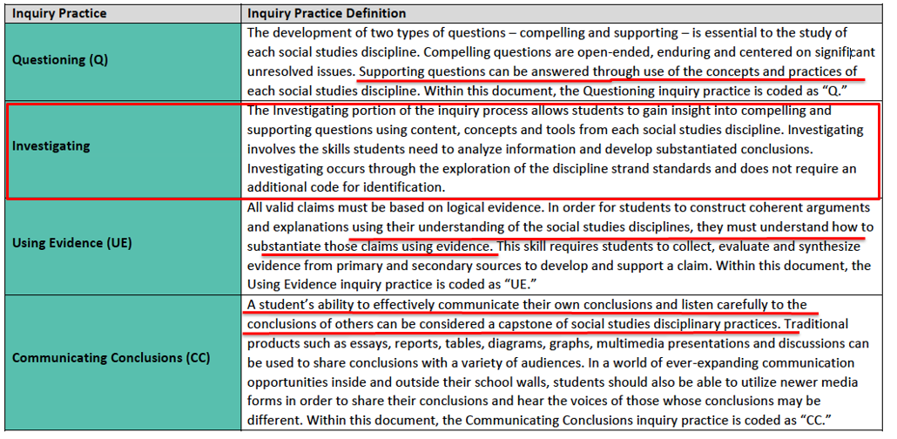
Inquiry Practices and Disciplinary Strands
Notes:
Guiding Notes:
When engaging with the KAS for Social Studies, it is important to understand the relationship between the inquiry practices and the discipline strand standards. At the first glance of the architecture, it may appear that the discipline strand standards only interact with the inquiry standards through the inquiry practice of investigation. However, this is not the case. As can be seen in the annotated chart on this slide, students cannot successfully engage in inquiry without the discipline strand standards. The social studies disciplines and the concepts and practices of the disciplines are required to ask compelling and supporting questions, acquire new knowledge, substantiate claims using evidence and effectively communicate conclusions.

Slide 62
Disciplinary Strands
The disciplinary strands identified in the KAS for Social Studies are civics, economics, geography and history.
In Kentucky, the discipline strands in social studies are meant to be taught in unison. Students recall and understand themes and topics better if the social studies strands are integrated and not taught in isolation.
Notes:
Guiding Notes:
Read this slide.

Slide 63
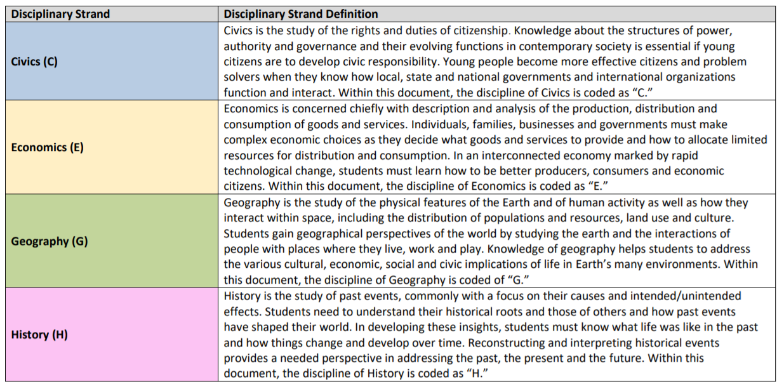
Disciplinary Strands (continued)
Notes:
Guiding Notes:
This slide shows the definition of each disciplinary strand, which can also be found on page 12 of the KAS for Social Studies.
Individually, with a partner or in a small grade-banded group, to complete the following:
1. Read through each disciplinary strand, and underline, highlight, circle, etc., elements that impact instruction.
2. What areas do you feel are a strength? In what areas do you need additional support?

Slide 64
What is discipline inquiry?
In order to learn more about disciplinary inquiry, watch the following videos to gain an understanding of what inquiry looks like in civics, economics, geography and history.
Civic Inquiry
Economic Reasoning
Geographic Inquiry
Historical Inquiry
As you watch these videos, complete the following statement for each discipline discussed (civics, economics, geography and history):
Discipline inquiry in (insert discipline) looks like…
Notes:
Watch the following videos to learn more about discipline inquiry. At the conclusion of each video, complete the following sentence: “Discipline inquiry in (insert discipline) is …
It is important to note that while these videos say Civic Inquiry: Gr. 4-6 or Economic Reasoning: Gr. 4-6, the content discussed in the films may not align to the KAS for Social Studies as these resources were made for another state. The main objective to watching these films is to provide participants with an introduction to discipline inquiry. Participants will explore this topic further in the next learning experience.
Resources:
Minnesota Center for Social Studies Education. (2015, September 4). Civic Inquiry: Gr. 4-6. https://www.mncsse.org/video/civic-inquiry-video-transcript-english
Minnesota Center for Social Studies Education. (2015, May 20). Economic Reasoning: Gr. 4-6. https://www.mncsse.org/video/economic-reasoning-video-transcript-english
Minnesota Center for Social Studies Education. (2015, September 4). Geographic Inquiry: Gr. 4-6. https://www.mncsse.org/video/geographic-inquiry-video-transcript-english
Minnesota Center for Social Studies Education. (2015, September 4). Historical Inquiry: Gr. 4-6. https://www.mncsse.org/video/historical-inquiry-video-transcript-english

Slide 65
Reflection:
What is discipline inquiry?
As you reflect on the jigsaw you just completed on discipline inquiry, engage with the “I used to think… Now I think…” thinking strategy.
I used to think...
Now, I think...
Complete the following sentence starters for each discipline discussed in the previous learning experience with civics, economics, geography and history.
Notes:
Guiding Notes:
Complete the task on the slide.
Resources:
Project Zero. (2019) I used to think… Now, I think… Harvard Graduate School of Education. https://pz.harvard.edu/sites/default/files/I%20Used%20to%20Think%20-%20Now%20I%20Think_1.pdf

Slide 66
Coming Up
Section E: How do students use the Using Evidence standards to analyze sources and apply relevant information to make evidence-based claims?
Section F: How do the Communicating Conclusions standards support students in synthesizing knowledge to support civic engagement?
Section G: Reflection
Notes:
Guiding Notes:
This slide previews the upcoming sections.
The KDE needs your feedback on the effectiveness of this module, the learning platform and how the consultants may best support you as you take the next steps in the implementation process. Complete a short survey to share our thinking and provide them with feedback on how the KDE can best meet our needs. Feedback from our surveys will be used by the KDE to plan and prepare future professional learning.
Post-survey: https://docs.google.com/forms/d/e/1FAIpQLSffTPNRAlm0EpnD7VfhUlfV-WtFTE7xVEyq4zjb5TYu9mSNxw/viewform

Slide 67
Inquiry Practices of the KAS for Social Studies
Section E: Using Evidence
Notes:
Guiding Notes:
This slide begins section E: Using Evidence

Slide 68
Module Overview
Section A: Introduction- What is inquiry?
Section B: What are Compelling Questions, and how do students ask them?
Section C: What are Supporting Questions, and how do students ask them?
Section D: How do students investigate through the disciplinary strand standards?
Section E: How do students use the Using Evidence standards to analyze sources and apply relevant information to make evidence-based claims?
Section F: How do the Communicating Conclusions standards support students in synthesizing knowledge to support civic engagement?
Section G: Reflection
Notes:
Guiding Notes:
This slide provides an overview of the module.

Slide 69
Module Objectives
Understand the inquiry practices as outlined in the KAS for Social Studies.
Define inquiry as outlined in the KAS for Social Studies.
Understand the characteristics of compelling and supporting questions.
Acquire ways to get students to engage with and create compelling and supporting questions when required.
Understand the skills and progressions found within the Using Evidence standards.
Understand the four components of the Communicating Conclusions standards and find examples and strategies to implement these components.
Notes:
Guiding Notes:
This slide provides the module objectives.

Slide 70
Using Evidence
All valid claims must be based on logical evidence.
In order for students to construct coherent arguments and explanations using their understanding of the social studies disciplines, they must understand how to substantiate those claims using evidence.
This skill requires students to collect, evaluate and synthesize evidence from primary and secondary sources to develop and support a claim.
Notes:
Guiding Notes:
In order for students to construct coherent arguments and explanations using their understanding of the social studies disciplines, they must understand how to substantiate those claims using evidence. This skill requires students to collect, evaluate and synthesize evidence from primary and secondary sources to develop and support a claim.

Slide 71
Using Evidence (continued)
Students are not only using sources to create claims, but they are using evidence to construct their knowledge relating to the disciplinary strand standards. Thus, students should use evidence to not only evaluate but also to formulate their conclusions.
Notes:
Guiding Notes:
Students should use evidence to not only evaluate but also to formulate their conclusions.

Slide 72
Why does using evidence matter?
In social studies classrooms in Kentucky, students will craft arguments, apply reasoning, make comparisons, corroborate their sources and interpret and synthesize evidence as political scientists, economists, geographers and historians.
The process of using evidence to not only evaluate but also to formulate their conclusions will better prepare students for the responsibilities and demands of civic life.
By studying the disciplines of civics, economics, geography and history, working individually and/or collaboratively, students will read, synthesize ideas, compose and communicate ideas effectively to analyze issues from multiple perspectives, make decisions and solve problems as a responsible member of society.
.
Notes:
Guiding Notes:
Read this slide.

Slide 73
Using Evidence: Purpose and Function
Students should have opportunities to use evidence to…
Spark compelling questions;
Ask discipline specific supporting questions;
Construct new knowledge when engaging with the disciplinary strand standards; and
Develop claims.
Notes:
Guiding Notes:
In order to prepare young people for civic life in the 21st century, students must apply reasoning, make comparisons, corroborate their sources and interpret and synthesize evidence as political scientists, economists, geographers and historians to develop students' knowledge of important social studies concepts and their use of disciplinary thinking skills.
Students should have opportunities to use evidence to…
● Spark compelling questions
● Ask discipline specific supporting questions
● Construct new knowledge when engaging with the disciplinary strand standards
● Develop claims

Slide 74
Using Evidence: Purpose and Function (continued)
Within the Using Evidence standards, students are required to:
Use sources to answer compelling and supporting questions.
Analyze sources and apply relevant information to make evidence-based claims when answering compelling and supporting questions.
Notes:
Guiding Notes:
Within the Using Evidence standards, students are required to:
● Use sources to answer compelling and supporting questions.
● Analyze sources and apply relevant information to make evidence-based claims when answering compelling and supporting questions.

Slide 75
Selecting Sources
When educators are selecting resources, they should ask the following questions:
Do the sources represent a variety of print and non-print sources, which may include but is not limited to visuals, charts, data and traditional text?
Are the sources complex and grade-level appropriate?
Do the sources provide access and opportunity for grade-level work?
Do the sources incorporate multiple perspectives?
Notes:
Guiding Notes:
When educators are selecting resources, they should ask the following questions:
• Do the sources represent a variety of print and non-print sources which may include but is not limited to visuals, charts, data and traditional text?
• Are the sources complex and grade-level appropriate?
• Do the sources provide access and opportunity for grade-level work?
• Do the sources incorporate multiple perspectives?
Note to the facilitator: Be sure to have participants consider the following when asking about whether or not a source is grade-level appropriate: Students should engage with foundational documents, such as but not limited to the Declaration of Independence, throughout their social studies education. However, how students interact with this document should be grade-level appropriate, meaning that at Grade 5 students might need an adaptation whereas students in high school can read the document.

Slide 76
Connecting Supporting Questions and Sources
When connecting supporting questions and sources, the following must be considered: The selected sources must:
Be purposeful.
Be clearly aligned to the questions.
Provide evidence to support claims and refute opposing claims when students are answering questions.
Provide opportunities for students to engage in disciplinary thinking.
Notes:
Guiding Notes:
Students should be using sources at all points in their learning. However, specific considerations must be made when connecting supporting questions and sources. When connecting supporting questions and sources, the following must be considered: The selected sources must:
• Be purposeful.
• Be clearly aligned to the questions.
• Provide evidence to support claims and refute opposing claims when students are answering questions.
• Provide opportunities for students to engage in disciplinary thinking.

Slide 77
Using Evidence (1)
In the KAS for Social Studies, the Using Evidence standards progress to develop to a higher, better or more advanced application of the skill stated in the standard. For example, a student’s interaction in elementary school with multiple perspectives progresses as follows:
K.I.UE.1 Identify information from two or more sources to investigate characteristics of a community.
1.I.UE.1 Identify information from two or more sources to describe multiple perspectives about communities in Kentucky.
2.I.UE.3 Identify a primary and secondary source, and explain who created it, when they created it, where they created it and why they created it.
3.I.UE.1 Describe how multiple perspectives shape the content and style of a primary and secondary source.
4.I.UE.1 Integrate evidence from two or more sources to answer compelling and supporting questions. 4.I.UE.2 Determine the value and limitations of primary and secondary sources
5.I.UE.2 Analyze primary and secondary sources on the same event or topic, noting key similarities and differences in the perspective they represent.
Notes:
Guiding Notes:
Read this slide.

Slide 78
Using Evidence (2)
The progression of a student’s interaction with multiple perspectives continues to progress beyond elementary throughout middle school and high school, as illustrated by the examples below:
6.I.UE.3 Gather primary and secondary sources, and determine their relevance and intended use to answer compelling and supporting questions.
7.I.UE.2 Analyze evidence from multiple perspectives and sources to support claims and refute opposing claims, noting evidentiary limitations to answer compelling and supporting questions.
8.I.UE.3 Gather relevant information from multiple sources while using the origin, authority, structure, context and corroborative value of the sources to guide the selection to answer compelling and supporting questions.
HS.I.UE.2 (for all disciplinary strands) Gather information and evidence from credible sources representing a variety of perspectives relevant to compelling and/or supporting questions in Civics, Economics, Geography, U.S. history and World History.
As a result, it is imperative that educators look at the Inquiry Progression: Using Evidence section of Appendix A in the KAS for Social Studies to ensure that they are building upon the skills that students’ acquired in the previous grade(s).
Notes:
Guiding Notes:
Read this slide.
Note: The Inquiry Progression: Using Evidence section of Appendix A in the KAS for Social Studies starts on page 196.

Slide 79
Using Evidence (3)
In the KAS for Social Studies, the Using Evidence standards progress in order to develop to a more advanced application of the skill stated in the standard. For example, a student’s interaction in elementary school with primary and secondary sources progresses as follows:
2.I.UE.1 Identify characteristics of primary and secondary sources.
3.I.UE.1 Describe how multiple perspectives shape the content and style of a primary and secondary source.
4.I.UE.2 Determine the value and limitations of primary and secondary sources.
5.I.UE.2 Analyze primary and secondary sources on the same event or topic, noting key similarities and differences in the perspective they represent.
Notes:
Guiding Notes:
Read this slide.

Slide 80
Using Evidence (4)
The progression of a student’s interaction with primary and secondary sources continues to progress beyond elementary throughout middle school and high school, as illustrated by the examples below:
6.I.UE.2 Compare evidence from primary and secondary sources to assist in answering compelling and supporting questions.
7.I.UE.2 Analyze evidence from multiple perspectives and sources to support claims and refute opposing claims, noting evidentiary limitations to answer compelling and supporting questions.
HS.I.UE.1 (for all disciplinary strands) Evaluate the credibility of multiple sources representing a variety of perspectives relevant to compelling and/or supporting questions in civics, economics, geography, U.S. history and World history.
As a result, it is imperative that educators look at the Inquiry Progression: Using Evidence section of Appendix A in the KAS for Social Studies to ensure that they are building upon the skills that students’ acquired in the previous grade(s).
Notes:
Guiding Notes:
Read this slide.
Note: The Inquiry Progression: Using Evidence section of Appendix A in the KAS for Social Studies starts on page 196.

Slide 81
Deeper Dive: Using Evidence
To explore your grade level Using Evidence standards, engage with this deeper dive for your grade level.
Elementary: Engage with slides 93 - 106.
Middle: Engage with slides 107 – 113.
High: Engage with slides 114 - 120.
Notes:
Guiding Notes:
Have participants jump to the slide numbers provided to engage with activities for their grade level. If participants would like to engage with more than one grade level, have them jump to multiple slide groups.

Slide 82
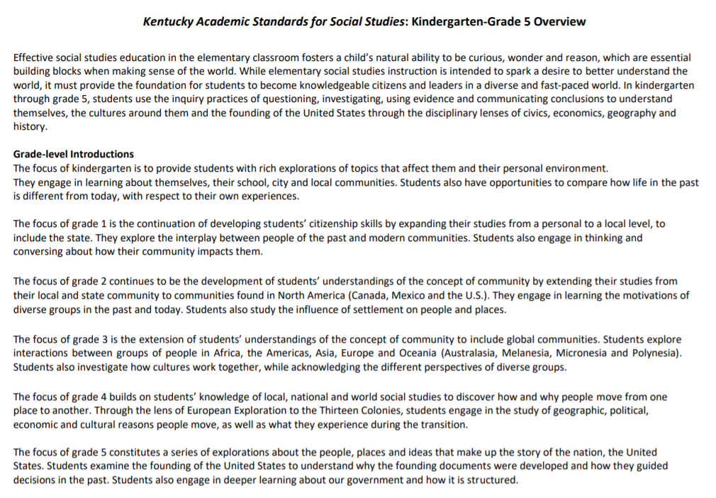
Deeper Dive: Using Evidence Kindergarten through Grade 5
Notes:
Guiding Notes:
Read the Using Evidence standards for elementary school.
Note: This grade band overview can be found on page 21 of the KAS for Social Studies.

Slide 83
Deeper Dive: Using Evidence Elementary
Primary and Secondary Sources Progression
For this deeper dive, you will engage with the Using Evidence standards to understand how a students’ understanding of primary and secondary sources progress throughout elementary school. Here is the progression of this skill in the KAS for Social Studies for elementary students:
K.I.UE.1 Identify information from two or more sources to investigate characteristics of a community.
1.I.UE.1 Identify information from two or more sources to describe multiple perspectives about communities in Kentucky.
2.I.UE.1 Identify characteristics of primary and secondary sources.
3.I.UE.1 Describe how multiple perspectives shape the content and style of a primary and secondary source.
4.I.UE.2 Determine the value and limitations of primary and secondary sources.
5.I.UE.2 Analyze primary and secondary sources on the same event or topic, noting key similarities and differences in the perspective they represent.
Notes:
Guiding Notes:
It is important to note that engaging with sources begins in Kindergarten and the skills progress kindergarten through high school. While students don’t distinguish between primary and secondary sources until Grade 2, students are required to understand that they use sources to construct meaning about the world around them as soon as they begin their social studies education.

Slide 84
Deeper Dive: Using Evidence Elementary
Primary and Secondary Sources Progression (2)
Let’s examine some of the key terms in the UE standards that involve primary and secondary sources. Individually, with a partner, a small grade level group, or PLC, circle and/or highlight the keywords in the following standards from Kindergarten through Grade 5:
K.I.UE.1 Identify information from two or more sources to investigate characteristics of a community.
1.I.UE.1 Identify information from two or more sources to describe multiple perspectives about communities in Kentucky.
2.I.UE.1 Identify characteristics of primary and secondary sources.
3.I.UE.1 Describe how multiple perspectives shape the content and style of a primary and secondary source.
4.I.UE.2 Determine the value and limitations of primary and secondary sources.
5.I.UE.2 Analyze primary and secondary sources on the same event or topic, noting key similarities and differences in the perspective they represent.
Notes:
Guiding Notes:
Read this slide, and circle and/or highlight the keywords in the Using Evidence standards from kindergarten through Grade 5.

Slide 85
Deeper Dive: Using Evidence Elementary
Primary and Secondary Sources Progression (3)
Let’s examine some of the key terms in UE 3. Individually, with a partner, a small grade level group, or PLC, circle and/or highlight the keywords in the following standards from Kindergarten through Grade 5:
K.I.UE.1 Identify information from two or more sources to investigate characteristics of a community.
1.I.UE.1 Identify information from two or more sources to describe multiple perspectives about communities in Kentucky.
2.I.UE.1 Identify characteristics of primary and secondary sources.
3.I.UE.1 Describe how multiple perspectives shape the content and style of a primary and secondary source.
4.I.UE.2 Determine the value and limitations of primary and secondary sources.
5.I.UE.2 Analyze primary and secondary sources on the same event or topic, noting key similarities and differences in the perspective they represent.
Notes:
Guiding Notes:
Read the slide, and consider the words that are highlighted. If working in groups, discuss with a partner.

Slide 86
Deeper Dive: Using Evidence Elementary
Remember, the Using Evidence standards progress in order for students to develop to a higher, better or more advanced application of the skill stated in the standard. Answer the following questions based on what you learned about the Using Evidence standards you just examined.
What was similar about these standards?
What was different?
How did these UE standards progress to have students engage with a more advanced application of the skills identified?
Notes:
Guiding Notes:
Read this slide, and consider the questions individually, with a partner or a small grade banded group.

Slide 87
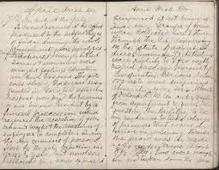
Deeper Dive: Using Evidence Elementary (2)
What is a primary source?
A primary source is an original source of information that was created at the time of the event.
Examples of primary sources:
diary/journal entry
artifact
autobiography
transcript or audio of speech
interviews
photographs
newspaper reports
Notes:
Guiding Notes:
To help students master the UE progression highlighted in this module, it is important that they know the meaning and characteristics of primary sources, and can identify examples of types of primary sources.

Slide 88
Deeper Dive: Using Evidence Elementary (3)
What is a secondary source?
A secondary source often uses primary sources to gather its information and is created after the time of the event.
Examples of secondary sources:
informational books
scholarly articles
biographies
documentaries
magazines
encyclopedias
Notes:
Guiding Notes:
Additionally, students should be able to explain the meaning and characteristics of secondary sources and identify examples of different types of secondary sources.
Additional resources for teaching the characteristics of primary and secondary sources to elementary students:
George W. Bush Presidential Library and Museum. (2011). Teaching Primary and Secondary Sources [pdf]. https://www.georgewbushlibrary.gov/s3fs-public/2017-06/ElementaryLP_PrimarySecondarySources_Web.pdf
American University. (2018). Primary vs. Secondary Sources. https://subjectguides.library.american.edu/primary
Smithsonian National Museum of American History. (n.d.). Engaging Students with Primary Sources [pdf]. https://historyexplorer.si.edu/sites/default/files/PrimarySources.pdf

Slide 89
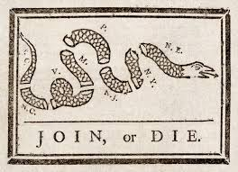
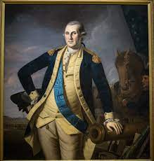
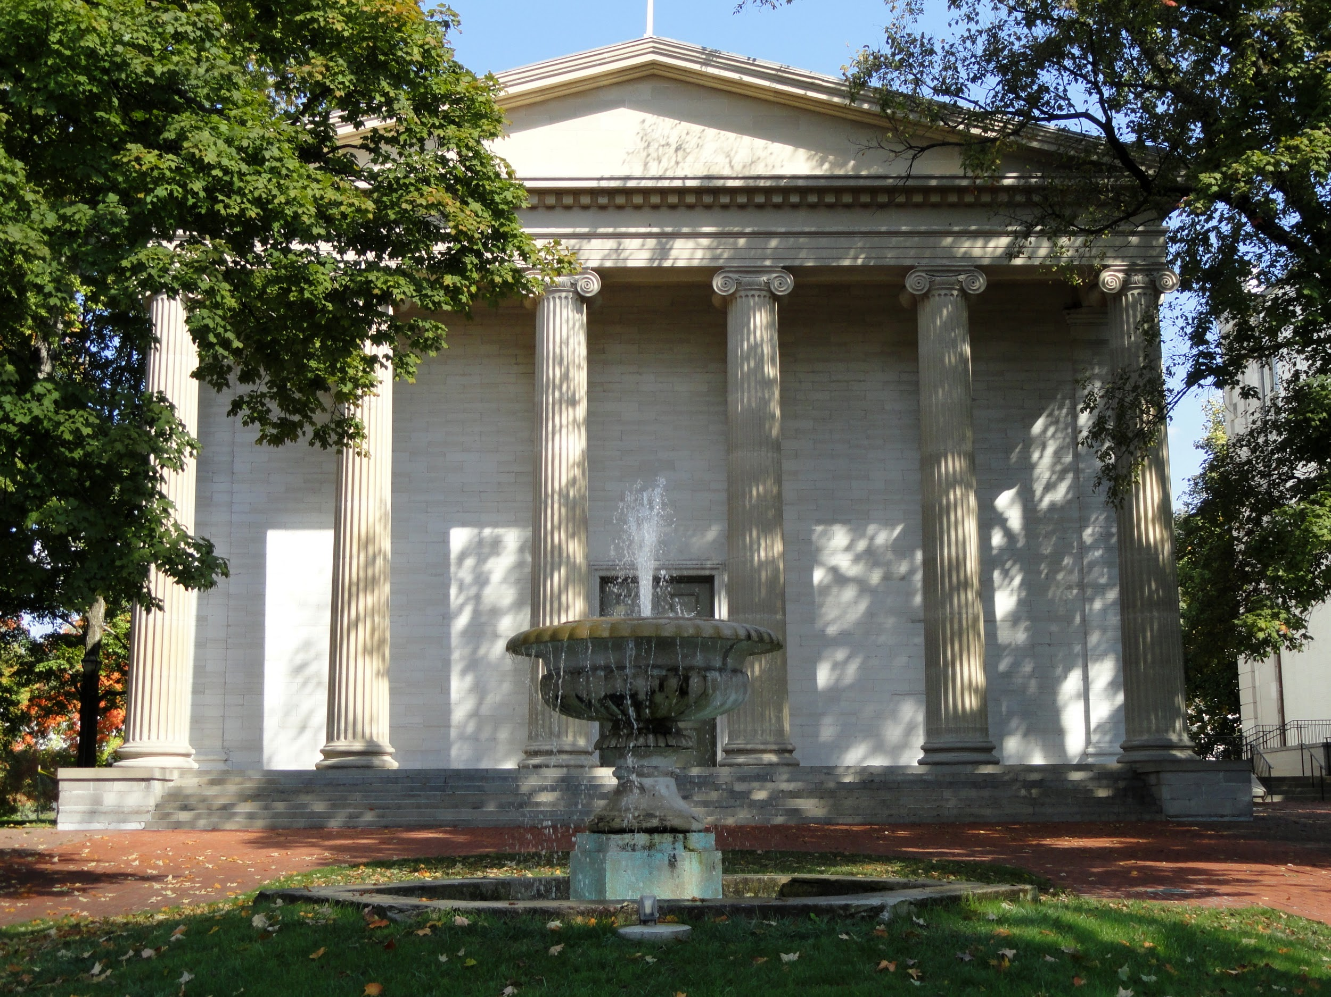
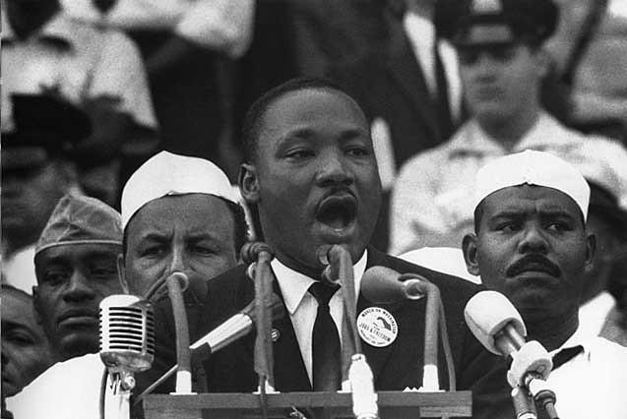
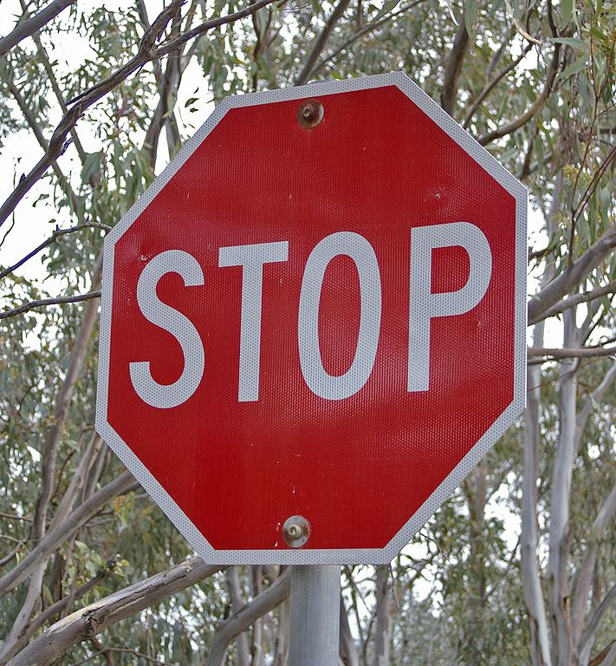
Deeper Dive:
Using Evidence Elementary (3)
Anything that communicates a message can be a source!
Notes:
Guiding Notes:
It’s important to note that anything that communicates a message can be a source! Traditionally, we think of primary and secondary sources being dominated by text, but symbols, objects, photos, etc., can serve as sources to investigate compelling and supporting questions, just as the more traditional types of sources we think of. For elementary students, this provides an opportunity for students to be exposed to and engage with sources that do not require reading proficiency.
According to the KAS for Reading and Writing Interdisciplinary Literacy Practice 1, text is anything that communicates a message. Therefore, images that communicate a message are considered text and can serve as a source for students to investigate. Access the Reading and Writing standards here: https://education.ky.gov/curriculum/standards/kyacadstand/Documents/Kentucky_Academic_Standards_Reading_and_Writing.pdf

Slide 90
Elementary Application
To explore your grade level Using Evidence standards, engage with this deeper dive for your grade level.
Kindergarten and Grade 1: Engage with slide 102.
Grade 2 and Grade 3: Engage with slide 103.
Grade 4 and Grade 5: Engage with slide 104.
Notes:
Guiding Notes:
For the purposes of this application, you will only engage with one Using Evidence standard. If you would like to investigate the Using Evidence standard of additional grades, access the slides for the additional grades.

Slide 91
Deeper Dive: Using Evidence Kindergarten and Grade 1 Application
In order to understand how to implement I.UE.1, access the Kindergarten Social Studies Using Evidence Assignment. Review each component to understand the context of the assignment.
Individually, with a partner, grade banded group, or a PLC, engage with this deeper dive by taking on the role of a student and engaging with the Kindergarten Strongly Aligned Assignment with Teacher Notes. Identify two sources from this assignment to use for this deeper dive.
Notes:
Guiding Notes:
Read this slide and engage with the assignment on this slide.
As a group, discuss how a graphic organizer may help elementary students when sourcing. While this graphic organizer is designed to meet the Kindergarten standard, how could this strategy be useful for students in Grade 1? How could this graphic organizer be modified for use with Grade 1 students?
Note: Grade 1 Using Evidence standards require students to identify information from two or more sources to describe multiple perspectives about communities in Kentucky (1.I.UE.1). In order to do this, students must be able to source effectively. Therefore, this activity would be useful for grade 1 students as well, as they can use the sourcing information to describe multiple perspectives presented in a source or sources about communities in Kentucky.

Slide 92
Deeper Dive: Using Evidence Grade 2 and 3 Application
Access the Grade 2 Strongly Aligned Assignment and look over each component to understand the context of the assignment.
Select a source provided, and complete the Grade 2 Using Evidence Assignment to analyze this source.
For more information on how these sources can be utilized to scaffold students, access the Grade 2 Strongly Aligned Assignment with Teacher Notes.
Notes:
Guiding Notes:
Using the Grade 2 Using Evidence Assignment, evaluate one source from the Grade 2 Strongly Aligned Assignment.
As a group, discuss how a graphic organizer may help elementary students when sourcing. While this organizer is designed to meet the grade 2 standard, how could using this strategy be useful for students in other grades? How could it be modified for use with younger students or older students?
Note: Grade 3 Using Evidence standards require students to describe how multiple perspectives shape the content and style of a primary
and secondary source (3.I.UE.1) and explain the relationship between two or more sources on the same theme or topic (3.I.UE.2). In order to do this, students must be able to source effectively. Therefore, this activity would be useful for grade 3 students as well, as they can use the sourcing information to analyze multiple perspectives presented in a source or sources, and to determine the relationship between sources on the same theme or topic.

Slide 93
Deeper Dive:
Using Evidence Grade 4 and 5 Application
Access the Boston Massacre of 1770 Sources.
Utilize these two sources to complete the Grade 5 Using Evidence Assignment to understand how to implement 5.I.UE.2.
Notes:
Guiding Notes:
The Using Evidence standards progress further by the intermediate grades. 5.I.UE.2 asks students to analyze primary and secondary sources on the same event or topic, noting key similarities and differences in the perspective they represent.
Using the two different Boston Massacre sources linked on the slide, complete the linked Grade 5 Using Evidence Assignment. Complete the graphic organizers to analyze each source and its perspective, and then answer the questions to compare the sources and their perspectives.
Consider how this assignment could be modified for grade 4 students. Note: Grade 4 Using Evidence standards require students to determine the value and limitations of primary and secondary sources. This assignment could be modified so that after sourcing, students could use the information from their analysis to determine the value and limitations of the source instead of comparing perspectives.

Slide 94
Deeper Dive: Using Evidence Elementary Reflection
What resonated with you as you engaged with the Social Studies Using Evidence Assignment for your grade level? What were your takeaways?
If your grade was not featured in the application activity, how would you modify this application the UE standards featured here to meet the needs of your grade level expectations?
Why is understanding the progressions of the UE standards elementary school critical for student learning?
Notes:
Guiding Notes:
Consider and/or discuss the questions on the screen individually, in partners or small grade banded groups.

Slide 95
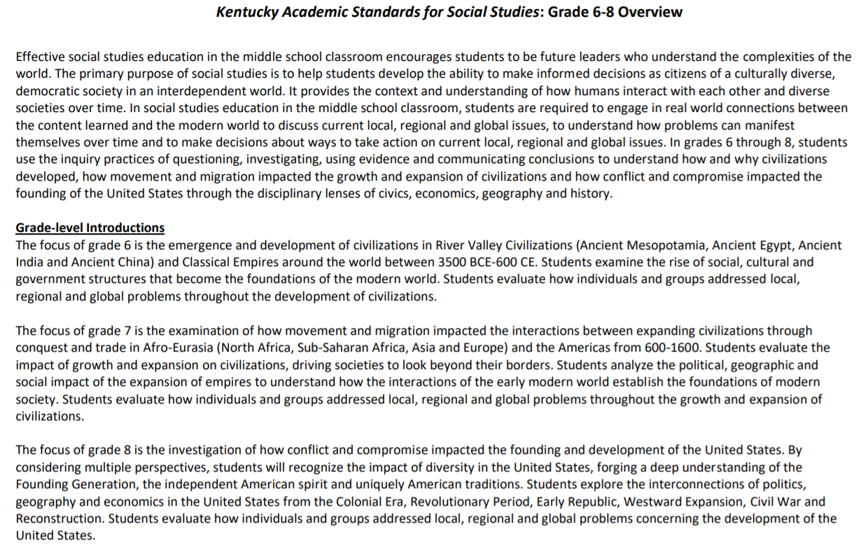
Deeper Dive: Using Evidence Grades 6-8
Notes:
Guiding Notes:
You will now engage with the Using Evidence standards for middle school.
Note: This grade band overview can be found on page 93 of the KAS for Social Studies.

Slide 96
Deeper Dive: Using Evidence Middle
For this deeper dive, you will engage with the Using Evidence standard 3 to understand how the skills of this progression advance from Grade 6 to Grade 8. Look at the Using Evidence standard 3 for middle school:
6.I.UE.3 Gather primary and secondary sources, and determine their relevance and intended use to answer compelling and supporting questions.
7.I.UE.3 Gather relevant information from multiple sources while using the origin, authority, structure and context of the sources to guide the selection to answer compelling and supporting questions.
8.I.UE.3 Gather relevant information from multiple sources while using the origin, authority, structure, context and corroborative value of the sources to guide the selection to answer compelling and supporting questions.
Notes:
Guiding Notes:
Read this slide.

Slide 97
Deeper Dive: Using Evidence Middle (2)
Let’s examine some of the key terms in UE 3. Individually, with a partner, a small grade level group, or PLC, circle and/or highlight the keywords in the following standards from Grades 6, 7 and 8:
6.I.UE.3 Gather primary and secondary sources, and determine their relevance and intended use to answer compelling and supporting questions.
7.I.UE.3 Gather relevant information from multiple sources while using the origin, authority, structure and context of the sources to guide the selection to answer compelling and supporting questions.
8.I.UE.3 Gather relevant information from multiple sources while using the origin, authority, structure, context and corroborative value of the sources to guide the selection to answer compelling and supporting questions.
Notes:
Guiding Notes:
Read this slide, and circle and/or highlight the keywords in the Using Evidence standards from Grades 6, 7 and 8.

Slide 98
Deeper Dive: Using Evidence Middle (2)
Let’s examine some of the key terms in UE 3. Did you identify the same key words?:
6.I.UE.3 Gather primary and secondary sources, and determine their relevance and intended use to answer compelling and supporting questions.
7.I.UE.3 Gather relevant information from multiple sources while using the origin, authority, structure and context of the sources to guide the selection to answer compelling and supporting questions.
8.I.UE.3 Gather relevant information from multiple sources while using the origin, authority, structure, context and corroborative value of the sources to guide the selection to answer compelling and supporting questions.
Notes:
Guiding Notes:
Read the slide, and consider the words that are highlighted. If working in groups, discuss with a partner.

Slide 99
Deeper Dive: Using Evidence Middle (3)
Remember, the Using Evidence standards progress in order for students to develop to a higher, better or more advanced application of the skill stated in the standard. Answer the following questions based on what you learned about 6.I.UE.3, 7.I.UE.3 and 8.I.UE.3.
What was similar about the three standards?
What was different?
How did I.UE.3 progress to have students engage with a more advanced application of the skills identified?
Notes:
Guiding Notes:
Read this slide, and consider the questions individually, with a partner or a small grade banded group.

Slide 100
Deeper Dive: Using Evidence Middle (4)
When engaging with UE standard 3 for middle school, it is important to remember the standards found within the KAS for Social Studies are not meant to be taught in silos because they impact one another.
At the middle school level, teachers should provide opportunities for students to develop their own compelling questions, with teacher support, relative to the grade level theme. Students are required to generate their own supporting questions.
Thus, when engaging UE standard 3, it is appropriate for students to gather evidence from a selection of sources provided by the teacher; however, students must have the opportunity to determine the relevance of information they are gathering to construct explanations and/or arguments regarding compelling and/or supporting questions.
Notes:
Guiding Notes:
Read this slide.

Slide 101
Deeper Dive: Using Evidence Middle Application
To understand how to implement I.UE.3, access the Grade 7 Social Studies Using Evidence Assignment.
Individually, with a partner, grade banded group, or a PLC, engage with this deeper dive by taking on the role of a student and completing the section entitled Investigation: Part three in the Grade 7 Strongly Aligned Assignment Teacher Notes.
Use the sources provided in the section entitled, Investigation: Part Three in the Grade 7 Strongly Aligned Teacher Notes to complete the tasks found in the Grade 7 Social Studies Using Evidence Assignment.
Notes:
Guiding Notes:
Read the slide. Next, access the Student Assignment Library on www.kystandards.org and access the Grade 7 Strongly Aligned Assignment Teacher Notes. It is important to note that I.UE.3 is not included the Grade 7 Strongly Aligned Teacher Notes. The Grade 7 Strongly Aligned Teacher Notes are used here to build context about Grade 7 and to provide resources for participant exploration of how to implement I.UE.3.
Engage with the section entitled, Investigation: Part Three. In this section, students are required to research important technologies that originated between 600-1600 using the sources provided to complete the chart. Use the sources provided in Investigation: Part Three to complete the Grade 7 Social Studies Using Evidence Assignment.
It is important to note that when students are engaging with the inquiry practices in Grade 7, they are developing their own compelling questions with teacher support and they are generating their own supporting questions. This will impact the evidence they gather, etc. Since this cannot be easily recreated here, participants are asked to use the Grade 7 Teacher Notes for examples of questions and resources.

Slide 102
Deeper Dive: Using Evidence Middle Reflection
What resonated with you as you engaged with the Grade 7 Social Studies Using Evidence Assignment? What were your takeaways?
If you are a Grade 6 or Grade 8 teacher, how would you modify this application of UE 3 to meet the needs of your grade level expectations?
Why is understanding the progressions of the UE standards in middle school critical for student learning?
Notes:
Guiding Notes:
Consider and/or discuss the questions on the screen individually, in partners or in small grade banded groups.

Slide 103
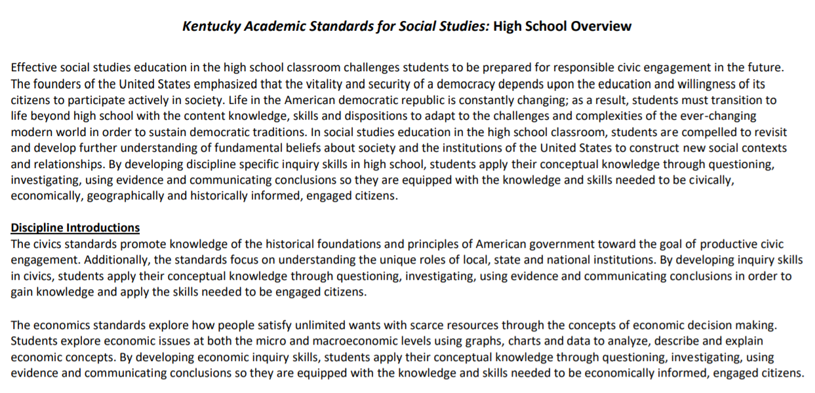
Deeper Dive: Using Evidence High School
Notes:
Guiding Notes:
You will now engage with the Using Evidence standards for middle school.
Note: This high school overview can be found on page 139 of the KAS for Social Studies.

Slide 104
Deeper Dive: Using Evidence High School
When engaging with UE standards for high school, it is important to remember the standards found within the KAS for Social Studies are not meant to be taught in silos because they impact one another.
Remember, at the high school level, teachers should provide opportunities for students to generate their own compelling questions to frame thinking, inquiry and/or understanding of key concepts in civics, economics, geography, U.S. history and world history. Students have been generating their own supporting questions since Middle school.
For example, when engaging with UE standard 2, students should be gathering information and evidence from credible sources representing a variety of perspectives relevant to the compelling and/or supporting questions they generate in the disciplines of civics, economics, geography, U.S. history and world history.
Notes:
Guiding Notes:
Read this slide.

Slide 105
Deeper Dive: Using Evidence High School (2)
For this deeper dive, you will engage with two Using Evidence standards, Standards 1 and 2, to understand some of the sourcing skills required at high school. They are:
HS.UH.I.UE.1 Evaluate the credibility of multiple sources representing a variety of perspectives relevant to compelling and/or supporting questions in U.S. history.
HS.UH.I.UE.2 Gather information and evidence from credible sources representing a variety of perspectives relevant to compelling and/or supporting questions in U.S. history.
This standard is repeated for civics, economics, geography, and world history in high school.
Notes:
Guiding Notes:
Read this slide.

Slide 106
Deeper Dive: Using Evidence High School (3)
Let’s examine some of the key terms in UE 1 and 2. Remember, we are using HS.C.I.UE.2 which refers to civics. However, this standard repeats with the disciplines of economics, geography, U.S. history and world history.
Individually, with a partner, a small grade level group, or PLC, circle and highlight the key words in the following standard:
HS.UH.I.UE.1 Evaluate the credibility of multiple sources representing a variety of perspectives relevant to compelling and/or supporting questions in U.S. history.
HS.UH.I.UE.2 Gather information and evidence from credible sources representing a variety of perspectives relevant to compelling and/or supporting questions in U.S. history.
Notes:
Guiding Notes:
Read this slide and circle and/or highlight the keywords in HS.UH.I.UE.1 and HS.UH.I.UE.2 .

Slide 107
Deeper Dive:
Using Evidence High School (4)
Let’s examine the standard. Did you identify the same key words?:
HS.UH.I.UE.1 Evaluate the credibility of multiple sources representing a variety of perspectives relevant to compelling and/or supporting questions in U.S. history.
HS.UH.I.UE.2 Gather information and evidence from credible sources representing a variety of perspectives relevant to compelling and/or supporting questions in U.S. history.
Notes:
Guiding Notes:
Read the slide, and consider the words that are highlighted. If working in groups, discuss with a partner.

Slide 108
Deeper Dive:
Using Evidence High School Application
To understand how to implement UE 1 and 2, access the High School Social Studies Using Evidence Assignment and the Strongly Aligned Assignment for High School.
For this deeper dive, you will engage with standards HS.UH.I.UE.1 and HS.UH.I.UE.2 to gather and evaluate sources to answer the supporting question: ““How have international trends, domestic and foreign policies impacted American culture and society from 1945 - present?”
Complete this work individually, with a partner, grade banded group, or a PLC.
Notes:
Guiding Notes:
Read the slide. Next, access the Student Assignment Library on www.kystandards.org and access the Strongly Aligned Assignment for High School. It is important to note that UE standard 1 is not included the Strongly Aligned Assignment for High School. However, engaging with UE 1 is critical for students to use UE 2. The High School Strongly Aligned Assignment provides additional context to support evaluating the credibility of multiple sources representing a variety of perspectives relevant to compelling and/or supporting questions in U.S. history. In this assignments, students must gather information and evidence from credible sources representing a variety of perspectives relevant to compelling and/or supporting questions in U.S. history.
When gathering sources for the Strongly Aligned Assignment for High School, students may investigate topics that include but are not limited to: international trends, domestic and foreign policies, and American culture. Since components of this assignment require students to analyze whether or not international trends, domestic and foreign policies impact their lives, students are required to gather information and evidence from credible sources representing a variety of perspectives relevant to compelling and/or supporting questions.

Slide 109
Deeper Dive: Using Evidence High School
Reflection
What resonated with you as you engaged with the High School Social Studies Using Evidence Assignment? What were your takeaways?
Why is understanding the progressions of the UE standards prior to high school critical for student learning in high school?
Notes:
Guiding Notes:
Consider and/or discuss the questions on the screen individually, in partners or in small grade banded groups.

Slide 110
Reflection
Revisit the Unpacking the Using Evidence Standards tool that you completed in Module One: Getting to Know the KAS for Social Studies.
As you review your responses in the chart, consider what you learned in this section of the Inquiry Practices Module. Are there any sections you would revise based on what you learned?
Notes:
Guiding Notes:
Access the Unpacking the Using Evidence Standards template you completed in Module One: Getting to Know the KAS for Social Studies. This tool may be accessed here: https://education.ky.gov/curriculum/standards/kyacadstand/Documents/Unpacking_the_Using_Evidence_Standards.docx
Read the slide, and revise any sections in this document that need to be updated based on what you learned in this section.

Slide 111
Reflection (continued)
Using the Using Evidence standards for the grade level identified, complete the following:
What is the inferred or possible content based on the nouns in the standard?
Vocabulary students will need to know.
Are there any other considerations to think about regarding the meaning of this standard?

Slide 112
Coming Up
Section F: How do the Communicating Conclusions standards support students in synthesizing knowledge to support civic engagement?
Section G: Reflection
Notes:
Guiding Notes:
This slide previews the upcoming sections.
The KDE needs your feedback on the effectiveness of this module, the learning platform and how the consultants may best support you as you take the next steps in the implementation process. Complete a short survey to share our thinking and provide them with feedback on how the KDE can best meet our needs. Feedback from our surveys will be used by the KDE to plan and prepare future professional learning.
Post-survey: https://docs.google.com/forms/d/e/1FAIpQLSffTPNRAlm0EpnD7VfhUlfV-WtFTE7xVEyq4zjb5TYu9mSNxw/viewform

Slide 113
Inquiry Practices of the KAS for Social Studies
Section F: Communicating Conclusions
Notes:
Guiding Notes:
This slide begins Section F: Communicating Conclusions.

Slide 114
Module Overview
Section A: Introduction- What is inquiry?
Section B: What are Compelling Questions, and how do students ask them?
Section C: What are Supporting Questions, and how do students ask them?
Section D: How do students investigate through the disciplinary strand standards?
Section E: How do students use the Using Evidence standards to analyze sources and apply relevant information to make evidence-based claims?
Section F: How do the Communicating Conclusions standards support students in synthesizing knowledge to support civic engagement?
Section G: Reflection
Notes:
Guiding Notes:
This slide contains an overview of the module.

Slide 115
Module Objectives
Understand the inquiry practices as outlined in the KAS for Social Studies.
Define inquiry as outlined in the KAS for Social Studies.
Understand the characteristics of compelling and supporting questions.
Acquire ways to get students to engage with and create compelling and supporting questions when required.
Understand the skills and progressions found within the Using Evidence standards.
Understand the four components of the Communicating Conclusions standards and find examples and strategies to implement these components.
Notes:
Guiding Notes:
This slide includes the module objectives.

Slide 116
Communicating Conclusions
Communicating conclusions is defined by a student’s ability to effectively communicate their own conclusions and listen carefully to the conclusions of others.
Students also should be able to utilize newer media forms in order to share their conclusions and hear the voices of those whose conclusions may be different.
Depending on the grade level, the Communicating Conclusions standards generally require that students construct explanations and/or arguments and determine how to address problems.
Notes:
Guiding Notes:
Communicating conclusions is defined by a student’s ability to effectively communicate his or her own conclusions and listen carefully to the conclusions of others. Students should also be able to utilize newer media forms in order to share their conclusions and hear the voices of those whose conclusions may be different. Depending on the grade level, the Communicating Conclusions standards generally require that students construct explanations and/or arguments and determine how to address problems.

Slide 117
Civic engagement
Civic engagement occurs when an individual or group works with others to address an issue of public interest or concern to make a difference in the community.
Civic engagement does not start when a student is 18. In the KAS for Social Studies, students are expected to be active members of their community starting in kindergarten. Kindergarteners, much like their older peers in later grades, have the capacity to make a difference in their communities: their classrooms, their schools and their families.
Being invested in their community is the at the heart of the Communicating Conclusions standards.
Notes:
Guiding Notes:
Read this slide.

Slide 118
Communicating Conclusions:
Purpose and Function
There are four components within the Communicating Conclusions standards. When students engage with the Communicating Conclusions standards, students should have opportunities to:
Synthesize information to construct new understandings, which will become the foundation for civic engagement;
Construct explanations and arguments;
Engage in deliberative and democratic procedures; and
Act civically by identifying and addressing problems.
Notes:
Guiding Notes:
A student’s ability to effectively communicate their own conclusions and listen carefully to the conclusions of others can be considered a capstone of social studies disciplinary practices. Traditional products such as essays, reports, tables, diagrams, graphs, multimedia presentations and discussions can be used to share conclusions with a variety of audiences.
Students should have opportunities to communicate conclusions to…
● Synthesize information to construct new understandings, which will become the foundation for civic engagement.
● Construct explanations and arguments
● Engage in deliberative and democratic procedures
● Act civically by identifying and addressing problems

Slide 119
Communicating Conclusions:
Explanations
Constructing Explanations:
When students are engaging with Communicating Conclusions standards where they have to construct explanations, they are examining a topic and conveying ideas, concepts and information through the selection, organization and analysis of relevant content.
For example, when students are constructing explanations in Grade 4, they are constructing an explanation, using reasoning and relevant information, to examine the causes and effects of an issue around migration and settlement.
The KAS for Social Studies progresses up to and beyond this standard K-3 and 5-high school.
Notes:
Guiding Notes:
Read this slide.

Slide 120
Communicating Conclusions:
Explanations (2)
Some examples of how this skill progresses include:
K.I.CC.1 Construct an explanation about their community’s civic life, history, geography and/or economy.
3.I.CC.1 Construct an explanation, using relevant information, to address a local, regional or global problem.
5.I.CC.1 Construct explanatory products, using reasoning, correct sequence, examples and details with relevant information and data, to convey the diverse perspectives that impacted the founding of the United States.
7.I.CC.1 Construct explanations, using reasoning, correct sequence, examples and details with relevant information and data, while acknowledging the strengths and weaknesses of the explanations concerning the growth and expansion of civilizations.
HS.C.I.CC.1 Engage in civil discussion, reach consensus when appropriate and respect diverse opinions relevant to compelling and/or supporting questions in civics.
Notes:
Guiding Notes:
This slide contains information on how Communicating Conclusions standard 1 progresses.
Take a few minutes to reflect on this slide. Consider: How does this standard progress from Kindergarten to high school?
For information on this progression, visit Inquiry Progression: Communicating Conclusions in Appendix A from the KAS for Social Studies. This progression starts on page 200.

Slide 121
Deeper Dive: Communicating Conclusions
Constructing Explanation Scavenger Hunt
For examples of assignments that require students to construct explanations, access the following strongly aligned assignments in Student Assignment Library on www.kystandards.org:
Elementary: Grade 2 Strongly Aligned Assignment
Middle: Grade 8 Strongly Aligned Assignment
High: Strongly Aligned Assignment
Assignments that require students to construct explanations will be found in the Task Aligned to Supporting Question or the Task Aligned to the Compelling Question sections.
As you review this assignment, discuss the following question with a partner, small group or PLC: How are students examining a topic and conveying ideas, concepts and/or information through the selection, organization and analysis of relevant content to construct an explanation?
Notes:
Guiding Notes:
Engage with the activity on the slide.
Individually, with a partner or small group examine additional assignments where students are required to construct explanations in the Student Assignment Library. Ask the reflection questions found on this slide of any additional assignment they explore. Additionally, you may want to access the Teacher Notes documents in the Student Assignment Library for more information on assignments that require students to construct explanations: https://kystandards.org/standards-resources/sal/ss_sal/
For more information on explanatory writing, access the KDE’s Composition in the Classroom. Explanatory Writing is discussed on pages 15-17.
Resources:
The Kentucky Department of Education. (2020, February). Composition in the Classroom. https://education.ky.gov/curriculum/standards/kyacadstand/Documents/Composition_in_the_Classroom.pdf

Slide 122
Communicating Conclusions:
Arguments
Constructing arguments:
When students are engaging with Communicating Conclusions standards that require constructing arguments, they are developing a claim or claims supported by logical, clear reasons and relevant, credible evidence.
For example, when students are constructing an argument in Grade 2, they are constructing an argument with reasons and details to address a civic issue on a community in North America.
The KAS for Social Studies progresses up to and beyond this standard K-3 and 5-high school.
Notes:
Guiding Notes:
Read this slide.

Slide 123
Communicating Conclusions: Arguments (2)
Some examples of how this skill progresses include:
K.I.CC.2 Construct an argument to address a problem in the classroom or school.
3.I.CC.2 Construct an argument with reasons and supporting evidence, to address a local, regional or global problem.
5.I.CC.2 Construct arguments using claims and evidence from multiple sources on how a founding principle(s) is applicable today.
7.I.CC.2 Construct arguments by drawing on multiple disciplinary lenses to analyze how a specific problem can manifest itself at local, regional and global levels over time, identifying its characteristics and causes and the challenges and opportunities faced by those trying to address the problem.
7.I.CC.2 Engage in disciplinary thinking and construct arguments, explanations or public communications relevant to meaningful and/or investigative questions in civics.
HS.C.I.CC.2 Engage in disciplinary thinking and construct arguments, explanations or public communications relevant to compelling or supporting questions in civics.
Notes:
Guiding Notes:
This slide contains information on how Communicating Conclusions standard 2 progresses.
Give participants a few minutes to reflect on this slide. Conduct a whole group discussion asking: How does this standard progress from Kindergarten to high school? For guidance on how to conduct a discussion, visit TeachingWorks Resource Library on Leading a Discussion for leading a large group discussion.
For information on this progression, visit Inquiry Progression: Communicating Conclusions in Appendix A from the KAS for Social Studies. This progression starts on page 200.

Slide 124
Deeper Dive: Communicating Conclusions
Constructing Arguments Scavenger Hunt
For examples of assignments that require students to construct arguments, access the following strongly aligned assignments in Student Assignment Library on www.kystandards.org for your grade level:
Elementary: Grade 1 Strongly Aligned Assignment
Middle: Grade 6 Strongly Aligned Assignment
High: High School Strongly Aligned Assignment 2
Assignments that require students to construct arguments will be found in the Task Aligned to Supporting Question or the Task Aligned to the Compelling Question sections.
As you review this assignment, discuss the following questions with a partner, small group or PLC: How are students constructing arguments and/or developing claims supported by logical, clear reasons and relevant, credible evidence in this example?
Notes:
Guiding Notes:
Engage with the activity on the slide.
Individually, with a partner or small group, examine additional assignments where students are required to construct arguments in the Student Assignment Library. Ask the reflection questions found on this slide of any additional assignment you explore. Additionally, you may want to access the Teacher Notes documents in the Student Assignment Library on www.kystandards.org for more information on assignments that require students to construct arguments.
For more information on explanatory writing, access the KDE’s Composition in the Classroom. Argument/Opinion Writing is discussed on pages 15-17.
Resources:
The Kentucky Department of Education. (2020, February). Composition in the Classroom. https://education.ky.gov/curriculum/standards/kyacadstand/Documents/Composition_in_the_Classroom.pdf

Slide 125
Why is it critical for students to
construct explanations and arguments?
Mastering how to construct explanations and arguments is the foundation for civic engagement.
Prior to engaging in civil discussion, reaching consensus when appropriate and respecting diverse opinions, students have to be able to articulate their own position on issues while citing evidence.
Constructing explanations and arguments provides students the opportunity to examine a topic, analyze relevant content, and develop claims using credible evidence.
Thus, constructing explanations and arguments enables students to determine their positions on issues while developing an understanding of the world.
This is central to students’ preparation for a successful transition into civic life.
Notes:
Guiding Notes:
Read this slide.

Slide 126
How does constructing explanations
and arguments prepare students for civic life?
Engage in a Chalk Talk to reflect on this question.
Notes:
Guiding Notes:
In order to reflect on the question presented, engage in a Chalk Talk:
Write this question on a large sheet of chart paper. Make several copies of this chart paper and place them around the room.
Have participants respond to the question by writing their responses on the chart paper provided at their table. Participants may respond by writing ideas and/or questions on the chart paper. Within this small group, participants should be encouraged to respond to the ideas and questions of their peers.
In their small groups, have participants rotate around the room to visit the other pieces of chart paper. At each new piece of chart paper, participants should be encouraged to respond to the ideas and questions of their peers.
After the small groups have rotated among the chart papers available, facilitate a discussion of the Chalk Talk. Ask groups to share their paper and identify common themes, responses and/or questions that appeared as they rotated among the chart papers.
It is important to remember that participants are supposed to silently complete the Chalk Talk.
Resource:
Project Zero. (2019). Chalk Talk. Harvard Graduate School of Education. https://pz.harvard.edu/sites/default/files/Chalk%20Talk_1.pdf

Slide 127
Communicating Conclusions:
Democratic Procedures and Civic Life
Democracy’s survival depends upon the generational transmission of the political vision of liberty and equality that makes and unites Americans.
The preservation of this American vision is dependent upon the willingness and ability of its citizens to collaboratively and deliberately address problems, defend their own rights and the rights of others and balance personal interests with the general welfare of society.
The preparation of young people for participation in America’s democratic society is vital. The progress of communities and the state, nation and world rests upon the preparation of young people to collaboratively balance personal interest with the public good.
Notes:
Guiding Notes:
Read the slide.

Slide 128
Communicating Conclusions:
Democratic Procedures and Civic Life (2)
Social studies classrooms are the ideal locations to foster civic virtue, apply inquiry practices, consider current issues, engage in civil discourse and build a civic identity and an awareness of international issues.
They should be laboratories of democracy where the diversity among learners embodies the democratic goal of embracing pluralism.
Students must be taught to cherish freedom and to accept responsibility for preserving and extending it by using civic mindedness to be informed citizens, foster civic dispositions and be lifelong participants in the political process.
Notes:
Guiding Notes:
Read this slide.

Slide 129
Communicating Conclusions:
Democratic Procedures and Civic Life (3)
In order to support a student’s ability to engage in civic life, the Communicating Conclusions standards require that students engage in democratic procedures to identify problems.
Deliberative and democratic processes - a process where deliberation is central to decision-making. This process also looks to generate outcomes that promote the common good through reasoning, rather than through a law-making process.
Democratic discourse - debate where one or more highly-valued positions search for authentic truth and are recognized without giving up their valid claims/position.
Students have to be taught the skills of civic life (deliberating, engaging in discussion while respecting diverse views) in social studies classrooms.
Notes:
Guiding Notes:
Read this slide.

Slide 130
Communicating Conclusions:
Democratic Procedures and Civic Life (4)
Some examples of how this skill progresses includes:
K.I.CC.4 Use listening skills to decide on and take action in their classrooms.
3.I.CC.4 Use listening, consensus-building and voting procedures to determine the best strategies to take to address local, regional and global problems.
5.I.CC.4 Use a range of deliberative and democratic procedures to identify strategies on how to address a current issue.
6.I.CC.4 Engage in a range of deliberative and democratic procedures to discuss current local, regional and global issues.
HS.C.I.CC.1 Engage in civil discussion, reach consensus when appropriate and respect diverse opinions relevant to compelling and/or supporting questions in civics.
Notes:
Guiding Notes:
This slide contains information on how Communicating Conclusions standard 4 progresses. Note: Communicating Conclusions standard 4 becomes standard 1 at high school.
Take a few minutes to reflect on this slide. Consider: How does this standard progress from Kindergarten to high school? For guidance on how to conduct a discussion, visit TeachingWorks Resource Library on Leading a Discussion for leading a large group discussion.
For information on this progression, visit Inquiry Progression: Communicating Conclusions in Appendix A from the KAS for Social Studies. This progression starts on page 200.

Slide 131
Communicating Conclusions:
Democratic Procedures and Civic Life (5)
Read the article entitled “How can you build democracy in the classroom?”. Once you have read the article, engage in the + 1 Routine to identify ideas presented in the article.
Individually, identify key ideas from the article.
Next, pass your paper to the right and have a partner add one idea to the list. Do this at least 2 or 3 times.
Return the paper to the author and review the additions to your work.
Notes:
Guiding Notes:
Read the slide and engage in this thinking strategy
Resources:
Knutson, Jeff. (2014, November 26). How can you build democracy in the classroom? Common Sense Education. https://www.commonsense.org/education/articles/how-you-can-build-democracy-in-the-classroom
Project Zero. (2019). +1 Routine. Harvard Graduate School of Education. https://pz.harvard.edu/sites/default/files/%2B1%20Routine.pdf

Slide 132
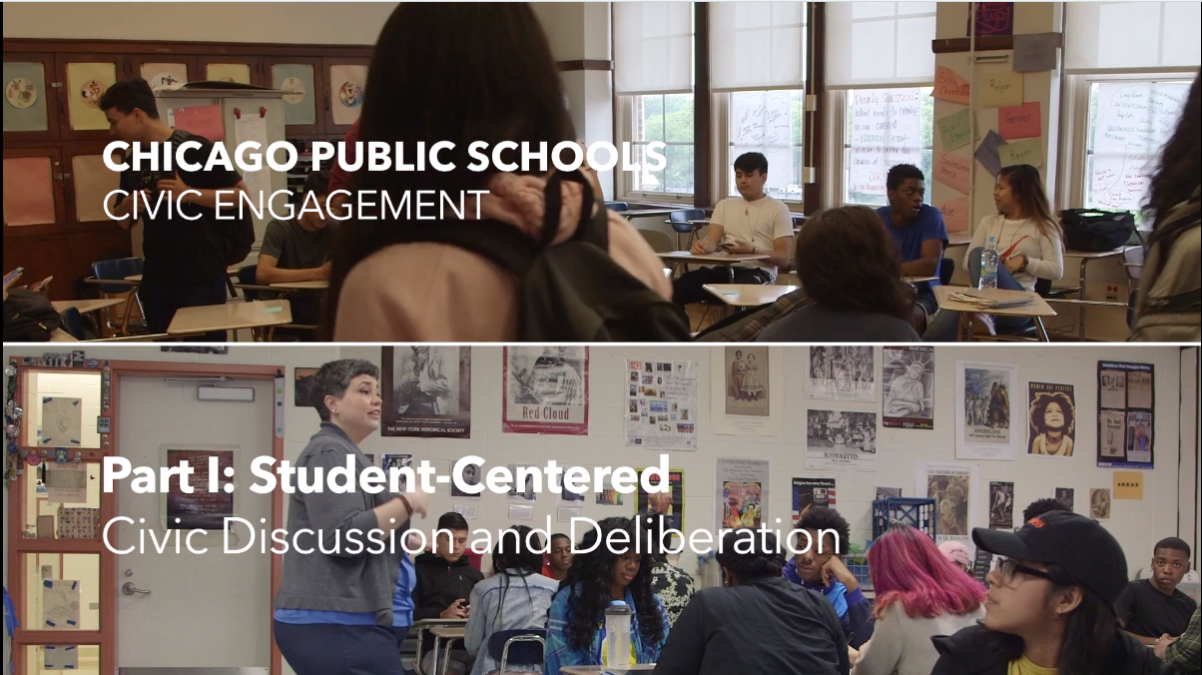
Student Centered Civic Discussion and Deliberation
As you watch Student Centered Civic Discussion and Deliberation, complete the Parts, Perspectives, Me thinking strategy by answering the following questions:
What are the parts of successful student centered civic discussion and deliberation? What are its various pieces or components?
What perspectives can you look at it from? Different users, makers; different physical perspectives.
How are you involved? What connections do you have? What assumptions, interests, or personal circumstances shape the way you see it?
Notes:
Read this slide and engage in this thinking strategy as you watch this clip.
Resources:
Project Zero. (2019). Parts, Perspectives, Me. Harvard Graduate School of Education. https://pz.harvard.edu/sites/default/files/Parts%20Perspectives%20Me.pdf
Civic Engagement Research Group- University of California- Riverside. (n.d.) Student Centered Civic Discussion and Deliberation. Series CPS/CERG Civic Discussion Videos. https://vimeo.com/292405879

Slide 133
Communicating Conclusions
Unpacking the Standards
Civic Engagement: Local, Regional and Global problems
When students are engaging with Communicating Conclusions, at times, they are identifying different problems at different scales by using democratic procedures and discourse.
Problems are events or situations that require solutions; they do not always have to be “negative” or something that is wrong that needs to be fixed.
For example, a Kindergarten student may identify ways to improve the procedures in the cafeteria so that students have more time to eat.
Or, a Grade 5 student may explain the lawmaking process to see the different approaches people can take to address local, regional and global problems, using examples from U.S. history.
Additionally, a Grade 7 student may analyze a specific problem from the growth and expansion of civilizations using each of the social studies disciplines. By using historical thinking skills, students can use what they learned about the past to discuss current local, regional and global issues.
Notes:
Guiding Notes:
Read this slide.

Slide 134
Communicating Conclusions
Civic Engagement: Local, Regional and Global Problems
Some examples of how this skill progresses includes:
K.I.CC.3 Identify ways to civically engage at school.
3.I.CC.3 Identify strategies to address local, regional or global problems
5.I.CC.3 Explain different approaches people can take to address local, regional and global problems, using examples from U.S. history.
7.I.CC.3 Evaluate how individuals and groups addressed local, regional and global problems throughout the growth and expansion of civilizations
HS.C.I.CC.3 Engage in disciplinary thinking and apply appropriate evidence to propose a solution or design an action plan relevant to compelling and/or supportive questions in civics
Notes:
Guiding Notes:
This slide contains information on how Communicating Conclusions standard 3 progresses.
Take a few minutes to reflect on this slide. Consider: How does this standard progress from Kindergarten to high school?
For information on this progression, visit Inquiry Progression: Communicating Conclusions in Appendix A from the KAS for Social Studies. This progression starts on page 200.

Slide 135
Deeper Dive: Communicating Conclusions
How do educators support students in identifying local, regional and global problems?
In order to investigate this question, access the following grade level examples from the Teacher Notes documents in the Student Assignment Library on www.kystandards.org.
Elementary: Grade 3 Strongly Aligned with Teacher Notes
Middle: Grade 7 Strongly Aligned with Teacher Notes
High: High School Strongly Aligned 2 with Teacher Notes
As you individually, with a small grade banded group or PLC, engage with these examples, identify strategies that are used to help students identify local, regional and global problems within the strongly aligned assignment.
Notes:
Guiding Notes:
Engage with the activity on the slide. Once you have examined one of the options on the screen, take additional time to make a list of all of the strategies used in the Teacher Notes to support students in considering local, regional and global problems. If you would like to explore strategies to identify local, regional and global problems further, record the strategies they found on a large poster board or Google sheet. If using poster paper, have one strategy per posterboard. If using a google document, have clear sections where everyone can populate their ideas. Once the poster board or Google sheet is set up, engage in a Gallery Walk. For more information, visit this webpage: https://www.theteachertoolkit.com/index.php/tool/gallery-walk
As you engage with the poster or Google sheet, ask questions of the strategies presented and take notes, such as Cornell Notes, on each poster/Google Sheet. For more information on Cornell Notes, visit this webpage: https://lsc.cornell.edu/how-to-study/taking-notes/cornell-note-taking-system/
Identify additional strategies that could support students in this work. At the conclusion of the Gallery Walk, reflect on what they learned about the strategies to support students in engaging with local, regional and global problems.

Slide 136
Communicating Conclusions:
Unpacking the Standards
Civic Engagement: Taking Action
When students are engaging with Communicating Conclusions standards, they are learning how to take action. While taking action has been politicized, it is important to remember the vision of the Kentucky teachers who wrote the KAS for Social Studies when engaging with this term:
The writing team envisioned standards that would afford students an opportunity to provide social studies learning experiences that will prepare all K-12 students in Kentucky to be productive and involved members of society. Under this framework, Kentucky students actively will engage with the social studies concepts, ideas and practices needed to participate in and navigate the community, state, nation and world in which they live. In an ever-changing and increasingly interconnected world, students must be life-long critical thinkers and questioners who can undertake multidimensional, complex reasoning.
Throughout grades K-12, students have the opportunity to interact with diverse groups of people, ask thoughtful questions, think critically, evaluate sources, make informed decisions and communicate logically and effectively—all skills students need to engage in the world around them with consideration of the past, present and future.
Notes:
Guiding Notes:
Read this slide.

Slide 137
Communicating Conclusions:
Unpacking the Standards (continued)
Civic Engagement: Taking Action
Thus, when students are learning about taking action, they are learning how to engage the appropriate authority figure(s) or agency in their community to create positive change.
For example, in Grade 1, students are required to use listening and voting procedures to decide on and take action in their school, local community or Kentucky.
This skill is critical for students to learning how to use civic mindedness to be informed citizens, foster civic dispositions and be life-long participants in the political process.
Notes:
Guiding Notes:
Read this slide.
When students are determining how to create positive change in their community, they must investigate which authority figure or agency in their community is the most appropriate to work with. For example, if students determine that they need to create an additional classroom rule to promote the safety of the members of the classroom community, the authority figure of that classroom may be their classmates or teacher, depending on how rules are constructed in the classroom. Additionally, if students determine that they want to improve the playground by changing the playground equipment, students will need to determine the authority figure or agency that has the control over making changes to the playground. They might need to propose the change to the school principal, but work with the School-Based Decision Making Council (SBDM) to submit a budget that the SBDM would have to approve. This concept applies to situations outside of the classroom as well. For instance, if students want to improve the sidewalks in their community, they might contact the local government as the agency to inspect the sidewalks, but then later understand that it is the homeowner’s responsibility to fix the sidewalks.

Slide 138
Communicating Conclusions:
Take Action
Some examples of how this skill progresses includes:
K.I.CC.4 Use listening skills to decide on and take action in their classrooms.
2.I.CC.4 Use listening and consensus-building procedures to discuss how to take action in the local community or Kentucky.
5.I.CC.4 Use a range of deliberative and democratic procedures to identify strategies on how to address a current issue.
7.I.CC.4 Analyze a specific problem from the growth and expansion of civilizations using each of the social studies disciplines
HS.C.I.CC.3 Engage in disciplinary thinking and apply appropriate evidence to propose a solution or design an action plan relevant to compelling and/or supportive questions in civics.
Notes:
Guiding Notes:
This slide contains information on how Communicating Conclusions standard 4 progresses. Note: This standard becomes standard 3 in high school.
Take a few minutes to reflect on this slide. Consider: How does this standard progress from Kindergarten to high school?
For information on this progression, visit Inquiry Progression: Communicating Conclusions in Appendix A from the KAS for Social Studies. This progression starts on page 200.

Slide 139
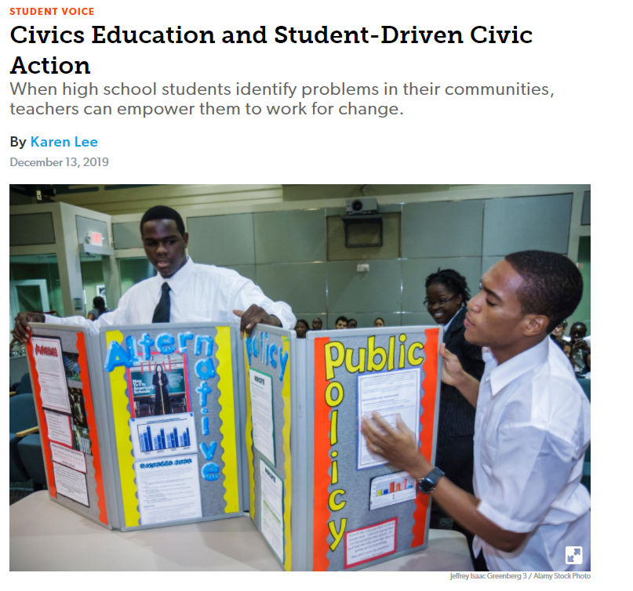
Deeper Dive: Civic Action
Read and annotate Civics Education and Student-Driven Civic Action.
To annotate this article as you read, complete the following:
Underline important points or key ideas (one per paragraph);
Circle new ideas;
Star any points that resonated with you;
Indicate areas you can implement immediately with a down arrow.
Notes:
Guiding Notes:
Read the slide and complete the annotation of the article as described.
Resources:
Lee, Karen. (2019, December 13). Civics Education and Student-Driven Civic Action. Edutopia. https://www.edutopia.org/article/civics-education-and-student-driven-civic-action.
Eastern Washington University Writing Center. (2020, May 26). Reading and Study Strategies: What is Annotating and Why do it? https://research.ewu.edu/writers_c_read_study_strategies.

Slide 140
Taking Action Examples
Write a newspaper editorial
Create a Facebook or Web page on an issue
Create short public service announcements
Write a letter to a government official
Present on the morning announcements.
Have a debate with invited guests
Work collaboratively to write a resolution.
Contact an organization with whose platform you agree and see how you can get involved.
Create & publish a class position statement
Organize a “flyer” campaign to raise awareness
Organize a fundraising event for a cause
Circulate a petition
Write (and perform) a song on an issue
Bringing stakeholders together for a classroom forum
Invite a guest speaker
Create a poster and hang it in a public space
Create a community education pamphlet
Organize community service
Initiate an informed conversation
Notes:
Guiding Notes:
Take Action examples modified from Joe Karb, NCSS Board of Directors, Teacher-Springville Middle School, Springville, NY by Mary Ellen Daneels for illinoiscivics.org and the Robert R. McCormick Foundation and adapted by the KDE.
Use this list to identify ways to take action on a problem. Individually, with a partner or small grade band group, identify a problem that could be solved through civic engagement. Once you have identified a problem, engage with the Options Explosion thinking strategy to identify an action strategy (on the list above or another example brainstormed by the group) that can be used to take action on the problem identified. Once you have engaged in this activity, share your work with others. Add to this list of take action examples if their peers identify an additional action strategy.
Resource:
Project Zero. (n.d.). Options Explosion. Harvard Graduate School of Education. https://pz.harvard.edu/sites/default/files/Options%20Explosion_0.pdf

Slide 141
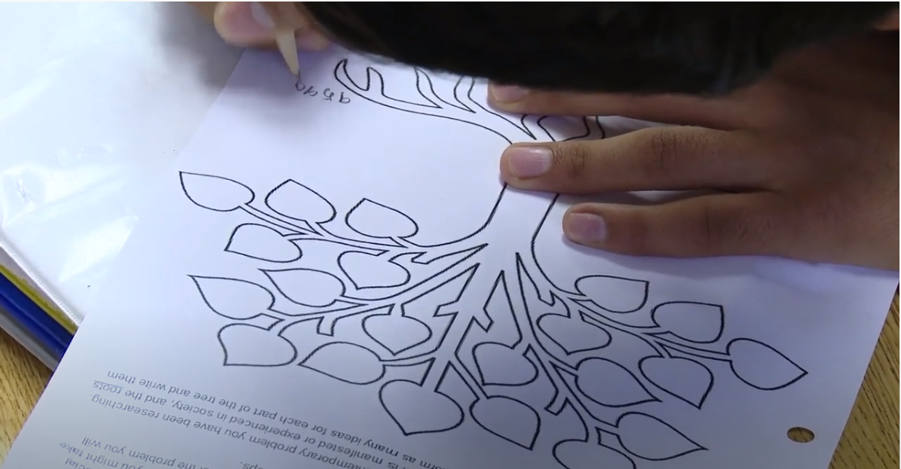
Why should students be encouraged to take action?
Answer this question while to you watch Encouraging Students to Take Action.
Notes:
Guiding Notes:
Read this slide and consider why students should be encouraged to take action as you watch this clip.
Resource:
Civic Engagement Research Group. (2020, February 14). Encouraging Students to Take Action. https://www.youtube.com/watch?v=MYzInovThPU&feature=emb_logo

Slide 142
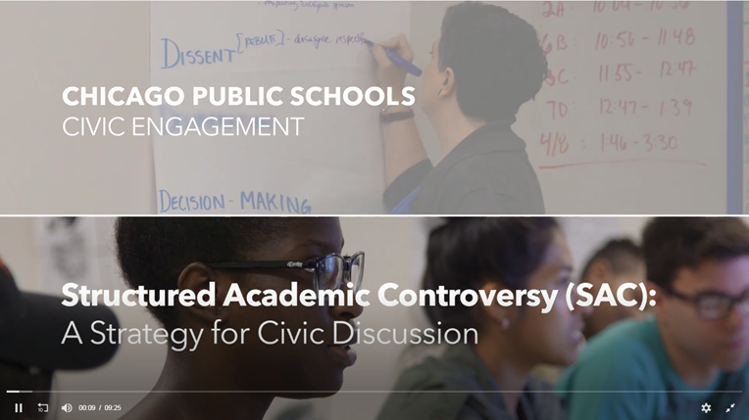
Reflection
As you watch Structured Academic Controversy, analyze the role of the Communicating Conclusions standards in supporting students in engaging with this strategy. Identify examples found in the video of the following components of the Communicating Conclusions standards:
Synthesize information to construct new understandings
Construct explanations and arguments
Engage in deliberative and democratic procedures
Act civically by identifying and addressing problems
Notes:
Guiding Notes:
Read the slide and engage with the activity presented as you watch the clip.
Resource:
Civic Engagement Research GroupUniversity of CaliforniaRiverside. (n.d.) Structured Academic Controversy (SAC). Series CPS/CERG Civic Discussion Videos. https://www.youtube.com/watch?v=5MPekCd0mHk

Slide 143
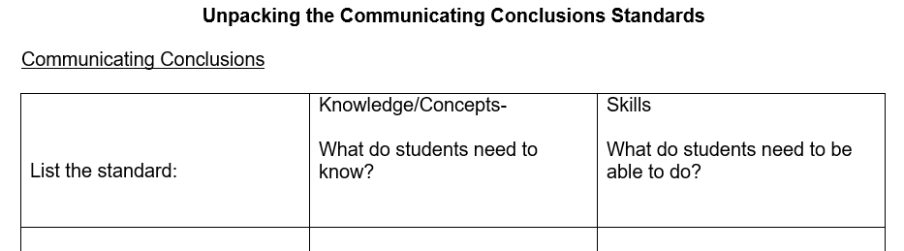
Discovery Task: Unpacking the Communicating
Conclusions standards
Using the Communicating Conclusions standards for the grade level identified, complete the following:
What is the inferred or possible content based on the nouns in the standard?
Vocabulary students will need to know.
Are there any other considerations to think about regarding the meaning of this standard?
Notes:
Guiding Notes:
Access the Unpacking the Communicating Conclusion Standards template they completed in Module One: Getting to Know the KAS for Social Studies. This tool may be accessed here: https://education.ky.gov/curriculum/standards/kyacadstand/Documents/Unpacking_the_Communicating_Conclusion_Standards.docx
Read the slide, and revise any sections in this document that need to be updated based on what you learned in this section.

Slide 144
Coming Up
Section G: Reflection
Notes:
Guiding Notes:
This slide previews the upcoming section.
The KDE needs your feedback on the effectiveness of this module, the learning platform and how the consultants may best support you as you take the next steps in the implementation process. Complete a short survey to share our thinking and provide them with feedback on how the KDE can best meet our needs. Feedback from our surveys will be used by the KDE to plan and prepare future professional learning.
Post-survey: https://docs.google.com/forms/d/e/1FAIpQLSffTPNRAlm0EpnD7VfhUlfV-WtFTE7xVEyq4zjb5TYu9mSNxw/viewform

Slide 145
Inquiry Practices of the KAS for Social Studies
Section G: Reflection
Notes:
Guiding Notes:
This slide begins Section G: Reflection.

Slide 146
Module Overview
Section A: Introduction- What is inquiry?
Section B: What are Compelling Questions, and how do students ask them?
Section C: What are Supporting Questions, and how do students ask them?
Section D: How do students investigate through the disciplinary strand standards?
Section E: How do students use the Using Evidence standards to analyze sources and apply relevant information to make evidence-based claims?
Section F: How do the Communicating Conclusions standards support students in synthesizing knowledge to support civic engagement?
Section G: Reflection
Notes:
Guiding Notes:
This slide provides an overview of the module.

Slide 147
Module Objectives
Understand the inquiry practices as outlined in the KAS for Social Studies.
Define inquiry as outlined in the KAS for Social Studies.
Understand the characteristics of compelling and supporting questions.
Acquire ways to get students to engage with and create compelling and supporting questions when required.
Understand the skills and progressions found within the Using Evidence standards.
Understand the four components of the Communicating Conclusions standards and find examples and strategies to implement these components.
Notes:
Guiding Notes:
This slide contains module objectives.

Slide 148
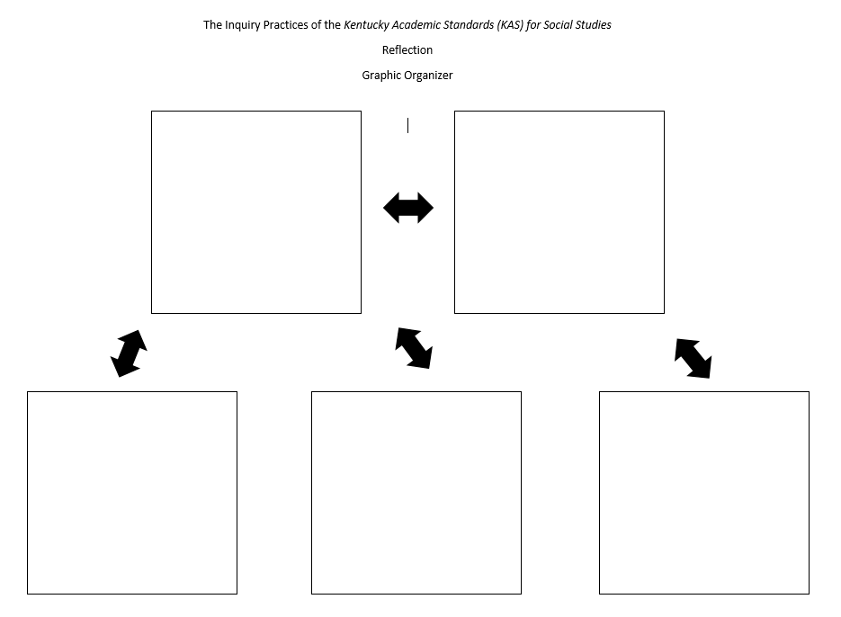
Reflection
In small groups, you will complete the graphic organizer provided to examine the components of and connections between the Inquiry Practices in the KAS for Social Studies.
Notes:
Guiding Notes:
In this reflection, you are being asked to examine the components of the Inquiry Practices in the KAS for Social Studies while also identifying the connect between the practices.
First, you will be divided into small groups where you will be assigned an Inquiry Practice: Questioning, Investigating through the exploration of the discipline strand standards, Using Evidence and Communicating Conclusions.
In your groups, you will complete the graphic organizer provided. In this graphic organizer, you must complete the following:
You and your group must provide a general overview of the inquiry practice you were assigned by defining/describing the most important components of the inquiry practice.
In the space provided, you must include a visual representation of the most important components of the inquiry practice.
Once you and your group have completed components A and B, examine the connections between the inquiry practice you were assigned and the other three remaining practices. In the space provided, list three examples of connections to another inquiry practice.

Slide 149
Reflection (2)
Engage in a Gallery Walk using the graphic organizers created by your peers. As you engage in the Gallery Walk, take post it notes and, either individually or in groups, jot down and post:
- Questions or clarifications about something on the post-it
- Agreement with an idea
- Ideas they think are important but are not on the poster
- Additional connections/applications to consider
Notes:
Guiding Notes:
Once the graphic organizers are complete, engage in a Gallery Walk. In this Gallery Walk, read through the information presented on the group generated graphic organizers. As you engage in the Gallery Walk, take post it notes and, either individually or in groups, jot down and post:
- Questions or clarifications about something on the post-it
- Agreement with an idea
- Ideas they think are important but are not on the poster
- Additional connections/applications to consider
At the conclusion of the Gallery Walk and as part of the activity debrief, share your graphic organizers.

Slide 150
Reflection (3)
What are the implications of the Inquiry Practices of the KAS for Social Studies on your current practice?
To answer this question, engage in the Claim, Support, Question thinking strategy.
Make a claim(s) about the question.
Identify support for your claim(s).
Ask a question about your claim(s).
Notes:
Guiding Notes:
Read the slide and complete this reflection individually. If working in groups. share out how the Inquiry Practices and the learning experienced in this module will impact their practice.
Resource:
Project Zero. (2019). Claim, Support, Question. Harvard Graduate School of Education. https://pz.harvard.edu/sites/default/files/Claim%20Support%20Question_0.pdf

Slide 151
Inquiry Practices of the KAS for Social Studies
Conclusion
Notes:
Guiding Notes:
The KDE needs your feedback on the effectiveness of this module, the learning platform and how the consultants may best support you as you take the next steps in the implementation process. Complete a short survey to share our thinking and provide them with feedback on how the KDE can best meet our needs. Feedback from our surveys will be used by the KDE to plan and prepare future professional learning.
Post-survey: https://docs.google.com/forms/d/e/1FAIpQLSffTPNRAlm0EpnD7VfhUlfV-WtFTE7xVEyq4zjb5TYu9mSNxw/viewform

