Slide 1
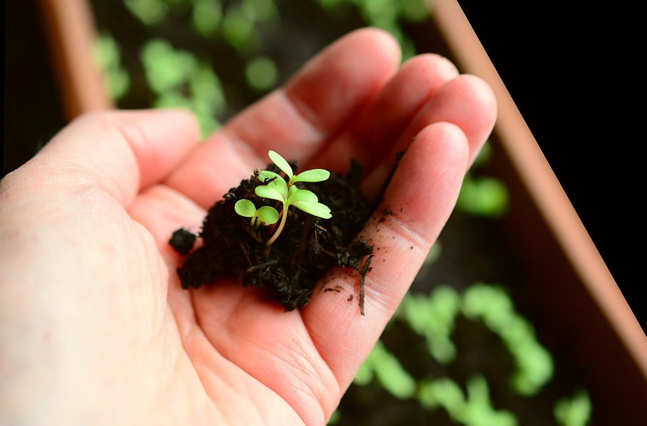



K-5 BCML Session 1
Building a Culture of Math Learning
Topic 1: Introduction to Standards for Mathematical Practice (SMPs)
Session 1: Shared Learning

Slide 2
Building a Culture of Math Learning
The Standards for Mathematical Practice support a culture of math learning where students feel empowered to take academic risks, persevere in problem solving, make meaning of mathematics, explain their thinking, and reflect on their own learning.
12-week Content Cycle
Introduction to the Standards for Mathematical Practice (SMPs) | SMP 1: Make sense of problems and persevere in solving them. | SMP 4: Model with mathematics. | SMP 3: Construct viable arguments and critique the reasoning of others.
Week 1: Shared Learning Week 2: Planning & Practice Week 3: Student Progress | Week 1: Shared Learning Week 2: Planning & Practice Week 3: Student Progress | Week 1: Shared Learning Week 2: Planning & Practice Week 3: Student Progress | Week 1: Shared Learning Week 2: Planning & Practice Week 3: Student Progress
2

Slide 3


Norms
Our Norms
Add your school or team norms here
3

Slide 4
Objectives
Agenda
Internalize the Standards for Mathematical Practice
Analyze how the SMPs support mathematical understanding and productive struggle
Break down the language of the Standards for Mathematical Practice
Observe a lesson where a teacher explicitly incorporates the SMPs and analyze the impact on student learning
Reflect on Criteria for Success and set goals
Closing and next steps
4

Slide 5
The Standards for Mathematical Practice (SMP)
Read aloud the bold print of the standards.
Using the KAS for Mathematics “Engaging the SMPs: Look-fors & Question stems” resource on
, jot down key takeaways for
your assigned SMP in the left-hand
column of ……………..... …… .
Handout 2
Handout 1
5

Slide 6
Jigsaw
Share out your key takeaways.
What does incorporating this SMP look like for teachers? For students?
Handout 1
Where do we see connections between/among the SMP? How might SMPs build or amplify related student skills and habits?
How might focusing on SMPs support equitable learning experiences for all students?
6

Slide 7
SMPs in Action (Grades K - 2)
Inside Mathematics Video:
Tracy Lewis, Grade 2
Lesson 2 - Regrouping in Addition
What planning steps did Ms. Lewis take to incorporate these SMPs into her instruction?
7
Handout 1

Slide 8
Share Out (Grades K-2)
What instructional steps did Ms. Lewis take to incorporate SMPs into this lesson? What impact did this have on student learning?
What planning steps were taken to explicitly connect the lesson objectives to the SMPs?
8
Handout 1

Slide 9
Share Out (Grades K-2)
What SMPs have you already incorporated into your instruction? What does this look like in terms of teacher and student actions?
In watching Ms. Lewis’s instruction and continuing to reflect on your own practice, what might you try next?
9
Handout 1

Slide 10
SMPs in Action (Grades 3 - 5)
Inside Mathematics Video:
Mia Buljan, Grade 3 Math
Lesson 1a - Interpreting Multiplication
What planning steps did Ms. Buljan take to incorporate these SMPs into her instruction?
10
Handout 1

Slide 11
Share Out (Grades 3 -5)
What instructional steps did Ms. Buljan take to incorporate SMPs into this lesson? What impact did this have on student learning?
What planning steps were taken to explicitly connect the lesson objectives to the SMPs?
11
Handout 1

Slide 12
Share Out (Grades 3-5)
What SMPs have you already incorporated into your instruction? What does this look like in terms of teacher and student actions?
In watching Ms. Buljan’s instruction and continuing to reflect on your own practice, what might you try next?
12
Handout 1

Slide 13

Criteria for Success
Criteria for Success
Read the teacher and student look-fors found on your handout.
How do these teacher and student look-fors connect to the focus for our learning this cycle?
Are there any look-fors you would add to the list?
13
Handout 1

Slide 14
Reflection and Looking Ahead
Complete the reflection on today’s session learnings, including a possible application of this learning to upcoming planning and instruction.
14
Handout 1

Slide 15
Closing Whip Around
Closing Whip Around
How might explicitly teaching the SMPs support mathematical understanding for all students, especially those who face the most significant obstacles to success?
15

Slide 16

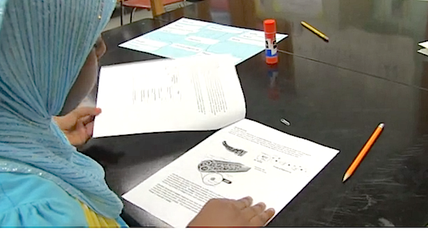
What’s Next
What's Next?
Session 2: Planning and Practice
Apply shared learning to planning and practice
Give and receive feedback from colleagues in order to revise plans and refine practices
16
16

