Slide 1
Kentucky Family Math Night
March 2020

Slide 2
Welcome
WELCOME
KY FAMILY MATH NIGHT
This Photo by Unknown Author is licensed under CC BY-SA-NC
Notes:
Hello, everyone.
For those of you who are new to the school’s evening activities, my name is _____ and I am the ________ here.
On behalf of our teaching staff, I would like to welcome you to our community/family math night.
Tonight’s activities are designed to get you and your kids excited about math, help you learn some strategies for using math at home, and set your child on the path to success in math!
We have a few housekeeping items before we get started:
When you arrived, you were given a folder. This folder has KY Standards Family Guides in it that explains the influence you can have every day in your child’s love of math and learning. These standards family guides are also available online at kystandards.org. So, if having electronic access is more convenient for you, feel free to access these guides that way in the future.
You also have a ticket book. We will be raffling off ______ at the end of the evening, so fill in your name and be sure to get a stamp at each activity station. When the ticket book is filled, you can drop it in the box here [describe location], and we will draw winners at the end of the evening.
The next document is the feedback survey. After you complete the activity stations this evening, please fill out the survey and place it in the box by the door on your way out. We need these surveys so we can understand what you liked about tonight and what could be improved for future events.

Slide 3

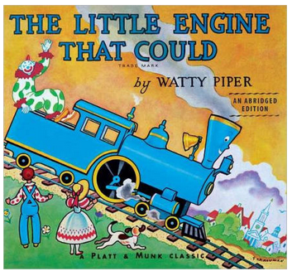

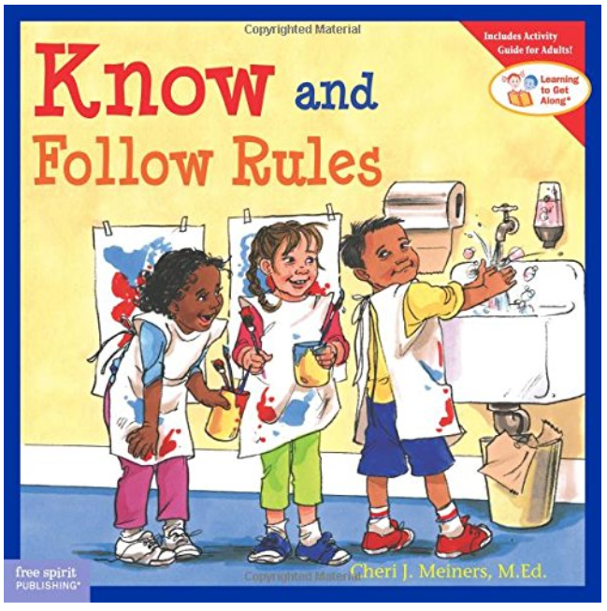
When you think about learning math, which book is most like you?
Why?
Notes:
As you have dinner and get settled in for activities, we want you to talk with the others sitting close to you.
To kick things off, introduce yourself and share which book you identify with when you think of being a math learner.
When you think of learning math are you…
The Little Engine That Could?
Oh, The Thinks You Can Think?
Know and Follow the Rules?
OR Alexander and the Terrible, Horrible, No Good, Very Bad Day?
Once we see most of you are done with dinner, we will get started with the activities.

Slide 4

Agenda
Welcome, introductions, and overview (15 minutes)
Math attitudes and growth mindset (15 minutes)
KY Standards Family Guides (15 minutes)
Math stations (1 hour and 15 minutes)
Wrap-up and prizes (15 minutes)
This Photo by Unknown Author is licensed under CC BY-SA-NC
Notes:
Facilitator will welcome participants and review the goals and agenda.

Slide 5
Why math?
Notes:
In the past, math was often taught as a set of rules to follow, but that's not what mathematics really is or how it’s taught today. Mathematics is about puzzling over problems, trying multiple strategies, and finding solutions.
Early math skills are essential to children’s learning and success in school (Claessens & Engel, 2013). Early math skills predict later math performance, as well as success in other subjects (Duncan et al., 2007).
Mathematics achievement is particularly important for students in Kentucky. Understanding math is important not just for future success in school, but for employment in growing sectors of the workforce.

Slide 6

Goal of Community Math Nights
Notes:
Let’s review the goal of the community math nights and why we think they are important. Community math nights are intended to engage the broader community (such as family members and community leaders) in understanding the importance of mathematics and learning how best to support their children in learning math.
From the research, we know that children who believe they can be successful in math will put in more effort and engage in productive struggle, which lead to better mathematics performance. Students who perform better in math in elementary school are more likely to have success in middle and high school. Success in high school leads to higher incomes and opportunity in a growing number of STEM and non-STEM jobs.
Source: https://ies.ed.gov/ncee/edlabs/infographics/pdf/REL_AP_Supporting_Your_Child_in_Developing_Math_Skills_for_Future_Success.pdf

Slide 7
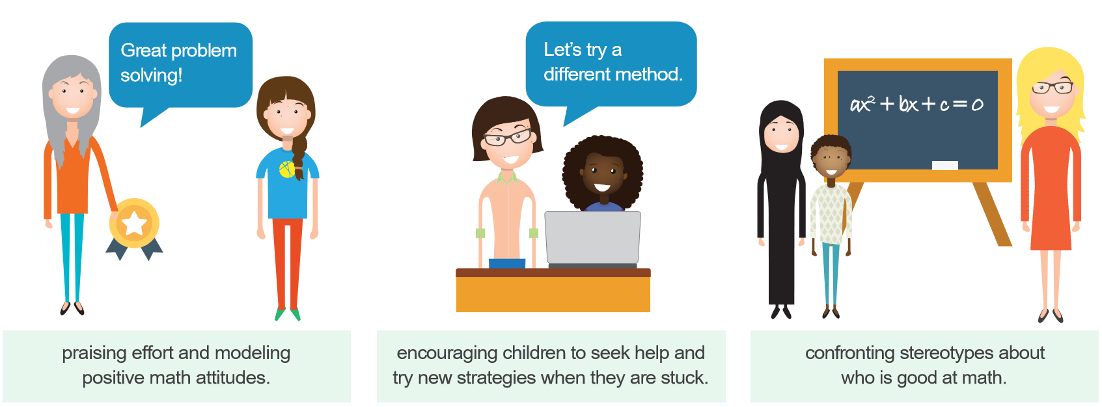
Families as Role Models
Notes:
We also know that families are natural math role models, and they can support their children in developing math skills by praising effort and modeling positive math attitudes, encouraging children to seek help and try new strategies, and confronting stereotypes about who is good at math.
So we want you to understand the importance of math and feel comfortable and confident in supporting your children to learn math.

Slide 8
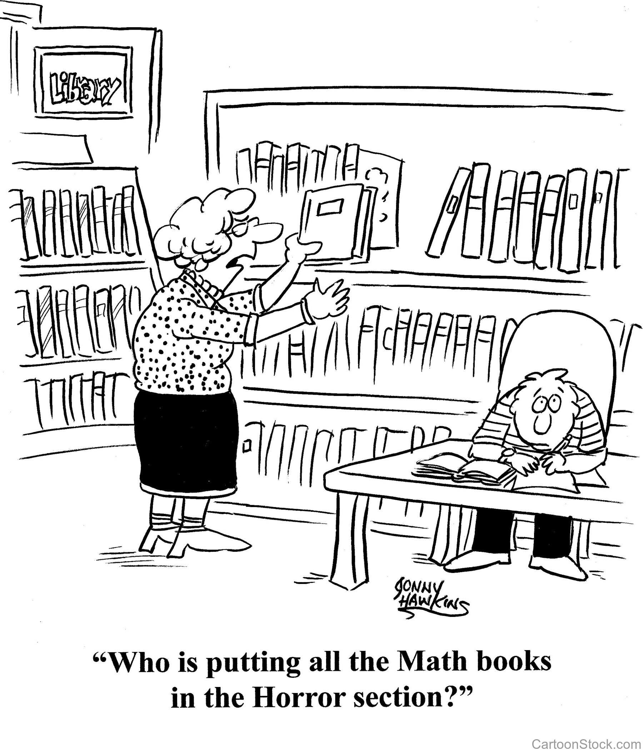
Math attitudes
Notes:
Before we get into the math activities and stations, we think it is important to talk with you about how adults’ attitudes toward math can influence children’s math learning.
Source: http://readingismysuperpower.org/wp-content/uploads/2018/01/math-books-horror-section.jpg

Slide 9
Adult attitudes toward math can influence a child’s math achievement
Multiple studies suggest that adults’ reactions to a student’s work will impact the student’s achievement and attitudes toward the subject.
Students may feel you have low expectations for them, which can lead to lower motivation and lower expectations for their own success in math.
Notes:
When a student is learning math, how adults talk to them about the subject really matters. Research studies have found that adult’s reactions to a student’s work will impact the student’s achievement and attitudes toward the subject. For example, if a child is learning something new in math and asks a parent for help, some parents may react by saying that they are not good at math, or that they don’t know how to do the “new math”. While they may feel this way, it is important to think about what this communicates to the child. If the parent doesn’t react positively, how can we expect the child to react positively?
In addition to paying attention to how we react when children ask us for help with their work, we need to pay attention to how we communicate our expectations for them. When a child is struggling with math, a parent or teacher may try to comfort the student instead of giving them strategies to succeed in math. For instance, take the phrase that we may have all heard, “Plenty of people have trouble in math but go on to be very successful in other fields.” This communicates that you have low expectations for them in math, so why should they try harder? Parents can use phrases like “I know this is hard, maybe you can try another way to solve the problem?” or “I know this is hard, but you are learning something new, and sometimes that takes a lot of work. ”
Blackwell, Trzesniewski, & Dweck (2007)
Blackwell, L. S., Trzesniewski, K. H., & Dweck, C. S. (2007). Implicit theories of intelligence predict achievement across an adolescent transition: A longitudinal study and an intervention. Child Development, 78, 246-263.

Slide 10
Math Attitudes Matter
Fixed mindset
Growth mindset
  The belief that a person is born with the intelligence they have and there is not much you can do to change it.
  The belief that a person can increase their intelligence through hard work and persistence. You can work your brain like your muscles.
Notes:
When we are engaging children in math, it is important to reflect on how we are approaching the subject and the attitudes we hold about math. There are two ways we categorize these attitudes, a fixed mindset and a growth mindset.
When a person has a fixed mindset, they believe their accomplishments are based on some innate traits and that their successes are made with little to no effort and based on their intelligence. People just are the way they are. Successful people are born to be successful.
With a growth mindset, a person believes they have the ability to succeed through hard work. While intelligence and innate traits may play a part, success is a result of hard work and time spent on a task or subject. Successful people are not born, they are made.
Often, adults talk about the ability to learn math as something that is fixed within a child, possibly using phrases that sound reassuring such as, “You completed that problem because you are really smart” or “You're good at so many other things, maybe math just isn’t your subject.” However, these phrases may not be the best way to encourage young children. They are promoting the fixed mindset. Phrases such as “You completed that problem so fast! I bet you worked really hard at it”, or “I know you are struggling with math, maybe you need to try a new strategy/study method to get better.” These phrases promote a growth mindset.
The main message is that we want to praise children’s effort, not intelligence. We all can and should tell our kids they are smart; don’t stop doing that, but try to include praise on their efforts too.

Slide 11

Praise Effort and Learning
Praise effort and learning
Not everyone is a math person; you’re so good at other subjects.
Well done, you’ve worked really hard on that problem.
This Photo by Unknown Author is licensed under CC BY-SA
Notes:
Now let’s try some different phrases. Read each phrase on the screen and talk with the person seated next to you. Which one praises effort?
[facilitator allows 1-2 minutes for participant discussion]
What do you think? Does phrase 1 praise effort? How about phrase 2? [facilitator allows for participants to respond nonverbally]
It is important to notice the strategies and different ways children are solving problems., you can also ask questions like:
Did you use good problem-solving skills?
On a scale of 1-10, 10 being the hardest you've ever tried to do something, how much effort did you put into this task?

Slide 12
Praise Effort and Learning (Continued)
Praise effort and learning
You got a higher grade on this assignment. You must have worked really hard.
You got a higher grade on this assignment. You must be really smart.
This Photo by Unknown Author is licensed under CC BY-SA
Notes:
Let’s discuss these two phrases. They are more similar to one another than the last two. Discuss with your neighbor, which one do you think praises effort?
[facilitator allows 1-2 minutes for participant discussion]
What do you think? Does phrase 1 praise effort? How about phrase 2? [facilitator allows for participants to respond nonverbally]
Again, you can expand how you talk about your child’s effort to include asking questions like, “What do you think? Did you work hard?”

Slide 13


Sample Responses from Children
Lisa’s students
“Oh my goodness,
I got a bad grade on this test!
I’m just not good at math.
I don’t think I will ever like it.
I’m not sure what I can do to get better.
Luckily I’m good at English and Science.”
I wasn’t expecting this grade.
I studied really hard, but not the night before the test.
I guess for the next test, I will study harder,
and study the day before the test.
Maybe my friend Martha can help me.
She got a good grade on this test.
Notes:
13
Now I would like to tell you a story to illustrate the difference in how children may react to adult attitudes toward learning math. Lisa is a third-grade math teacher.
She just administered a test on measurement in her classroom.
Two students, Josh and Madison, received the exact same grade on the test, a C.
Lisa asked them how they planned on improving their scores on the next test.
Josh explained, “oh my goodness, I got a bad grade on this test! I’m just not good at math. I don’t think I will ever like it. I’m not sure what I can do to get better. Luckily, I’m good at English and Science.”
Madison responded to Lisa in another way, “I wasn’t expecting this grade. I studied really hard, but not the night before the test. I guess for the next test, I will study harder, and study the day before the test. Maybe my friend Martha can help me. She got a good grade on this test.”
Both student received the same grade, but reacted very differently.
Lisa recognized that Madison had a growth mindset for mathematics. She encouraged Madison to ask Martha for help and provided her with additional study strategies to help her improve.
What can the teacher do for Josh? [wait for participants to respond]
The exact same thing! First, Lisa can encourage Josh to have a positive attitude toward learning math.
She can also remind him that she has the same high expectations for all her students, and he is no exception.
She can give him some study strategies to help him feel better about the math content.
Lastly, she can help Josh find a study partner who may be able to share different ways to tackle the problems that give difficulty.
What else can Lisa do?
[facilitator takes responses from participants]

Slide 14


Take Home Message
Take-home message
Adult attitudes toward math can influence a child’s math achievement.
Family and teacher feedback is important for math learning.
Changing your mindset and feedback can help your children succeed at math.
Praise effort
and learning
Projects 5.1.6/5.2.10
Notes:
Share the take-home messages.

Slide 15
KY Standards Family Guides
Notes:
Now let’s take a look at some more of the activities we have planned for the night.

Slide 16

Family Guides
The Kentucky Academic Standards (KAS) Family Guides have been developed to help families familiarize themselves with the content of each grade level’s standards. Each guide contains a standards overview for Reading & Writing, Mathematics, Science and Social Studies.
Notes:
Notes: This tool provides information about the key ideas and skills teachers will introduce in mathematics, reading and writing, science and social studies. It also was designed to help parents understand how they can work with teachers to support the learning of their child at each grade level K-12.

Slide 17
Family Guides
Each content area contains the following sections:
  Why are the Kentucky Academic Standards important?
  How are the standards organized?
  Overview of the grade level content
  Examples of Your Child’s Work at School
  How to Help Your Child at Home
  Questions You Can Ask Your Child
  Questions You Can Ask Your Child’s Teacher
Notes:
Notes: This is a great resource in providing all shareholders access to understanding the Kentucky Academic Standards when conducting community events; whether its Family Math Night or Literacy Night or an open house event, this tool opens the door for conversations around a students’ success. Have participants find their child’s grade level in mathematics and look at the different components. Ask participants which component of the KY Standards Family Guides helps them the most and why? Have participants share out.

Slide 18
Math night station activities
Notes:
Now let’s take a look at some more of the activities we have planned for the night.

Slide 19
Sample Layout for Four Stations
Station 1:
Geometry
Station 4:
Measurement and Data
Cafeteria
Station 2:
Operations and Algebraic thinking
Station 3:
Number and Operations in Base 10
Notes:
Tell participants they will visit four stations around the room and let them know that each station will focus on a different area of math and have three-four activities geared toward different grade levels. When they finish participating in a station, the station facilitator can stamp the ticket and the child can submit the ticket for the raffle.
Explain that there are four stations and there are three tables (for different grade levels) at each station. They can choose which table to work at, depending on the ages and interests of their children.

Slide 20
Suggestions for the Stations
Let the children lead.
It’s OK to use fingers.
Make mistakes!
It’s OK to go slowly.
Show your thinking.
Have fun!
Notes:
Provide tips for family members on participating in the stations.
Let the children lead. Let your children show you what they know. Ask them questions and encourage them to figure things out. There will be suggestions at each station to help you support and encourage your children.
It’s OK to go slowly. Don’t rush through the activity. Counting, calculating, and noticing patterns take time, especially when you are learning it.
It’s OK to use fingers or other physical objects to count and do addition and subtraction.
Show your thinking. Talking through your thinking helps your children see how you work things out and the strategies you are using.
Make mistakes! Mistakes can lead to learning. It also shows your children that you can laugh and keep going even when you make a mistake.
Have fun!

Slide 21
Sample Layout for Stations (continued)
Station 1:
Geometry
Station 4:
Measurement and Data
Cafeteria
Station 2:
Operations and Algebraic thinking
Station 3:
Number and Operations in Base 10
Notes:
When families come in, they should have received a number from 1 to 4 (or colors or shape), which will tell them which station to start at.
Say that you will ring a bell every 15 minutes to remind them to go to the next station.
Direct them to their first station.
They should then return to the main room/gym/cafeteria for the wrap-up and raffle.

Slide 22
Wrap-up and raffle

Slide 23



Thank you
Thank you!
Notes:
Thank you for your time today!

