Slide 1
Local Adoption Process
Strengthening Tier 1 Instruction

Slide 2
Today’s Purpose
To assist districts in effectively selecting an approved Tier 1 comprehensive reading program for grades K-3 so that the resource adopted ultimately leads to high-quality instruction and improved student outcomes.

Slide 3
Adoption of High-Quality K-3 Comprehensive Reading Program
Senate Bill 156 (2023) amended KRS 158.305,which is part of the Read to Succeed Act, related to the adoption and implementation of high-quality instructional resources (HQIRs) for K-3 reading.
The law establishes that by July 1, 2024, “each superintendent shall adopt a common comprehensive reading program that is determined by the department to be reliable, valid, and aligned to reading and writing standards required by KRS 158.6453 and outlined in administrative regulation promulgated by the Kentucky Board of Education for kindergarten through grade three (3) for all schools or a subset of schools, with consultation of all affected elementary school councils," (emphasis added).

Slide 4
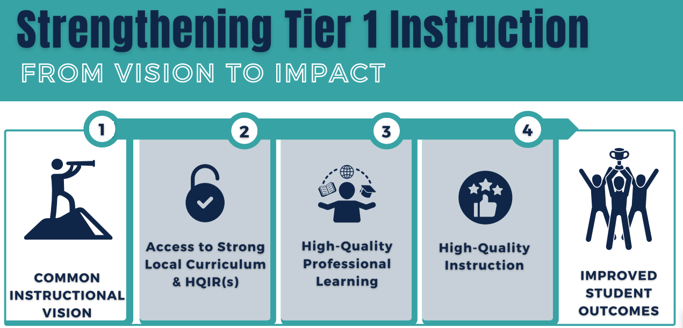
Strengthening Tier 1 Instruction

Slide 5
Effective Curriculum Work’s Essential Qualities
Clear & Inclusive
Collaborative & Committed
Strategic & Aligned

Slide 6
Effective Curriculum Work’s Essential Qualities: Group Chat
Which of these qualities has tended to be a strength during prior rounds of curriculum work?
Which of these qualities might you want to learn more about to help enhance curriculum work in your district?
Clear & Inclusive
Collaborative & Committed
Strategic & Aligned

Slide 7
Key Tools
Curriculum Development Process
Reading and Writing Instructional Resources Consumer Guide

Slide 8
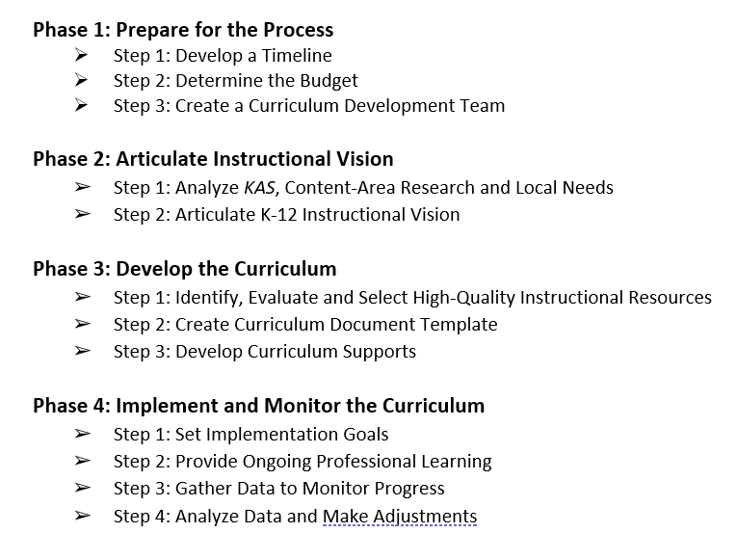
Curriculum Development Process

Slide 9
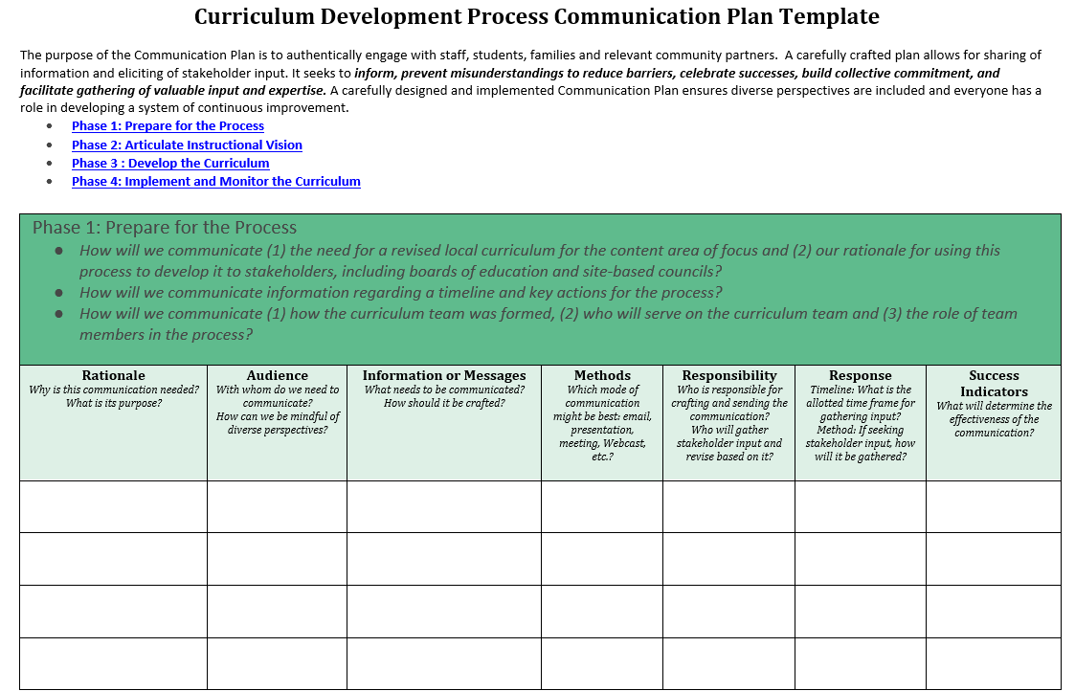
Curriculum Development Process Communications Plan template

Slide 10
Curriculum Development Process: Phase 1

Slide 11
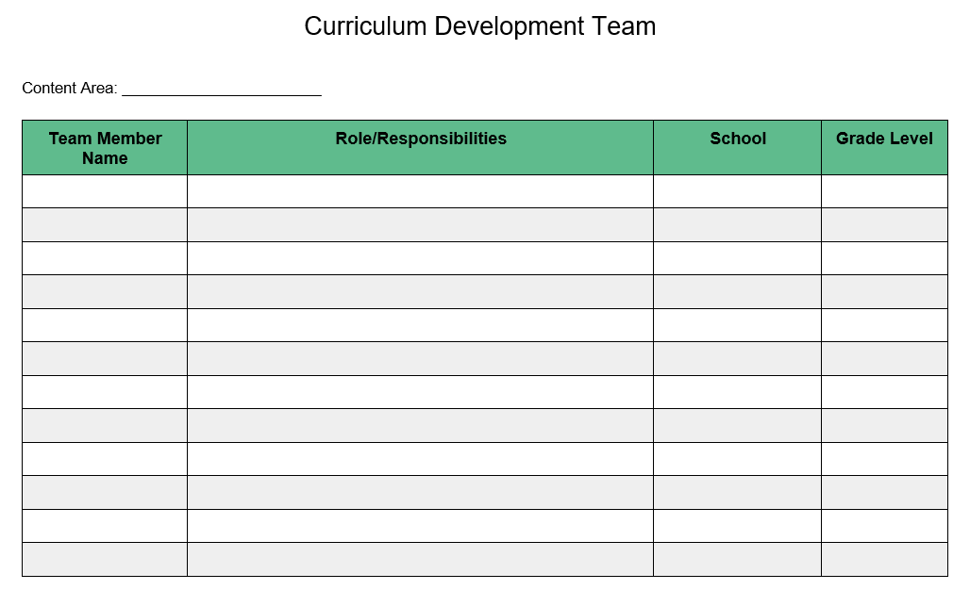
Phase 1: Step 3 (Create Curriculum Development Team)
Curriculum Development Team Template:
Note the members of the team, their role and/or grade-level to ensure diverse representation.

Slide 12
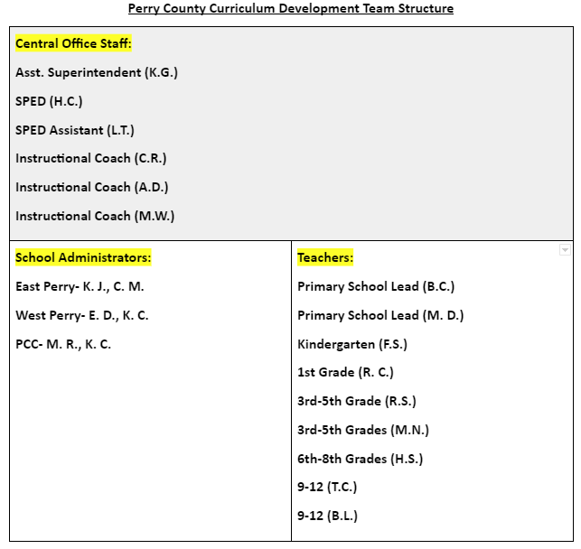
Curriculum Development Team Example
(Perry County)

Slide 13
Curriculum Development Team: Group Chat
In addition to role groups mentioned on the previous slide it could be important to include, what other staff might also help to diversify perspectives and voices?

Slide 14
Curriculum Development Process: Phase 2

Slide 15
Instructional Vision
Serves as your North Star or guiding light - what we are working towards.
Ensures everyone is aligned with a common language and observable indicators.
Guides decisions about curriculum, instructional resources and professional learning.
It is a living, breathing, changing document that is regularly revisited.

Slide 16
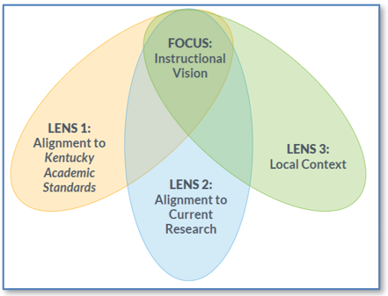
Three Lenses, One Focus
Notes:
KDE Reading and Writing Team Analysis Resource

Slide 17
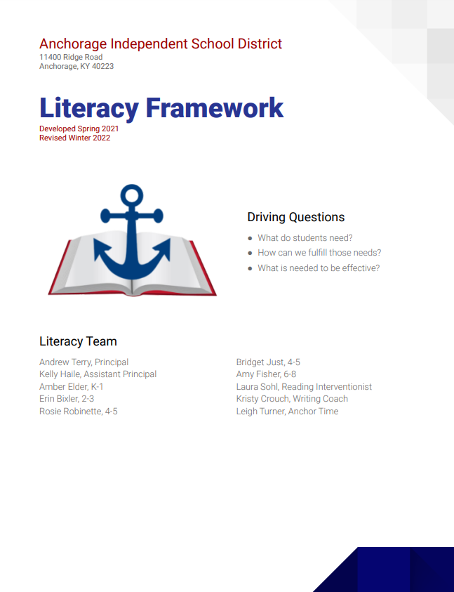
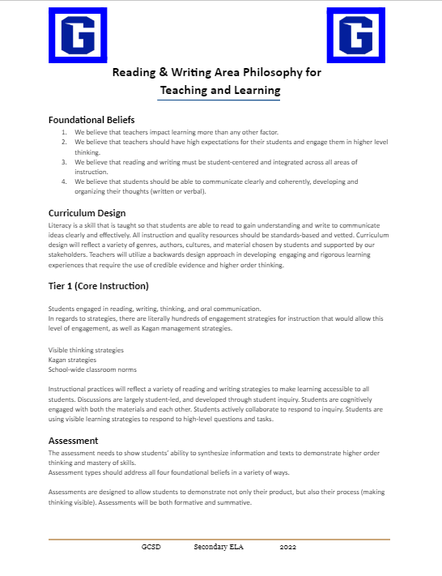
Sample Instructional Visions

Slide 18
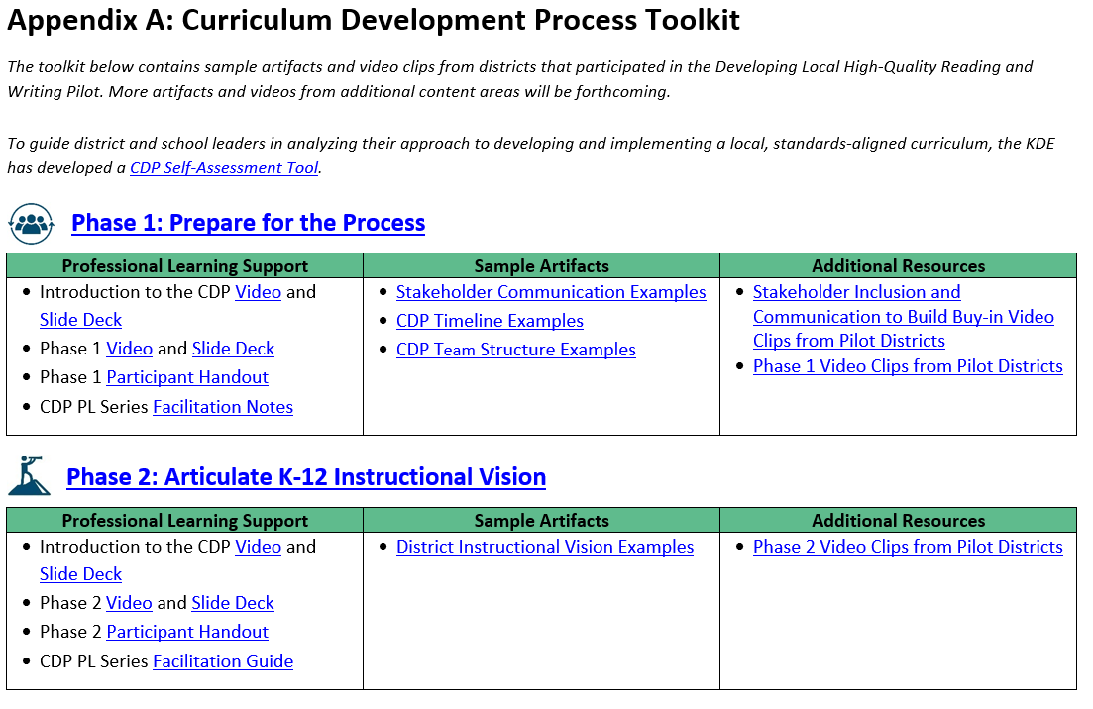
Phase 2: Articulate K-12 Instructional Vision

Slide 19
Instructional Vision: Group Chat
Where is your district in the process of creating a Reading and Writing Instructional Vision?
Do not have one yet for R/W
R/W is in process
R/W is established

Slide 20
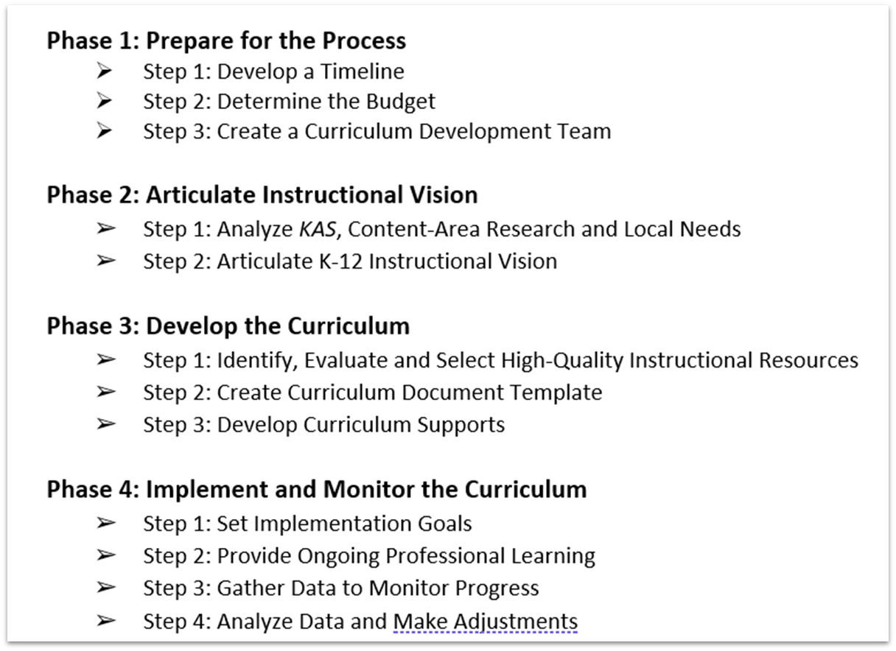
Curriculum Development Process: Phase 3

Slide 21
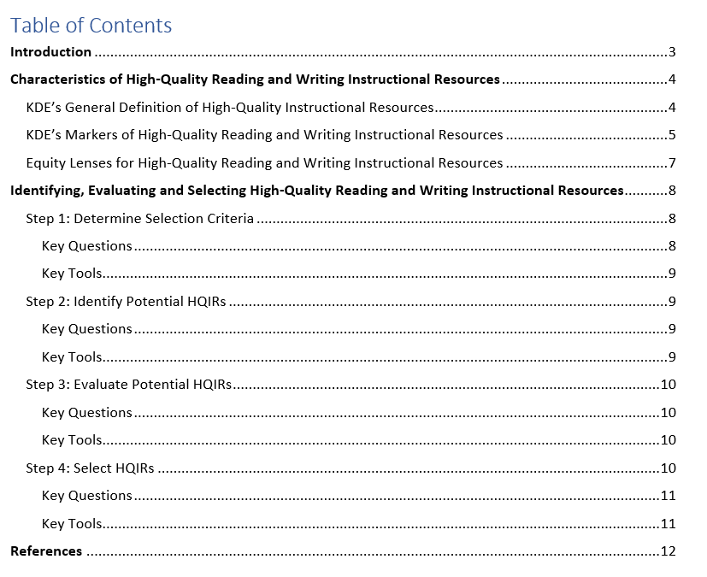
Reading and Writing Consumer Guide Structure
c

Slide 22
KDE’s General Definition of HQIRs
Aligned with the Kentucky Academic Standards (KAS);
Research-based and/or externally validated;
Comprehensive to include engaging texts (books, multimedia, etc.), tasks and assessments;
Based on fostering vibrant student learning experiences;
Culturally relevant, free from bias; and
Accessible for all students.

Slide 23
R/W Consumer Guide: Markers
KDE Markers of High-Quality R/W Instructional Resources:
Text Quality and Complexity
High-Quality Text-Dependent Questions and Tasks
Interdisciplinary Literacy Practices
Research-Based Practices for Foundational Skills Instruction
Access to Standards for All Learners

Slide 24
R/W Consumer Guide: Markers
KDE Markers of High-Quality R/W Instructional Resources:
Text Quality and Complexity
High-Quality Text-Dependent Questions and Tasks
Interdisciplinary Literacy Practices
Research-Based Practices for Foundational Skills Instruction
Access to Standards for All Learners
Which of these five markers might be most needed in a resource to support literacy instruction given your local context?

Slide 25
KDE’s General Definition of HQIRs
Aligned with the Kentucky Academic Standards (KAS);
Research-based and/or externally validated;
Comprehensive to include engaging texts (books, multimedia, etc.), tasks and assessments;
Based on fostering vibrant student learning experiences;
Culturally relevant, free from bias; and
Accessible for all students.

Slide 26
Reading and Writing Consumer Guide Structure
c

Slide 27
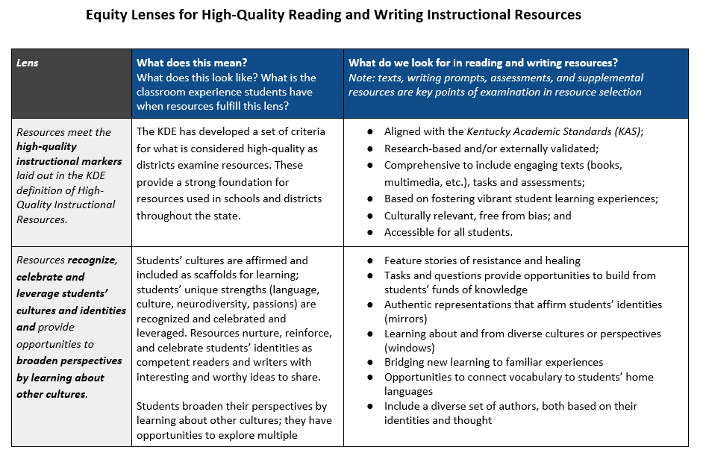
Equity Lenses for Hiqh-quality reading and writing instructional resources

Slide 28
Reading and Writing Consumer Guide Structure
c

Slide 29
Local Selection Process
Determine Selection Criteria
Identify Potential HQIRs
Evaluate Potential HQIRs
Select HQIRs

Slide 30
Determine Selection Criteria
Informed by:
District’s Reading and Writing Instructional Vision
KDE’s Characteristics of High-Quality Reading and Writing Instructional Resources (Markers/Equity “Look-Fors”)
Stakeholder Input

Slide 31
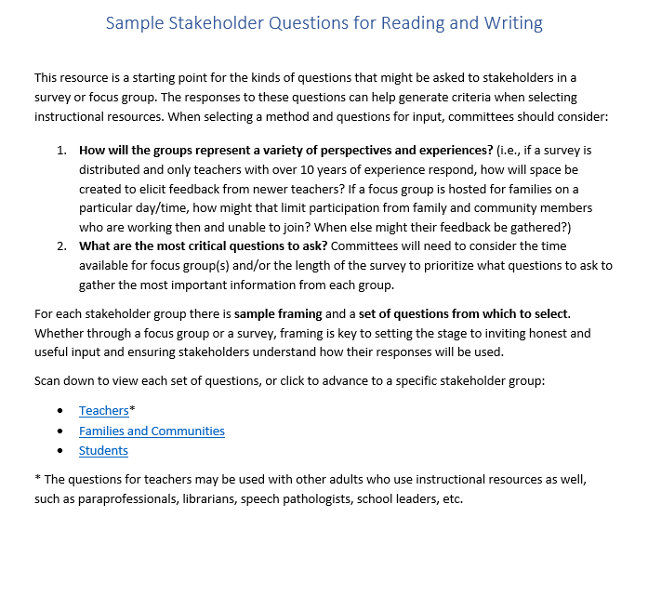
Sample Stakeholder Questions
Possible questions to support gathering input from:
Teachers
Families & Communities
Students

Slide 32
Local Selection Process
Determine Selection Criteria
Identify Potential HQIRs
Evaluate Potential HQIRs
Select HQIRs

Slide 33
Local Selection Process
What might be some ways instructional resources have traditionally been identified and evaluated internally within districts across the state?

Slide 34
KDE’s General Definition of HQIRs
Aligned with the Kentucky Academic Standards (KAS);
Research-based and/or externally validated;
Comprehensive to include engaging texts (books, multimedia, etc.), tasks and assessments;
Based on fostering vibrant student learning experiences;
Culturally relevant, free from bias; and
Accessible for all students.
Notes:
.

Slide 35
EdReports is for Educators, by Educators
Curriculum review teams:
5 diverse review team members (roles, states, grade-level expertise)
Multiple sets of perspectives looking extensively at all elements of the core curriculum
Reviewers touch every page of the materials
Over 150 hours of review time per reviewer/series

Slide 36
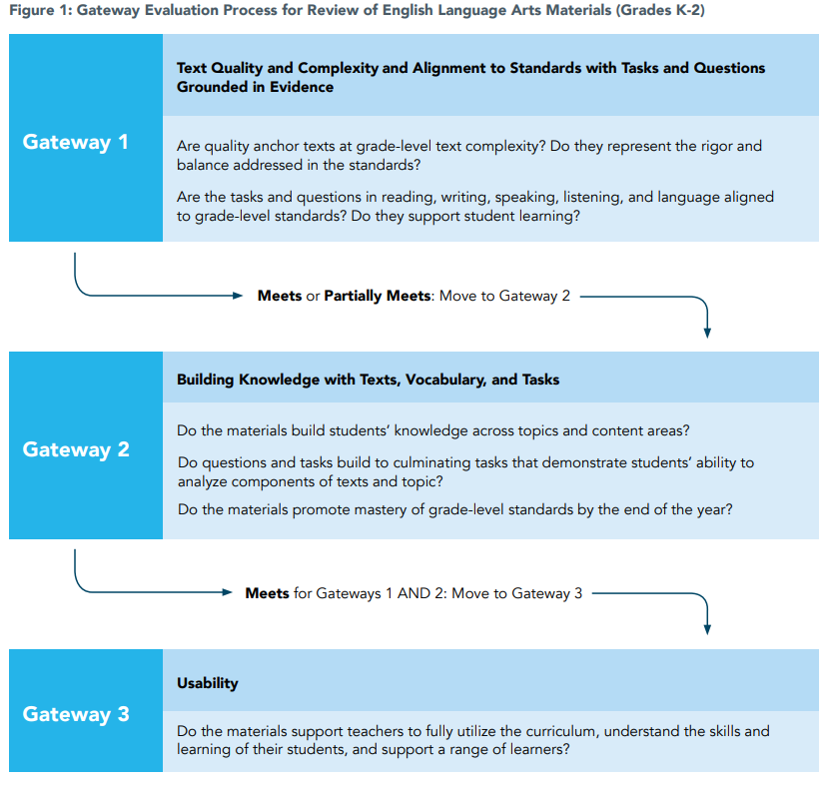
EdReports Grades K-2 Reading and Writing Evaluation Criteria

Slide 37
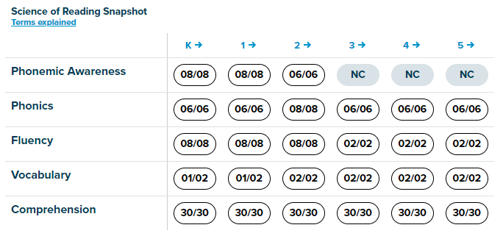
EdReports K-2 Science of Reading Snapshot

Slide 38
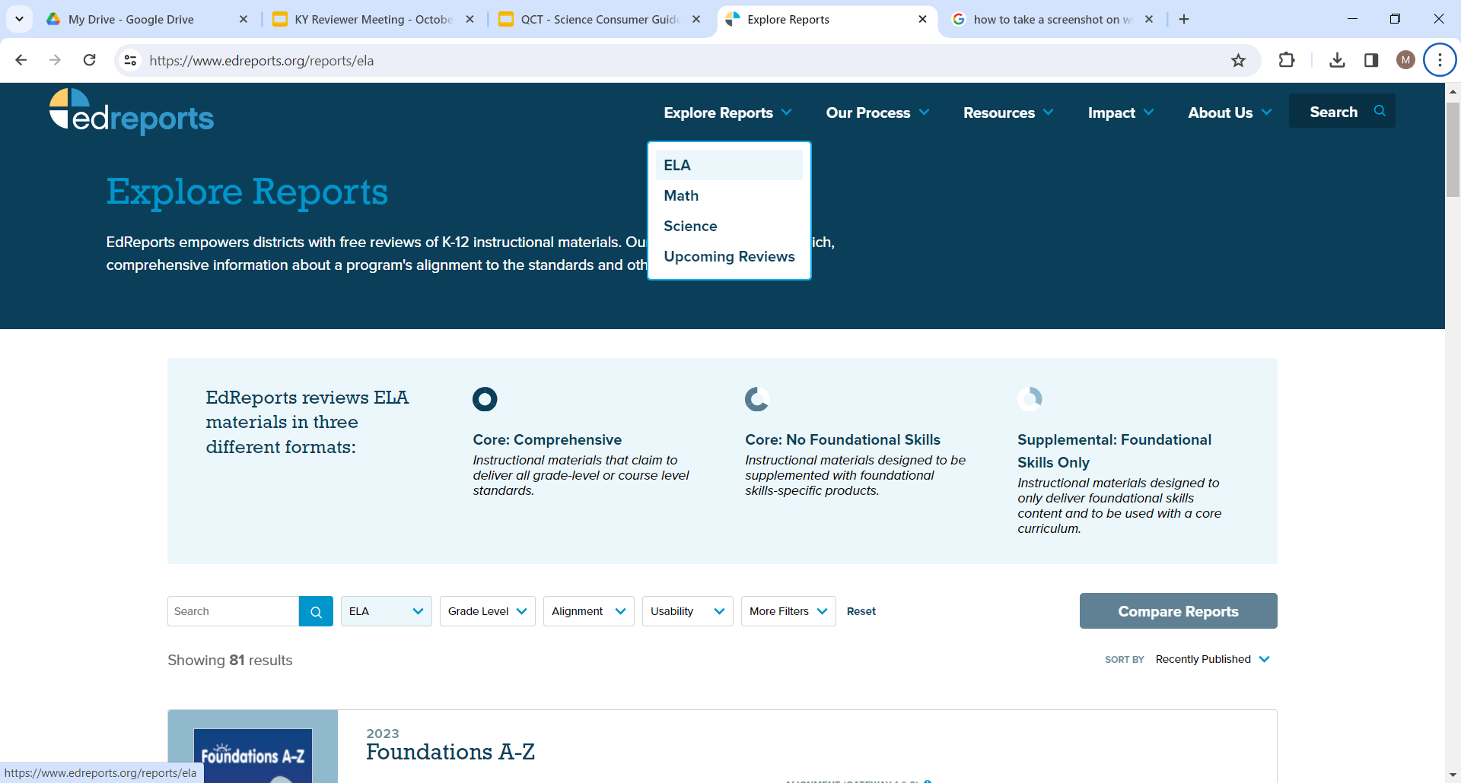
EdReports Website

Slide 39
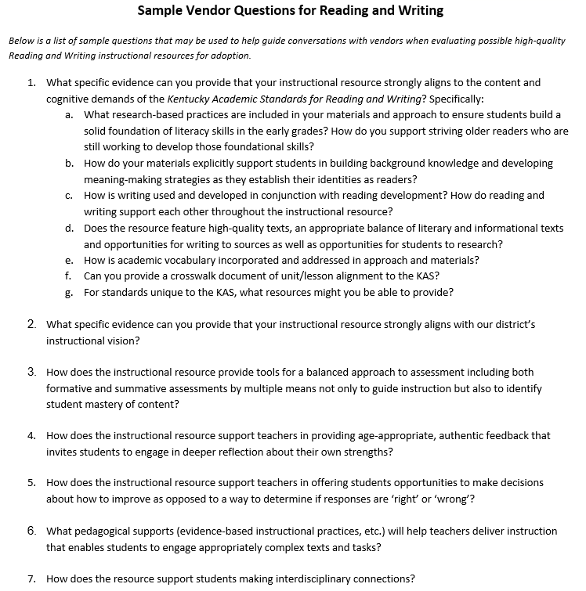
Sample Vendor Questions
​Includes possible questions to guide conversations with vendors to ensure resources meet local needs

Slide 40
HQIR Evaluation: Stakeholder Input
Create opportunities for stakeholders to provide input on the potential HQIRs
Should include teachers, parents/community members, students and SBDM/BOE
Having “full” samples available for review
Support input with guide/guidance

Slide 41
Local Selection Process
Determine Selection Criteria
Identify Potential HQIRs
Evaluate Potential HQIRs
Select HQIRs

Slide 42
Local Selection Process
Within the frame of what has been shared today, what is one thing your district has done well when selecting resources in the past or what is one thing you might consider doing differently now?

Slide 43
Recommended Next Steps
Develop a communication plan.
Establish a district curriculum team.
Draft R/W instructional vision.
Follow the four-step adoption process.
Clear & Inclusive
Collaborative & Committed
Strategic & Aligned

Slide 44
Phases 2 and 3 of Strengthening Tier 1 Instruction

Slide 45
Curriculum Development Process: Phase 4

Slide 46
Community of Practice Opportunities
90-minute professional learning workshops every other month beginning in April.
Support provided for all three stages of implementation–launch, early and ongoing–including CBPL.

Slide 47
Questions?

Slide 48
Questions
Fox DeMoisey
fox.demoisey@education.ky.gov
Misty Higgins
misty.higgins@education.ky.gov
Key Resources:
Curriculum Development Process
Reading and Writing Instructional Resources Consumer Guide

