Slide 1
Module 5: Interpreting Evidence of Student Learning
Mathematics
Kentucky Department of Education

Slide 2
Learning Goals (1)
Participants will understand:
The role of evidence of student learning in monitoring and supporting student progress toward Learning Goals and Success Criteria
Strategies to engage students in interpreting their own progress toward Learning Goals and Success Criteria
Notes:
Introduce the content on the slide by providing the following information.
Module 5 in this series focuses on interpreting evidence of student learning.
In all the modules in this series, we have emphasized that understanding where we, as learners, are heading and how we will know if we are successful is essential for teaching and learning and is a key aspect of quality assessment practices.
Share the Learning Goals on the slide.

Slide 3
Learning Goals (2)
Participants will understand:
Strategies to interpret evidence of student learning to inform teaching and learning within specific disciplines
Notes:
Introduce the content on the slide by providing the following information.
Module 5 in this series focuses on interpreting evidence of student learning.
In all the modules in this series, we have emphasized that understanding where we, as learners, are heading and how we will know if we are successful is essential for teaching and learning and is a key aspect of quality assessment practices.
Share the Learning Goals on the slide.

Slide 4
Success Criteria
Participants will be able to:
Plan to interpret evidence of student learning throughout a lesson
Develop specific strategies to engage students in interpreting their own progress toward Learning Goals and Success Criteria
Notes:
Introduce the content on the slide by providing the following information.
At the end of this learning sequence (including this module and the teacher collaboration activity), you should be able to:
Plan to interpret evidence of student learning throughout a lesson
Develop specific strategies to engage students in interpreting their own progress toward Learning Goals and Success Criteria
Facilitators may want to note that the terms classroom and classroom setting are used throughout this presentation and can refer to both physical classrooms and distance learning environments. Additionally, the term lesson is used to refer to a coherent set of learning opportunities focused on the same content and goals. It may refer to the learning plan for a single class period or could reflect a learning plan that covers several days.

Slide 5
Review: Formative Assessment Process
Notes:
This first section of the presentation focuses on formative assessment and some key concepts presented in Modules 1-4.
Facilitators should determine if participants need these reminders, particularly if they just recently engaged in the previous modules.

Slide 6
Formative Assessment:
A Definition
Formative assessment is a planned, ongoing process used by all students and teachers during learning and teaching to elicit and use evidence of student learning to improve student understanding of intended disciplinary learning outcomes and support students to become self-directed learners.
(CCSSO, 2018)
Notes:
Introduce the content on the slide by providing the following information.
This definition of formative assessment comes from the Council of Chief State School Officers (CCSSO).
If participants engaged in Modules 2, 3 and 4, facilitators may want to acknowledge that they have seen this definition in that module.
Ask participants to read and reflect on this definition.
Next, facilitate a brief discussion in which participants consider this definition in the context of the role that interpretation of evidence of student learning plays in the formative assessment process.
Consider using some of the following questions to support the discussion. ​
What words or phrases in this definition address interpreting evidence of student learning in the formative assessment process?​
What does this definition, taken as a whole, tell you about interpreting evidence of student learning in the formative assessment process?​
​
Some key things to notice might be:​
The definition emphasizes that formative assessment is planned and ongoing; it isn’t something that happens primarily by accident or spontaneous inspiration.​
The definition emphasizes that students and teachers both elicit and use evidence of student learning. ​Interpreting evidence is not just for teachers.
The definition prioritizes the use of evidence to improve learning and support students to become self-directed learners. Evidence isn’t elicited for its own sake but to inform next steps, which means that teachers and students must make sense of evidence to understand where students are in their learning.
​
For more information on this definition, including the reasoning behind it, refer to this document: https://ccsso.org/resource-library/revising-definition-formative-assessment​

Slide 7
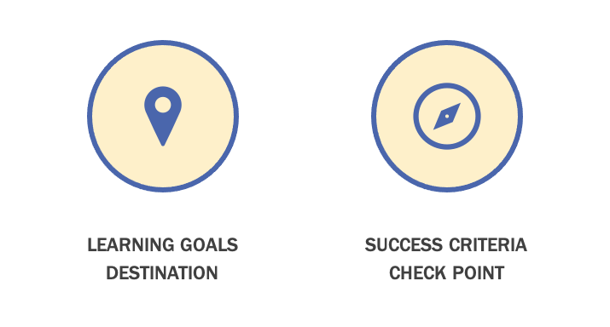
Mapping Student Learning
Notes:
Introduce the content on the slide by providing the following information.
In order to get the most out of this module, participants are encouraged to have gone through the previous assessment modules in the series, specifically Modules 2, 3 and 4.
As we discussed previously, self-directed learners need to understand what they are learning and how to get there. Learning Goals and Success Criteria work in tandem to help students understand where they are going with their learning so that they can actively manage their own learning. If a lesson is a journey that students and teachers take together, Learning Goals represent to students the destination of their journey, signaling clearly what they are learning and why it is important.
Success Criteria demonstrate to students what it looks like to be successful in achieving the Learning Goals. Success Criteria represent the check points along the route, giving students a specific information to understand their progress and make adjustments to move their learning forward.
Learning Goals and Success Criteria are essential tools for students to understand where they are in their learning so that they can become self-directed learners.
For more information on Learning Goals and Success Criteria, see Module 3 in this series.

Slide 8
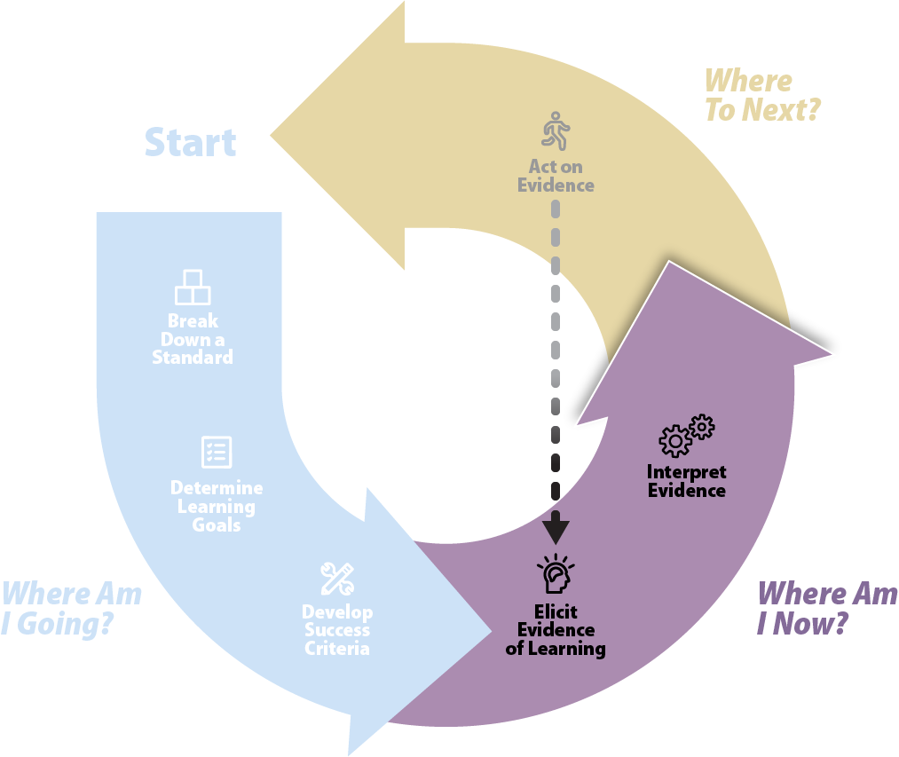
Where am I now?
Adapted from Formative Assessment Insights (WestEd)
Notes:
Introduce the content on the slide by providing the following information.
This graphic represents the formative assessment process. You may remember it from past modules. You’ll notice that this graphic identifies the specific practices that make up the formative assessment cycle and that these practices are grouped to aligned to the three critical questions.
In this module, Interpreting Evidence of Student Learning, we will focus on the second question, “Where am I now?”
Once a shared answer to the question, “Where am I going?” has been established by clarifying and sharing Learning Goals and Success Criteria, students and teachers need to understand their current status so that they can make decisions to move learning forward.
This starts with eliciting meaningful evidence and then interpreting that evidence in order to inform next steps.

Slide 9




Key Considerations for Evidence of Student Learning
Intentionally design and implement
Make student learning visible
Inform students and teachers about next steps
Integrate into learning
Notes:
Introduce the content on the slide by providing the following information.
As discussed in Module 4, evidence of student learning is central to inform student and teacher decisions about next steps to move students toward their Learning Goals. A critical element of lesson planning is integrating strategies to gather evidence of student learning during the learning and then having the requisite tools and strategies at your fingertips to interpret the evidence.

Slide 10
Evidence-Based Interpretation
Notes:
Introduce the content on the slide by providing the following information.
Our main focus in this module is on interpreting meaningful evidence elicited from student learning that can support students and teachers to move their learning forward.

Slide 11
What is Evidence-Based Interpretation? (1)
Students and teachers use evidence to guide an ongoing process of teaching and learning.
Evidence is:
  observable
  guided by learning in real time
  engaged in by teachers and students
Notes:
Introduce the content on the slide by providing the following information.
Evidence is student learning that can be observed, and it is understood in relation to the specific Learning Goals that students are working toward.
Evidence-based interpretation in the formative assessment process is the ability to use evidence to guide learning while learning is occurring.
Interpreting evidence isn’t something only engaged in by teachers. Interpreting evidence of their own learning is an essential skill for students to become self-directed learners.

Slide 12
What is Evidence-Based Interpretation? (2)
Students and teachers:
Situate evidence in a progression of learning
  Interpret evidence of what students know and can do
  Interpretation of evidence is an ongoing process
Notes:
Introduce the content on the slide by providing the following information.
Interpreting evidence requires students and teachers to pay close attention not simply to the specific artifacts that students produce, but what they tell us about the development of student learning.
The interpretation of evidence is not a single event but is instead part of a continuous and ongoing process engaged in by students and teachers throughout the course of instruction.

Slide 13
What is Evidence-Based Interpretation? (3)
Students and teachers:
Use evidence to identify nuances of learning (not simply right or wrong) to inform next steps
  Deep knowledge and understanding of learning progressions
Notes:
Introduce the content on the slide by providing the following information.
To interpret evidence in ways that can inform next steps in both teaching and learning, teachers need a strong understanding of the disciplinary and cognitive path toward the Learning Goals. Teachers must have clarity on what comes next in learning and clearly communicate that information to students in order to guide students forward in their learning.
Interpreting evidence of student learning in the formative assessment process requires an understanding that goes beyond “got it” or “didn’t get it” and provides a more nuanced understanding of students’ learning in order to support decisions about next steps in learning. For example, there is a difference between understanding where a student is in their learning progression, and whether an assignment has been completed or not. Noting that an assignment is complete or incomplete does not provide any actionable evidence that can be used to move learning forward.

Slide 14
What is Evidence-Based Interpretation? (4)
  In mathematics, an understanding of learning progressions involves recognition of the Coherence within and across Kentucky Academic Standards. The standards are sequenced to make mathematical sense and are based on the progressions for how students learn.
  To emphasize the cohesiveness of the K–12 standards, the standards include Coherence/Vertical Alignment mapping that indicates a mathematics connection within and across grade levels.
  For example, the coherence of the development of arithmetic knowledge, skills, and understandings at K–5 is explicitly linked within the standards.
    Coherence KY.K.NBT.1→KY.1.NBT.2
    Coherence KY.K.NBT.1→KY.1.NBT.2→KY.2.NBT.1
    Coherence KY.1.NBT.2→KY.2.NBT.1→KY.3.NBT.1
Notes:
Introduce the content on the slide by providing the following information.
The Kentucky Academic Standards (KAS) provide specific information about the vertical alignment of the standards that could be a helpful resource in planning to identify students’ prior content knowledge. In mathematics, each standard (K–8) presents Coherence in the clarifications section, providing links to the matching standard from the preceding and following grade. Additionally, teachers can use the Breaking Down a Standard Protocol to help deepen their understanding of the specific standards: https://kystandards.org/standards-resources/mathematics-resources/breaking-down-a-mathematics-standard/
The Clarifications and Coherence section of the Getting to Know the KAS for Mathematics (Section 1E) provides a focused investigation of the connections within and across grade level to develop teachers’ understandings of how the Clarifications communicate expectations of the standards more clearly and concisely. The module in its entirety can be found at this website: https://kystandards.org/wp-content/uploads/2019/06/Module_1_Getting_to_Know_the_Kentucky_Academic_Standards_for_Mathematics.pptx
Next, facilitate a discussion in which participants identify different aspects of student learning they often focus on throughout their lessons.
Facilitators can consider using some of the following questions:
To what extent are students involved making sense of their own learning progress?
In your class, how do students understand where to go next in their learning?

Slide 15
Engaging Students with Evidence of Learning
Notes:
Introduce the content on the slide by providing the following information.
In this section, we will discuss how to support students to engage with evidence of their own learning.

Slide 16

Student Engagement with Evidence of Learning
Recognize their own expression and work as evidence of their own learning
Embrace opportunities to make their learning public
Engage with their own ideas and those of their peers in the context of Learning Goals and Success Criteria
Notes:
Introduce the content on the slide by providing the following information.
When students are engaged in interpreting the evidence of learning they produce, they can develop the skills of metacognition–thinking about their thinking–and self-regulation. Self-regulated learners monitor their learning, compare it to specific criteria (e.g., Learning Goals and Success Criteria) and then make adaptations to their learning strategies as they see fit.
Student engagement is key to the interpreting of evidence and allows teachers and students to meaningfully engage in the formative assessment process. Student engagement means that students can make the connection between the behaviors they exhibit in class and evidence of their learning, ultimately supporting them to move their learning forward.
Next, facilitate a discussion about student engagement.
Facilitators may want to use some of the following questions to support the discussion:
How can I help students recognize that the things they do and say are evidence of their learning?
How can I support students in making their ideas visible and public?

Slide 17
Classroom Culture and Evidence
How can classroom culture support students to use evidence of their own learning?
Make meaning
Manage learning
Participate and collaborate
Notes:
Introduce the content on the slide by providing the following information.
Students can become the kind of self-directed, engaged learners who can recognize evidence of their own learning, embrace opportunities to make their learning public and engage with evidence of their own learning (as described on the previous slide) when the classroom culture empowers them to engage fully in the formative assessment process.
As described on Module 2, the Fundamentals of Learning is a framework that presents three fundamental aspects of learning. When students have ownership of their own learning, they can:
Make meaning for themselves by thinking critically and creatively, connecting to prior knowledge and using language and symbols.
Manage their own learning by taking responsibility for learning, adapting learning tactics and persevering through challenges.
Participate and collaborate by engaging with others and communicating and connecting with others about ideas, feelings and perspectives.
Next, facilitate a discussion that helps participants relate the concepts of culture and climate to their own classrooms.
Consider using some of the following questions to support the discussion.
What does your current classroom culture signal to students about evidence of their own learning?
How does your classroom culture support the Fundamentals of Learning?
What adult mindset changes may be needed to build a classroom culture that supports the formative assessment process?

Slide 18
Self- and Peer-Assessment
Students and teachers must share common understanding of what they are working toward.
Self- and peer-assessment is explicitly taught and modeled by teacher.
Students need opportunities to practice engaging with evidence of their own learning and the learning of their peers.
Students need explicit tools and strategies to support engaging with evidence of learning.
Notes:
Introduce the content on the slide by providing the following information.
The purpose of self- and peer-assessment is to help students manage their own learning. Students who manage their own learning can set goals, make plans, monitor their progress and adapt their approaches to learning. Essential to this process is being able to view their own work and ideas and the work of their peers critically and use it to make decisions about how to proceed in their learning.
If students and teachers do not have a shared understanding of the learning they are working toward and a shared sense of what constitutes quality work, students will not be able to appropriately manage their own learning. These expectations are based on the Success Criteria. It is important for students to have a clear understanding of the teacher’s expectations in order to self-assess and to provide meaningful feedback to peers.
This slide lists some important ways that teachers must support students to engage in meaningful peer- and self-assessment. The next several slides will explore the ways that each of these strategies are important for building a classroom culture that supports full student engagement in the formative assessment process by empowering them to make sense of evidence of their own learning and the learning of their peers.

Slide 19
Common View of Success (1)
Share and clarify Learning Goals and Success Criteria
Be transparent about how understanding will be evaluated
Provide examples and non-examples
Demonstrate a variety of approaches
Notes:
Introduce the content on the slide by providing the following information.
To build a common view of success, teachers can help students and their families internalize expectations in a variety of ways.
The Kentucky Academic Standards (KAS) Family Guides have been developed to help families familiarize themselves with the content of each grade level’s standards. Each guide contains a standards overview for Reading & Writing, Mathematics, Science and Social Studies. Each grade-level document presents information that can help to build a common view of success between the teacher and families by providing families with the key ideas and skills teachers will introduce in each subject area. Information presented in each Family Guide includes possible examples of what students will be asked to do in class, how to help students at home, questions families can ask students at home and questions families can ask their student’s teacher. Family Guides in English and in Spanish can be found at this website: https://kystandards.org/standards-family-guides/.
Additionally, A Family’s Guide to Understanding Student Assessment was developed to help families understand how assessment can support student learning. This guide can be found at this website: https://education.ky.gov/curriculum/standards/kyacadstand/Documents/A_Family's_Guide_to_Student_Assessment.pdf

Slide 20
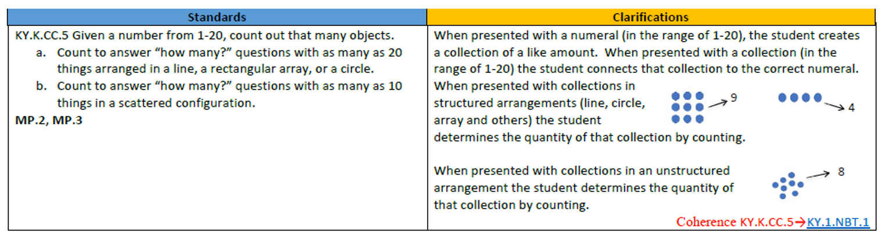
Common View of Success (2)
Share and clarify Learning Goals and Success Criteria
Learning Goal | Success Criteria
We are learning to count things put together in different ways. | I can count the number of buttons my teacher shows me. I can make my own groups have just the amount my teacher asks.
Notes:
Introduce the content on the slide by providing the following information.
To build a common view of success, teachers can help students internalize expectations by
Learning Goals and Success Criteria: Key to this common view are the sharing and clarification of Learning Goals and Success Criteria. If students are to use them to guide their understanding of their own progress, students need more than just seeing the Learning Goals and Success Criteria on the board.
Communication of Learning Goals and Success Criteria should occur throughout a lesson.
At the start of a lesson, talk students through what they will be learning and ways that evidence of learning can be shown.
Throughout the lesson, help students build connections between where they have been and where they are going in their learning.
At the end of the lesson, ask students to summarize in their own words what they learned and how they know they learned it.
These points will be discussed in further detail later.

Slide 21
Common View of Success (3)
Be transparent about how understanding will be evaluated
Example Counting Checklist
I can… | By Role Counting | By Counting Objects | By Writing Numbers
Count to 5
Count to 10
Count to 20
KY.K.CC.5
Notes:
Introduce the content on the slide by providing the following information.
To build a common view of success, teachers can help students internalize expectations by
Being transparent about evaluation criteria: Students need to understand how their learning will be evaluated and what criteria will be used to determine where students are in their understanding. This understanding helps to organize learning, improve communication, increase engagement, and provide a sense of fairness.
For the counting standard on the previous slide, KY.K.CC.5, teachers can create a checklist of the knowledge and skills they will be looking for as students work individually and collaboratively. This checklist can be shared with students and families to provide clear communication about the evaluation of learning goals and success criteria.

Slide 22
Common View of Success (4)
Provide examples and non-examples
Grade 1 Example
Sam has 12 apples. Then Sam gives away some apples. Now Sam has 5 apples. How many apples does Sam give away?
Micah’s equation: 12 + 5 = ?
Ariel’s equation: 12 – ? = 5
Whose equation can be used to solve the problem? How do you know?
KY.1.OA.1
Notes:
Before introducing the content of this slide, have teachers access KY.1.OA.1 and associated clarifications.
Introduce the content on the slide by providing the following information.
To build a common view of success, teachers can help students internalize expectations by
Providing examples and non-examples: Providing students with examples that can illustrate what Success Criteria can look like can strengthen student understanding of what they are working toward. Examples can be used in concert with non-examples that illustrate common misconceptions students may make, perhaps with modeling focused on how to improve the non-example.
In mathematics, worked examples can be used to illustrate work and/or reasoning that students can critique, keying in on the specific knowledge and skills of the Success Criteria (e.g., determining a solution to a start unknown addition/subtraction problem, communicating reasoning about why a given equation would or would not work to determine the solution).
The example on the slide can be presented to student for discussions about whether or not an equation can be used to answer the question. These conversations can focus on how students know which number in an equation is the answer and different ways of writing an equation that will lead to the same answer.
Appendix A, Table 1 of the KAS for Mathematics (p. 254) provides the set of common addition and subtraction situations addressed in the standards.
KY.K.OA.2 Solve addition and subtraction word problems and add and subtract within 10 by using objects or drawings to represent the problem.
KY.1.OA.1 Use addition and subtraction within 20 to solve word problems involving situations of adding to, taking from, putting together, taking apart and comparing, with unknowns in all positions.
KY.2.OA.1 Use addition and subtraction within 100 to solve one- and two-step word problems involving situations of adding to, taking from, putting together, taking apart and comparing, with unknowns in all positions, by using drawings and equations with a symbol for the unknown number to represent the problem.
A useful resource when planning for high school instruction is Teaching Strategies for Improving Algebra Knowledge in Middle and High School Students: Practice Guide Summary. This summary provides recommendations for incorporating solved problems into secondary classroom instruction and activities. The document can be found at this website: https://ies.ed.gov/ncee/wwc/Docs/practiceguide/wwc_algebra_summary_072115.pdf

Slide 23
Common View of Success (5)
Demonstrate a variety of approaches
Grade 1 Example
Which numbers are “just right” for you to answer this question?
John has [9 or 14] water balloons. Some of the balloons pop. John now has 6 balloons. How many of the balloons John has pop?
KY.1.OA.1
Notes:
Introduce the content on the slide by providing the following information.
To build a common view of success, teachers can help students internalize expectations by
Demonstrating a variety of approaches: Teachers can also provide students with multiple approaches that can lead to success. This provides students with diverse learning needs, different learning styles and different background knowledge with the ability to obtain success and take ownership of their learning.
Mathematics teachers can identify students who approach the same problem in different ways and have these students present their approaches to the class. They could also provide students choice during problem solving activities, for example asking students to demonstrate their knowledge of computation by choosing the “just right” numbers to use when solving a contextually based problem. When solving addition and subtraction problems, an example could incorporate numbers that require different strategies to solve: John has [9 or 14] water balloons. Some of the balloons pop. John now has 6 balloons. How many of John’s balloons John popped?
In this example, the numbers provided in the first sentence bridge student development of addition and subtraction skills.
For students struggling to cross tens, using 9 helps them show they understand how to solve the problem without being hindered by their struggles computing.
For students who can fluently add and subtract within 20, the use of 14 provides the same opportunity.
As mentioned in the notes on the previous slide, Appendix A, Table 1 of the KAS for Mathematics (p. 254) provides the set of common addition and subtraction situations addressed in the standards.
Next, facilitate a discussion in which participants consider ways in which they build a common view of success in their classrooms.
Facilitators can consider using some of the following questions to support the discussion:
How do you currently help students build an understanding of success that matches your own?
Do you feel that your students understanding of quality of work in relation to the Success Criteria is in line with your own?

Slide 24
Teaching and Modeling (1)
Making intended learning visible
Explicit teaching and modeling of self-assessment
Explicit teaching and modeling of peer- assessment
Notes:
Introduce the content on the slide by providing the following information.
Nearly everything a teacher does during a lesson can be seen as modeling, but deliberate, purposeful modeling is a powerful instructional strategy. Teaching and modeling self- and peer-assessment is no different.

Slide 25
Teaching and Modeling (2)
Making intended learning visible
Grade 6 Teacher Talk
I notice that the rate in the problem is given in feet per second, but the answer needs to be in inches per second. I will multiply the initial rate by 12, since there are 12 inches in 1 foot.
KY.6.RP.3c
Notes:
Before introducing the content of this slide, have teachers access KY.6.RP.3c and associated clarifications.
KY.6.RP.3c: Use ratio reasoning to convert measurement units; manipulate and transform units appropriately when multiplying or dividing quantities.
Introduce the content on the slide by providing the following information.
Making intended learning visible
Making intended learning visible: Teachers can help students develop their peer- and self-assessment skills by modeling what it looks like to make evidence of student learning visible. By sharing their own work and process, teachers demonstrate what it looks like for students to view their own ideas and work as evidence and use that evidence to make decisions.
In mathematics, this could be verbalizing specific reasoning during problem solving. For example, during a lesson focused on rates, a grade 6 teacher might say, “I notice that the rate in the problem is given in feet per second, but the answer needs to be in inches per second. I will multiply the initial rate by 12, since there are 12 inches in 1 foot.”)

Slide 26
Teaching and Modeling (3)
Explicit teaching and modeling of self-assessment
Grade 5 Teacher Talk
We are working on clear and complete explanations for why multiplying a given number by a fraction greater than 1 results in a product greater than the given number. I have a set of examples that show this is true, but this doesn’t mean it works for any number. I need to add some words to my response that generalizes the examples in a way that explains why it works for any number.
KY.5.NF.5b
Notes:
Before introducing the content of this slide, have teachers access KY.5.NF.5b and associated clarifications.
KY.5.NF.5b: Interpret multiplication as scaling (resizing), by explaining why multiplying a given number by a fraction greater than 1 results in a product greater than the given number (recognizing multiplication by whole numbers greater than 1 as a familiar case); explaining why multiplying a given number by a fraction less than 1 results in a product smaller than the given number; and relating the principle of fraction equivalence 𝑎/𝑏 = (𝑛 × 𝑎)/(𝑛 × 𝑏) to the effect of multiplying 𝑎/𝑏 by 1.
Introduce the content on the slide by providing the following information.
Teaching and modeling self-assessment
Teachers can help students learn to make sense of their own learning by providing explicit instruction and modeling to demonstrate looking at evidence of their own learning in the context of the Learning Goals and Success Criteria.
In mathematics, this could be sharing a worked example of the teacher’s own solution process and reviewing it aloud with the Success Criteria in mind (e.g., “We are working on clear and complete explanations for why multiplying a given number by a fraction greater than 1 results in a product greater than the given number. I have a set of examples that show this is true, but this doesn’t mean it works for any number. I need to add some words to my response that generalizes the examples in a way that explains why it works for any number.)

Slide 27
Teaching and Modeling (4)
Explicit teaching and modeling of peer- assessment
Grade 2 Teacher Talk
I heard you say two hundred nine, but you wrote 290. Which number did you mean?
KY.2.NBT.3
Notes:
Before introducing the content of this slide, have teachers access KY.2.NBT.3 and associated clarifications.
KY.2.NBT.3: Read and write numbers to 1000 using base-ten numerals, number names and expanded form.
Introduce the content on the slide by providing the following information.
Teaching and modeling peer-assessment
In the same way that teachers can make self-assessment explicit, they can support students in understanding where their peers are in their learning by thinking about evidence of their peers’ learning in the context of the Learning Goals and Success Criteria. This requires helping students understand they have a responsibility to notice their peers’ learning and to respond in ways that support progress toward the Learning Goals.
In mathematics, this might be showing students what it looks like to listen closely to someone’s reasoning, look closely at someone’s work and notice and respond to the provided evidence (e.g., I heard you say two hundred nine, but you wrote 290. Which number did you mean?). Additionally, responses to valid evidence could be focused on helping other students develop greater meaning for the concepts, skills and practices being demonstrated and discussed.
Next, facilitate a discussion in which participants consider ways in which modeling can support peer- and self-assessment.
Facilitators can consider using some of the following questions to support the discussion:
How do you use modeling in your classroom to support students to understand where they are in their own learning?
What strategies have you used to teach your students to assess their own work and that of their peers?
What challenges have you experienced in modeling self- and peer-assessment skills?

Slide 28
Practice
Classroom culture
Low stakes, learning focused
Repeated opportunities
Feedback on self- and peer-assessment
Notes:
Introduce the content on the slide by providing the following information.
Students need the time and space to practice engaging with evidence of their own learning and the learning of their peers. In order to get better at applying Success Criteria to their own work and the work of their peers, students need opportunities to practice in an environment that makes it safe for them to manage their own learning and support the learning of their peers.
Classroom culture: As discussed on a previous slide and in detail in Module 2, students can engage in the formative assessment process when they are learning in contexts that supports them to do so. To practice and improve at self- and peer-assessment, students need a culture that supports them to make meaning for themselves, manage their own learning and participate and contribute in a collaborative environment. Students need a culture that values and makes space for errors and mistakes as learning opportunities.
Low stakes: Students can practice and get better at meaningful self- and peer-assessment when they understand assessment as an opportunity to understand where they are in their learning in order to make decisions about how to improve, as opposed to a way to determine if they are right or wrong based on whether they get a good grade or a bad grade. In mathematics, this could mean allowing students to revise incorrect or incomplete responses based on formative feedback about their initial work.
Opportunities: Just like with other skills your students are learning, students need many opportunities to practice the skills related to peer- and self-assessment and they need to progress from scaffolded peer- and self-assessment to being able to apply Success Criteria to evidence of learning independently.
Feedback: Repeated practice needs to be coupled with specific feedback about how students are doing at self- and peer-assessment. Students need a chance to hear their teacher’s perspective on what they are doing well and how they can sharpen their peer- and self-assessment skills and become more independent. They also need to discuss their own reflections on the process.
Next, facilitate a discussion in which participants discuss ways their students can practice peer- and self-assessment.
Facilitators can consider using some of the following questions to support the discussion:
How can you ensure that students understand formative assessment as an opportunity to learn?
What are some ways that your students practice self- and peer-assessment?
What are your students’ strengths and weaknesses at self- and peer-assessment?

Slide 29
Tools and Strategies
Templates
Self- and peer-correction checklists and look-fors
Sentence starters
Examples of student work/writing
Background knowledge anchor charts
Graphic organizers for the intended learning sequence
Question prompts
Explicit comprehension strategies (e.g., QRAC-the-code, Concrete-Representational-Abstract)
Notes:
Introduce the content on the slide by providing the following information.
In addition to teaching, modeling and opportunities to practice, teachers can provide a variety of strategies and tools that students can use to build student responsibility, ownership and skills at managing their own learning through self- and peer-assessment.
While by no means comprehensive, this slide lists some examples of tools and strategies that can support students to make sense of evidence of their learning and of their peers to gain an understanding of their current learning status and inform next steps. Walk through the examples on the slide, elaborating as necessary.
For example, facilitators may want to elaborate on how to use question prompts to support student self- and peer-evaluation by offering questions related to the Success Criteria that help students gauge their own understandings. The questions should be purposeful, and their purpose should be conveyed to students along with encouragement for them to answer candidly. With young children, this activity can be simplified to drawing a face or choosing a picture that communicates how they feel about what they know and can do in relation to the Success Criteria.
Next, facilitate a discussion in which participants share ideas about tools and strategies that can support peer- and self-assessment.
Facilitators can consider using some of the following questions to support the discussion:
What strategies and tools have you used to support students to assess their own learning and the learning of their peers?
What tools and strategies have been most successful?
How have you supported your students to transition from scaffolded to more independent analysis of their own learning?

Slide 30
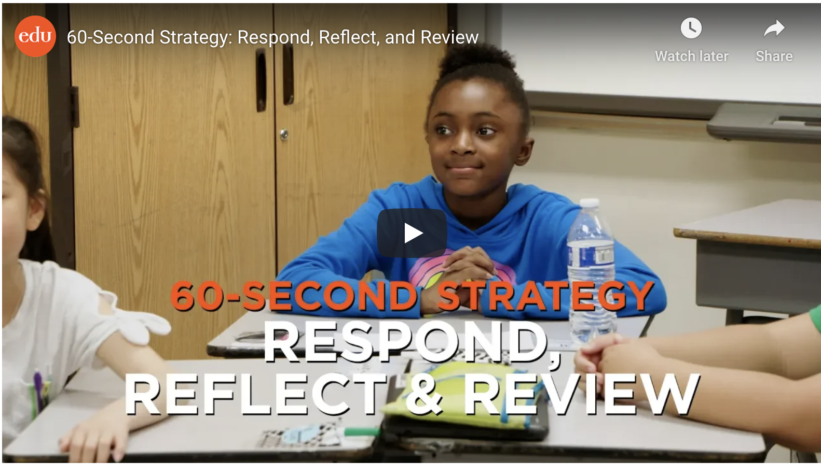
Culture of Peer- and Self-Assessment in Action
https://www.edutopia.org/video/60-second-strategy-respond-reflect-and-review
Notes:
https://www.edutopia.org/video/60-second-strategy-respond-reflect-and-review
Here is a quick video showcasing peer- and self-assessment.
Next, facilitate a discussion utilizing the following questions:
What are some examples of peer- and self-assessment you noticed?
What can you infer about the teacher’s classroom climate that would allow for this peer- and self-assessment?

Slide 31
Strategies for Interpreting Evidence of Student Thinking in Mathematics
Notes:
Introduce the content on the slide by providing the following information.
In this section we will discuss strategies for teachers to interpret evidence of student thinking to inform their instruction.

Slide 32
Analyzing Evidence
  Progress of individual students toward Learning Goals and Success Criteria
  Disciplinary misconceptions, confusions and challenges
  Patterns and trends
  Reflections on teaching practice
Notes:
Introduce the content on the slide by providing the following information.
When teachers interpret evidence of student learning, they are focusing both on the progress of individual students as well as groups of students and where the class is, as a whole, in terms of their learning progressions. As teachers look at evidence of student learning, they are looking for gaps between where students are in their learning and where they are headed. But merely identifying a gap is not enough to support effective pedagogical action. Teachers need to understand why there is a gap in order to support students to move forward in their learning.
Teachers can interpret evidence considering specific disciplinary misconceptions or issues that may constrain students from reaching their Learning Goals. Teachers can draw on their content knowledge as well as their understanding of how students learn disciplinary ideas and skills to anticipate these kinds of issues and support in-process pedagogical responses. For example, in mathematics, teachers can encourage students to describe both the process, the conceptual understanding, and, informally, the mathematical practices that drive a problem-solving process.
Additionally, teachers can look for patterns that show common errors, misconceptions or issues among groups of students. For example, a mathematics teacher might notice that a group of students can identify fourths when each part of the whole is the same shape and size (e.g., a rectangle partitioned horizontally and vertically into 4 same-sized squares) but cannot identify fourths when this is not true (e.g., a rectangle partitioned into two halves vertically, where one half is partitioned into two same-sized parts vertically and the other half is partitioned into two same-sized parts horizontally).
Note: The above example addresses KY.2.G.3: Partition circles and rectangles into two, three, or four equal shares; describe the shares using the words halves, thirds, half of, a third of, etc.; and describe the whole as two halves, three thirds, four fourths. Recognize that equal shares of identical wholes need not have the same shape.
The Breaking Down a Standard tool can also serve as a resource for exploring student misconceptions related to specific mathematics content. The section “What are the possible misconceptions that will need to be addressed during instruction?” provides opportunities for teachers to pre-think any potential barriers to student learning. (https://kystandards.org/standards-resources/mathematics-resources/breaking-down-a-mathematics-standard/)
This analysis supports providing direct support and actionable feedback to both individual students or groups of students, depending upon the activity. In addition to the student-facing piece, this analysis should also prompt reflection on and continuous improvement of the teacher’s practice. For example, a mathematics teacher may notice that her students consistently struggle with providing explanations for their thinking. The teacher then reflects on his or her own teaching methods around written and verbal explanations and decides to create more scaffolding for students in the form of sentence stems.
Next, facilitate a discussion about analyzing evidence.
Facilitators may want to use some of the following questions to support the discussion:
What do you look for when you analyze evidence of student learning?
How do you interpret evidence of student learning during instruction as well as in between instruction?
What are common misconceptions and patterns that you look for in your students’ work and ideas?
How do you use evidence of student learning to help you reflect on and improve your practice?

Slide 33
Evaluating the Quality of Your Evidence
Factors that impact the value of evidence of learning:
Prior student knowledge
Student language barriers
Technological challenges
Questioning method
Notes:
Introduce the content on the slide by providing the following information.
Even when evidence gathering opportunities are carefully constructed and are aligned to Learning Goals and Success Criteria, the evidence elicited can still be clouded by other factors.
An important step in making meaning of student evidence is evaluating the quality of the evidence in the context of the Learning Goals and Success Criteria. This sometimes means filtering extraneous information that doesn’t provide insight into students’ current learning status relative to the Learning Goals and Success Criteria and focusing tightly on the intended learning. For example, a mathematics teacher may overhear students misnaming properties of operations when applying them in problem solving situations (e.g., “comunative” property instead of “commutative” property). Since the Learning Goal and Success Criteria focus on the application of properties of operations and not the naming of the properties, the teacher chooses to only address conceptual errors associated with the properties.
However, evaluating the quality of evidence can also mean considering possible factors that may be limiting your students’ capacities to demonstrate what they know and can do relative to the Learning Goals and Success Criteria. This slide presents several examples of factors that may impact the quality of the evidence of student learning to inform good decisions about student learning.
For example, if a student is asked to work independently on a math problem that requires them to have a working knowledge of the game of golf, the evidence of learning being analyzed may not be representative of that student’s math knowledge if the student does not have the appropriate prior knowledge structures to engage with the content of the problem.
As teachers work to identify any issues clouding evidence, it's an opportunity to go back and elicit evidence in a different way to ensure that teachers understand what students know and can do. The formative assessment process is predicated on meaningful evidence of student learning and teachers must be aware of the other filters that may impact a student’s ability to demonstrate their knowledge as it relates to the evidence elicited to demonstrate specific Learning Goals and Success Criteria.
Next, facilitate a discussion about potential barriers to analyzing evidence.
Can you think of a lesson where you were sidetracked in your feedback because you were focused on student evidence that wasn’t aligned to the Learning Goals and Success Criteria?
Are there areas that often get in the way of your own students demonstrating what they know and can do?
How do you identify what factors influenced evidence of student learning for your students?
What are some strategies you can use to remove your own filters and focus on analysis of evidence aligned to Learning Goals and Success Criteria?

Slide 34
Anticipating Student Understanding (1)
Support in-process feedback and questioning
Based on:
  Disciplinary knowledge
  Familiarity with disciplinary progression of learning
  Understanding of students as learners
  Specifics of lesson
Notes:
Introduce the content on the slide by providing the following information.
By anticipating the understanding of knowledge and concepts that students bring when embarking on new Learning Goals, teachers position themselves to respond with in-process feedback that can quickly move students in the right direction. Anticipating possible student responses is a set of skills that teachers hone over time as they develop their deep knowledge of the discipline and understanding of how students progress through their disciplinary learning. The also rely on contextual factors including the profile of their individual students as learners and the specific way that learning is structured in the lesson.
Teachers prepare for a lesson by reflecting on common preconceptions, misconceptions and challenges or confusions that might arise for the students in their class. By thinking about when these issues are likely to arise in the lesson, teachers can plan to use strategies that will support students to clarify and advance their learning. Planning to use these strategies allows teachers to be ready to quickly take appropriate pedagogical action for many of their learners. Key to anticipating student responses to interpret in-process evidence is responding to what the students present in the evidence of their learning, not what they do not do. Interpreting evidence to inform the formative assessment process is about more than just catching what students may not get right but understanding where they are in their thinking and why.
In the next several slides, we will consider some examples of what it could look like to anticipate student understanding when planning a lesson.

Slide 35
Anticipating Student Understanding (2)
In the next several slides, we will consider some examples of what it could look like to anticipate student understanding when planning a lesson.

Slide 36
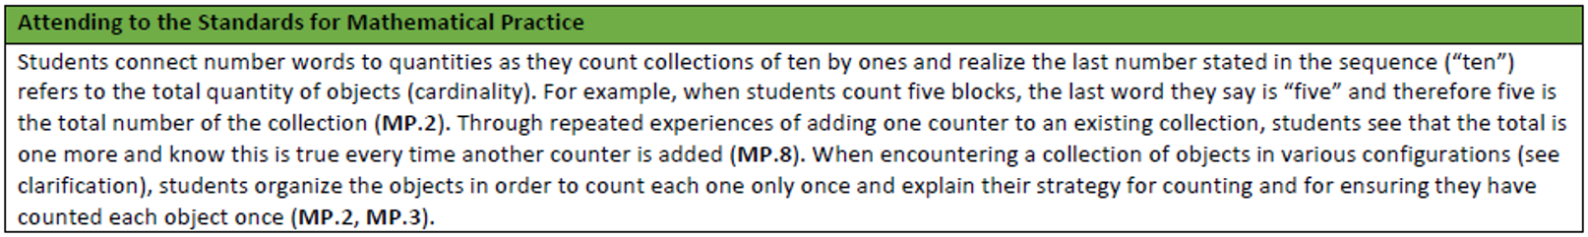
Anticipating Student Responses in Mathematics (1)
36
Notes:
Introduce the content on the slide by providing the following information.
We introduced this standard in Module 3 and earlier in this module. Here we include the Attending to the Standards for Mathematical Practice addressing the set of KY.K.CC standards.
Ask participants to take a moment to review the Standard, the Clarifications, and the Attending to the Standards for Mathematical Practice and reflect to themselves about strategies they might use to gather evidence of student learning.

Slide 37
Anticipating Student Responses in Mathematics (2)
For KY.K.CC.5
Learning Goal | Success Criteria
We are learning to count things put together in different ways. | I can count the number of buttons my teacher shows me. I can make my own groups have just the amount my teacher asks.
Start of Lesson | Middle of Lesson | End of Lesson
Evidence Gathering Strategy: Activate Prior Knowledge | Evidence Gathering Strategy: Questioning | Evidence Gathering Strategy: Peer- and Self-Assessment
Practice counting skills as a whole class. | Ask students to show different ways to count the buttons. | Students work together to count items and make groups as requested.
37
Notes:
Introduce the content on the slide by providing the following information.
We introduced this Learning Goal and these Success Criteria for KY.K.CC.5 in Module 3. In Module 4, we added some example strategies to gather evidence of student learning at key points in the lesson.
In the next few slides, we will consider ways to couple planned evidence gathering strategies with anticipated student responses in order to facilitate in-process feedback during teaching and learning of the lesson.
Ask participants to take a moment to review the Learning Goal, Success Criteria, and evidence gathering strategies and to reflect to themselves about what they might be looking for as students engage in evidence gathering opportunities throughout the lesson.

Slide 38
Example: Start of Lesson
Evidence Gathering Strategy: Activating Prior Knowledge
Practice counting skills as a whole class
KY.K.CC.5
Possible Student Understanding Issues
Skipping a number in the counting sequence
Saying the number sequence out of order
Using incorrect words to name numbers
Notes:
As a reminder, the examples presented on slides 37–39 address KY.K.CC.5: Given a number from 1–20, count out that many objects. A) Count to answer “how many?” questions with as many as 20 things arranged in a line, a rectangular array, or a circle. B) Count to answer “how many?” questions with as many as 10 things in a scattered configuration, and SMP 4: Model with mathematics.
Introduce the content on the slide by providing the following information.
An evidence gathering strategy that can be used by the teacher at the start of a lesson is activating prior knowledge. Anticipating student responses, lesson planning should include consideration of possible misconceptions or confusions students might have about the knowledge and skills that have the potential to impact current learning.
Connecting this strategy to the kindergarten Learning Goal of counting things put together in different ways, activating prior knowledge could include rote counting as a class. To rote count, students need to know how to name the numbers in the counting sequence and the sequence of the numbers when counting. Young students often have difficulty with teen numbers, for example, naming fifteen as five-teen. They might also skip a number in the counting sequence or count the numbers in a sequence out of order. Being aware of these potential student counting errors in advance of the lesson provides listen-fors during counting activities to identify which students might need additional counting experiences. Note that concrete counting activities may also help to develop and strengthen student rote counting skills and that resolving gaps and insufficiencies in student counting skills likely requires time and practice.
One resource to reference is the Look-fors and Questioning Stems for the SMPs which can be found at: https://education.ky.gov/curriculum/standards/kyacadstand/Documents/SMP_Look_Fors_and_Question_Stems.pdf.
Next, facilitate a discussion in which participants consider student responses they may anticipate:
Consider using some of the following questions:
What other student responses might you anticipate in an activity like this?
What questions or feedback might you give a student who responds in the ways identified here?
What challenges or confusions do you look for at the beginning of lessons that might be different than later in a lesson?
What kinds of confusion or challenges to student learning do you look for when students engage in disciplinary discourse?
How does anticipating student responses support you to take pedagogical action?

Slide 39
Example: Middle of Lesson
Evidence Gathering Strategy: Questioning
Ask students to show different ways to count the buttons
KY.K.CC.5
Possible Student Understanding Issues
Thinking that the number of objects is related to the order in which objects are counted
Struggling to keep track of which objects have been counted
Notes:
Introduce the content on the slide by providing the following information.
An evidence gathering strategy that can be used by the teacher in the middle of a lesson is questioning. Anticipating student responses, lesson planning should consider possible misconceptions or confusions students might have about the content embodied by the Learning Goals and Success Criteria that can be surfaced through teacher- and peer-questioning.
Connecting this strategy to the kindergarten Learning Goal of counting things put together in different ways, questioning might involve asking students to show different ways to count a set of buttons. This activity engages student understanding about whether the number of buttons changes based on which button the counting sequence starts with. It also allows the teacher to observe the ways in which students keep track of the objects that have been counted and have yet to be counted. Whole class conversation could focus on ways that students know how many objects they count and ways that they keep track of their counting.
Referencing the Look-fors and Questioning Stems for the SMPs might also be beneficial here: https://education.ky.gov/curriculum/standards/kyacadstand/Documents/SMP_Look_Fors_and_Question_Stems.pdf.
Next, facilitate a discussion in which participants consider student responses they may anticipate:
Consider using some of the following questions:
What other student responses might you anticipate in an activity like this?
What questions or feedback might you give a student who responds in the ways identified here?
What kinds of evidence do you look for or listen for during whole class activities?
What strategies do you use to elicit evidence of learning during whole class activities?

Slide 40
Example: End of Lesson
Evidence Gathering Strategy:
Self- and Peer-Assessment
Students work together to count items and make groups as requested
KY.K.CC.5
Possible Student Understanding Issues
Counting an object more than once
Thinking that rearranging the objects might change the number of objects
Notes:
Introduce the content on the slide by providing the following information.
An evidence gathering strategy that can be used by the teacher at the end of a lesson is self- and peer-assessment. Anticipating student responses, lesson planning should consider possible misconceptions or confusions students might have about the content embodied by the Learning Goals and Success Criteria that can be surfaced during group work.
Connecting this strategy to the kindergarten Learning Goal of counting things put together in different ways, questioning might involve asking students to work together to 1) count a given set of objects and 2) to create a set of objects of a given number.
Having established a classroom culture where the sharing of ideas is welcome and everyone participates fully, the students in each group could count a given set of objects silently, then share out their counts, modeling their counting processes. This allows others to see how a student arrived at the number of objects and to provide additional thinking when necessary. In the same way, each student in a group could make a set of objects given the number of objects and then compare their sets with each other, again modeling the understandings engaged and providing additional thinking when necessary.
Next, facilitate a discussion in which participants consider student responses they may anticipate:
Consider using some of the following questions:
What other student responses might you anticipate in an activity like this?
How do you support students to assess their own knowledge and skills?
How do you support students to respond to each other’s use of math practices to support their ideas?
What kinds of questions or feedback might you offer to students struggling with any of these issues?

Slide 41
Strategies for Interpreting Evidence
Interpretation strategies and tools should be aligned to:
  Learning Goals and Success Criteria
  Type of evidence needed
  User (teacher or student)
Notes:
Introduce the content on the slide by providing the following information.
In addition to anticipating common student responses, teachers can employ a variety of strategies to support them to interpret evidence of student learning in ways that facilitate effective pedagogical response during the learning. Interpretation strategies should not exist in a vacuum but should be anchored and aligned to both the stated Learning Goals and Success Criteria, as well as to the type of evidence needed to demonstrate student mastery. Additionally, strategies should reflect how they will be used. Teachers need different tools and strategies to analyze and respond to student learning and what students do to make sense of their own learning and the learning of their peers.
While much of this interpretation happens “on the fly,” educators must anticipate student thinking as part of their planning process.
What questions might unlock student thinking?
What whole-class discussion might need to happen and with what focus?
Are examples and artifacts of student work needed?

Slide 42
Example: Teacher-Facing Strategy
Student | Count subjects | Make own group | Notes
Amir | No | Yes | For numbers 1–10
Chelsea | Yes | No | Skips 13
Cinda | Yes | Yes | For numbers 1–20
Joel | No | Yes | Needs additional practice knowing that the last number counted is the total number of objects
Tracy | No | No | Needs additional practice saying teen numbers and assigning one number to each object counted
KY.K.CC.5
Notes:
As a reminder, the examples presented on this slide address KY.K.CC.5: Given a number from 1-20, count out that many objects. A) Count to answer “how many?” questions with as many as 20 things arranged in a line, a rectangular array, or a circle. B) Count to answer “how many?” questions with as many as 10 things in a scattered configuration.
Introduce the content on the slide by providing the following information.
Teacher-facing strategies and supporting tools can help a teacher focus their attention on key learning in a lesson and track their observations and next steps.
A strategy that teachers could use to track student progress can be as simple as a checklist on a clipboard or iPad.
In this example, the teacher is circulating among students as they count objects and make groups of objects. While overhearing conversations and through direct questioning, the teacher can note students who are able to both 1) count a given number of objects and 2) make a group given the number of objects. They are also then able to keep track of who is getting stuck at a specific point and provide additional supports for students to work through concepts that they may be struggling with.

Slide 43
Example: Student-Facing Strategy
Function | I can discover | I can apply
Sine | - | -
Cosine | - | -
Tangent | - | -
KY.HS.G.12a
Notes:
Before introducing the content of this slide, have teachers access KY.HS.G.12a and associated clarifications.
KY.HS.G.12a: Understand that by similarity, side ratios in right triangles are properties of the angles in the triangle, leading to definitions of trigonometric ratios for acute angles (sine, cosine and tangent).
Introduce the content on the slide by providing the following information.
Students can be supported to engage in self- and peer-assessment with specific tools that help structure and provide language for them to make sense of their learning and the learning of their peers. The teacher can have a set of questions related to the Success Criteria that help students gauge their own understandings. The questions should be purposeful, and their purpose should be conveyed to students along with encouragement for them to answer honestly. With young children, this activity can be simplified to drawing a face that communicates how they feel about what they know and can do in relation to the Success Criteria.
For example, in the context of Learning Goals and Success Criteria associated with properties of right triangles in high school geometry, given a variety of similar triangles, students can record their perceived success discovering and applying the definitions of trigonometric ratios for acute angles. Student recordings could be simple (e.g., placing a checkmark in each cell that is true) or provide specific information (e.g., a description of any challenges they faced as they completed an associated activity).
This is an example of a student-facing tool that could support students to effectively engage in this activity in ways that help them move their learning forward. Each student could work with their peers to answer the questions about their own work. This is an example of a more scaffolded strategy to support students’ emerging skills at peer- and self-assessment. The goal of tools like these is not just to manage the specific activity but to help students develop skills that will allow them to independently assess and manage their own learning.

Slide 44
Interpreting Evidence in Action

Slide 45
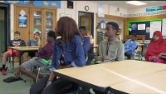
Mathematics Example: Interpretation Strategies
Notes:
https://youtu.be/37CTCDTesWA
Introduce the content on the slide by providing the following information.
This video is about 3 minutes long. The purpose of the video is to think about the way evidence is interpreted. This specific video features a teacher using formative assessment strategies to gather evidence from students efficiently and effectively. Although the content of the lesson focuses on percents, this assessment strategy can be utilized for any content at any grade level.
Direct participants to use the Classroom Practice Video Observation Guide to track their observations and reflections on the video. This guide is available at the end of the Facilitator Guide for this module.
If time is a consideration, facilitator may want to preview the video and select a segment of the video to focus on with the group.

Slide 46
Reflection
Moving forward, what strategies will you use to interpret evidence of student learning? In what context(s)?
How does evidence-based interpretation support the culture of formative assessment practice in your classroom?
In what ways will you engage students to interpret their own learning?
Notes:
Facilitate a discussion that allows participants to reflect on their own practices for gathering evidence of student learning.
Facilitators can use the questions on the slide or may wish to include their own questions.

Slide 47
Feedback Survey
Please take a few minutes to complete the feedback survey so we can continue to improve this module. EILA credit is available upon completion of the survey.
https://docs.google.com/forms/d/e/1FAIpQLSfm4IncFTDVHMvp-Pk2TMZq0uagDQLHaNOKGn2Iy8JpC8DDgg/viewform

