Slide 1
Module 5: Interpreting Evidence of Student Learning
Science
Kentucky Department of Education

Slide 2
Learning Goals (1)
Participants will understand:
The role of evidence of student learning in monitoring and supporting student progress toward Learning Goals and Success Criteria
Strategies to engage students in interpreting their own progress toward Learning Goals and Success Criteria
Notes:
Introduce the content on the slide by providing the following information.
Module 5 in this series focuses on interpreting evidence of student learning.
In all the modules in this series, we have emphasized that understanding where we, as learners, are heading and how we will know if we are successful is essential for teaching and learning and is a key aspect of quality assessment practices.
Share the Learning Goals on the slide.

Slide 3
Learning Goals (2)
Participants will understand:
Strategies to interpret evidence of student learning to inform teaching and learning within specific disciplines
Notes:
Introduce the content on the slide by providing the following information.
Module 5 in this series focuses on interpreting evidence of student learning.
In all the modules in this series, we have emphasized that understanding where we, as learners, are heading and how we will know if we are successful is essential for teaching and learning and is a key aspect of quality assessment practices.
Share the Learning Goals on the slide.

Slide 4
Success Criteria
Participants will be able to
Plan to interpret evidence of student learning throughout a lesson
Develop specific strategies to engage students in interpreting their own progress toward Learning Goals and Success Criteria
Notes:
Introduce the content on the slide by providing the following information.
At the end of this learning sequence (including this module and the teacher collaboration activity), you should be able to:
Plan to interpret evidence of student learning throughout a lesson
Develop specific strategies to engage students in interpreting their own progress toward Learning Goals and Success Criteria
Facilitators may want to note that the terms classroom and classroom setting are used throughout this presentation and can refer to both physical classrooms and distance learning environments. Additionally, the term lesson is used to refer to a coherent set of learning opportunities focused on the same content and goals. It may refer to the learning plan for a single class period or could reflect a learning plan that covers several days.

Slide 5
Review: Formative Assessment Process
Notes:
This first section of the presentation focuses on formative assessment and some key concepts presented in Modules 1-4.
Facilitators should determine if participants need these reminders, particularly if they just recently engaged in previous modules.

Slide 6
Formative Assessment:
A Definition
Formative assessment is a planned, ongoing process used by all students and teachers during learning and teaching to elicit and use evidence of student learning to improve student understanding of intended disciplinary learning outcomes and support students to become self-directed learners.
(CCSSO, 2018)
Notes:
This definition of formative assessment comes from the Council of Chief State School Officers (CCSSO).
If participants engaged in Modules 2, 3 and 4, facilitators may want to acknowledge that they have seen this definition in that module.
Ask participants to read and reflect on this definition.
Next, facilitate a brief discussion in which participants consider this definition in the context of the role that interpretation of evidence of student learning plays in the formative assessment process.
Consider using some of the following questions to support the discussion. ​
What words or phrases in this definition address interpreting evidence of student learning in the formative assessment process?​
What does this definition, taken as a whole, tell you about interpreting evidence of student learning in the formative assessment process?​
​
Some key things to notice might be:​
The definition emphasizes that formative assessment is planned and ongoing; it isn’t something that happens primarily by accident or spontaneous inspiration.​
The definition emphasizes that students and teachers both elicit and use evidence of student learning. ​Interpreting evidence is not just for teachers.
The definition prioritizes the use of evidence to improve learning and support students to become self-directed learners. Evidence isn’t elicited for its own sake, instead the right evidence should inform next steps, which means that teachers and students must make sense of evidence to understand where students are in their learning.
​
For more information on this definition, including the reasoning behind it, refer to this document: https://ccsso.org/resource-library/revising-definition-formative-assessment​

Slide 7
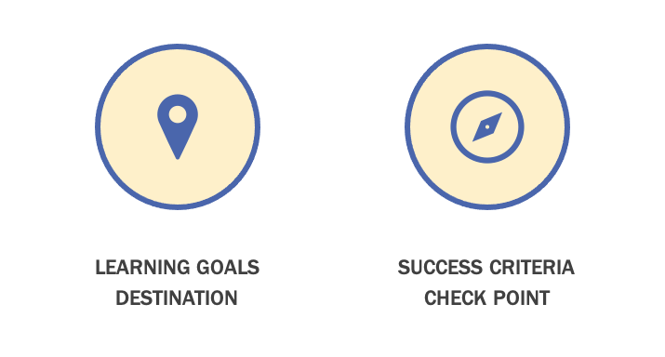
Mapping Student Learning
Notes:
Introduce the content on the slide by providing the following information.
In order to get the most out of this module, participants are encouraged to have gone through the previous assessment modules in the series, specifically Modules 2, 3 and 4.
As we discussed previously, self-directed learners need to understand what they are learning and how to get there. Learning Goals and Success Criteria work in tandem to help students understand where they are going with their learning so that they can actively manage their own learning. If a lesson is a journey that students and teachers take together, Learning Goals represent to students the destination of their journey, signaling clearly what they are learning and why it is important.
Success Criteria demonstrate to students what it looks like to be successful in achieving the Learning Goals. Success Criteria represent the checkpoints along the route, giving students specific information to understand their progress and make adjustments to move their learning forward.
Learning Goals and Success Criteria are essential tools for students to understand where they are in their learning so that they can become self-directed learners.
For more information on Learning Goals and Success Criteria, see Module 3 in this series.

Slide 8
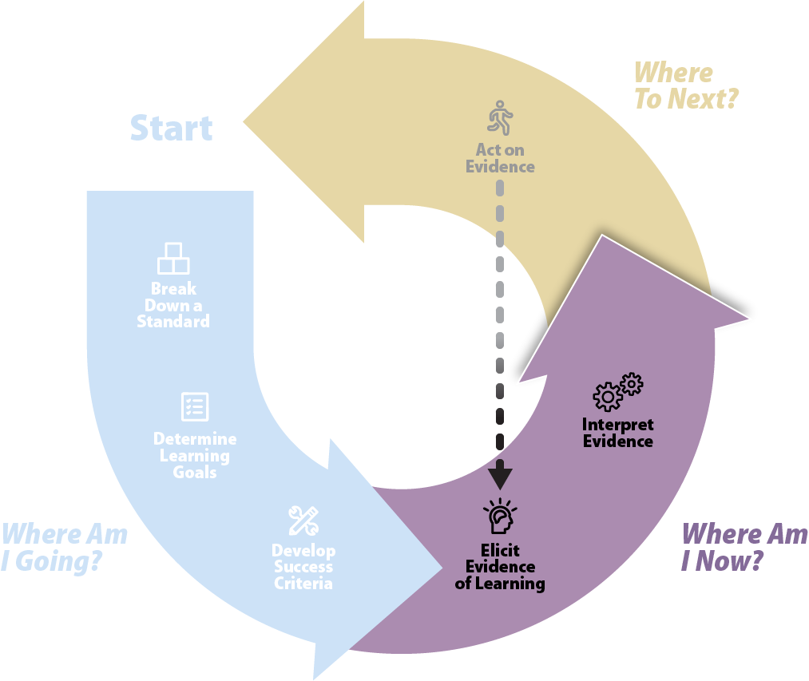
Where am I now?
Adapted from Formative Assessment Insights (WestEd)
Notes:
Introduce the content on the slide by providing the following information.
This graphic represents the formative assessment process. You may remember it from past modules. You’ll notice that this graphic identifies the specific practices that make up the formative assessment cycle and that these practices are grouped to align to the three critical questions.
In this module, Interpreting Evidence of Student Learning, we will focus on the second question, “Where am I now?”
Once a shared answer to the question, “Where am I going?” has been established by clarifying and sharing Learning Goals and Success Criteria, students and teachers need to understand their current status so that they can make decisions to move learning forward.
This starts with eliciting meaningful evidence and then interpreting that evidence in order to inform next steps.

Slide 9




Key Considerations for Evidence of Student Learning
Intentionally design and implement
Make student learning visible
Inform students and teachers about next steps
Integrate into learning
Notes:
Introduce the content on the slide by providing the following information.
As discussed in Module 4, evidence of student learning is central to inform student and teacher decisions about next steps to move students toward their Learning Goals. A critical element of lesson planning is integrating strategies to gather evidence of student learning during the learning, and then having the requisite tools and strategies at your fingertips to interpret the evidence.

Slide 10
Evidence-Based Interpretation
Notes:
Introduce the content on the slide by providing the following information.
Our main focus in this module is on interpreting meaningful evidence elicited from student learning that can support students and teachers to move student learning forward.

Slide 11
What is Evidence-Based Interpretation? (1)
Students and teachers:
Use evidence to guide an ongoing process of teaching and learning
Evidence is:
  observable
  guided by learning in real time
  engaged in by teachers and students
Notes:
Introduce the content on the slide by providing the following information.
Evidence is student learning that can be observed, and it is understood in relation to the specific Learning Goals that students are working toward.
Evidence-based interpretation in the formative assessment process is the ability to use evidence to guide learning while learning is occurring.
Interpreting evidence isn’t something only engaged in by teachers. Interpreting evidence of their own learning is an essential skill for students to become self-directed learners.

Slide 12
What is Evidence-Based Interpretation? (2)
Students and teachers:
Situate evidence in a progression of learning
  Interpret evidence of what students know and can do
  Interpretation of evidence is an ongoing process
Notes:
Introduce the content on the slide by providing the following information.
Interpreting evidence requires students and teachers to pay close attention not simply to the specific artifacts that students produce, but what they tell us about the development of student learning.
The interpretation of evidence is not a single event but is instead part of a continuous and ongoing process engaged in by students and teachers throughout the course of instruction.

Slide 13
What is Evidence-Based Interpretation? (3)
Students and teachers:
Use evidence to identify nuances of learning (not simply right or wrong) to inform next steps
  Deep knowledge and understanding of learning progressions
Notes:
Introduce the content on the slide by providing the following information.
To interpret evidence in ways that can inform next steps in both teaching and learning, teachers need a strong understanding of the disciplinary and cognitive path toward the Learning Goals. Teachers must have clarity on what comes next in learning and clearly communicate that information to students in order to guide students forward in their learning. The Kentucky Academic Standards provide specific information about the vertical alignment of the standards that could be a helpful resource in planning to identify students’ prior content knowledge. In science, the “Connections to other DCIs” (located below the foundational boxes) show connections to related or foundational DCIs at the lower grades within a grade band and the “Articulation of the DCIs across the grade-levels” include the DCIs that may provide foundational information for the PE in lower grades and/or grade bands.
Interpreting evidence of student learning in the formative assessment process requires an understanding that goes beyond “got it” or “didn’t get it” and provides a more nuanced understanding of students’ learning in order to support decisions about next steps in learning. For example, there is a difference between understanding where a student is in their learning progression, and whether an assignment has been completed or not. Noting that an assignment is complete or incomplete does not provide any actionable evidence that can be used to move learning forward. Another nuance occurs when students use their own language that may be void of usual or expected scientific vocabulary to express valid scientific ideas. The ideas expressed, rather than the language used, provide evidence of the student’s mastery of a concept and/or ability to make connections.
Next, facilitate a discussion in which participants identify different aspects of student learning they often focus on throughout their lessons.
Facilitators can consider using some of the following questions:
To what extent are students involved making sense of their own learning progress?
In your class, how do students understand where to go next in their learning?

Slide 14
Engaging Students with Evidence of Learning
Notes:
Introduce the content on the slide by providing the following information.
In this section, we will discuss how to support students to engage with evidence of their own learning.
NOTE: It is important to ensure that Success Criteria are aligned to Learning Goals and Learning Goals are aligned to the learning progressions for the standards. For more information on how to ensure alignments, please review Module 3: Clarifying and Sharing Learning Goals and Success Criteria presented previously as part of this professional learning sequence.

Slide 15

Student Engagement with Evidence of Learning
Recognize their own expression and work as evidence of their own learning
Embrace opportunities to make their learning public
Engage with their own ideas and those of their peers in the context of Learning Goals and Success Criteria
Notes:
Introduce the content on the slide by providing the following information.
When students are engaged in interpreting the evidence of learning they produce, they can develop the skills of meta-cognition–thinking about their thinking–and self-regulation. Self-regulated learners monitor their learning, compare it to specific criteria (e.g., Learning Goals and Success Criteria) and then make adaptations to their learning strategies as they see fit.
Student engagement is key to the interpreting of evidence and allows teachers and students to meaningfully engage in the formative assessment process. Student engagement means that students can make the connection between the behaviors they exhibit in class and evidence of their learning, ultimately supporting them to move their learning forward.
Next, facilitate a discussion about student engagement.
Facilitators may want to use some of the following questions to support the discussion:
How can I help students recognize that the things they do and say are evidence of their learning?
How can I support students in making their ideas visible and public?

Slide 16
Classroom Culture and Evidence
How can classroom culture support students to use evidence of their own learning?
Make meaning
Manage learning
Participate and collaborate
Notes:
Introduce the content on the slide by providing the following information.
Students can become the kind of self-directed, engaged learners who can recognize evidence of their own learning, embrace opportunities to make their learning public and engage with evidence of their own learning (as described on the previous slide) when the classroom culture empowers them to engage fully in their learning in order to participate in the formative assessment process.
As described on Module 2, the Fundamentals of Learning is a framework that presents three fundamental aspects of learning. When students have ownership of their own learning, they can:
Make meaning for themselves by thinking critically and creatively, connecting to prior knowledge and using language and symbols
Manage their own learning by taking responsibility for learning, adapting learning tactics and persevering through challenges
Participate and collaborate by engaging with others and communicating and connecting with others about ideas, feelings and perspectives
Next, facilitate a discussion that helps participants relate the concepts of culture and climate to their own classrooms.
Consider using some of the following questions to support the discussion. Wherever possible, reflect back on previous conversations and try to make connections.
What does your current classroom culture signal to students about evidence of their own learning?
How does your classroom culture support the Fundamentals of Learning?
What adult mindset changes may be needed to build a classroom culture and climate that supports the formative assessment process?

Slide 17
Self- and Peer-Assessment
Students and teachers must share common understanding of what they are working toward
Self- and peer-assessment is explicitly taught and modeled by teacher
Students need opportunities to practice engaging with evidence of their own learning and the learning of their peers
Students need explicit tools and strategies to support engaging with evidence of learning
Notes:
Introduce the content on the slide by providing the following information.
The purpose of self- and peer-assessment is to help students manage their own learning. Students who manage their own learning can set goals, make plans, monitor their progress and adapt their approaches to learning. Essential to this process is being able to view their own work and ideas and the work of their peers critically and use it to make decisions about how to proceed in their learning.
If students and teachers do not have a shared understanding of the learning they are working toward and a shared sense of what constitutes quality work, students will not be able to appropriately manage their own learning. These expectations are based on the Success Criteria. It is important for students to have a clear understanding of the teacher’s expectations in order to self-assess and to provide meaningful feedback to peers.
This slide lists some important ways that teachers must support students to engage in meaningful peer- and self-assessment. The next several slides will explore the ways that each of these strategies are important for building a classroom culture that supports full student engagement in the formative assessment process by empowering them to make sense of evidence of their own learning and the learning of their peers.

Slide 18
Common View of Success
Share and clarify Learning Goals and Success Criteria
Be transparent about how understanding will be evaluated
Provide examples and non-examples
Demonstrate a variety of approaches
Notes:
Introduce the content on the slide by providing the following information.
To build a common view of success, teachers can help students internalize expectations in a variety of ways.
Learning Goals and Success Criteria: Key to this common view are the sharing and clarification of Learning Goals and Success Criteria. If students are to use them to guide their understanding of their own progress, students need more than just seeing the Learning Goals and Success Criteria on the board.
Transparent evaluation criteria: Students need to understand how their learning will be evaluated and what criteria will be used to determine where students are in their understanding.
Examples and non-examples: Providing students with examples that can illustrate what success might look like can strengthen student understanding of what they are working toward. Examples can be used in compliment with non-examples that illustrate common misconceptions students may make, perhaps with guidance about how to improve the non-example. In the science content area, an example could be a student-developed model/diagram to show a cause-and-effect relationship or the flow of energy in an ecosystem, earth/space system or a physical system (e.g., use of labeling, arrows showing connections or graphic organizers).
Variety of approaches: Teachers can also provide students with examples of multiple approaches that can lead to success. This provides students with diverse learning needs, different learning styles, and different background knowledge with the ability to obtain success and take ownership of their learning. For example, science teachers could provide examples of different ways students approached a plan to investigate a scientific question or a solution to a design problem. Student choice can be exercised in their approach to solving the design problem or planning the investigation.
Next, facilitate a discussion in which participants consider ways in which they build a common view of success in their classrooms.
Facilitators can consider using some of the following questions to support the discussion:
How do you currently help students build an understanding of success that matches your own?
Do you feel that your students understanding of quality is in line with your own?

Slide 19
Teaching and Modeling
Making intended learning visible
Explicit teaching and modeling of self-assessment
Explicit teaching and modeling of peer-assessment
Notes:
Introduce the content on the slide by providing the following information.
Nearly everything a teacher does during a lesson can be seen as modeling, but deliberate, purposeful modeling is a powerful instructional strategy. Teaching and modeling self- and peer-assessment are no different. The examples on this and next few slides are meant to be general. We will look at some specific examples later in this presentation.
Making intended learning visible: Teachers can help students develop their peer- and self-assessment skills by modeling what it looks like to make evidence of student learning visible. By sharing their own work and process, teachers demonstrate what it looks like for students to view their own ideas and work as evidence and use that evidence to make decisions. In science, this could look like verbalizing observations about an explanation of a phenomenon (e.g., I notice that there are two types of evidence here to support this explanation, but I’m not sure if I have accurately analyzed the data for one of those. The scientific reasoning that connects the evidence to the explanation is strong in the first part of the explanation.)
Teaching and modeling self-assessment: Teachers can help students learn to make sense of their own learning by providing explicit instruction and modeling to demonstrate looking at evidence of their own learning in the context of the Learning Goals and Success Criteria. In science, this could look like sharing a draft of a teacher’s investigation plan and reviewing with the Success Criteria in mind (e.g., “We are working on planning investigations that are fair tests. But I’m not sure my plan is a fair test. I only described one variable that I wanted to keep the same every time. Is keeping only that variable the same enough to be sure it’s a fair test? I could include a step that says to do everything three times so there will be more than one trial. I wasn’t very specific about the data I need to record. I could add a step to describe the data and how it should be measured.”)
Teaching and modeling peer-assessment: In the same way that teachers can make self-assessment explicit, they can support students in understanding where their peers are in their learning by thinking about evidence of their peers’ learning in the context of the Learning Goals and Success Criteria. This requires helping students understand they have a responsibility to notice their peers’ learning and to respond in ways that support progress toward the Learning Goals. In science, this could look like showing students what it looks like to listen to a scientific argument and respectfully disagree or ask for clarification (e.g., “I understand your argument, but have you considered…,” or “Could you rephrase your point about…,” or “Can you tell me how your evidence supports the claim that…”). It could also take the form of a checklist or template to provide scaffolding for the students during peer assessment.
Next, facilitate a discussion in which participants consider ways in which modeling can support peer- and self-assessment.
Facilitators can consider using some of the following questions to support the discussion:
How do you use modeling in your classroom to support students to understand where they are in their own learning?
What strategies have you used to teach your students to assess their own work and that of their peers?
What challenges have you experienced in modeling self- and peer-assessment skills?

Slide 20
Practice
Classroom culture
Low stakes, learning focused
Repeated opportunities
Feedback on self- and peer-assessment
Notes:
Introduce the content on the slide by providing the following information.
Students need the time and space to practice engaging with evidence of their own learning and the learning of their peers. In order to get better at applying Success Criteria to their own work and the work of their peers, students need opportunities to practice in an environment that makes it safe for them to manage their own learning and support the learning of their peers.
Classroom culture: As discussed on a previous slide and in detail in Module 2, students can engage in the formative assessment process when they are learning in contexts that supports them to do so. To practice and improve at self- and peer-assessment, students need a culture that supports them to make meaning for themselves, manage their own learning and participate and contribute in a collaborative environment. Students need space to make errors and recognize mistakes as learning opportunities.
Low-stakes: Students can practice and get better at meaningful self- and peer-assessment when they understand assessment as an opportunity to understand where they are in their learning in order to make decisions about how to improve, as opposed to a way to determine if they are right or wrong, if they get a good grade or a bad grade. In science, this could mean allowing students to practice reviewing their work using rubrics and their included work samples that focus attention on a progression of key criteria related to the task, not on assigning a point value or determining if it is right or wrong.
Opportunities: Just like with other skills your students are learning, students need many opportunities to practice the skills related to peer- and self-assessment and they need to progress from scaffolded peer- and self-assessment to being able to apply Success Criteria to evidence of learning independently.
Feedback: Repeated practice needs to be coupled with specific feedback about how students are doing at self- and peer-assessment. Students need a chance to hear their teachers’ perspective on what they are doing well and how they can sharpen their self- and peer-assessment skills and become more independent. They also need to discuss their own reflections on the process.
Next, facilitate a discussion in which participants discuss ways their students can practice peer- and self-assessment.
Facilitators can consider using some of the following questions to support the discussion:
How can you ensure that students understand formative assessment in terms of an opportunity to learn?
What are some ways that your students practice self- and peer-assessment?
What are your students’ strengths and weaknesses at self- and peer-assessment?

Slide 21
Tools and Strategies
Templates
Self- and peer-correction checklists and look-fors
Sentence starters
Examples of student work/writing
Background knowledge anchor charts
Graphic organizers for the intended learning sequence
Question prompts
Explicit comprehension strategies
Notes:
Introduce the content on the slide by providing the following information.
In addition to teaching, modeling and opportunities to practice, teachers can provide a variety of strategies and tools that students can use to build student responsibility, ownership and skills at managing their own learning through self- and peer-assessment.
While by no means comprehensive, this slide lists some examples of tools and strategies that can support students to make sense of evidence of their learning and that of their peers to gain an understanding of their current learning status and inform next steps. Walk through the examples on the slide, elaborating as necessary.
For example, facilitators may want to elaborate on how to use question prompts to support student self- and peer-evaluation by offering questions related to the Success Criteria that help students gauge their own understandings. The questions should be purposeful, and their purpose should be conveyed to students along with encouragement for them to answer candidly. With young children, this activity can be simplified to drawing a face or choosing a picture that communicates how they feel about what they know and can do in relation to the Success Criteria.
Next, facilitate a discussion in which participants share ideas about tools and strategies that can support peer- and self-assessment.
Facilitators can consider using some of the following questions to support the discussion:
What strategies and tools have you used to support students to assess their own learning and the learning of their peers?
What tools and strategies have been most successful?
How have you supported your students to transition from scaffolded to more independent analysis of their own learning?

Slide 22
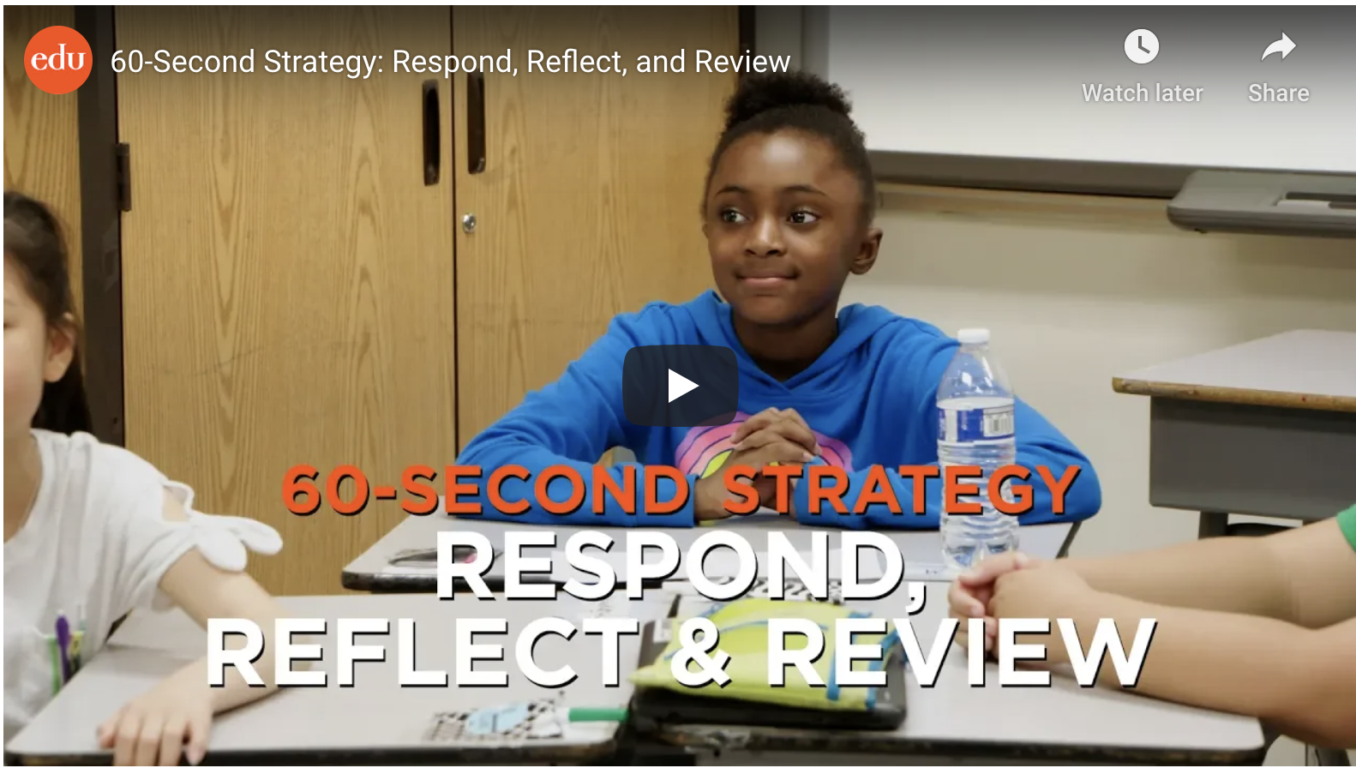
Culture of Peer- and Self-Assessment in Action
https://www.edutopia.org/video/60-second-strategy-respond-reflect-and-review
Notes:
https://www.edutopia.org/video/60-second-strategy-respond-reflect-and-review
Here is a quick video showcasing peer- and self-assessment.
Next, facilitate a discussion utilizing the following questions:
What are some examples of peer- and self-assessment you noticed?
What can you infer about the teacher’s classroom climate that would allow for this peer- and self-assessment?

Slide 23
Strategies for Interpreting Evidence of Student Thinking in Science
Notes:
Introduce the content on the slide by providing the following information.
In this section, we will discuss strategies for teachers to interpret evidence of student thinking to inform their instruction.

Slide 24
Analyzing Evidence
  Progress of individual students toward Learning Goals and Success Criteria
  Disciplinary misconceptions, confusions and challenges
  Patterns and trends
  Reflection on teaching practice
Notes:
Introduce the content on the slide by providing the following information.
When teachers interpret evidence of student learning, they are focusing both on the progress of individual students as well as groups of students and where the class is, as a whole, in terms of their learning progression. As teachers look at evidence of student learning, they are looking for gaps between where students are in their learning and where they are headed. But merely identifying a gap is not enough to support effective pedagogical action. Teachers need to understand why there is a gap in order to support students to move forward in their learning.
Teachers can interpret evidence considering specific disciplinary misconceptions or issues that may constrain students from reaching their Learning Goals. Teachers can draw on their content knowledge as well as their understanding of how students learn disciplinary ideas and skills to anticipate these kinds of issues and support pedagogical responses during teaching and learning. For example, in science, exploring a phenomenon that cannot be explained using the misconception might help some students reason through the misconception OR having small groups construct concept maps showing connections and interrelationships can produce evidence that allows students to see and discuss differences between their own thinking and the thinking of their peers.
Additionally, teachers can look for patterns that show common errors, misconceptions or issues among groups of students. For example, a science teacher might notice from student work (e.g., models or explanations) that students' models of substances at the particle level do not include empty space, that objects sink because they have less mass, that plants obtain food energy by absorbing soil through their roots, or that probes can be sent to the center of Earth or the galaxy.
This analysis supports providing direct support and actionable feedback to both individual students or groups of students, depending upon the activity. In addition to the student-facing piece, this analysis should also prompt reflection on and continuous improvement of the teacher’s practice. For example, a science teacher may notice a consistent misconception that plants obtain food energy from soil to grow, a teacher may show time-lapse video of a plant growing in a container of water (no soil) on a sunny windowsill and may reflect on this evidence and decide in future teaching of this content to bring in an analogous phenomenon (e.g., another real-world example) that can be used as evidence to counter the student-held errors, misconceptions or issues that were identified.
Next, facilitate a discussion about analyzing evidence.
Facilitators may want to use some of the following questions to support the discussion:
What do you look for when you analyze evidence of student learning?
How do you interpret evidence of student learning during instruction as well as in between instruction?
What are common misconceptions and patterns that you look for in your students’ work and ideas?
How do you use evidence of student learning to help you reflect on and improve your practice?

Slide 25
Evaluating the Quality of Your Evidence
Factors that impact the value of evidence of learning:
Prior student knowledge
Student language barriers
Technological challenges
Questioning method
Notes:
Introduce the content on the slide by providing the following information.
Even when evidence gathering opportunities are carefully constructed and are aligned to Learning Goals and Success Criteria, the evidence elicited can still be clouded by other factors.
An important step in making meaning of student evidence is evaluating the quality of the evidence in the context of the Learning Goals and Success Criteria. This sometimes means filtering extraneous information that doesn’t provide insight into students’ current learning status relative to the Learning Goals and Success Criteria and focusing tightly on the intended learning.
However, evaluating the quality of evidence can also mean considering possible factors that may be limiting your students’ capacity to demonstrate what they know and can do relative to the Learning Goals and Success Criteria. This slide presents several examples of factors that may impact the quality of the evidence of student learning to inform good decisions about student learning.
For example, if students are asked to work independently on a physics problem about Newton’s laws that requires them to have a working knowledge of a particular sport or the terminology specific to that sport, the evidence of learning may not be representative of the student’s science knowledge if the student does not have the appropriate prior knowledge structures to engage in the problem. Complex scientific terminology and idiomatic usage of scientific terms, such as the common usages of terms like “energy” or “work,” may also be language barriers for students that prevent them from producing evidence that reflects their understanding of the science.
As teachers work to identify any issues clouding evidence, it's an opportunity to go back and elicit evidence in a different way to ensure that teachers understand what students know and can do. The formative assessment process is predicated on meaningful evidence of student learning and teachers must be aware of the other filters that may impact a student’s ability to demonstrate their knowledge as it relates to the evidence elicited to demonstrate specific Learning Goals and Success Criteria.
Next, facilitate a discussion about potential barriers to analyzing evidence.
Can you think of a lesson where you were sidetracked in your feedback because you were focused on student evidence that wasn’t aligned to the Learning Goals and Success Criteria?
Are there areas that often get in the way of your own students demonstrating what they know and can do?
How do you identify what factors influenced evidence of student learning for your students?
What are some strategies you can use to remove your own filters and focus on analysis of evidence aligned to Learning Goals and Success Criteria?
The quality of a task is directly related to the quality of the evidence gathered. If a task is poorly aligned, the data gathered may not provide evidence of the intended learning goals or success criteria.
For more professional learning on how to analyze the learning goals and success criteria of existing tasks (Session A), or how to develop quality learning goals, success criteria, and tasks (Session B), please visit the modules at this resource: https://kystandards.org/standards-resources/science-resources/sci-pl-mods/

Slide 26
Anticipating Student Understanding (1)
Support in-process feedback and questioning
Based on:
  Disciplinary knowledge
  Familiarity with disciplinary progression of learning
  Understanding of students as learners
  Specifics of lesson
Notes:
Introduce the content on the slide by providing the following information.
By anticipating the understanding of knowledge and concepts that students bring when embarking on new Learning Goals, teachers position themselves to respond with in-process feedback that can quickly move students in the right direction. Anticipating possible student responses is a set of skills that teachers hone over time as they develop their deep knowledge of the discipline and understanding of how students progress through their disciplinary learning. They also rely on contextual factors including the profile of their individual students as learners and the specific way that learning is structured in the lesson.
Teachers prepare for a lesson by reflecting on common pre-conceptions, misconceptions and challenges or confusions that might arise for the students in the class. By thinking about when these issues are likely to arise in the lesson, teachers can plan to use strategies that will support students to clarify and advance their learning. Planning to use these strategies allows teachers to be ready to quickly take appropriate pedagogical action for many of their learners. Key to anticipating student responses to interpret in-process evidence is responding to what the students present in the evidence of their learning, not what they do not do. Interpreting evidence to inform the formative assessment process is about more than just catching what students may not get right but understanding where they are in their thinking and why.
In the next several slides, we will consider some examples of what it could look like to anticipate student understanding when planning a lesson.

Slide 27
Anticipating Student Understanding (2)
In the next several slides, we will consider some examples of what it could look like to anticipate student understanding when planning a lesson.

Slide 28
Investigating a Phenomenon
Phenomenon: Some types of fabric can be used for raincoats and other types of fabric cannot.
PEs: 2-PS1-1 and 2-PS1-2
DCI: PS1.A Different properties are suited to different purposes.
Notes:
This section is focused on gathering evidence of learning as students explore the phenomenon that some types of fabric can be used for raincoats and other types of fabric cannot.
This phenomenon is aligned to two Performance Expectations (PEs) in a bundle. The main focus of the Disciplinary Core Idea (DCI) is on the concept that different properties are suited to different purposes. Students will use a range of Science and Engineering Practices (SEPs) and Crosscutting Concepts (CCCs) (not just those identified in the PE bundle) that are necessary and appropriate to help make sense of the phenomenon.

Slide 29
Anticipating Student Responses in Science
Standard
2-PS1-1: Plan and conduct an investigation to describe and classify different kinds of materials by their observable properties.
Learning Goal | Success Criteria
Today we are learning to use the properties of materials in order to place them into different groups. | I can identify the properties of the materials I see. I can name the patterns I see in the properties of the materials. I can sort different materials into categories based upon the patterns of their properties.
Start of Lesson | Middle of Lesson | End of Lesson
Evidence Gathering Strategy: Activating Prior Knowledge | Evidence Gathering Strategy: Questioning | Evidence Gathering Strategy: Peer- and Self-Assessment
In pairs, students identify a pattern in a small set of materials. | As a class, students brainstorm strategies they could use in the properties of materials to find patterns. | Students sort new materials into groups and explain the patterns they used to a peer group.
29
Notes:
Introduce the content on the slide by providing the following information.
We introduced this Learning Goal and Success Criteria in Module 3 and in Module 4, we added some ideas about strategies to gather evidence of student learning at key points in the lesson. This lesson is intended to come early in the exploration of the phenomenon that “some types of fabric can be used for raincoats and other types of fabric cannot.”
Note that the Learning Goal and Success Criteria on the slide would be appropriate for a lesson targeting 2-PS1-1. The Learning Goal includes both the SEP of Analyzing and Interpreting Data and the CCC of Patterns. The Learning Goal and Success Criteria are appropriate for a student who is in the beginning stages of exploring the phenomenon.
In the next few slides, we will consider ways to couple planned evidence gathering strategies with anticipated student responses in order to facilitate in-process feedback during teaching and learning of the lesson.
Ask participants to take a moment to review the Learning Goal, Success Criteria, and evidence gathering strategies and to reflect to themselves about what they might be looking for as students engage in evidence gathering opportunities throughout the lesson.

Slide 30
Example: Start of Lesson
Evidence Gathering Strategy:
Activating Prior Knowledge
In pairs, students make observations of a small set of materials to identify and name their properties.
Possible Student Understanding Issues
Able to identify only one property among multiple possibilities
Struggles to name properties
Only materials that are rigid are identified as solids
Notes:
Introduce the content on the slide by providing the following information.
Activating prior knowledge at the beginning of a lesson can help to identify students’ depths of knowledge and elements that may be missing in students’ skill or understanding of the properties of materials, elicit misconceptions about materials and their properties, and clarify where to begin the lesson. It can also help students make connections between what they know and what they are learning and engage them in thinking about the Learning Goal. (Adapted from Five Evidence Gathering Routines, Formative Assessment Insights)
This is not a comprehensive list, but at this early stage in exploring the phenomenon, the teacher may be looking for students who are unable to identify more than one property of the materials presented or who are able to identify only the simplest properties (e.g., color, shape). Either of these may constrain a student from making the observations and measurements that could allow them to extend their ability to investigate. While teachers may notice students not using discipline-specific terminology, this is not important for this beginning lesson. The focus is students demonstrating their understanding of materials having different properties and, as such, students may utilize non-scientific words as they develop understanding of scientific terminology.
Next, facilitate a discussion in which participants consider student responses they may anticipate:
Consider using some of the following questions:
What other student responses might you anticipate in a lesson like this?
What questions or feedback might you give a student who responds in the ways identified here?
What challenges or confusions do you look for at the beginning of lessons that might be different than later in a lesson?
What kinds of confusion or challenges to student learning do you look for when students engage in disciplinary discourse?
How does anticipating student responses support you to take pedagogical action?

Slide 31
Example: Middle of Lesson
Evidence Gathering Strategy:
Questioning
As a class, students brainstorm strategies they could use to find patterns in the properties of materials.
Possible Student Understanding Issues
Confusion about ways of describing the amount of substance
Struggles with strategies involving quantitative measurements (e.g., using a ruler to measure length)
Notes:
Introduce the content on the slide by providing the following information.
Eliciting evidence through questioning allows the teacher to elicit and explore student thinking. This strategy can also reinforce a classroom culture that encourages learning and risk taking and supports students in their learning. In preparation for using this strategy, teachers should plan some of their questions in advance and then be ready to follow up based on student responses, thus encouraging a conversation. Teachers should keep in mind the research on effective questioning such as wait time, questions that encourage higher-level thinking, and pre-thinking strategies appropriate for the grade-level such as pair/share. (Adapted from Five Evidence Gathering Routines, Formative Assessment Insights)
While this list is not comprehensive, the teacher may be looking for students struggling to describe measurements and observations that they could use to determine properties.
Next, facilitate a discussion in which participants consider student responses they may anticipate:
Consider using some of the following questions:
What student responses might you anticipate in a lesson like this?
What questions might you ask to build on student thinking or to help them make connections with prior learning?
What questions might you ask to probe students’ ideas or challenge their thinking?
What questions might you ask to elicit different thinking on patterns in properties of materials?

Slide 32
Example: End of Lesson
Evidence Gathering Strategy:
Peer and Self-Assessment
Students sort new materials into groups and explain the patterns in properties they used to a peer group.
Possible Student Understanding Issues
Patterns limited to only easily observable properties rather than including less obvious patterns in properties
May leave some materials out of the groups
Notes:
Introduce the content on the slide by providing the following information.
As students approach the end of this lesson, students engage in peer- and self-assessment, by asking students to explain the observations and patterns they used to sort the materials to their peers and to assess those of their peers. Teachers can support students to think critically about the patterns they identified and extend their thinking to consider other possible patterns.
While this list is not comprehensive and participants may have ideas for better responses to anticipate, teachers could look for students struggling to make the measurements and observations that can be used make comparisons, struggling to find patterns in their observations or being unable to describe the patterns they used.
Next, facilitate a discussion in which participants consider student responses they may anticipate:
Consider using some of the following questions:
What student responses might you anticipate in a lesson like this?
How do you support students to assess their own use of observations to classify and sort materials?
How do you support students to respond to each other’s ideas about patterns used to sort materials?
What kind of questions or feedback might you offer to students struggling with any of these issues?

Slide 33
Strategies for Interpreting Evidence
Interpretation strategies and tools should be aligned to:
  Learning Goals and Success Criteria
  Type of evidence needed
  User (teacher or student)
Notes:
Introduce the content on the slide by providing the following information.
In addition to anticipating common student responses, teachers can employ a variety of strategies to support them to interpret evidence of student learning in ways that facilitate effective pedagogical response during the learning. Interpretation strategies should not exist in a vacuum but should be anchored and aligned to both the stated Learning Goals and Success Criteria, as well as to the type of evidence needed to demonstrate student mastery. Additionally, strategies should reflect how they will be used. Teachers need different tools and strategies to analyze and respond to student learning than students do to make sense of their own learning and the learning of their peers.
While much of this interpretation happens “on the fly,” educators must anticipate student thinking as part of their planning process.
What questions might unlock student thinking?
What whole-class discussion might need to happen and with what focus?
Are examples and artifacts of student work needed?

Slide 34
Example: Teacher-Facing Strategy
Student | Names more than one property | Finds more than one pattern | Includes all of the materials when sorting by properties | Notes
Amir | Yes | Yes | Yes | -
Bo | Yes | Yes | No | Left out three materials
Chris | No | Yes | Yes | Only names color
Sofia | Yes | No | Yes | Only found a pattern of shape
Mateo | Yes | Yes | Yes | -
Notes:
Introduce the content on the slide by providing the following information.
Teacher-facing strategies and supporting tools can help a teacher focus their attention on key learning in a lesson and track their observations and next steps.
A strategy that teachers could use to track student progress can be as simple as a checklist on a clipboard or iPad.
In this example, the teacher is circulating among students as they explain how they sorted the set of new materials. While overhearing conversations and through direct questioning, the teacher can note students who are able to both name and find patterns and then use patterns to sort the complete set of new materials. They are also then able to keep track of who is getting stuck at a specific point and work directly with students on the concepts they may be struggling with.

Slide 35



Example: Student-Facing Strategy
I can… | I can do it. | I need a little help. | I need more help.
Name properties of materials | - | - | -
Observe and measure properties of materials | - | - | -
Sort materials into groups based on their properties | - | - | -
Notes:
Introduce the content on the slide by providing the following information.
Students can be supported to engage in self- and peer-assessment with specific tools that help structure and provide language for them to make sense of their learning and the learning of their peers. The teacher can have a set of questions related to the Success Criteria that help students gauge their own understandings. The questions should be purposeful, and their purpose should be conveyed to students along with encouragement for them to answer honestly. With young children, this activity can be simplified to drawing a face that communicates how they feel about what they know and can do in relation to the Success Criteria.
In this example, the teacher is circulating among students as they explain how they sorted the set of new materials. While overhearing conversations and through direct questioning, the teacher can note students who are able to both name and find patterns and then use patterns to sort the complete set of new materials. They are also then able to keep track of who is getting stuck at a specific point and work directly with students on the concepts they may be struggling with.
This is an example of a student-facing tool that could support students to effectively engage in this activity in ways that help them move their learning forward. Each student could work with their peers to answer the questions about their own work. This is an example of a more scaffolded strategy to support students’ emerging skills at peer- and self-assessment. The goal of tools like these is not just to manage the specific activity, but to help students develop skills that will allow them to independently assess and manage their own learning.

Slide 36
Interpreting Evidence in Action

Slide 37
Science Example: Interpretation Strategies
Formative Assessment in 7th Grade Science
https://www.ket.org/program/senate-bill-1-modules/formative-assessment-in-7th-grade-science/
Notes:
Introduce the content on the slide by providing the following information.
Important note to facilitators: The purpose of the video is to have participants think about the way that a teacher can interpret student evidence. The lesson in this video was developed prior to the release of the current KAS science standards (see the KAS Science standards document for more information: https://education.ky.gov/curriculum/standards/kyacadstand/Documents/Kentucky_Academic_Standards_Science.pdf). Therefore, the focus of this video should be on the formative assessment strategies used to gather evidence rather than on the specific evidence gathered as students investigate the layers of Earth.
Direct participants to use the Classroom Practice Video Observation Guide to track their observations and reflections on the video. This guide is available at the end of the Facilitator Guide for this module.
This video is 11 minutes long. If time is a consideration, facilitator may want to preview the video and select a segment of the video to focus on with the group.
Time Stamps
0:48 – Self-assessment: 1-2-3 ranking of prior knowledge
2:20 – Educator explanation: evidence-based interpretation to guide/adjust instruction
2:40 – Self- and peer-assessment: evidence of learning
6:15 – Example: questioning (small group discussion)
6:55 – Class discussion on evidence and inference
9:30 – Evidence-gathering: written response
10:15 – Educator explanation: using evidence from written response to provide feedback and adjust instruction

Slide 38
Reflection
Moving forward, what strategies will you use to interpret evidence of student learning? In what context(s)?
How does evidence-based interpretation support the culture of formative assessment practice in your classroom?
In what ways will you engage students to interpret their own learning?
Notes:
Facilitate a discussion that allows participants to reflect on their own practices for gathering evidence of student learning.
Facilitators can use the questions on the slide or may wish to include their own questions.
For additional examples of Learning Goals and Success Criteria aligned to KAS Science Standards, please refer to the Classroom Embedded Assessment (CEAs) at this link: https://louisville.edu/education/centers/crimsted/cea-examples

Slide 39
Feedback Survey
Please take a few minutes to complete the feedback survey so we can continue to improve this module. EILA credit is available upon completion of the survey.
https://docs.google.com/forms/d/e/1FAIpQLSfm4IncFTDVHMvp-Pk2TMZq0uagDQLHaNOKGn2Iy8JpC8DDgg/viewform

