Slide 2
Why PLCs?
Understanding the importance of PLCs as the vehicle for improving teaching and learning
Webcast
October 3, 2019
Notes:
Jackie
GoSoapbox KAS
Welcome to our 2nd installment of our 7 part series. If you missed the first webcast, you can find it archived at kystandrds.org under resources.

Slide 3
Essential Questions:
Why is a PLC important in improving teaching and learning at all levels?
How can PLCs support teacher clarity around the standards?

Slide 4
KAS 3 Year Implementation Plan Snapshot
Year 1 - Systems/Structures to Support Standards Implementation
2019-2020
Year 2 - Balanced Assessment
2020-2021
Year 3 - Instructional Best Practice
2021-2022
Notes:
Jackie
Keeping in line with our 3 year plan, we are continuing this journey into systems and structures of support for standards implementation. We’ve looked at resources and practiced using an assignment alignment protocol. Now we are in the second phase of this series taking a closer look at the PLC structure and how it is essential in teaching and learning.

Slide 5
Why PLCs?
Two factors that can have the greatest impact on student achievement
Access to a Guaranteed and Viable Curriculum aligned to the standards
Quality of Classroom Instruction
John Hattie, 2009 Robert Marzano, 2003
Visible Learning What Works in Schools
Notes:
Misty

Slide 6
Why PLCs?
Bridges the gap between the intended curriculum and the implemented curriculum
Creates more equitable learning environments for all students
Provides job-embedded professional learning
Notes:
Misty
Can tie back to Opportunity Myth

Slide 7
What is a PLC?
Defined as “an ongoing process in which educators work collaboratively in recurring cycles of collective inquiry and action research to achieve better results for the students they serve.”
Learning by Doing
DuFour et al., 2010
Notes:
Misty
not a program or a meeting

Slide 8
3 Big Ideas of a PLC
Focus on Learning
Based on belief that the fundamental purpose of a school is to ensure all students learn at high levels
Collaborative Culture and Collective Responsibility
Teachers work together interdependently in order to impact their classroom practice in ways that will lead to better results for all students
Results Orientation
Uses evidence of student learning to inform and improve their practice and to respond to individual student needs through intervention and enrichment
Notes:
Jackie
Transition to next slide: With these ideas in mind, we have to understand that just giving teachers time to collaborate is not going to necessarily impact student achievement The goal of helping more students achieve at higher levels can only be accomplished if the team is focused on the right work. To help focus the work, PLCs work together to respond to the four driving questions.

Slide 9
4 Questions of a PLC
What do we expect our students to learn?
How will we know if they’ve learned it?
How will we respond if they don’t learn it?
How will we respond and enrich if they already know it?
Notes:
Jackie
These questions drive the work of a PLC. If a group strays from this focus, it stops being a PLC.

Slide 10
Question 1: What do we want students to know and be able to do?
Learning Outcomes
What do the standards expect of students?
What specific knowledge, skills and dispositions do they need to accomplish this learning?
Notes:
Jackie
These goals of learning include soft skills and dispositions that may be necessary to be successful for not only this learning, but for the next thing, the next grade, for the future. Each of the KAS documents were written by teachers for teachers with components that help build a better understanding of the grade level expectations to help answer this first question of a PLC.

Slide 11
Question 2: How will we know if they’ve learned it?
Assessment
What evidence do we expect to see to determine if students have reached the learning outcomes?
Are we gathering evidence of student learning through team-developed common formative assessments?
Notes:
Jackie
How will we work together to figure this out? Are we using formative assessment to keep a check on each student? Fluency checker, participation, student work analysis, collaboration, common assessments, teacher observation, student self-assessment or reflection

Slide 12
Question 3: How will we respond if they don’t learn it?
Intervention
How do we use the data from common formative assessments to analyze and improve our classroom practice?
Can we identify students that need additional time and support for each learning outcome?
Notes:
Misty
Using data analysis we have to decide action - how will we intervene. Differentiated instruction, additional time, flexible grouping, leveled materials, graphic organizers. How do we know BEFORE a summative assessment?

Slide 13
Question 4: How will we respond & enrich if they already know it?
Enrichment/Gifted
How will we know they’ve already learned it before teaching?
Have we identified possible ways to extend the learning of students that have reached the expected outcomes?
Notes:
Misty
Independent projects, peer tutoring, accelerated reading, different curriculum: doing all of this while also working with students who didn’t learn it.

Slide 14
Virtual Workshop
Mock PLCs: Breaking Down a Standard
October 24
Zoom
4:00 ET https://zoom.us/j/153927926
5:00 ET https://zoom.us/j/212762108
Notes:
Misty

Slide 15
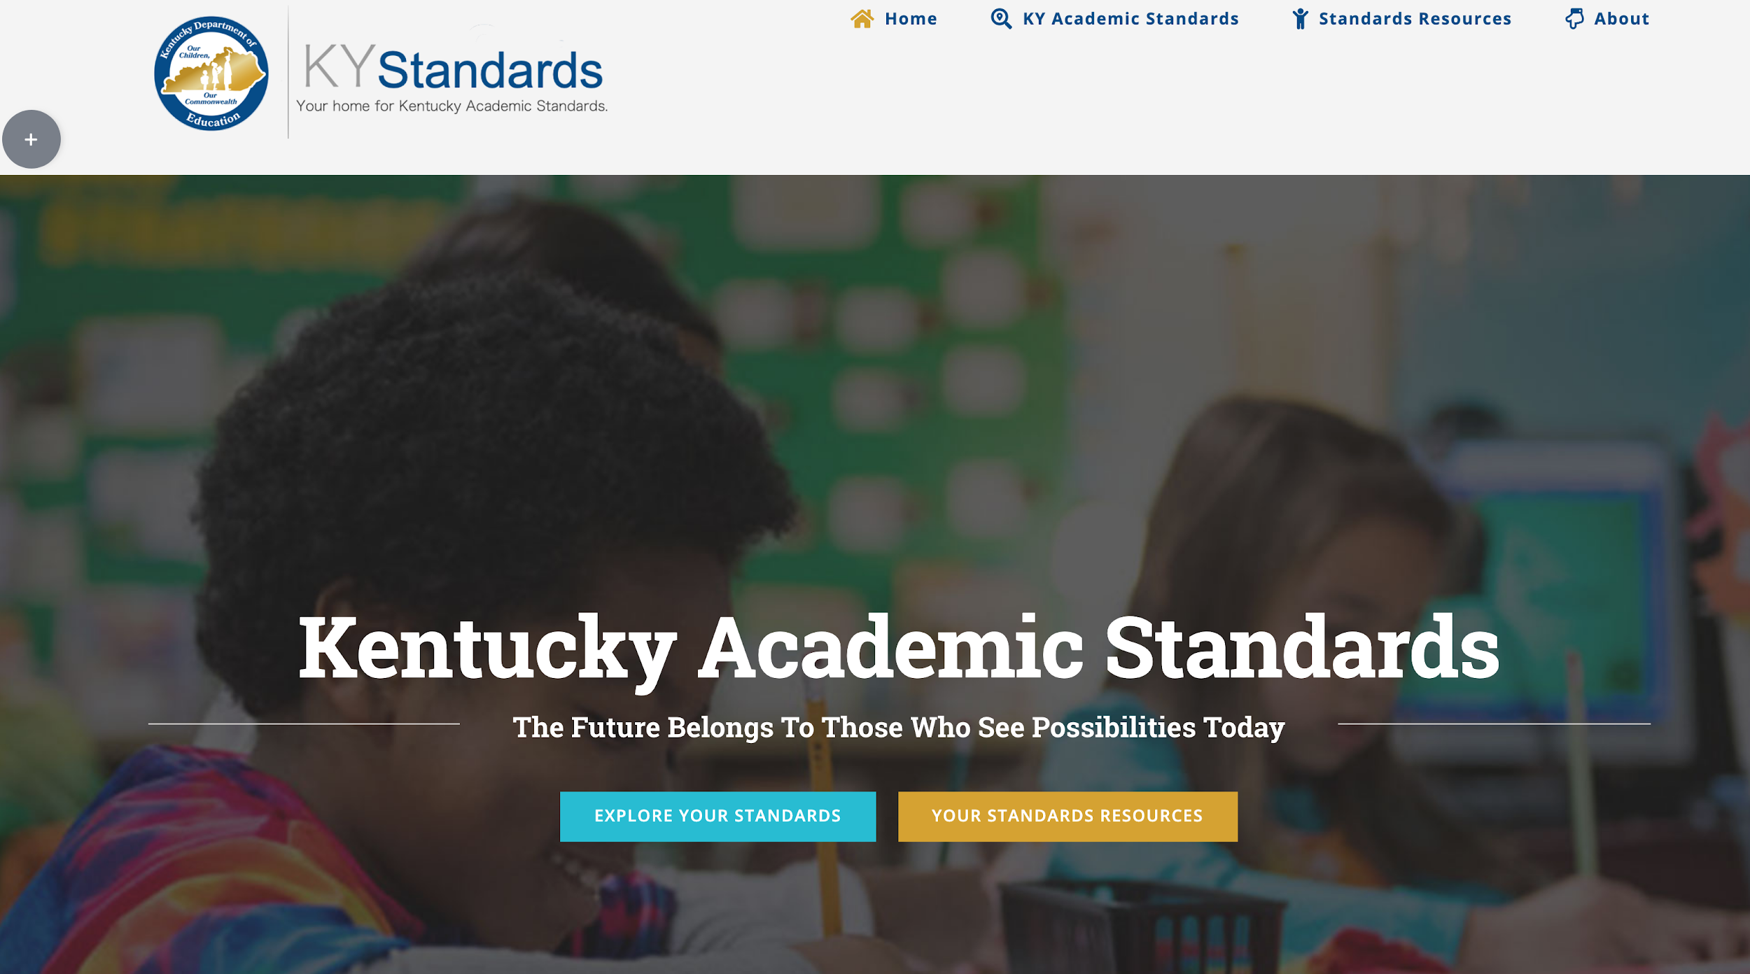
Your Standards Resources
Notes:
Misty
Connect to the last webcast about resources and the website. We want your feedback about the website as well as what other resources you need.

Slide 16
Professional Learning Opportunities
Notes:
Misty
Find info about VW

Slide 17
PL Opps
Notes:
Misty

Slide 18
Mock PLCs – Breaking Down a Standard
Notes:
Misty

Slide 19
KAS Implementation Professional Learning Mini Grant
RFA now out
KDE Competitive Grants page
$10,000 to support PL around standards implementation
52 awards to be given
Technical Assistance: Friday, 10/4
Deadline to submit: 10/28/19
Notes:
Jackie

Slide 20
5 Things to Know Before you Go
Subscribe to www.kystandards.org
Webcasts (1st & 3rd Thursday) Virtual Workshops (4th Thursday)
Book Study
9/16/19 - 12/13/19
Clarity for Learning
Virtual Workshop: Mock PLCs - Breaking Down a Standard
October 24; 4:00 ET & 5:00 ET
Website Feedback: https://www.surveymonkey.com/r/NWTTRCY
Notes:
Jackie

