Slide 2
Kentucky Academic Standards for Reading and Writing
Creating Text Dependent Questions to Support Implementation of the KAS for Reading & Writing
March 19, 2020
Notes:
GoSoapbox KAS
Welcome

Slide 3
Academic Program Consultants
Whitney Hamilton
Kelly Philbeck
Pam Wininger
Questions? Email us:
elateam@education.ky.gov

Slide 4
KAS 3 Year Implementation Plan Snapshot
Year 1 - Systems/Structures to Support Standards Implementation
2019-2020
Year 2 - Balanced Assessment
2020-2021
Year 3 - Instructional Best Practice
2021-2022

Slide 5
Spring 2020
Professional Learning Series
Webcasts
1st & 3rd Thursday
Digital Professional Learning Opportunity
4th Thursday
Topic Study
Building a Culture of Learning: A Focus on PLCs

Slide 6
Content Area Focus
January - Science
February - Social Studies
March - Reading and Writing
April - Mathematics
May - Preview Summer PL Opportunities

Slide 7
Upcoming Reading and Writing Professional Learning Opportunities

Slide 8
TDQ Module
Notes:
As we’ve said, we are in year 1 of the KAS implementation plan, which means we are in the process of sharing resources with you that are available on kystandards.org to support implementation and alignment to the new reading and writing standards. This webcast is going to focus on our Understand Text Dependent Questions module available on ky.standards.org. Everything we’re going to highlight about text dependent questions today is explained in more detail in the TDQ module, so we urge you to take a deeper dive into text dependent questions using the module.

Slide 9
In this session, you will…
learn the process for creating text dependent questions aligned to the KAS for Reading & Writing.
identify text-dependent vs. non-text dependent questions.
understand how text-dependent questions focus students’ efforts on the most important parts of a complex text.
understand how text-dependent questions guide students through the process of creating meaning of a text.

Slide 10
What is a Text Dependent Question (TDQ)?
A TDQ is a question that is ONLY answerable by referring to the text being read.

Slide 11
TDQs and Literacy Connection
Notes:
Now that we know what text dependent questions are, let’s take a look at how TDQs can be used in every lesson to improve student literacy.
As you can see in the graphic, we always want to begin with a complex text and, of course, the KAS for Reading & Writing. While the graphic does not include the KAS, it is important to apply knowledge of the standards from the beginning and throughout the development of TDQs. Using TDQs helps students analyze, synthesize and evaluate in order to build deep understanding of text meaning.

Slide 12
Why use TDQs?
To help students understand complex text
To deepen students’ understanding of a text by sequencing questions to build on each other
To direct students to intentionally read certain parts of the text to gain required knowledge

Slide 13
Characteristics of TDQs
TDQs Do:
Ground student responses in complex text - one of the key components of excellent literacy instruction.
TDQs Do Not:
Assume a student has background knowledge that can’t be found in text.

Slide 14
Crafting TDQs
Remember, TDQs...
Are not low-level, recall, literal questions.
Are not questions that students can answer without reading the text.
Are not questions that rely on personal background/context to answer.
Are not questions that rely on speculation.

Slide 15
TDQ & Non-TDQ Examples
Questions to accompany the Gettysburg Address
TDQs:
What is the importance of meeting on the “portion of that field” and “this ground”?
Non-TDQs:
Why did the north fight the Civil War?
Notes:
Non-TDQ: Why did the north fight the civil war? Requires background knowledge and privileges one student above the other creating an equity issue. Doesn’t allow all students to be successful at answering it. Since the Gettysburg Address does not answer this question, it is not a TDQ.

Slide 16
Three Categories for TDQs
Questions assessing vocabulary and comprehension | Questions assessing syntax and structure | Questions assessing themes and central ideas
Write questions from each of these categories to build meaning.
Create a sequence of questions that build in complexity to help students navigate text.

Slide 17
Is it text dependent or not?
Who are “our fathers”? What can we know about “our fathers” from this sentence?

Slide 18
Is it text dependent or not?
Who are “our fathers”? What can we know about “our fathers” from this sentence?
Yes, this is a TDQ!
This text dependent question is a vocabulary TDQ. It requires students to look at a familiar word (fathers) in conjunction with the rest of the text and in a way that has a different meaning than how students traditionally use the word.

Slide 19
Is it text dependent or not?
Why does Lincoln start this section with the word “but”?

Slide 20
Is it text dependent or not?
Why does Lincoln start this section with the word “but”?
Yes, this is a TDQ!
This TDQ assesses structure because it requires readers to look back at the relationship between the two thoughts Lincoln is proposing.

Slide 21
Is it text dependent or not?
What is a metaphor? Make up a metaphor that Lincoln could use in the Gettysburg Address.

Slide 22
Is it text dependent or not?
What is a metaphor? Make up a metaphor that Lincoln could use in The Gettysburg Address.
No, this is NOT a TDQ!
This question does not require the reader to return to a specific portion of the text to gain specific knowledge and does not guide the reader to build a deep understanding of the text’s meaning.

Slide 23
Going from Non-TDQ to TDQ
Not TDQ: What is a metaphor? Make up a metaphor that Lincoln could use in the Gettysburg Address.
Revised to TDQ: How does using the metaphor “new birth of freedom” impact the meaning/tone of the passage?
Why TDQ?: The revised version requires an answer grounded in the text and can only be answered by referring to the text.

Slide 24
TDQ Key Take-Aways
Level the playing field for all students
Help all students make meaning
Require students to closely examine complex text
Facilitate close reading in order build a deeper understanding of text
Guide readers back to the text to specific portions for specific answers

Slide 25
TDQ Module
Available at kystandards.org
Notes:
link to march 26

Slide 26
Kentucky Academic Standards Webpage
Notes:
Once you get to kystandards.org, you will access the Understand Text Dependent Questions Module through the Your Standards Resources link.

Slide 27
Standards Resources on www.kystandards.org
Notes:
Since the module is a reading and writing specific resource, we recommend going straight to the Content Area Resources and clicking on the RED Reading & Writing Resources button. Red icons will always represent reading and writing resources.

Slide 28
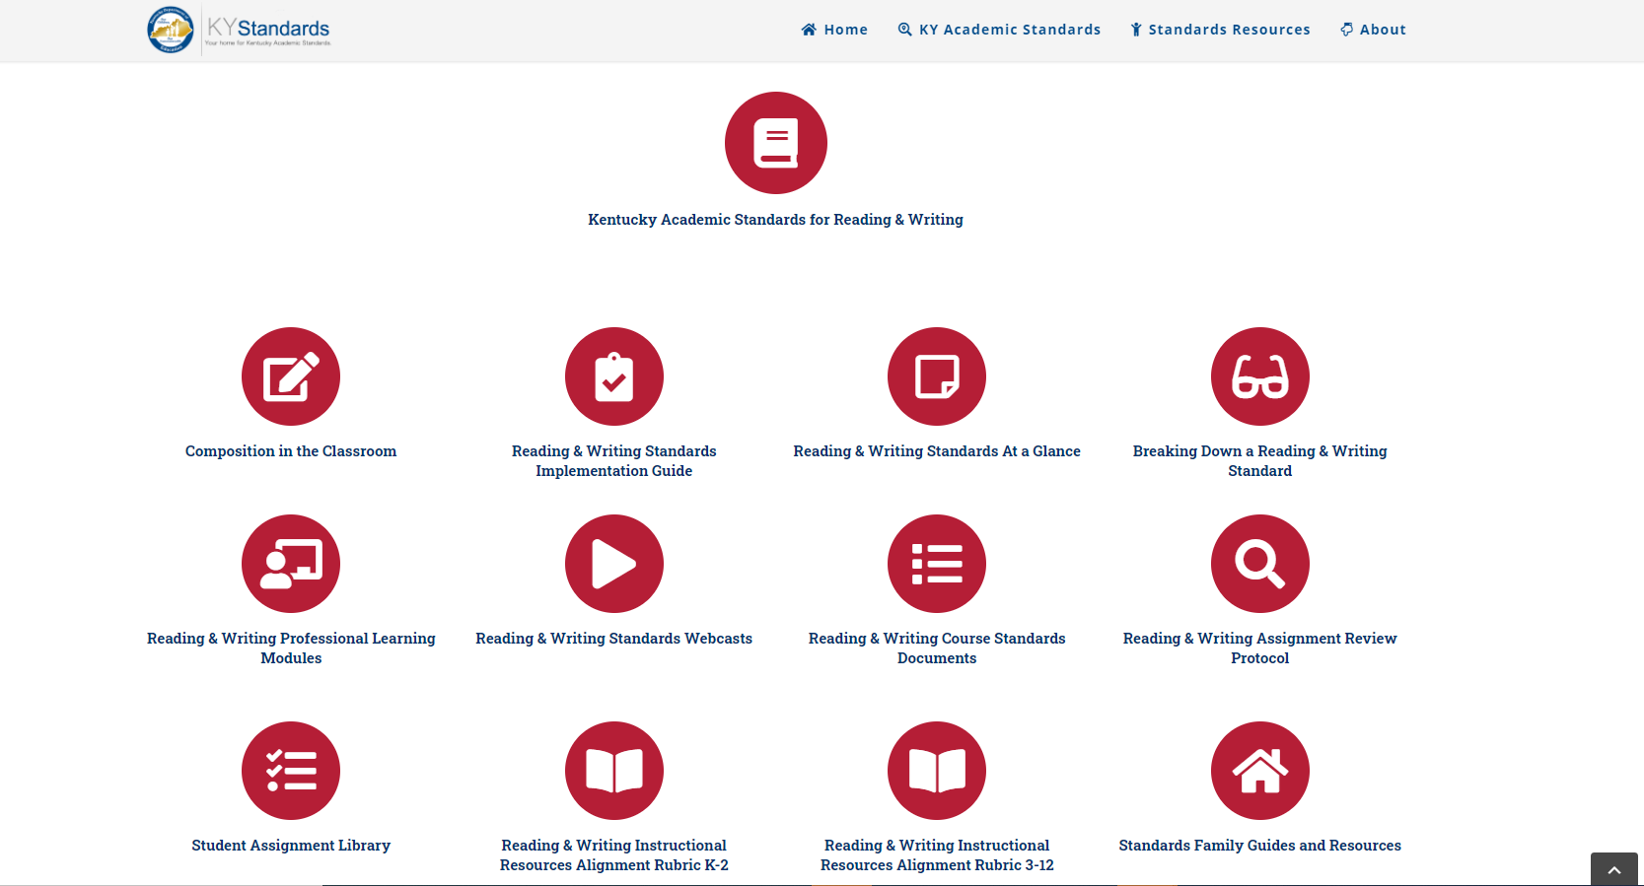
Reading and Writing Resources
Notes:
The Understand Text Dependent Questions Module can be found by choosing the Reading & Writing Professional Learning Modules button on the far left of the second row of resources.

Slide 29
March 26 Digital Professional Learning Opportunity
Creating Standards Aligned Text Dependent Writing Tasks

Slide 30
5 Things to Know Before you Go
Subscribe to www.kystandards.org
Digital Professional Learning Release: March 26 Creating Standards Aligned Text Dependent Writing Tasks
New Modules Coming Soon: Plan a Close Reading Lesson & Quantitative & Qualitative Analysis
Reading and Writing Summer Standards Workshop, June 2020
Next Webcast: KAS for Mathematics Alignment
Resources on April 9

