Slide 1
Kentucky Academic Standards for Social Studies
Resources for Implementation found in the KAS for Social Studies
Additional Resources for Implementation Support
Lauren Gallicchio and Heather Ransom
Academic Program Consultants
kdesocialstudies@education.ky.gov

Slide 2
In this session, you will…
Review the implementation resources found within the KAS for Social Studies document.
Learn about additional resources to support implementation available at www.kystandards.org. Such as:
Module One: Getting to Know the KAS for Social Studies
Module Two: Minding the Gap (available soon)
Module Series: Inquiry Ready
Instructional Resources Alignment Tool
Assignment Review Protocol
Family Guides
Fall Webcasts

Slide 3
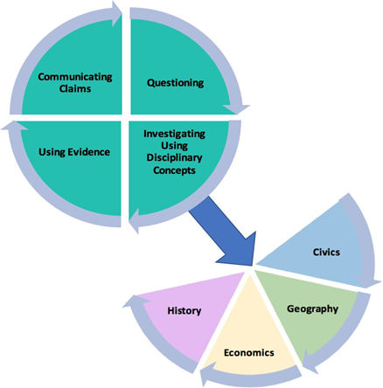
Organization of the Standards
Notes:
Within the architecture, the standards place an equal importance on both the mastery of important social studies concepts and disciplinary practices. Throughout a child’s social studies education, students engage in the inquiry practices – questioning, investigating, using evidence and communicating conclusions. Students use these practices to acquire, refine and extend knowledge and understanding of key social studies concepts within the four disciplinary lenses of civics, economics, geography and history. As indicated by the graphic on this slide, concept knowledge cannot be achieved effectively without the practice of inquiry. Neither development of the practices nor development of the knowledge and understanding within the lenses is sufficient on its own to equip young people with the knowledge and skills necessary to carry on the ideals of the founders.

Slide 4
Additional Supports Found within the KAS for Social Studies document
Grade Band Overviews
Grade Specific Overviews
Disciplinary Clarifications
Appendix A - Progressions

Slide 5
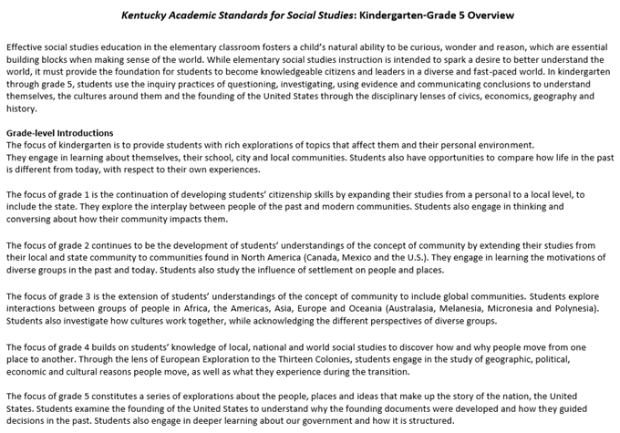
Grade Band Overviews for K-8
Notes:
●Grade band overviews for K-5 (page 25), 6-8 (page 96) and high school (pages 139-140) are provided. At the top of each grade band page, information is included to provide guidance on what effective social studies education looks like in each grade band. As was stated previously in section 1B of Module 1, short introductions are included with the architecture to provide a brief overview of the theme in k-8. In high school, each discipline includes an introductory paragraph that provides an overview of the standards within the concepts and practices that will be mastered prior to high school graduation. These short introductions have been included in the grade-band overview, below the introductory paragraph, to provide all of the introductions for K-5, 6-8 and high school so that stakeholders could obtain a more complete view of social studies during a particular grade band.

Slide 6
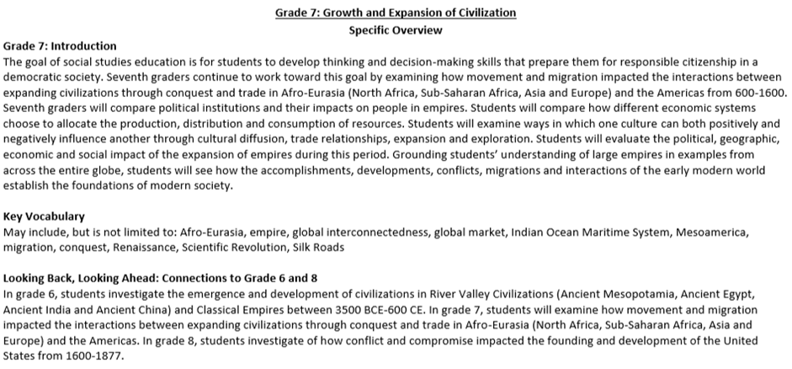
Specific Overview for K-8
Notes:
●Based on feedback provided during the standards revision process, grade-level specific overviews were added to the Kentucky Academic Standards (KAS) for Social Studies document in kindergarten through grade 8. In K-8, each grade level is introduced with a grade-level specific overview that includes an expanded grade-level introduction, suggested key vocabulary, connections to the previous and following grade, and an explanation of what inquiry looks like in practice. The grade-level theme presented in the introduction drives the standards within the concepts and practices through the four disciplines of civics, economics, geography and history.
●Grade-level introductions: Feedback indicated that stakeholders valued the additional clarity of an expanded introduction specific to each grade level. The expanded introduction provides additional information on the grade-level theme and explains how the goal of social studies education connects with students as they progress through their social studies education.
●Additionally, the expanded introduction provides examples of how learners engage with each of the four disciplines during the year.
●Suggested key vocabulary: Feedback also indicated that stakeholders valued suggested key vocabulary specific to each grade level. The writing committee identified terms that they felt were essential to understanding the content and skills in the standards. The identified key vocabulary terms listed are possible suggestions; they are not the only terms that may be used during instruction. Additionally, it is important to note that merely knowing the definitions of these terms is not enough to obtain mastery of the standards.
●Looking Back, Looking Ahead: progression snapshots: Feedback indicated that stakeholders valued the progression snapshots found in the overviews. Short summaries of the previous and following grades are included to provide educators information on what a student’s social studies learning experience is focused on in the previous and following grade. This short snapshot provides a short narrative on how the current grade’s theme progresses.

Slide 7
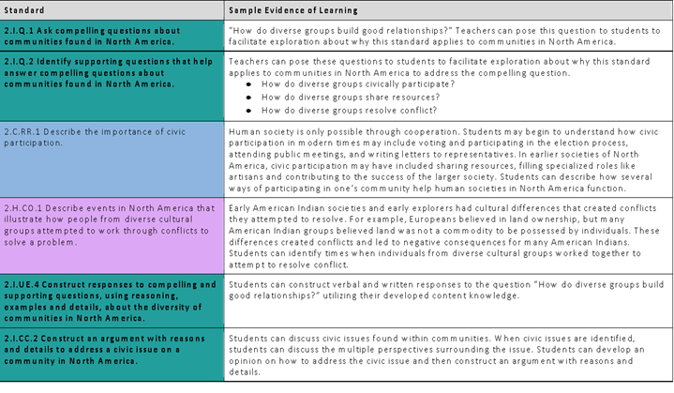
Specific Overview
Notes:
This section provides guidance on how to combine the inquiry and discipline strand standards into a learning experience for students and how the standards work together to ensure students are engaged in the inquiry practices throughout K-8. The identified sample evidence of learning is a possible suggestion of how the disciplinary strand standards interact with the inquiry practices; however, it is not the only pathway and is not comprehensive to obtain mastery of the standards.

Slide 8
Specific Overview
Notes:
●Opportunities for cross disciplinary connections were also identified. Feedback provided indicated that teachers needed support, especially at the elementary school level, when understanding how cross disciplinary connections could be made among the content standards. In this section, connections are made between the KAS for Social Studies and the Kentucky Academic Standards (KAS) for Reading and Writing.

Slide 9
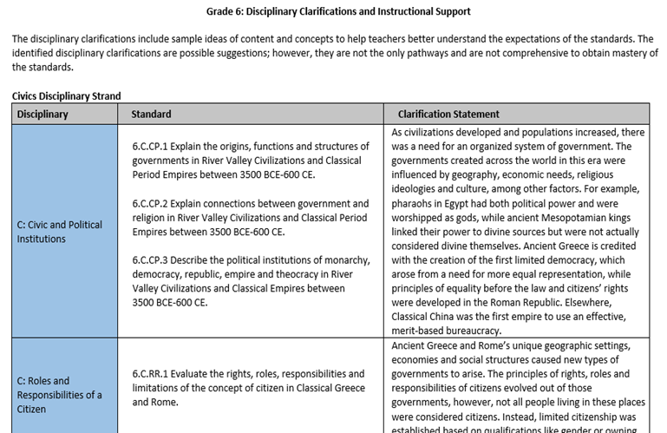
Grade 6 Disciplinary Clarifications
Notes:
Following the grade-level standards for kindergarten through grade 8, disciplinary clarifications are provided. The disciplinary clarifications include sample ideas of content and concepts to help teachers better understand the expectations of the standards. The identified disciplinary clarifications are possible suggestions; however, they are not the only pathways and are not comprehensive to obtain mastery of the standards.

Slide 10
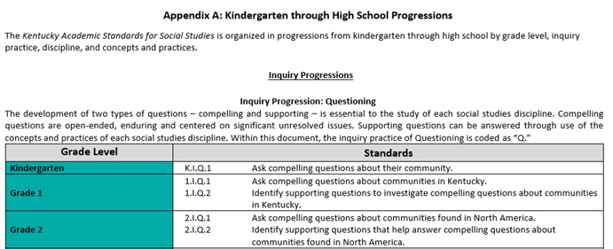
Kentucky Academic Standards for Social Studies
Additional Highlights:
•Organized in progressions from K-12 by grade level, inquiry practice, discipline, and concepts and practices.
Notes:
The KAS for Social Studies has been organized in progressions from K-12 by grade level, inquiry practice, discipline, and concepts and practices to aid districts in curriculum development. (See pages 155-227.)

Slide 11
Where can you access resources to support implementation of the KAS for Social Studies from the KDE?
Notes:
●Welcome to KYstandards.org! Please add your name and email to subscribe to our Standards Newsletter.

Slide 12
General Resources

Slide 13
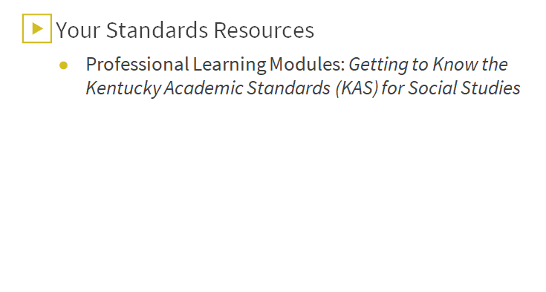
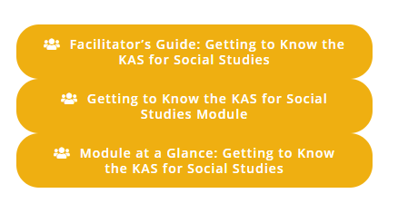
Module One: Getting to Know the KAS for Social Studies
Notes:
●Module 1 is a resource for developing an understanding of the new standards and the new components of the KAS for Social Studies.
●
●Educators at the school and district level may feel the need to start aligning programs (curricula, pacing guides, assessments, etc.) to the new standards immediately. Yet, utilizing this module before beginning standards alignment work is recommended in order to build knowledge and capacity around the standards and to capitalize on the opportunity to improve teaching and learning.
●
●The module contains 8 sections. Each section of Module 1 is designed to be administered in a 45-minute PLC session; however, the timeline and work sessions can be adjusted to best fit the needs of schools and districts.
●
●Module facilitators may include, but are not limited to: district leaders, school administrators, instructional specialists/coaches, department chairs, and/or teacher leaders. With that in mind, the facilitator notes include content information and instructional support intended to provide support to a facilitator who may or may not have an extensive background in social studies.

Slide 14
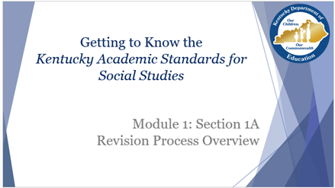
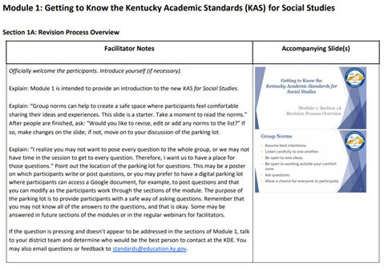
Getting to Know the KAS for Social Studies
PowerPoint Facilitator’s Guide

Slide 15
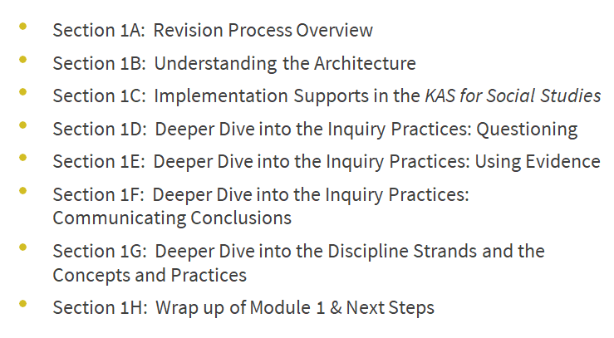
Getting to Know the KAS for Social Studies

Slide 16
Getting to Know the KAS for Social Studies
Notes:
●The KDE needs your feedback on the effectiveness of this module, the learning platform and how the consultants may best support you as you take the next steps in the implementation process. As you work through this module, please consider completing the short survey provided to share your thinking and provide feedback on how the KDE can best meet our needs. Feedback from our surveys will be used by the KDE to plan and prepare future professional learning.

Slide 17
Module 2: Minding the Gap

Slide 18
Module 2: Minding the Gap Goals
Build a shared understanding of the KAS for Social Studies progressions and grade-level expectations.
Begin to map the expectations of the KAS for Social Studies to current practice and curricula.
Identify gaps and overlaps between the KAS for Social Studies and current practice and curricula.
Identify and prioritize gaps that exist, and consider available curriculum resources, time allocation for each content area, and any additional solutions to eliminate gaps.
Create a proposed plan of action to successfully implement the 2019 KAS for Social Studies and close gaps.

Slide 19
Module 2: Minding the Gap
Key Features:
Pre-recorded voiceovers for communicating a common message
Proposal examples on how to address gaps
Reflection questions to prompt thinking about gap analysis
Resources provided:
PowerPoint
Facilitators Guide
Tasks to apply learning
Planning tool to fill gaps
Tool to identify gaps

Slide 20
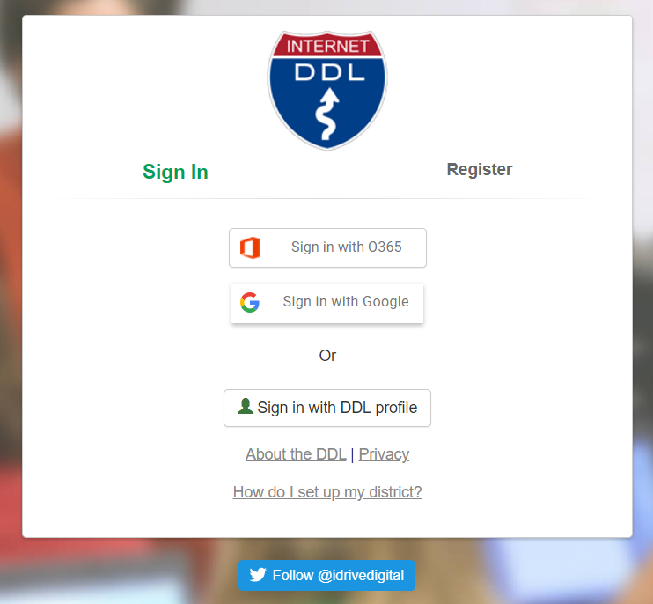
Module Series:
The Kentucky Department of Education (KDE) has partnered with the University of Kentucky to offer a series of modules on inquiry.

Slide 21
Module Series KAS for Social Studies: Inquiry Ready
KAS for Social Studies: Inquiry Ready are three online modules for developing an understanding of the new Kentucky Academic Standards (KAS) for Social Studies.
These online modules help educators by unpacking big ideas (inquiry, equity, literacy and action) and instructional tools for the work.
This interactive module is available through the web based platform, Digital Driver’s License.
Every Kentucky school district has access to this platform and educators can log in with their school email or their Google account.

Slide 22
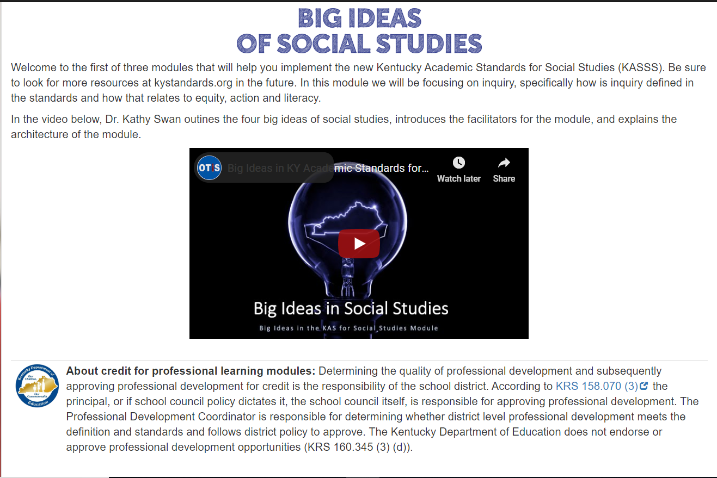
Module One: Big Ideas of Social Studies
This module focuses on inquiry, specifically how inquiry is defined in the KAS for Social Studies and how inquiry relates to equity, action and literacy.
Key features: videos, annotated slides, video transcripts, formative assessments and a summative assessment.

Slide 23
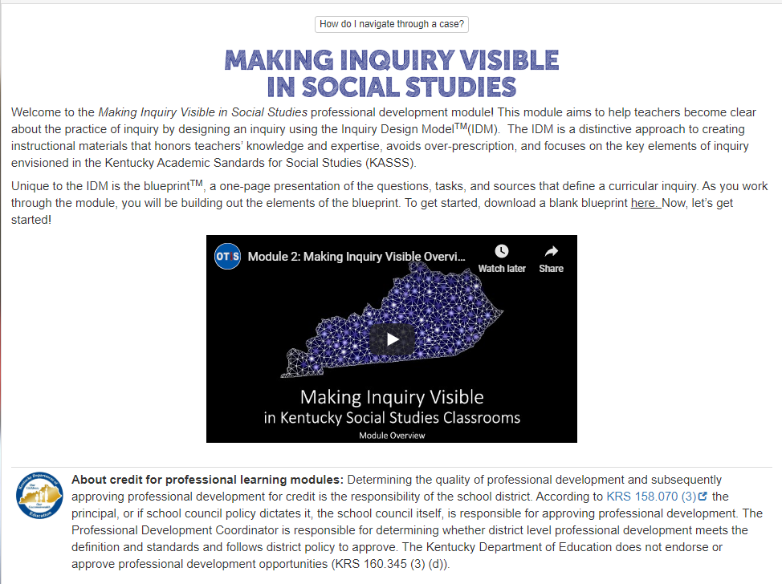
Module Two: Making Inquiry Visible in Social Studies
This module aims to help teachers become clear about the practice of inquiry by designing an inquiry using the Inquiry Design ModelTM(IDM).
Key features: videos, annotated slides, video transcripts, formative assessments and a summative assessment.

Slide 24
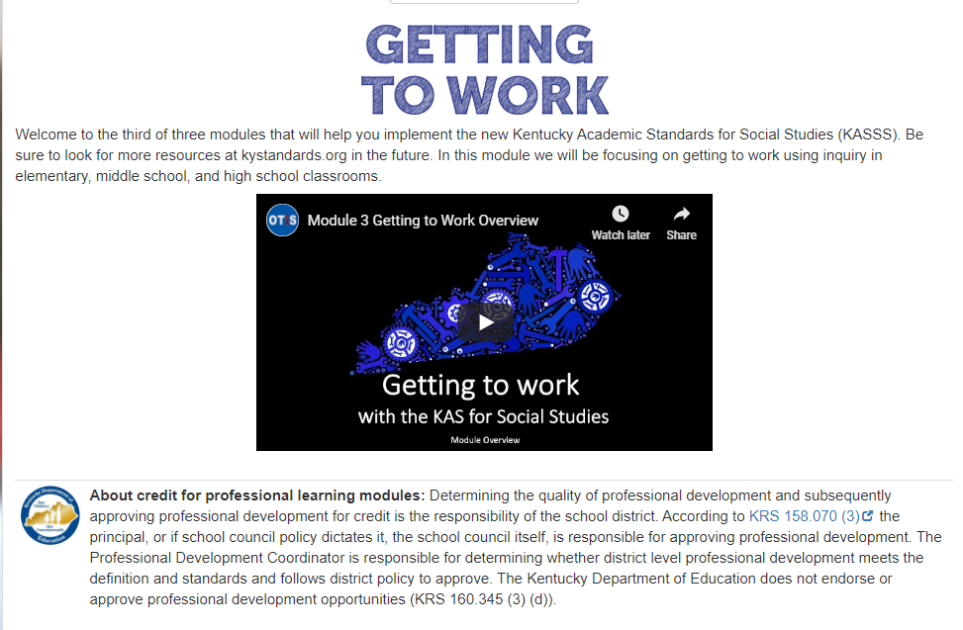
Module Three: Getting to Work
This module focuses on getting to work using inquiry in elementary, middle school, and high school classrooms.
Key features: videos, annotated slides, video transcripts, formative assessments and a summative assessment.

Slide 25
Instructional Resources Alignment Rubric
Purpose: to guide districts and schools in assessing existing or purchasing new instructional resources to determine what revisions may be needed to ensure alignment to the KAS for Social Studies.

Slide 26
Instructional Resources Review Rubric
Notes:
Other categories: Instructional design, Organization, Equity and accessibility, assessment

Slide 27
Assignment Review Protocol
Purpose: to determine how well the task requires students to engage in the work to master the standards-based content and skills.

Slide 28
Assignment Review Protocol
Standards/Content/Skills:
Alignment to the Content
Alignment to the Skills
Assignment:
Construction of Knowledge
Elaborated Expressive (Speaking, Writing and Visually Representing) Communication
Connection to Students’ Lives
Impactful Instructional Strategies:
Alignment to Instructional Shifts
Reflection:
Connection to Standards:
Connection to Rigor:
Connections to Instructional Shifts:

Slide 29
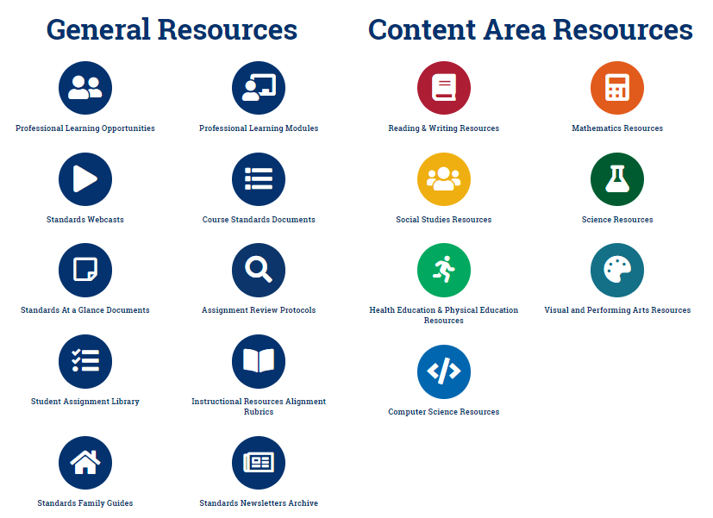
Family Guides
The guides are available on www.kystandards.org

Slide 30
Family Guides
Designed to help families familiarize themselves with the content of each grade level’s standards.
There is a guide for each grade, kindergarten through 8th grade, and one for high school.
Each guide covers reading and writing, mathematics, science and social studies.

Slide 31
Fall Webcasts
Archived:
September 5: Standards Resources
September 19: Alignment Tools
October 3: Why PLCs?
October 17: Gaining Clarity Through PLCs
Upcoming
November 14: Social Studies Alignment Tool
November 21: Social Studies Virtual Workshop

Slide 32
Subscribe for Updates

Slide 33
Things to Know Before You Go...
Subscribe for updates at www.kystandards.org.
Check back for the next social studies webcast and virtual workshop in November.
Complete the Getting to Know the KAS for Social Studies module/use facilitator’s guide.

Slide 34
Kentucky Academic Standards for Social Studies
Resources for Implementation found in the KAS for Social Studies
Additional Resources for Implementation Support
Lauren Gallicchio and Heather Ransom
Academic Program Consultants
kdesocialstudies@education.ky.gov

