Slide 2
Standards Resources:
Explore resources to support Kentucky Academic Standards implementation
Webcast
September 6, 2019

Slide 3
Essential Questions:
What resources are available to Kentucky educators for implementing the KY Academic Standards (KAS)?
How might schools and districts utilize these tools in their implementation plans?

Slide 4
KAS 3 Year Implementation

Slide 5
KAS 3 Year Implementation Plan Snapshot
Year 1 - Systems/Structures to Support Standards Implementation
2019-2020
Year 2 - Balanced Assessment
2020-2021
Year 3 - Instructional Best Practice
2021-2022

Slide 6
Fall 2019
Professional Learning Series
Webcasts
1st & 3rd Thursday
Virtual Workshops
4th Thursday
Book Study
Clarity for Learning

Slide 7
Homepage

Slide 8
Subscribe
Subscribe

Slide 9
Your Standards Resources

Slide 10
General Resources

Slide 11
Content Area Resources

Slide 12
Example Content Area Resources Page

Slide 13
PL Resources 1

Slide 14
PL Resources 2

Slide 15
PL Resources 3

Slide 16
Virtual Workshops

Slide 17
PL Modules

Slide 18
Getting to Know the KAS Modules
Mathematics
Reading & Writing
Science
Social Studies
PE & Health

Slide 19
Getting to Know Your KAS Modules

Slide 20
Three Module Documents

Slide 21
Assgnment Review Protocols

Slide 22
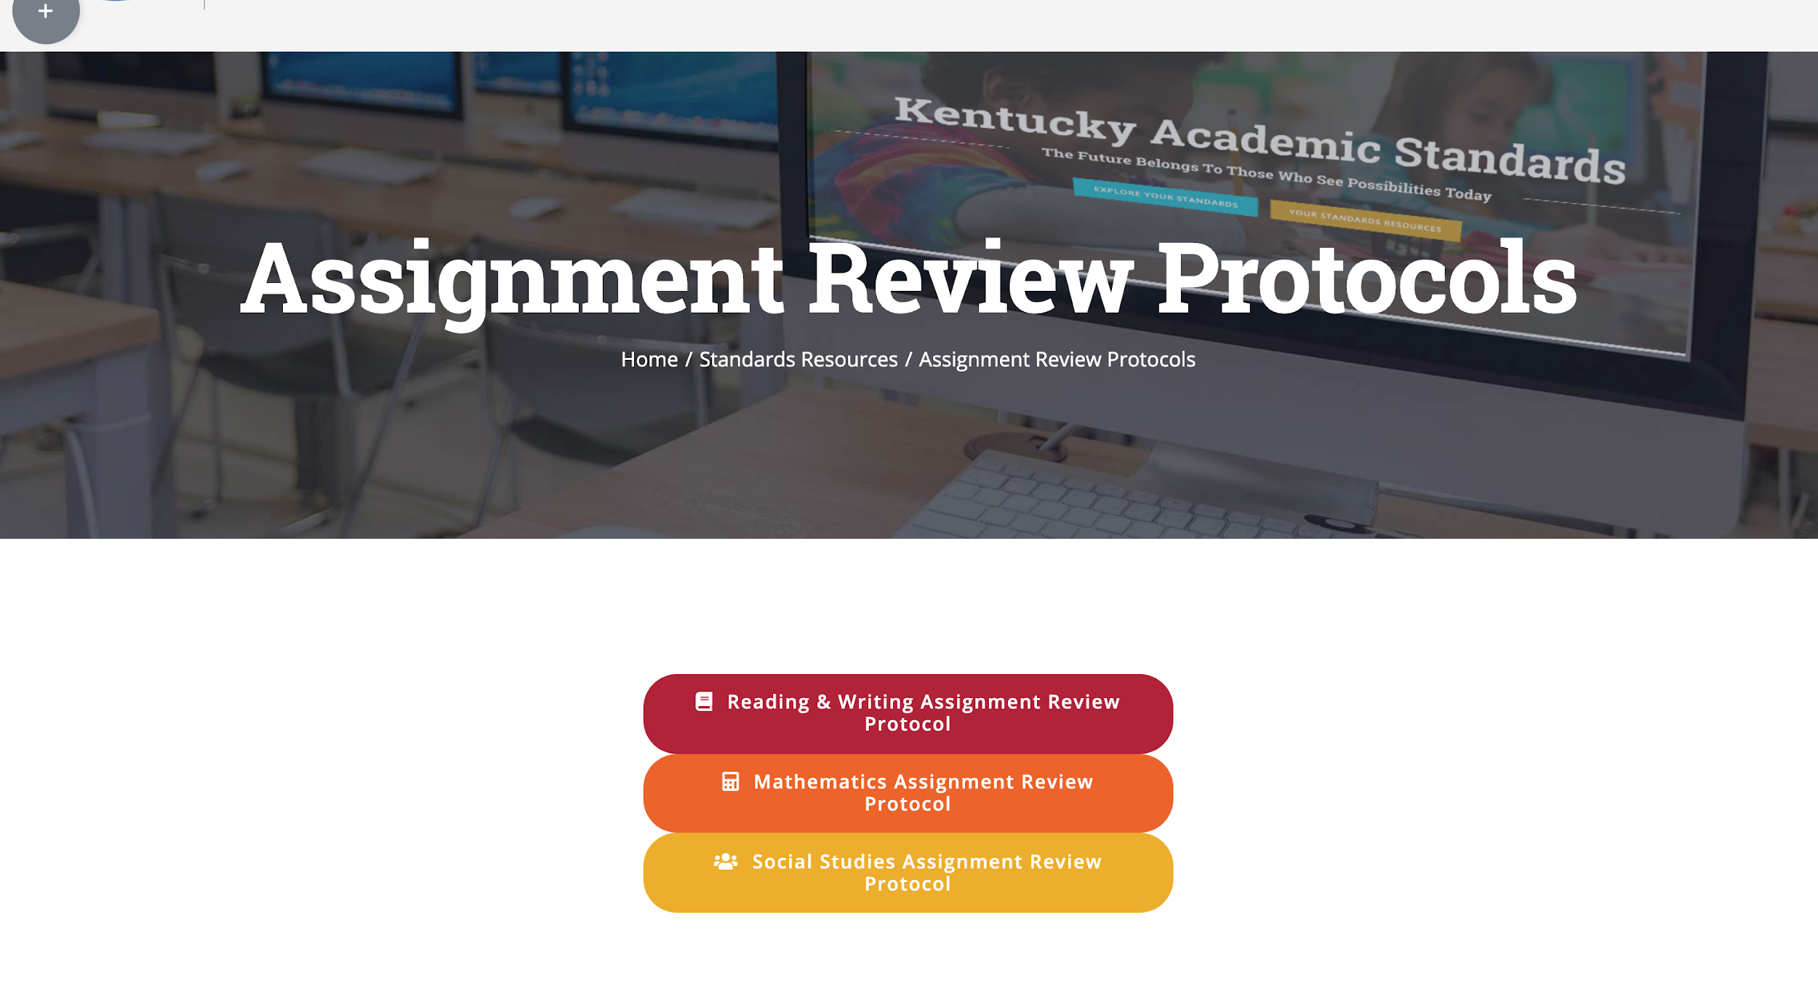
Assignment Review Protocols 2

Slide 23
Standards Webcasts

Slide 24
5 Things to Know Before you Go
Subscribe to www.kystandards.org
Professional Learning Modules as Step 1
Next Webcast: Alignment Tools, 9/19/19
Book Study
9/16/19 - 12/13/19
Clarity for Learning: Five Essential Practices that Empower Students and Teachers
Virtual Workshop: Using Alignment Tools for Standards Implementation
Link to join: https://zoom.us/j/540504708
9/26/19 at 4:00 EST

