Slide 1
Social Studies Assignment Review Protocol
How to Use the Protocol
Module 5
Notes:
Facilitator’s Notes:
Module Overview:
Social Studies Assignment Review Protocol: How to Use the Protocol Module contains the materials to be used in work sessions at the district, school or department level. These sessions are intended to support the successful implementation of strongly KAS for Social Studies aligned assignments in classrooms across the state.
The duration, scope and sequence of the module sections may be customized to accommodate local needs and conditions. The sections are designed to provide flexibility for districts and schools and, as such, can be viewed as stand-alone lessons or within the progression of the module as written.
Materials:
The following materials are part of this module:
Kentucky Academic Standards (KAS) for Social Studies
Social Studies Assignment Review Protocol
Social Studies Student Assignment Library
Grade 1 Example for Evaluation
Grade 1 Assignment Review Protocol
Grade 4 Example for Evaluation
Grade 4 Assignment Review Protocol
Grade 7 Example for Evaluation
Grade 7 Assignment Review Protocol
High School Example A for Evaluation
High School Example A Assignment Review Protocol
Grade 5 Example for Evaluation
Grade 5 Assignment Review Protocol
Grade 8 Example for Evaluation
Grade 8 Assignment Review Protocol
High School Example B for Evaluation
High School Example B Assignment Review Protocol
Social Studies Student Work Review Protocol
Social Studies Student Assignment Library
TNTP, inc. (2019). The Opportunity Myth [presentation]. Retrieved from https://opportunitymyth.tntp.org/.
Goals:
The goals for Social Studies Assignment Review Protocol: How to Use the Protocol Module are for districts and schools to:
Engage with the Kentucky Academic Standards (KAS) for Social Studies.
Understand the purpose and use of the Social Studies Assignment Review Protocol.
Learn how to evaluate an assignment using the Social Studies Assignment Review Protocol.
Understand the characteristics of a strongly aligned KAS for Social Studies assignment.
Intended Audiences:
Participants
Module participants may include, but are not limited to, district leadership, school administrators, instructional specialists/coaches, intervention specialists, department chairs, special educators and classroom teachers. In addition, districts may choose to have anyone planning to conduct observations or walkthroughs participate in this session in order to develop an understanding of how to evaluate strongly aligned KAS for Social Studies assignments.
Facilitators
Module session facilitators may include, but are not limited to, district leaders, school administrators, instructional specialists/coaches, intervention specialists, department chairs, special educators and classroom teachers.
This facilitator’s guide provides suggestions for structuring each section of Module 5, recommended activities to evaluate grade-level assignments to determine if they are aligned to the KAS for Social Studies and guidance on talking points to use with the provided slideshows.
As you work through Module 5, there will be activities provided to aid in developing participant knowledge of designed strongly KAS for Social Studies aligned assignments. Facilitators may need to revise specific tasks in order to meet the needs of the participants or to be respectful of the time planned within the work session.
Helpful Hint
The implementation of strongly KAS for Social Studies aligned assignments will cause Kentucky educators to face changes in instructional practices. It is important to realize that while you are the facilitator of these work sessions, you may not have all the answers to the questions asked by participants. And that is okay.
Throughout the module, participants may have questions that will be addressed in future work sessions. When that happens, reflect on this quote from Graham Fletcher, “Every teachable moment doesn’t need to be a teachable moment in that moment.” Use these moments to encourage participants to attend future work sessions where those questions will be addressed. If participants ask questions you are not prepared to answer, offer to follow up on that during the next work session.
Planning Ahead:
● Determine which stakeholders to invite as participants. In the invitation, describe how the work sessions will benefit them.
● A few days before the meeting, you may want to remind participants to bring their documents to the meeting. (See below for Participant Documents Needed.)
● Reserve adequate space and equipment. Tables or desks should be set up to support small-group discussion.
● Access to the Internet for participants.
● Consider how you might handle participants who may not be in attendance at all work sessions. It might be worthwhile to consider how those participants might access missed sections of the module between work sessions in order to feel as prepared as the other participants.
Preparation
Participant Documents Needed:
Kentucky Academic Standards (KAS) for Social Studies
Social Studies Assignment Review Protocol
Social Studies Student Assignment Library
Grade 1 Example for Evaluation
Grade 1 Assignment Review Protocol
Grade 4 Example for Evaluation
Grade 4 Assignment Review Protocol
Grade 7 Example for Evaluation
Grade 7 Assignment Review Protocol
High School Example A for Evaluation
High School Example A Assignment Review Protocol
Grade 5 Example for Evaluation
Grade 5 Assignment Review Protocol
Grade 8 Example for Evaluation
Grade 8 Assignment Review Protocol
High School Example B for Evaluation
High School Example B Assignment Review Protocol
Social Studies Student Work Review Protocol
Social Studies Student Assignment Library
The Opportunity Myth
Facilitator Work Session Supplies Needed:
● Computer with Social Studies Assignment Review Protocol: How to Use the Protocol Module
● Technology with projection capability
● Copies of the participant handouts needed for the session (See links in the Facilitator's Guide.)
● Parking Lot for questions - This may be a poster on which participants can write or post questions, or you may prefer to have a digital parking lot where participants can access a Google document, for example, to post questions and that you can modify as the participants work through the sections of the module.
● Self-Sticking Notes (optional)
● Poster paper (optional)
● Highlighters and/or colored pens/markers (optional)
Work Session Suggestion
Building a Community
Building a community is important for any group that will work together, especially if participants have not worked together before. The concept is the same as building a safe, respectful, productive classroom climate. Incorporating community-building into each session builds trust, shows participants that they are valuable as individuals and engages them in the learning process. It is also useful for creating a professional learning network where participants can be supported in their work. Community-building can be as simple as allowing participants to introduce themselves and their role in the school/district, developing or refining group norms, allowing for questions, and/or the sharing of answers to reflection questions or individual discovery task items that are included in the Module 5 sections. Again, time allotted for community-building will allow participants to have a voice and be engaged as active contributors and learners in the sessions.

Slide 2
Social Studies Assignment Review Protocol
How to Use the Protocol
Module 5: Section A
Introduction to the protocol and KAS for Social Studies aligned assignments
Notes:
Facilitator’s Notes:
Materials:
The following materials needed for this section:
Kentucky Academic Standards (KAS) for Social Studies

Slide 3
Group Norms
Assume best intentions.
Listen carefully to one another.
Be open to new ideas.
Be open to working outside your comfort zone.
Ask questions.
Allow a chance for everyone to participate.
Notes:
Facilitator’s Notes:
Explain: “Group norms can help to create a safe space where participants feel comfortable sharing their ideas and experiences. This slide is a starter. Take a moment to read the norms.” After people are finished, ask: “Would you like to revise, edit or add any norms to the list?” If so, make changes on the slide; if not, move on to your discussion of the parking lot.
Explain: “I realize you may not want to pose every question to the whole group, or we may not have time in the session to get to every question. Therefore, I want us to have a place for those questions.” Point out the location of the parking lot for questions. This may be a poster on which participants write or post questions, or you may prefer to have a digital parking lot where participants can access a Google document, for example, to post questions and that you can modify as the participants work through the sections of the module. The purpose of the parking lot is to provide participants with a safe way of asking questions. Remember that you may not know all of the answers to the questions, and that is okay. Some may be answered in future sections of the module.
If the question is pressing and doesn’t appear to be addressed in the sections of Module 5, talk to your district team and determine who would be the best person to contact at the KDE. You may also email questions or feedback to standards@education.ky.gov.

Slide 4
Overview of this module:
Section A: Introduction to the protocol and KAS for Social Studies aligned assignments
Section B: Social Studies Assignment Review Protocol Overview
Section C: Evaluating an assignment using the Social Studies Assignment Review Protocol
Section D: Understanding the Student Work Review Protocol
Section E: Reflection
Notes:
Facilitator’s Notes:
This slide provides an overview the sections included in this module.

Slide 5
Goals of this Module:
Engage with the Kentucky Academic Standards (KAS) for Social Studies.
Understand the purpose and use of the Social Studies Assignment Review Protocol.
Learn how to evaluate an assignment using the Social Studies Assignment Review Protocol.
Understand the characteristics of a strongly aligned KAS for Social Studies assignment.
Notes:
Facilitator’s Notes:
Explain: The goals for Module 5 are on this slide.

Slide 6
Essential Question
● Does my assignment meet the intended depth and rigor of the KAS for Social Studies?
Notes:
Facilitator’s Notes:
Move on by explaining: Section 5A of this module provides an overview of the organization of the Kentucky Academic Standards (KAS) for Social Studies. One essential question will be answered by the end of the module. Read the question on the slide.

Slide 7
The Organization of the KAS for Social Studies
Notes:
Facilitator’s Notes:
Move on by explaining: Section 5A of this module provides an overview of the organization of the Kentucky Academic Standards (KAS) for Social Studies. Participants need to access the KAS for Social Studies document for this section.

Slide 8
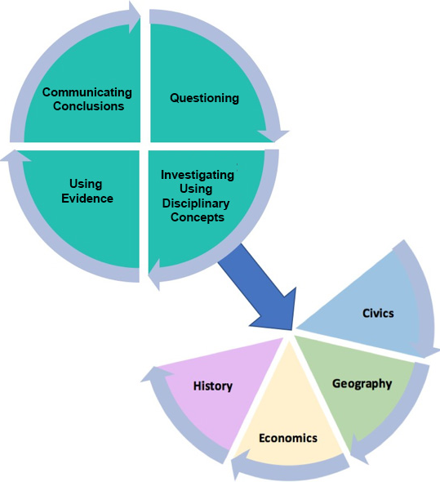
Organization of the Standards
Notes:
Facilitator’s Guide:
Explain: In order to understand how to design and evaluate whether or not an assignment is strongly aligned to the KAS for Social Studies, participants must have a good understanding of the organization of the standards. This image may be found on page 14 of the KAS for Social Studies.

Slide 9
Organization of the Standards
The organization of the KAS for Social Studies requires a balance between the inquiry practices and the discipline strand standards as both are crucial to develop mastery understanding of the standards.
Notes:
Facilitator’s Notes:
Explain: Within the architecture, the standards place an equal importance on both the mastery of important social studies concepts and disciplinary practices. Throughout a child’s social studies education, students engage in the inquiry practices – questioning, investigating, using evidence and communicating conclusions. Students use these practices to acquire, refine and extend knowledge and understanding of key social studies concepts within the four disciplinary lenses of civics, economics, geography and history. As indicated by the graphic on this slide, concept knowledge cannot be achieved effectively without the practice of inquiry. Neither development of the practices nor development of the knowledge and understanding within the lenses is sufficient on its own to equip young people with the knowledge and skills necessary to carry on the ideals of the founders.

Slide 10
Organization of the Standards
The inquiry process is critical for effective student understanding of civics, economics, geography and history.
Students will engage in inquiry using the tools, conceptual understandings and the language of political scientists, economists, geographers and historians at a developmentally appropriate level.
Students will craft arguments, apply reasoning, make comparisons, corroborate their sources and interpret and synthesize evidence as political scientists, economists, geographers and historians.
Notes:
Facilitator’s Notes:
Explain:
The inquiry process is critical for effective student understanding of civics, economics, geography and history.
Students will engage in inquiry using the tools, conceptual understandings and the language of political scientists, economists, geographers and historians at a developmentally appropriate level.
Students will craft arguments, apply reasoning, make comparisons, corroborate their sources and interpret and synthesize evidence as political scientists, economists, geographers and historians.

Slide 11
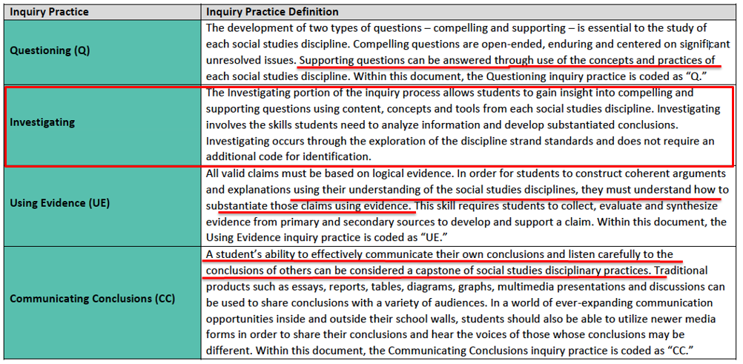
Discipline Strands and the Inquiry Practices
Notes:
Facilitator’s Notes:
Explain: When engaging with the KAS for Social Studies, it is important to understand the relationship between the inquiry practices and the discipline strand standards. At the first glance of the architecture, it may appear that the discipline strand standards only interact with the inquiry standards through the inquiry practice of investigation. However, this is not the case. As can be seen in the annotated chart on this slide, students cannot successfully engage in inquiry without the discipline strand standards. The social studies disciplines and the concepts and practices of the disciplines are required to ask compelling and supporting questions, acquire new knowledge, substantiate claims using evidence and effectively communicate conclusions.

Slide 12
Organization of the Standards and the impact on aligned Assignments
In order to be culturally literate, students must have knowledge of each of the four social studies disciplines (civics, economics, geography and history) and an appreciation for the interconnectedness of all four disciplines. This is central to students’ preparation for a successful transition into civic life.
In Kentucky, the discipline strands in social studies are meant to be taught in unison. Students recall and understand themes and topics better if the social studies strands are integrated and not taught in isolation.
Notes:
Facilitator’s Notes:
Explain:
In order to be culturally literate, students must have knowledge of each of the four social studies disciplines (civics, economics, geography and history) and an appreciation for the interconnectedness of all four disciplines. This is central to students’ preparation for a successful transition into civic life.
In Kentucky, the discipline strands in social studies are meant to be taught in unison. Students recall and understand themes and topics better if the social studies strands are integrated and not taught in isolation.

Slide 13
Organization of the Standards and the impact on aligned Assignments
As a result of the importance of the interconnectedness of the inquiry practices and the disciplinary strand standards, any assignment where students engage in the KAS for Social Studies should require that students engage in the inquiry practices and the disciplinary strand standards.
While not always a requirement, educators should strive to create strongly aligned KAS for Social Studies assignments that require students to engage in more than one disciplinary standard.
For example, one assignment may require students to demonstrate mastery of a civics and a geography standard, etc.
Notes:
Facilitator’s Notes:
Explain:
As a result of the importance of the interconnectedness of the inquiry practices and the disciplinary strand standards, any assignment where students engage in the KAS for Social Studies should require that students engage in the inquiry practices and the disciplinary strand standards.
While not always a requirement, educators should strive to create strongly aligned KAS for Social Studies assignments that require students to engage in more than one disciplinary standard.
For example, one assignment may require students to demonstrate mastery of a civics and a geography standard, etc.

Slide 14
Reflection
How is the KAS for Social Studies organized?
How will engaging with all four disciplinary lenses prepare students to be culturally literate citizens beyond the classroom?
In Kentucky, how are the discipline strands in the KAS for Social Studies supposed to be taught?
As a result of the importance of the interconnectedness of the inquiry practices and the disciplinary strand standards, what should each strongly KAS for Social Studies aligned assignment contain?
Notes:
Facilitator’s Notes:
Ask participants, individually, with a partner or in a small grade-banded group, to discuss the questions on the slide after engaging with this introduction. Facilitate discussion over the reflection questions and address any comments that need further clarification or additional support. Responses to the questions found in the slide may include, but are not limited to the following:
How is the KAS for Social Studies organized?
Within the architecture, the standards place an equal importance on both the mastery of important social studies concepts and disciplinary practices. Throughout a child’s social studies education, students engage in the inquiry practices – questioning, investigating, using evidence and communicating conclusions - to acquire, refine and extend knowledge and understanding of key social studies concepts within the four disciplinary lenses of civics, economics, geography and history.
How will engaging with all four disciplinary lenses prepare students to be culturally literate citizens beyond the classroom?
The standards are designed to include a breadth of knowledge, not as isolated facts to be simply memorized, but as useable knowledge to be integrated into an understanding of the world. Students must have knowledge of each of the four social studies disciplines and an appreciation for the interconnectedness of all four disciplines. This is central to students’ preparation for a successful transition into civic life as people generally try to understand or solve a problem or make an informed decision using the information available. This generally requires operating within and beyond disciplinary boundaries.
In Kentucky, how are the discipline strands in the KAS for Social Studies supposed to be taught?
In Kentucky, the discipline strands in social studies are meant to be taught in unison. Students recall and understand themes and topics better if the social studies strands are integrated and not taught in isolation.
As a result of the importance of the interconnectedness of the inquiry practices and the disciplinary strand standards, what should each strongly KAS for Social Studies aligned assignment contain?
Any assignment strongly aligned KAS for Social Studies assignment should require that students engage in the inquiry practices and the disciplinary strand standards. While not always a requirement, educators should strive to create strongly aligned KAS for Social Studies assignments that require students to engage in more than one disciplinary standard.
If participants feel that they need to dig deeper into the standards before engaging with the alignment tool, complete Module One: Getting to Know the KAS for Social Studies prior to moving on to the next section.
Consider maintaining a Google document to house these reflections for continued consideration and further application.

Slide 15
Coming Up
Section A: Introduction to the protocol and KAS for Social Studies aligned assignments
Section B: Social Studies Assignment Review Protocol Overview
Section C: Evaluating an assignment using the Social Studies Assignment Review Protocol
Section D: Understanding the Student Work Review Protocol
Section E: Reflection
Notes:
Facilitator’s notes:
Bring the group back together and preview the additional contents of this module.

Slide 16
Stop here
Stop here if you are completing Module 5: Section A: Introduction to the protocol and KAS for Social Studies aligned assignments
If you would like to complete another section of Module 5 at this time, continue onto the next slide to begin facilitating Module 5: Section B: Social Studies Assignment Review Protocol
Survey Link: Social Studies Assignment Review Protocol Module PL Survey
Notes:
Facilitator’s note:
Explain: The KDE needs your feedback on the effectiveness of this module, the learning platform and how the consultants may best support you as you take the next steps in the implementation process. We are going to complete a short survey to share our thinking and provide them with feedback on how the KDE can best meet our needs. Feedback from our surveys will be used by the KDE to plan and prepare future professional learning.
Post-survey: Social Studies Assignment Review Protocol Module PL Survey

Slide 17
Social Studies Assignment Review Protocol
How to Use the Protocol
Module 5: Section B
Overview of the Social Studies Assignment Review Protocol
Notes:
Facilitator’s Notes:
The following materials are part of this section:
Social Studies Assignment Review Protocol

Slide 18
Group Norms
Assume best intentions.
Listen carefully to one another.
Be open to new ideas.
Be open to working outside your comfort zone.
Ask questions.
Allow a chance for everyone to participate.
Notes:
Facilitator’s Notes:
Explain: “Group norms can help to create a safe space where participants feel comfortable sharing their ideas and experiences. This slide is a starter. Take a moment to read the norms.” After people are finished, ask: “Would you like to revise, edit or add any norms to the list?” If so, make changes on the slide; if not, move on to your discussion of the parking lot. NOTE: If participants made changes to this slide in the session over Section 1A, you will need to update this slide for their initial reading of the norms.
Explain: “I realize you may not want to pose every question to the whole group, or we may not have time in the session to get to every question. Therefore, I want us to have a place for those questions.” Point out the location of the parking lot for questions. This may be a poster on which participants write or post questions, or you may prefer to have a digital parking lot where participants can access a Google document, for example, to post questions and that you can modify as the participants work through the sections of the module. The purpose of the parking lot is to provide participants with a safe way of asking questions. Remember that you may not know all of the answers to the questions, and that is okay. Some may be answered in future sections of the module.
If the question is pressing and doesn’t appear to be addressed in the sections of Module 5, talk to your district team and determine who would be the best person to contact at the KDE. You may also email questions or feedback to standards@education.ky.gov.

Slide 19
Overview of this module:
Section B: Social Studies Assignment Review Protocol Overview
Section C: Evaluating an assignment using the Social Studies Assignment Review Protocol
Section D: Understanding the Student Work Protocol
Section E: Reflection
Notes:
Facilitator’s Notes:
This slide provides an overview the sections included in this module.

Slide 20
Goals of this Module:
Engage with the Kentucky Academic Standards (KAS) for Social Studies.
Understand the purpose and use of the Social Studies Assignment Review Protocol.
Learn how to evaluate an assignment using the Social Studies Assignment Review Protocol.
Understand the characteristics of a strongly aligned KAS for Social Studies assignment.
Notes:
Facilitator’s Notes:
Explain: The goals for Module 5 are on this slide.

Slide 21
Essential Question
● Does my assignment meet the intended depth and rigor of the KAS for Social Studies?
Notes:
Facilitator’s Notes:
Move on by explaining: Section 5B of this module provides an overview of the components of the Social Studies Assignment Review Protocol. One essential question will be answered by the end of the module. Read the question on the slide.

Slide 22
Social Studies Assignment Review Protocol Overview
The purpose of this document is to determine how well the assignment requires students to engage in the work to master the standards-based content and skills.
Notes:
Facilitator’s Notes:
Explain: The purpose of this document is to determine how well the assignment requires students to engage in the work to master the standards-based content and skills.

Slide 23
Investigating the Assignment Review Protocol
While analyzing the Assignment Review Protocol, mark your noticings by underlining, writing in the margins, circling or highlighting. Noticings are your thoughts while reading - things you want to remember, places that confuse you, your questions, your connections and more.
Notes:
Facilitator’s Notes:
Explain: Have participants mark their noticings when analyzing the Assignment Review Protocol by following the directions on the slide.

Slide 24
Assignment Review Protocol
Standards/Content/Skills:
Alignment to the Content
Alignment to the Skills
Assignment:
Construction of Knowledge
Elaborated Expressive (Speaking, Writing and Visually Representing) Communication
Connection to Students’ Lives
Impactful Instructional Strategies:
Alignment to Instructional Shifts
Reflection
Connection to Standards
Connection to Rigor
Connections to Instructional Shifts
Notes:
Facilitator’s Notes:
Explain: These are the sections of the Social Studies Assignment Review Protocol that will be explored during Section B of this module. The following slides will explore each section of the Social Studies Assignment Review Protocol.

Slide 25
Assignment Review Protocol
Purpose: to determine how well the assignment connects directly to the content expectations of the standards identified.
Notes:
Facilitator’s Notes:
Explain: While there are not finite rules as to where standards live in this document, it is recommended that when Professional Learning Communities (PLCs) analyze their assignments using this protocol, they start with the disciplinary strand standards as this component requires educators to examine the assignment’s alignment to content.
It is important to note that when determining whether or not the assignment aligns to the content requirement of the standards, the entire standard must be considered as the content and skills outlined in the standard impact the level of rigor students need to engage in order to demonstrate mastery of the standards.
Rate that aspect of the assignment either weakly aligned (1), partially aligned (2) or strongly aligned (3).

Slide 26
Assignment Review Protocol
Purpose: to determine how well the assignment connects directly to the skill(s) expectations of the standards identified.
Notes:
Facilitator’s Notes:
Explain: While there are not finite rules as to where standards live in this document, it is recommended that when PLCs analyze their assignments using this protocol, they start with the inquiry practice standards as this component requires educators to examine the assignment’s alignment to skills. Since neither the development of the inquiry practices nor development of the knowledge and understanding within the disciplinary lenses is sufficient to understanding a topic, PLCs may find that they need to analyze the skills present in the disciplinary strand standards here as well.
It is important to note that when determining whether or not the assignment aligns to the content requirement of the standards, the entire standard must be considered as the content and skills outlined in the standard impact the level of rigor students need to engage in order to demonstrate mastery of the standards.
Rate that aspect of the assignment either weakly aligned (1), partially aligned (2) or strongly aligned (3).

Slide 27
Assignment Review Protocol
Purpose: to determine how well the assignment asks students to organize and interpret information in addressing a concept, problem or issue.
Notes:
Facilitator’s Notes:
Explain: When reviewing the assignment using this Construction of Knowledge Component, the PLC must determine if the assignment’s dominant expectation is for students to interpret, analyze, synthesize or evaluate information, rather than merely to reproduce information.
Rate that aspect of the assignment either weakly aligned (1), partially aligned (2) or strongly aligned (3).

Slide 28
Assignment Review Protocol
Purpose: to determine how well the assignment asks students to elaborate on their understanding, explanations or conclusions on important social studies concepts through elaborated expressive communication.
Notes:
Facilitator’s Notes:
Explain: When reviewing the assignment using this Construction of Knowledge Component, the PLC must determine if the assignment requires explanations of generalizations, classifications and relationships relevant to a situation, problem or theme, AND requires the student to substantiate them with examples, summaries, illustrations,
details or reasons. Examples include attempts to analyze, explain, argue and synthesize.
Rate that aspect of the assignment either weakly aligned (1), partially aligned (2) or strongly aligned (3).

Slide 29
Assignment Review Protocol
Purpose: to determine if the assignment asks students to address a concept, problem or issue that is similar to one that they have encouraged or are likely to encounter in daily life outside of school.
Notes:
Facilitator’s Notes:
Explain: When reviewing the assignment using this Connection to Students’ lives component, the PLC must determine if the assignment has a question, issue or problem that clearly resembles one that students have encountered or are likely to encounter in their lives. The assignment asks students to connect the topic to experiences, observations, feelings or situations significant in their lives.
Rate that aspect of the assignment either weakly aligned (1), partially aligned (2) or strongly aligned (3).

Slide 30
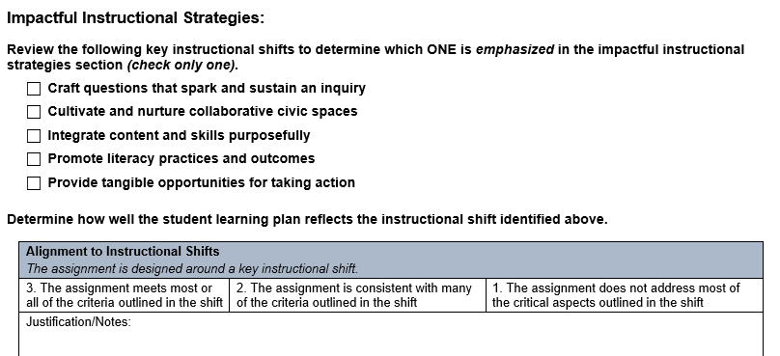
Assignment Review Protocol
Purpose: to determine how well the student learning plan emphasizes one of the instructional shifts listed in the above image.
.
Notes:
Facilitator’s Notes:
Explain: In order to complete this section, the PLC will need to determine which of the impactful instructional strategies is the focus of this assignment and evaluate the assignment based on these criteria provided in the protocol.

Slide 31
Assignment Review Protocol
Purpose: to determine the implications for practice and if any changes are needed to be made to better address the expectations of the standards.
Notes:
Facilitator’s Notes:
Explain: If the assignment did not score as strongly aligned on a component when it was evaluated using the Social Studies Assignment Review Protocol, then the assignment must be revised to better address the expectations of the standards. This is an opportunity for the PLC to reflect on the alignment of the assignment and make changes to the assignment as needed.

Slide 32
Reflection
How will your Professional Learning Community (PLC) use this protocol?
How will this learning impact the creation and evaluation of strongly KAS for Social Studies aligned assignments?
What supports will you/teachers need in your school(s) to implement strongly KAS for Social Studies aligned assignments?
Notes:
Facilitator’s Notes:
Ask participants, individually, with a partner or in a small grade-banded group, to discuss the questions on the slide after engaging with this introduction. Facilitate discussion over the reflection questions and address any comments that need further clarification or additional support.
Consider maintaining a Google document to house these reflections for continued consideration and further application.

Slide 33
Coming Up
Section A: Introduction to the protocol and KAS for Social Studies aligned assignments
Section B: Social Studies Assignment Review Protocol Overview
Section C: Evaluating an assignment using the Social Studies Assignment Review Protocol
Section D: Understanding the Student Work Review Protocol
Section E: Reflection
Notes:
Facilitator’s notes:
Bring the group back together and preview the additional contents of this module.

Slide 34
Stop here
Stop here if you are completing Module 5: Section B: Social Studies Assignment Review Protocol Overview
If you would like to complete another section of Module 5 at this time, continue onto the next slide to begin facilitating Module 5: Section C: Evaluating an assignment using the Assignment Review Protocol
Survey Link: Social Studies Assignment Review Protocol Module PL Survey
Notes:
Facilitator’s note:
Explain: The KDE needs your feedback on the effectiveness of this module, the learning platform and how the consultants may best support you as you take the next steps in the implementation process. We are going to complete a short survey to share our thinking and provide them with feedback on how the KDE can best meet our needs. Feedback from our surveys will be used by the KDE to plan and prepare future professional learning.
Post-survey: Social Studies Assignment Review Protocol Module PL Survey

Slide 35
Social Studies Assignment Review Protocol
How to Use the Protocol
Module 5: Section C
Evaluating Assignments using the Social Studies Assignment Review Protocol
Notes:
Materials:
The following materials are part of this module:
Kentucky Academic Standards (KAS) for Social Studies
Social Studies Assignment Review Protocol
Social Studies Student Assignment Library
Grade 1 Example for Evaluation
Grade 1 Assignment Review Protocol
Grade 4 Example for Evaluation
Grade 4 Assignment Review Protocol
Grade 7 Example for Evaluation
Grade 7 Assignment Review Protocol
High School Example A for Evaluation
High School Example A Assignment Review Protocol
Grade 5 Example for Evaluation
Grade 5 Assignment Review Protocol
Grade 8 Example for Evaluation
Grade 8 Assignment Review Protocol
High School Example B for Evaluation
High School Example B Assignment Review Protocol

Slide 36
Group Norms
Assume best intentions.
Listen carefully to one another.
Be open to new ideas.
Be open to working outside your comfort zone.
Ask questions.
Allow a chance for everyone to participate.
Notes:
Facilitator’s Notes:
Explain: “Group norms can help to create a safe space where participants feel comfortable sharing their ideas and experiences. Take a moment to read the norms.” After people are finished, ask: “Would you like to revise, edit or add any norms to the list?” If so, make changes on the slide; if not, move on to your discussion of the parking lot. NOTE: If participants made changes to this slide in the session since Section 5A, you will need to update this slide for their initial reading of the norms.
Explain: “I realize you may not want to pose every question to the whole group, or we may not have time in the session to get to every question. Therefore, I want us to have a place for those questions.” Point out the location of the parking lot for questions. For additional information on how to design the “parking lot” and address the questions, please see the note for the facilitator in Section 5A.

Slide 37
Overview of this module:
Section A: Introduction to the protocol and KAS for Social Studies aligned assignments
Section B: Social Studies Assignment Review Protocol Overview
Section C: Evaluating an assignment using the Social Studies Assignment Review Protocol
Section D: Understanding the Student Work Protocol
Section E: Reflection
Notes:
Facilitator’s Notes:
This slide provides an overview the sections included in this module.

Slide 38
Goals of this Module:
Engage with the Kentucky Academic Standards (KAS) for Social Studies.
Understand the purpose and use of the Social Studies Assignment Review Protocol.
Learn how to evaluate an assignment using the Social Studies Assignment Review Protocol.
Understand the characteristics of a strongly aligned KAS for Social Studies assignment.
Notes:
Facilitator’s Notes:
Explain: The goals for Module 5 are on this slide.

Slide 39
Essential Question
● Does my assignment meet the intended depth and rigor of the KAS for Social Studies?
Notes:
Facilitator’s Notes:
Move on by explaining: Section 5C of this module provides an on opportunity to evaluate grade-level assignment examples to assess whether they are strongly, partially or weakly aligned. One essential question will be answered by the end of the module. Read the question on the slide.

Slide 40
Assignment One: Is it strongly, partially or weakly aligned?
In this section of the module, you will determine whether or not the assignment provided is strongly, partially or weakly aligned to the KAS for Social Studies using the Social Studies Assignment Review Protocol.
Grade 1 Example for Evaluation
Grade 4 Example for Evaluation
Grade 7 Example for Evaluation
High School Example A for Evaluation
Notes:
Facilitator’s Notes:
Read the slide and distribute the grade-level assignment that the participants decide to evaluate. Participants may select one, two or all of the examples, depending on their needs, to engage with during this section of the module.

Slide 41
Is it strongly, partially or weakly aligned?
Individually or with your Professional Learning Community (PLC), use the Social Studies Assignment Review Protocol to determine whether or not the assignment is strongly, partially or weakly aligned to the KAS for Social Studies.
Record your responses on the Social Studies Assignment Review Protocol provided.
Notes:
Facilitator’s Notes:
Read the slide. Allow participants several minutes to complete this activity.

Slide 42
Is it strongly, partially or weakly aligned?
Compare the results of your completed protocol with this sample completed protocol for Grade 1, Grade 4, Grade 7 or High School by engaging with the following questions:
Are there any discrepancies between how you and/or your PLC rated the assignment and how the assignment is rated on the sample protocol? If not, move on to the next question. If so, discuss the differences with your PLC or if working alone ask a colleague to discuss the difference(s) with you. Focus the discussion on trying to get to the "Why?" behind the differences.
Review the reflection section of the Social Studies Assignment Review Protocol. What changes are needed to improve alignment to the KAS for Social Studies?
Notes:
Facilitator’s Notes:
Read the slide. Allow participants several minutes to complete this activity.

Slide 43
Assignment Two: Is it strongly, partially or strongly aligned?
Now, you will work with the Assignment Review Protocol to evaluate another assignment. Using one of the examples below, you will determine whether or not another assignment provided is strongly, partially or weakly aligned to the KAS for Social Studies using the Social Studies Assignment Review Protocol.
Grade 5 Example for Evaluation
Grade 8 Example for Evaluation
High School Example B for Evaluation
Notes:
Facilitator’s Notes:
Read the slide and distribute the grade-level assignment that the participants decide to evaluate. Participants may select one, two or all of the examples, depending on their needs, to engage with during this section of the module.

Slide 44
Is it strongly, partially or weakly aligned?
Individually or with your Professional Learning Community (PLC), use the Social Studies Assignment Review Protocol to determine whether or not the assignment is strongly, partially or weakly aligned to the KAS for Social Studies.
Record your responses on the Social Studies Assignment Review Protocol provided.
Notes:
Facilitator’s Notes:
Read the slide. Allow participants several minutes to complete this activity.

Slide 45
Is it strongly, partially or weakly aligned?
Compare the results of your completed protocol with this sample completed protocol for Grade 5, Grade 8 or High School by engaging with the following questions:
Are there any discrepancies between how you and/or your PLC rated the assignment and how the assignment is rated on the sample protocol? If not, move on to the next question. If so, discuss the differences with your PLC or if working alone ask a colleague to discuss the difference(s) with you. Focus the discussion on trying to get to the "Why?" behind the differences.
Review the reflection section of the Social Studies Assignment Review Protocol. What changes are needed to improve alignment to the KAS for Social Studies?
Notes:
Facilitator’s Notes:
Read the slide. Allow participants several minutes to complete this activity.

Slide 46
Extension: Student Assignment Library
For additional examples of strongly KAS for Social Studies assignments, visit the Student Assignment Library on www.kystandards.org.
Notes:
Facilitator’s Notes:
Read the slide. If participants are interested and if time allows, have participants explore the Social Studies Student Assignment Library on their own or with a partner. Allow participants several minutes to complete this activity.

Slide 47
Student Assignment Library
The Student Assignment Library provides examples of student assignments that are weakly, partially and strongly aligned to standards.
Strongly aligned assignments are provided for each grade Kindergarten through Grade 8 and one assignment is provided for the high school grade band.
One weakly and/or partially aligned assignment example are provided for elementary, middle and high.
The assignments can be used with the Assignment Review Protocol to develop a better understanding of the tool and how it can be applied to a teacher’s own work.
Notes:
Facilitator’s Notes:
Read the slide.

Slide 48
Reflection
How will this learning impact your instruction? In your response, think about your experience with the example(s) you evaluated.
What supports will you/teachers need in your school(s) to design and implement strongly KAS for Social Studies aligned assignments.
How will you and/or your PLC use the Student Assignment Library?
Notes:
Facilitator’s Notes:
Ask participants, individually, with a partner or in a small grade-banded group, to discuss the questions on the slide after engaging with this section. Facilitate discussion over the reflection questions and address any comments that need further clarification or additional support.
Consider maintaining a Google document to house these reflections for continued consideration and further application.

Slide 49
Coming Up
Section A: Introduction to the protocol and KAS for Social Studies aligned assignments
Section B: Social Studies Assignment Review Protocol Overview
Section C: Evaluating an assignment using the Social Studies Assignment Review Protocol
Section D: Understanding the Student Work Review Protocol
Section E: Reflection
Notes:
Facilitator’s notes:
Bring the group back together and preview the additional contents of this module.

Slide 50
Stop here
Stop here if you are completing Module 5: Section C: Social Studies Assignment Review Protocol Overview
If you would like to complete another section of Module 5 at this time, continue onto the next slide to begin facilitating Module 5: Section D Understanding the Student Work Review Protocol.
Survey Link: Social Studies Assignment Review Protocol Module PL Survey
Notes:
Facilitator’s note:
Explain: The KDE needs your feedback on the effectiveness of this module, the learning platform and how the consultants may best support you as you take the next steps in the implementation process. We are going to complete a short survey to share our thinking and provide them with feedback on how the KDE can best meet our needs. Feedback from our surveys will be used by the KDE to plan and prepare future professional learning.
Post-survey: Social Studies Assignment Review Protocol Module PL Survey

Slide 51
Social Studies Assignment Review Protocol
How to Use the Protocol
Module 5: Section D
Understanding the Student Work Review Protocol
Notes:
Materials:
The following materials are part of this module:
Social Studies Student Work Review Protocol

Slide 52
Group Norms
Assume best intentions.
Listen carefully to one another.
Be open to new ideas.
Be open to working outside your comfort zone.
Ask questions.
Allow a chance for everyone to participate.
Notes:
Facilitator’s Notes:
Explain: “Group norms can help to create a safe space where participants feel comfortable sharing their ideas and experiences. This slide is a starter. Take a moment to read the norms.” After people are finished, ask: “Would you like to revise, edit or add any norms to the list?” If so, make changes on the slide; if not, move on to your discussion of the parking lot. NOTE: If participants made changes to this slide in the session since Section 5A, you will need to update this slide for their initial reading of the norms.
Explain: “I realize you may not want to pose every question to the whole group, or we may not have time in the session to get to every question. Therefore, I want us to have a place for those questions.” Point out the location of the parking lot for questions. This may be a poster on which participants write or post questions, or you may prefer to have a digital parking lot where participants can access a Google document, for example, to post questions and that you can modify as the participants work through the sections of the module. The purpose of the parking lot is to provide participants with a safe way of asking questions. Remember that you may not know all of the answers to the questions, and that is okay. Some may be answered in future sections of the module.
If the question is pressing and doesn’t appear to be addressed in the sections of Module 5, talk to your district team and determine who would be the best person to contact at the KDE. You may also email questions or feedback to standards@education.ky.gov.

Slide 53
Overview of this module:
Section A: Introduction to the protocol and KAS for Social Studies aligned assignments
Section B: Social Studies Assignment Review Protocol Overview
Section C: Evaluating an assignment using the Social Studies Assignment Review Protocol
Section D: Understanding the Student Work Protocol
Section E: Reflection
Notes:
Facilitator’s Notes:
This slide provides an overview the sections included in this module.

Slide 54
Goals of this Module:
Engage with the Kentucky Academic Standards (KAS) for Social Studies.
Understand the purpose and use of the Social Studies Assignment Review Protocol.
Learn how to evaluate an assignment using the Social Studies Assignment Review Protocol.
Understand the characteristics of a strongly aligned KAS for Social Studies assignment.
Notes:
Facilitator’s Notes:
Explain: The goals for Module 5 are on this slide.

Slide 55
Essential Question
● Does my assignment meet the intended depth and rigor of the KAS for Social Studies?
Notes:
Facilitator’s Notes:
Move on by explaining: Section 5D of this module provides an overview of the Social Studies Student Work Review Protocol. One essential question will be answered by the end of the module. Read the question on the slide.

Slide 56
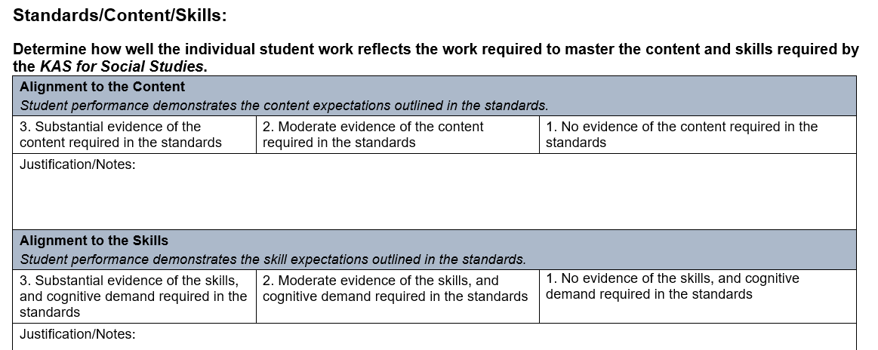
Student Work Review Protocol
The purpose of this document is to help teachers answer the question, “Are students demonstrating the expectations of the content and skills of the KAS for Social Studies?” Each section of the protocol will allow you to rate that aspect of the student work either weakly aligned (1), partially aligned (2) or strongly aligned (3). After completing sections one through three, you will have the opportunity to determine changes that need to be made to better address the expectations of the standards if the assignment is weakly (1) or partially aligned (2).
Notes:
Facilitator’s Notes:
Explain: Unlike the Assignment Review Protocols for Reading and Writing and Math, the Social Studies Student Work Review Protocol is a separate document. We understand that due to the massive shifts with implementing the KAS for Social Studies, PLCs are challenged with creating potentially brand new grade-level standards aligned assignments. The separation of these two documents allows PLCs to focus on the creation of the assignment and then revisit the implementation of the assignments when reflecting on student work.
While these two documents are presented separately, it is critical that PLCs use both documents when determining the alignment of a grade-level assignment. The analysis of the assignment design and the student products resulting from the assignment are both critical to determining if the assignment is strongly aligned to the KAS for Social Studies.

Slide 57
Investigating the Student Work Review Protocol
While analyzing the Student Work Review Protocol, mark your noticings by underlining, writing in the margins, circling or highlighting. Noticings are your thoughts while reading - things you want to remember, places that confuse you, your questions, your connections and more.
Notes:
Facilitator’s Notes:
Explain: Have participants mark their noticings as they analyze the Student Work Review Protocol by following the directions on the slide.

Slide 58
Student Work Review Protocol
Purpose: to determine if student performance demonstrates the content expectations in the standards.
Notes:
Facilitator’s Notes:
Explain: When reviewing the assignment to determine how well the individual student work reflects the work required to master the content required by the KAS for Social Studies, the PLC must determine if there is substantial evidence of the content required in the standards present in the student work.
Rate that aspect of the assignment either weakly aligned (1), partially aligned (2) or strongly aligned (3).

Slide 59
Student Work Review Protocol
Purpose: to determine if student performance demonstrates the skills outlined in the standards.
Notes:
Facilitator’s Notes:
Explain: When reviewing the assignment to determine how well the individual student work reflects the work required to master the skills required by the KAS for Social Studies, the PLC must determine if there is substantial evidence of the skills and cognitive demand required in the standards present in the student work.
Rate that aspect of the assignment either weakly aligned (1), partially aligned (2) or strongly aligned (3).

Slide 60
Student Work Review Protocol
Purpose: to determine if the student performance demonstrates thinking with social studies content by questioning, investigating, using evidence and communicating conclusions to produce comparisons/contrasts, arguments, application of new information to new contexts, and consideration of alternative viewpoints.
Notes:
Facilitator’s Notes:
Explain: When determining how well individual student work reflects the rigorous work required to master the KAS for Social Studies, the PLC must determine if there is substantial evidence of analysis. A moderate portion of the student’s work includes analysis and inquiry.
Rate that aspect of the assignment either weakly aligned (1), partially aligned (2) or strongly aligned (3).

Slide 61
Student Work Review Protocol
Purpose: to determine if the student performance demonstrates an understanding of ideas, concepts, theories, and principles from the social studies disciplines by using them to interpret and explain specific, concrete information or events.
Notes:
Facilitator’s Notes:
Explain: When determining how well individual student work reflects the rigorous work required to master the KAS for Social Studies, the PLC must determine if the student has used social studies concepts and practices to organize, explain, interpret, summarize, and extend the meaning and significance of otherwise discrete pieces of information. The use of ideas or application of concepts illustrates exemplary understanding.
Rate that aspect of the assignment either weakly aligned (1), partially aligned (2) or strongly aligned (3).

Slide 62
Student Work Review Protocol
Purpose: to determine if the student performance demonstrates an elaboration of his or her understanding or explanations through elaborated expressive communication.
Notes:
Facilitator’s Notes:
Explain: When determining how well individual student work reflects the rigorous work required to master the KAS for Social Studies, the PLC must determine if the explanations or arguments are clear, convincing, and accurate, with no significant errors. Communication is exemplary.
Rate that aspect of the assignment either not aligned (1), weakly aligned (2), partially aligned (3) or strongly aligned (4).

Slide 63
Student Work Review Protocol
Purpose: to determine if the student performance demonstrates the ability to address a concept, problem or issue that is similar to one that they have encountered or are likely to encounter in daily life outside of school.
Notes:
Facilitator’s Notes:
Explain: When determining how well individual student work reflects the rigorous work required to master the KAS for Social Studies, the PLC must determine if the student work demonstrates multiple ways the content connects to the student’s life.
Rate that aspect of the assignment either weakly aligned (1), partially aligned (2) or strongly aligned (3).

Slide 64
Reflection
This reflection section allows educators to reflect on the alignment of the assignment based on student work samples and allows for educators to make plans for improvement.
Notes:
Facilitator’s Notes:
Explain: This reflection section allows educators to reflect on the alignment of the assignment based on student work samples and allows for educators to make plans for improvement.

Slide 65
Reflection
How will this learning impact your instruction? In your response, think about the Student Work Review Protocol you just analyzed.
How could the Student Work Review Protocol further help you evaluate your assignment’s alignment?
How could this tool be useful in your PLC?
What supports will you/teachers need in your school(s) to design and implement strongly KAS for Social Studies aligned assignments.
Notes:
Facilitator’s Notes:
Ask participants, individually, with a partner or in a small grade-banded group, to discuss the questions on the slide after engaging with this section. Facilitate discussion over the reflection questions and address any comments that need further clarification or additional support.
Consider maintaining a Google document to house these reflections for continued consideration and further application.

Slide 66
Coming Up
Section A: Introduction to the tool and KAS for Social Studies aligned assignments
Section B: Social Studies Assignment Review Protocol Overview
Section C: Evaluating an assignment using the Social Studies Assignment Review Protocol
Section D: Understanding the Student Work Review Protocol
Section E: Reflection
Notes:
Facilitator’s notes:
Bring the group back together and preview the additional contents of this module.

Slide 67
Stop here
Stop here if you are completing Module 5: Section D: Social Studies Assignment Review Protocol Overview
If you would like to complete another section of Module 5 at this time, continue onto the next slide to begin facilitating Module 5: Section E: Evaluating an assignment using the Assignment Review Protocol
Survey Link: Social Studies Assignment Review Protocol Module PL Survey
Notes:
Facilitator’s note:
Explain: The KDE needs your feedback on the effectiveness of this module, the learning platform and how the consultants may best support you as you take the next steps in the implementation process. We are going to complete a short survey to share our thinking and provide them with feedback on how the KDE can best meet our needs. Feedback from our surveys will be used by the KDE to plan and prepare future professional learning.
Post-survey: Social Studies Assignment Review Protocol Module PL Survey

Slide 68
Social Studies Assignment Review Protocol
How to Use the Protocol
Module 5: Section E
Reflection
Notes:
Facilitator’s Notes:
Materials:
The following materials are needed for this section:
The Opportunity Myth

Slide 69
Group Norms
Assume best intentions.
Listen carefully to one another.
Be open to new ideas.
Be open to working outside your comfort zone.
Ask questions.
Allow a chance for everyone to participate.
Notes:
Facilitator’s Notes:
Explain: “Group norms can help to create a safe space where participants feel comfortable sharing their ideas and experiences. This slide is a starter. Take a moment to read the norms.” After people are finished, ask: “Would you like to revise, edit or add any norms to the list?” If so, make changes on the slide; if not, move on to your discussion of the parking lot. NOTE: If participants made changes to this slide in the session since Section 5A, you will need to update this slide for their initial reading of the norms.
Explain: “I realize you may not want to pose every question to the whole group, or we may not have time in the session to get to every question. Therefore, I want us to have a place for those questions.” Point out the location of the parking lot for questions. This may be a poster on which participants write or post questions, or you may prefer to have a digital parking lot where participants can access a Google document, for example, to post questions and that you can modify as the participants work through the sections of the module. The purpose of the parking lot is to provide participants with a safe way of asking questions. Remember that you may not know all of the answers to the questions, and that is okay. Some may be answered in future sections of the module.
If the question is pressing and doesn’t appear to be addressed in the sections of Module 5, talk to your district team and determine who would be the best person to contact at the KDE. You may also email questions or feedback to standards@education.ky.gov.

Slide 70
Overview of this module:
Section A: Introduction to the protocol and KAS for Social Studies aligned assignments
Section B: Social Studies Assignment Review Protocol Overview
Section C: Evaluating an assignment using the Social Studies Assignment Review Protocol
Section D: Understanding the Student Work Protocol
Section E: Reflection
Notes:
Facilitator’s Notes:
This slide provides an overview the sections included in this module.

Slide 71
Goals of this Module:
Engage with the Kentucky Academic Standards (KAS) for Social Studies.
Understand the purpose and use of the Social Studies Assignment Review Protocol.
Learn how to evaluate an assignment using the Social Studies Assignment Review Protocol.
Understand the characteristics of a strongly aligned KAS for Social Studies assignment.
Notes:
Facilitator’s Notes:
Explain: The goals for Module 5 are on this slide.

Slide 72
Essential Question
● Does my assignment meet the intended depth and rigor of the KAS for Social Studies?
Notes:
Facilitator’s Notes:
Move on by explaining: Section 5E of this module provides an opportunity to reflect on your learning and experiences during this module. One essential question will be answered by the end of the module. Read the question on the slide.

Slide 73
Why do the standards matter?
Why do the standards matter?
TNTP’s report, The Opportunity Myth, examines the quality of student’s academic experiences in school—and its effect on their long-term success.
At the heart of this report are real students, their aspirations and dreams, and how school sets them up – or doesn’t – to reach those goals.
Notes:
Facilitator’s Notes:
Move on by explaining that Section E explores why this work matters by revisiting the Opportunity Myth. Read the slide.

Slide 74
Here’s what TNTP found:
Students have big, clear plans for college and career.
Most students do that they’re asked in school - but are still not ready to succeed after school.
Students spend most of their time in school without access to four key resources: grade-appropriate assignments, strong instruction, deep engagement, and teachers with high expectations.
Students of color, those from low-income families, English language learners, and students with mild to moderate disabilities have even less access to these resources than their peers.
Greater access to the four resources can and does improve student achievement- particularly for students who start the year behind.
Notes:
Facilitator’s Notes:
Explain: This slide summarizes TNTP’s findings. Read the slide.

Slide 75
Opportunity myth
Notes:
Facilitator’s Notes:
Explain: This slide summarizes TNTP’s findings. Read the slide.

Slide 76
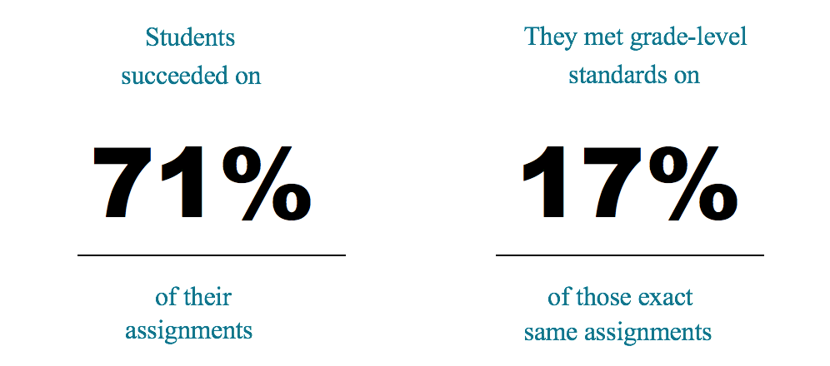
In the nearly 1,000 lessons observed, students were working on activities related to class 88 percent of the time and more than half brought home A’s and B’s.
Even though most students are meeting the demands of their assignments, they're not prepared for meeting the demands of grade-level assignments.
Notes:
Facilitator’s Notes:
Explain: This slide summarizes TNTP’s findings. Read the slide.

Slide 77
Opportunity myth
Notes:
Facilitator’s Notes:
Explain: This slide summarizes TNTP’s findings. Read the slide.

Slide 78
Opportunity myth
Notes:
Facilitator’s Notes:
Explain: This slide summarizes TNTP’s findings. Read the slide.

Slide 79
Opportunity myth
Notes:
Facilitator’s Notes:
Explain: This slide summarizes TNTP’s findings. Read the slide.

Slide 80
Opportunity myth
Notes:
Facilitator’s Notes:
Explain: This slide summarizes TNTP’s findings. Read the slide.

Slide 81
Opportunity myth
Most students get those chances far too infrequently.
TNTP found four key commitments that influence a student’s school experience and outcomes.
Notes:
Facilitator’s Notes:
Explain: This slide summarizes TNTP’s findings. Read the slide.

Slide 82
Opportunity myth
Notes:
Facilitator’s Notes:
Explain: This slide summarizes TNTP’s findings. Read the slide.

Slide 83
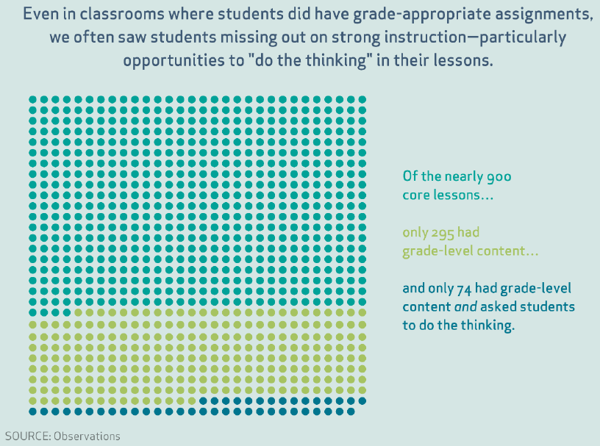
Opportunity myth
Even in classrooms where students did have grade-appropriate assignments, TNTP often saw students missing out on strong instruction – particularly opportunities to “do the thinking.”
Of the nearly 900 core lessons …
Only 295 had grade-level content …
And only 74 had grade-level content and asked students to do the thinking.
Notes:
Facilitator’s Notes:
Explain: This slide summarizes TNTP’s findings. Read the slide.

Slide 84
Opportunity myth
Inequitable access isn’t random. White students and those from higher-income families were more likely to be in classrooms that offered the four key commitments.
Notes:
Facilitator’s Notes:
Explain: This slide summarizes TNTP’s findings. Read the slide.

Slide 85
Opportunity myth
Notes:
Facilitator’s Notes:
Explain: This slide summarizes TNTP’s findings. Read the slide.

Slide 86
Opportunity Myth Reflection
Four Key Commitments:
Grade-Appropriate Assignments
Strong Instruction
Deep Engagement
High Expectations
Based on your classroom, school, district or region in which areas do you see
Strong evidence of implementation?
Inconsistent evidence of implementation?
Little to no evidence of implementation?
Notes:
Facilitator’s Notes:
Ask participants, individually, with a partner or in a small grade-banded group, to discuss the questions on the slide after engaging with this section. Facilitate discussion over the reflection questions and address any comments that need further clarification or additional support.
Consider maintaining a Google document to house these reflections for continued consideration and further application.

Slide 87
Reflection
Why is there an urgency around successful implementation of the Kentucky Academic Standards?
Why is it essential that students have opportunities to engage with assignments strongly aligned to the KAS for Social Studies?
How can PLC(s) use the Assignment Review Protocol and the Student Work Review Protocol when designing KAS for Social Studies aligned curriculum?
Notes:
Facilitator’s Notes:
Continue the reflection by asking participants, individually, with a partner or in a small grade-banded group, to discuss the questions on the slide after engaging with this module. Facilitate discussion over the reflection questions and address any comments that need further clarification or additional support.
Consider maintaining a Google document to house these reflections for continued consideration and further application.

Slide 88
Stop here
This concludes Module 5: Social Studies Assignment Review Protocol - How to Use the Protocol
Survey Link: Social Studies Assignment Review Protocol Module PL Survey
Notes:
Facilitator’s note:
Explain: The KDE needs your feedback on the effectiveness of this module, the learning platform and how the consultants may best support you as you take the next steps in the implementation process. We are going to complete a short survey to share our thinking and provide them with feedback on how the KDE can best meet our needs. Feedback from our surveys will be used by the KDE to plan and prepare future professional learning.
Post-survey: Social Studies Assignment Review Protocol Module PL Survey

