Slide 1
First Slide

Slide 2
Standards Alignment: How will you ensure your curriculum, assignments and assessments are aligned? Kentucky Academic Standards for Reading and Writing
Webcast
May 30, 2019

Slide 3
Essential Questions:
Why is standards alignment important?
How can we ensure assignments, assessments, curricula are aligned?
Where can schools and districts go for resources and support?

Slide 4
KYStandards.org

Slide 5
The Importance of Standards Alignment
The Opportunity Myth
Grade-appropriate Assignments
Strong Instruction
High Expectations
Deep Engagement

Slide 6
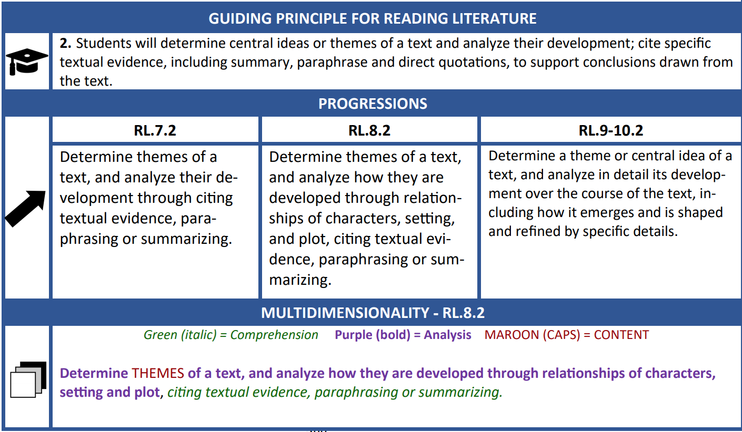
The Importance of Standards Alignment
Notes:
19,355

Slide 7
Supporting Standards Components
Within the KAS documents are the supporting components needed for alignment.
Learn more:
Getting to Know Your KAS Modules
Webcasts (KYStandards.org)
June Conference
Notes:
The teachers writers of the standards included supporting components in the KAS documents to help in the alignment process. If teachers are only looking at the standards, there is a lot of information that will be lost in helping have that deeper understanding. These resources were developed for teachers by teachers, who understood that this level of support would be needed as standards implementation took place. For instance, by just looking at the standard only in the RW document, you’d be missing the breakdown view and the interdisciplinary practices that are meant to clarify the depth and rigor of the standards.

Slide 8
How can we ensure curricula, assignments, and assessments are aligned?
Assignment Review
Curriculum Review
Assessment Review
Focus Team
Build a Plan for Professional Learning and Alignment
Monitor Instruction
Notes:
Monitor to ensure students are experiencing grade level assignments/instruction.

Slide 9
Getting to Know Your KAS Learning Lab Conference
June 10 Christian Co
June 11 Jefferson Co
June 12 Carter Co
June 14 Lexington

Slide 10
5 Things to Know Before You Go
Building a Firm Foundation in the KAS
Soon-to-be-Released Tools
Kentucky-specific Instructional Decision Guide
Kentucky-specific Work Library
Digital Learning Experiences
KYStandards.org
June Conference
Educational Cooperative Summer Experiences

Slide 11
First Slide

