Slide 1
Supporting Students in Using Evidence
Module Series Overview

Slide 2
Supporting Students in Using Evidence2
Module Four: What Should Students Do Before Engaging with Complex Sources?
Notes:
Module Series Overview:
Supporting Students in Using Evidence module series is a set of six of modules designed to support students when using evidence as required by the Kentucky Academic Standards (KAS) for Social Studies. While this module series is designed in a progression, you may engage with the module section that best meets your professional learning needs.
Supporting Students in Using Evidence module series is intended to support the successful implementation of the KAS for Social Studies in classrooms across the state. The duration, scope and sequence of the module sections may be customized to accommodate local needs and conditions. The sections are designed to provide flexibility for districts and schools and, as such, can be viewed as stand-alone lessons or within the progression of the module as written. You are supported in engaging with this module individually, if desired.
Materials:
The following materials are part of this module:
●Kentucky Academic Standards (KAS) for Social Studies
●Additional materials, such as but not limited to, articles, discussion strategies, etc. are provided within the notes section of applicable slides throughout the module.
Guiding Notes
Guiding notes are provided in the Notes section of the PowerPoint to support your learning. The information provided in the Notes section includes additional information, directions for the activities on the slide, and citations of used resources, where appropriate. It is critical that you read the material presented in the Notes section to ensure that you are acquiring the important knowledge, skills and understanding required when engaging with this module.
Virtual Training Note:
If you plan to engage with this module virtually as a group, consider directing participants to the Social Studies Professional Learning Modules webpage on kystandards.org so that you may access the resources used directly from the links provided in the PowerPoint. Additionally, you may consider downloading the resources contained within each section of the module and placing them into a Google folder for you or your colleagues to access.
Module Four: Compelling and Supporting Questions
Compelling Question: How do I support students in communicating their own conclusions, using evidence to substantiate their claims?
Supporting Question: How do I support students’ comprehension of primary and secondary sources?
Learning Target and Success Criteria:
The Learning Target and Success Criteria for districts and schools of Module Four: What should students do before engaging with complex sources? are:
Learning Target: I can support students in using evidence to substantiate their claims.
Success Criteria: I will be successful when I can develop coherent periods of learning that supports students’ comprehension of primary and secondary sources.
Intended Audiences:
Participants
Module participants may include, but are not limited to, district leadership, school administrators, instructional specialists/coaches, intervention specialists, department chairs, special educators and classroom teachers.
It is important to note that it is recommended that participants have engaged with the following modules prior to engaging with this module:
Getting to know the Kentucky Academic Standards (KAS) for Social Studies Module
The Minding the Gap Module
The Inquiry Practices of the Kentucky Academic Standards (KAS) for Social Studies Module
Thus, participants are encouraged to engage with these modules prior to participating in this module.
Facilitators:
While this module series is designed for a teacher to engage with it individually, it may be implemented with a group of educators led by a facilitator. If this module is being completed as a group, facilitators may include, but are not limited to, district leaders, school administrators, instructional specialists/coaches, intervention specialists, department chairs, special educators, and classroom teachers. Facilitators may need to revise specific tasks in order to meet the needs of the participants or to be respectful of the time planned within the work session. As stated above, the Kentucky Department of Education (KDE) recommends that participants engage with the four modules mentioned above prior to engaging with this work. If the facilitator has not engaged with these modules, it is recommended that they complete the four modules mentioned before facilitating this module.
Helpful Hint for Facilitators:
The learning that will take place in this module may cause Kentucky educators to face changes in instructional practices amidst this transition. It is important to realize that while you are the facilitator of these work sessions, you may not have all the answers to the questions asked by participants, and that is okay. Throughout the module, participants may have questions that will be addressed in future work sessions. When that happens, reflect on this quote from Graham Fletcher, “Every teachable moment doesn’t need to be a teachable moment in that moment.” Use these moments to encourage participants to attend future work sessions where those questions will be addressed. If participants ask questions you are not prepared to answer, offer to follow up on that during the next work session.
Planning Ahead for Facilitators:
• Determine which stakeholders to invite as participants. In the invitation, describe how the work sessions will benefit them.
• A few days before the meeting, you may want to remind participants to be prepared to have their documents available during the meeting. (See below for Participant Documents Needed.)
• Reserve adequate space and equipment. Tables or desks should be set up to support small-group discussion. If conducting this module virtually, ensure that your technology platform can support break out rooms to support small group collaboration.
• Ensure that participants have access to the Internet.
• Consider how you might handle participants who may not be in attendance at all work sessions. It might be worthwhile to consider how those participants might access missed sections of the module between work sessions in order to feel as prepared as the other participants.
Preparation
Participant Documents Needed:
Plan ahead regarding how you will feel most comfortable engaging with the KAS for Social Studies, either:
• A device with access to the KAS for Social Studies, or
• A hard copy of the KAS for Social Studies
Supplies Needed:
• Computer with the Module Four: What should students do before engaging with complex sources? PowerPoint presentation.
• Technology with projection capability if in person with a group. Technology platform where presenters have sharing ability and breakout room options if virtual with a group.
• Copies of the handouts needed for the session either in hard copy format or available in a folder online. If facilitating this work with a group, links to the participant handouts needed for the session also may be built right into the agenda.
• Parking Lot for questions - If completing as a group, you may consider providing a poster on which participants can write or post questions, or you may prefer to have a digital parking lot where participants can access a Google document, for example, to post questions and that you can modify as the participants work through the sections of the module.
• Self-Sticking Notes (optional)
• Poster paper (optional)
• Highlighters and/or colored pens/markers (optional)
Building a Community:
Building a community is important for any group that will work together, especially if participants have not worked together before. The concept is the same as building a safe, respectful, productive classroom climate. Incorporating community-building into each session builds trust, shows participants that they are valuable as individuals and engages them in the learning process. It is also useful for creating a professional learning network where participants can be supported in their work. Community-building can be as simple as allowing participants to introduce themselves and their role in the school/district, developing or refining group norms, allowing for questions, and/or the sharing of answers to reflection questions or individual discovery task items that are included in this module. Again, time allotted for community-building will allow participants to have a voice and be engaged as active contributors and learners in the sessions.
Virtual Training Options: Be sure to conduct continual check-ins throughout the presentation. Build Google documents to continue to collect feedback, such as questions, hopes, and/or concerns to which participants may continually add.

Slide 3
Introduction
Compelling Question: How do I support students in communicating their own conclusions, using evidence to substantiate their claims?
Supporting Question: How do I support students’ comprehension of primary and secondary sources?
Learning Target: I can support students in using evidence to substantiate their claims.
Success Criteria: I will be successful when I can develop coherent periods of learning that supports students’ comprehension of primary and secondary sources.
Notes:
Guiding Notes:
For more information on compelling questions, visit Section 3B: “What are Compelling Questions and how do students ask them?” from the Inquiry Practices of the KAS for Social Studies module.
For more information on supporting questions, visit “Section C: What are Supporting Questions, and how do students ask them?” from the Inquiry Practices of the KAS for Social Studies module.
For more information on Learning Goals and Success Criteria and their alignment to the KAS for Social Studies, visit Learning Goals, Success Criteria and the KAS for Social Studies.

Slide 4
Supporting Students When Engaging With Complex Sources
The Phases of Engaging with Sources
Before Engaging with the Source(s)
While Engaging with the Source(s)
After Engaging with the Source(s)
Notes:
Guiding Notes:
Supporting student comprehension of complex sources may occur in three phases. When implementing a complex source in the local curriculum, teachers can support student comprehension of the source by using strategies before, during and after reading the complex source. Module Four discusses ways to prepare students to comprehend complex sources before engaging with the source.
As you engage with Module Four, you are encourage to view this PowerPoint in slideshow or presentation mode to ensure that you are able to read the text featured on each slide.
As participants progress through Module Four, they will record their work in the Module Four Notecatcher.

Slide 5
Supporting Students When Engaging With Complex Sources:
Before Engaging with the Source(s) (1)
Before engaging with the source(s), support students’ introduction to the source by:
Setting the purpose for engaging with the sources
Generating interest in the topic
Activating prior knowledge
Supporting students with unknown vocabulary
Notes:
Guiding Notes:
Read the slide.

Slide 6
Supporting Students When Engaging With Complex Sources:
Before Engaging with the Source(s) (2)
Generate interest in the source by:
Framing the source
Provide a statement about the purpose of their learning with the source that will focus the attention of students as they begin to look at the source.
Notes:
Guiding Notes:
It is important to note another resource in this module, Adapting Documents for the Classroom: Equity and Access similarly calls for framing the source, but it recommends to do it through a head note. In this web page, it states “create a head note that includes background information and even a brief reading guide.” This helps students to focus on what they’re reading while using background knowledge to make sense of it.
Resource:
Teachinghistory.org. (2018). Adapting Documents for the Classroom: Equity and Access. Roy Rosenzweig Center for History and New Media at George Mason University. https://teachinghistory.org/teaching-materials/teaching-guides/23560

Slide 7
Supporting Students When Engaging With Complex Sources:
Before Engaging with the Source(s) (3)
Generate interest in the source by:
Framing the source
In this Grade 2 example, the teacher provides a statement about who the Maya were, where they lived, and that their ancestors are still present in Mexico today before students engage with a source about the Maya.
Inform students that one of the largest groups found in the Yucatan peninsula was the Maya and identify where they were located on the infographic map. Explain that they were an ancient indigenous group who lived a very long time ago, and their ancestors still live there today. Show students two video clips: Ancient Maya 101, which discusses what artifacts show about Maya lifestyle and culture, and Maya People, which provides more information about Maya culture and how it is still seen among the descendants of Maya people today. Share the following questions to students before watching the videos so they can be looking for this information as they watch:
Notes:
Guiding Notes:
Read the slide.
This slide provides an excerpt of a Teacher Note that shows how a student is supporting in meeting the source during an investigation. You may access the full Teacher Note using the link provided in the word “example.”
Resource:
Kentucky Department of Education (n.d.) Grade 2 Strongly Aligned with Teacher Notes. Social Studies Student Library. https://education.ky.gov/curriculum/standards/kyacadstand/Documents/Grade_2_SS_Strongly_Aligned_Assignment_TN.docx

Slide 8
Before Engaging with the Source(s): Application (1)
Access your Module Four Notecatcher and record your definition of framing the source.
Access a text-based source from your curated source set from Module Two of the Supporting Students in Using Evidence Model Series.
Generate interest in the source by framing the source.
Provide a statement about the purpose of their learning with the source or create a head note.
Record this statement on your notecatcher.
Notes:
Guiding Notes:
Read the slide and complete the application activity on the slide. Record your responses on in the Module Four Notecatcher.
Resource:
Kentucky Department of Education (n.d.) Grade 2 Strongly Aligned with Teacher Notes. Social Studies Student Library. https://education.ky.gov/curriculum/standards/kyacadstand/Documents/Grade_2_SS_Strongly_Aligned_Assignment_TN.docx

Slide 9
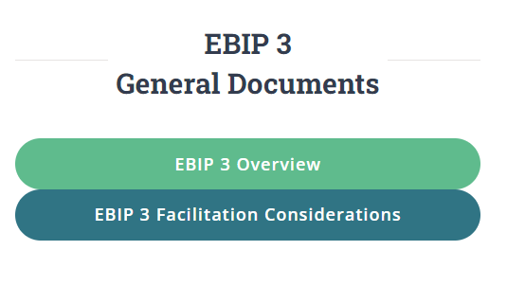
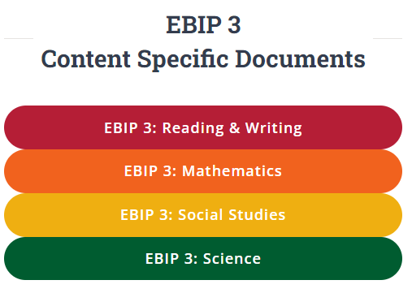
Supporting Students When Engaging With Complex Sources:
Before Engaging with the Source(s) (4)
Generate interest in the source by:
Engaging in Explicit Teaching and Modeling of the topic
In order for a student to understand a source, students need to understand the topic the source engages with or relates to. Prior to engaging with a source, educators must use explicit teaching and modeling when/in presenting concepts to students so that students feel confident when engaging with a source.
Notes:
Guiding Notes:
Read the slide.
Resource:
Kentucky Department of Education (n.d.) Evidence-Based Instructional Practices Explicit Teaching and Modeling and the Kentucky Academic Standards for Social Studies. Evidence Based Instructional Practices. https://education.ky.gov/curriculum/standards/kyacadstand/Documents/EBIP_3_Social_Studies.pdf

Slide 10
Supporting Students When Engaging With Complex Sources:
Before Engaging with the Source(s) (5)
Generate interest in the source by:
Engaging in Explicit Teaching and Modeling of the topic
For example, teachers must:
Provide clear, detailed instructions and explanations and chunk content to support students in synthesizing their knowledge of the disciplinary strand and/or inquiry standards that supports a student’s understanding of the source; and
Strike a balance in how much information is provided as providing too much information could prevent a student from interacting with a source because they already know everything about it.
Notes:
Guiding Notes:
Read the slide.
Resource:
Kentucky Department of Education (n.d.) Evidence-Based Instructional Practices Explicit Teaching and Modeling and the Kentucky Academic Standards for Social Studies. Evidence Based Instructional Practices. https://education.ky.gov/curriculum/standards/kyacadstand/Documents/EBIP_3_Social_Studies.pdf

Slide 11
Supporting Students When Engaging With Complex Sources:
Before Engaging with the Source(s) (6)
Generate interest in the source by:
Engaging in Explicit Teaching and Modeling of the topic
Explain to students that you are going to investigate interactions between people in our community. As a reminder, “community” in Kindergarten refers to the students’ classroom, school and local town, city or district. First, ensure that students understand the word “interaction” when referring to individuals in a community. Provide them with a student-friendly definition, such as “people talking to each other” and provide examples. Ask students to Turn and Talk to a partner to share examples of interactions between people that they have seen today. Students should take turns talking and listening to each other; provide Partner A with two minutes to speak while Partner B listens, and two minutes for Partner B to speak while Partner A listens.
In this Kindergarten example, the teacher supports students in understanding positive and negative interactions among people in a community and facilitates a role-playing exercise for students to practice identifying examples.
Notes:
Guiding Notes:
Read the slide.
This slide provides an excerpt of a Teacher Note that shows how a student is supporting in meeting the source during an investigation. You may access the full Teacher Note using the link provided in the word “example.”

Slide 12
Before Engaging with the Source(s): Application (2)
Access the same text-based source from your curated source set from Module Two of the Supporting Students in Using Evidence Model Series that you used earlier.
Write a narrative overview that summarizes how you could engage in explicit teaching and modeling before students engage with this source.
Notes:
Guiding Notes:
Read the slide and complete the application activity on the slide. Record your responses on in the Module Four Notecatcher.
Resource:
Kentucky Department of Education (n.d.) Evidence-Based Instructional Practices Explicit Teaching and Modeling and the Kentucky Academic Standards for Social Studies. Evidence Based Instructional Practices. https://education.ky.gov/curriculum/standards/kyacadstand/Documents/EBIP_3_Social_Studies.pdf

Slide 13
Supporting Students When Engaging With Complex Sources:
Before Engaging with the Source(s) (7)
Generate interest in the source by:
Supporting students in meeting the source
Have students explore the source by skimming it or observing it. Have students record what they notice and wonder about the source.
When meeting a source, a student could ask “What do I see?”, “Is the document handwritten, typed or both?” and “What do I think this object is?”
Notes:
Guiding Notes:
Read the slide.

Slide 14
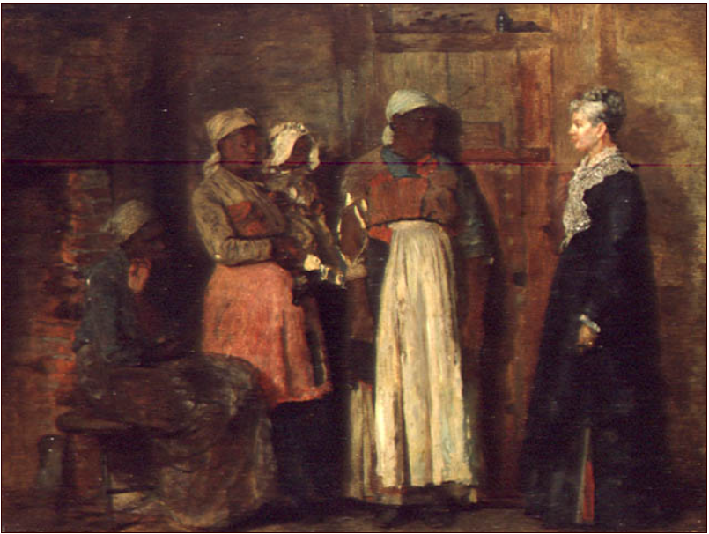
Supporting Students When Engaging With Complex Sources:
Before Engaging with the Source(s) (8)
Generate interest in the source by:
Supporting students in meeting the source
Access this Grade 8 example from KDE’s Including Diverse Groups module and visit page 24. Students “meet” a painting, A Visit from the Old Mistress, by using the National Archives Analyze Artwork tool. Students meet the painting and observe its parts prior to understanding the cultural context of the work.
Notes:
Guiding Notes:
Read the slide.
This slide provides an excerpt of a Teacher Note that shows how a student is supporting in meeting the source during an investigation. You may access the full Teacher Note using the link provided in the word “example.”

Slide 15
Before Engaging with the Source(s): Application (3)
Access a text-based source. You may use your curated source set from slide 12 of Module Two of the Supporting Students in Using Evidence Model Series if you completed this module previously.
Write a narrative overview that summarizes how you could support students in meeting the source.
How will you support them in skimming the source?
What questions can you design that would support the student in meeting the source?
Notes:
Guiding Notes:
Read the slide and complete the application activity on the slide. Record your responses on in the Module Four Notecatcher.

Slide 16
Supporting Students When Engaging With Complex Sources:
Before Engaging with the Source(s) (9)
Generate interest in the source by:
Previewing text structure
Have students preview text structure for titles and subheadings by asking students to look for chapter titles, section headings or subheadings to learn more about the information found in the source.
Title:
Subheading
Title:
Subheading
Notes:
Guiding Notes:
Read the slide.

Slide 17
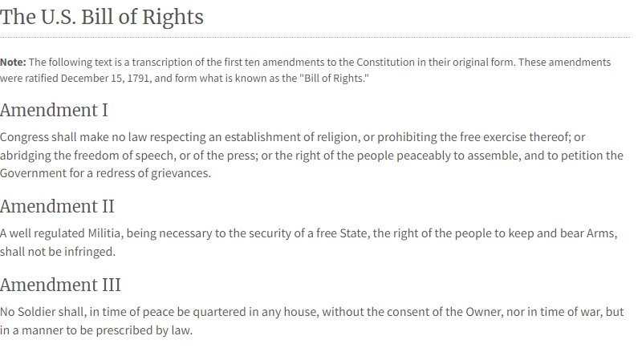
Supporting Students When Engaging With Complex Sources:
Before Engaging with the Source(s) (10)
Generate interest in the source by:
Previewing text structure
In this excerpt of the Bill of Rights, students will learn that the Bill of Rights is divided among ten amendments. Students can use this knowledge when reading the Bill of Rights to understand that each Amendment outlines different rights. This will support their comprehension of the Bill of Rights because they will understand that each new section contains new information.
Notes:
Guiding Notes:
Read the slide.

Slide 18
Before Engaging with the Source(s): Application (4)
Access a text-based source. You may use your curated source set from slide 12 of Module Two of the Supporting Students in Using Evidence Model Series if you completed this module previously.
Design an assignment where students preview the text structure.
What questions can you ask to help a student use the structure of the text to learn more about the information found in the source?
Notes:
Guiding Notes:
Read the slide and complete the application activity on the slide. Record your responses on in the Module Four Notecatcher.

Slide 19
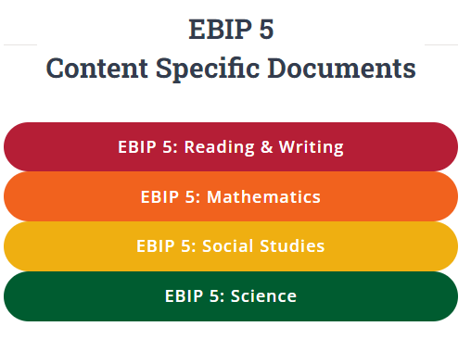
Supporting Students When Engaging With Complex Sources:
Before Engaging with the Source(s) (11)
Generate interest in the source by:
Engaging in Questioning that can be answered by engaging with the source
Questions can be taken up in written text, through research or discussion, and one question may generate others as students question texts, peers or solutions (Hoffer, 2020).
Notes:
Guiding Notes:
Read the slide.
Resource:
Kentucky Department of Education (n.d.) Questioning and the Kentucky Academic Standards for Social Studies. Evidence Based Instructional Practices. https://education.ky.gov/curriculum/standards/kyacadstand/Documents/EBIP_5_Social_Studies.pdf

Slide 20
Supporting Students When Engaging With Complex Sources:
Before Engaging with the Source(s) (12)
Student generated questions can be used for the purposes of:
Reviewing content;
Elaborating on information;
Setting the purpose for listening or viewing content;
Showing gaps in student comprehension;
Making predictions;
Prompting thinking about a source’s content, structure or language;
Clarifying information that may be misunderstood or missing;
Assisting teachers in guiding classroom discussion and close reading analysis;
Demonstrating that all students’ ideas are valued and supported (Marzano, 2017; Miller, 2020; Fisher, et al., 2016; Frazin & Wischow, 2020; Hoffer, 2020).
Ensuring that student voice is valued through questioning in Kentucky social studies classrooms empowers students to unlock the unknown through questioning because it capitalizes on their curiosity as learners.
Notes:
Guiding Notes:
Read the slide.
Resource:
Kentucky Department of Education (n.d.) Questioning and the Kentucky Academic Standards for Social Studies. Evidence Based Instructional Practices. https://education.ky.gov/curriculum/standards/kyacadstand/Documents/EBIP_5_Social_Studies.pdf

Slide 21
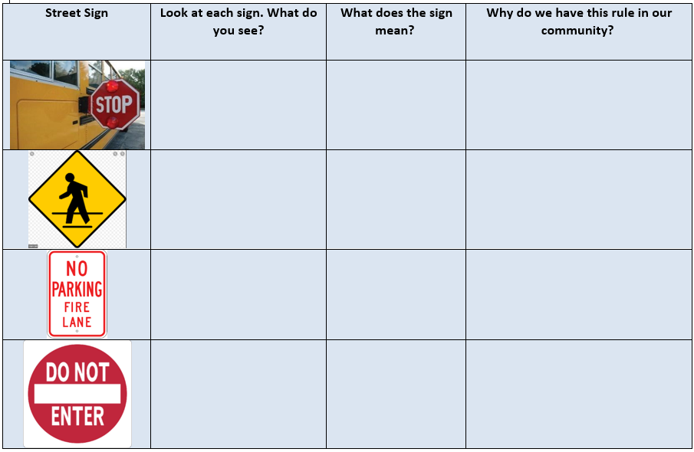
Supporting Students When Engaging With Complex Sources:
Before Engaging with the Source(s) (13)
Generate interest in the source by:
Engaging in questioning that can be answered by engaging with the source.
In this Kindergarten example, students engage with the sources pictured in the chart, which are images of street signs with which students are likely familiar with from their community. The teacher poses the questions on the chart to support students with understanding the sources.
Notes:
Guiding Notes:
Read the slide.
This slide provides an excerpt of a Teacher Note that shows how a student is supporting in meeting the source during an investigation. You may access the full Teacher Note using the link provided in the word “example.”

Slide 22
Before Engaging with the Source(s): Application (5)
Access a text-based source. You may use your curated source set from slide 12 of Module Two of the Supporting Students in Using Evidence Model Series if you completed this module previously.
Write questions that will generate interest in the source.
What questions can you ask to generate student curiosity about a source or the information in it?
Notes:
Guiding Notes:
Read the slide and complete the application activity on the slide. Record your responses on in the Module Four Notecatcher.

Slide 23
Supporting Students When Engaging With Complex Sources:
Before Engaging with the Source(s) (14)
Activate prior knowledge by…
Asking students what they already know about this topic. Students may skim the source to support them in this work.
Additionally, educators may use strategies including, but not limited to, the following:
See, Think, Wonder
Think, Puzzle, Explore
The Explanation Game
Think, Pair, Share
Chalk Talk
Compass Points
Notes:
Guiding Notes:
Read the slide.
Resources:
Project Zero. (2019). See, Think, Wonder. Harvard Graduate School of Education. http://www.pz.harvard.edu/sites/default/files/See%20Think%20Wonder_2.pdf
Project Zero. (2019). Think, Puzzle, Explore. Harvard Graduate School of Education. http://www.pz.harvard.edu/sites/default/files/Think%20Puzzle%20Explore_2.pdf
Project Zero. (2019). The Explanation Game. Harvard Graduate School of Education. http://www.pz.harvard.edu/sites/default/files/The%20Explanation%20Game_1.pdf
Project Zero. (2019). Think, Pair, Share. Harvard Graduate School of Education. https://pz.harvard.edu/sites/default/files/Think Pair Share_1.pdf
Project Zero. (2019). Chalk Talk. Harvard Graduate School of Education. http://www.pz.harvard.edu/sites/default/files/Chalk%20Talk_1.pdf
Project Zero. (2019). Compass Points. Harvard Graduate School of Education. http://www.pz.harvard.edu/sites/default/files/Compass%20Points_0.pdf

Slide 24
Supporting Students When Engaging With Complex Sources:
Before Engaging with the Source(s) (15)
Introduce the compelling question, “How does where we live affect how we live?” to students by discussing the characteristics and unique qualities of where we live. First, have students do the following:
Turn and Talk to a partner to answer the following question: What are the characteristics of where we live in Kentucky?
If needed, prompt them to think about the climate, landforms, natural resources, animals, etc. Once they have had time to share ideas, create a list on the board or chart paper and record students’ ideas. Some responses may include, but are not limited to, the following:
In this Grade 3 example, the teacher activates prior knowledge on the characteristics of their community to support student investigation of the compelling question “How does where we live affect how we live?” The teacher activates students’ prior knowledge on how the environment where they live impacts their lifestyles to support them in understanding sources about U.S. exports and the movement of goods around the world.
mild climate/all four seasons
rainfall throughout the year
grassy
many hills
some mountains
rivers
lakes
forests/many trees
many animals (they may list common ones like squirrels, deer, etc.)
coal
farming
Notes:
Guiding Notes:
Read the slide.
This slide provides an excerpt of a Teacher Note that shows how a student is supporting in meeting the source during an investigation. You may access the full Teacher Note using the link provided in the word “example.”

Slide 25
Before Engaging with the Source(s): Application
Access a text-based source. You may use your curated source set from slide 12 of Module Two of the Supporting Students in Using Evidence Model Series if you completed this module previously.
Design an activity that activates a student’s prior knowledge.
Can you modify one of the strategies provided on slide 96 to activate a student’s prior knowledge about a topic featured in a source?
Notes:
Guiding Notes:
Read the slide and complete the application activity on the slide. Record your responses on in the Module Four Notecatcher.

Slide 26
Supporting Students When Engaging With Complex Sources:
Before Engaging with the Source(s) (16)
Support students with unknown vocabulary by:
Reviewing unknown vocabulary with students.
Having the student preview any bolded words in the margins or within the text
Asking the student to look up any unknown vocabulary in the dictionary
Engaging in strategies that helps students build their vocabulary development.
For examples of strategies for teaching vocabulary, see Session 9: Vocabulary Lessons of the Academic Vocabulary module on KyStandards.org.
Notes:
Guiding Notes:
Read the slide.
For more information about vocabulary, access the Academic Vocabulary module on www.kystandards.org. This module provides information on implementing both implicit and explicit vocabulary instruction with modules for both grades 6-8 and 9-12. Session 9 linked above details how to implement four vocabulary strategies: Interactive Word Walls; Quiz, Quiz, Trade; Word Play Questions; and Give One, Get One, Move On.

Slide 27
Supporting Students When Engaging With Complex Sources:
Before Engaging with the Source(s) (17)
In order for students to examine the Civil Rights Movement in Kentucky, students will continue their exploration of this period by investigating how cultural factors contributed to migration patterns and population distribution in Kentucky during the 1950s and 1960s. Prior to beginning this investigation, have students complete a word map on the term “cultural factors.” Some examples of cultural factors that impact migration patterns and population distribution include, but are not limited to the following:
Religious freedoms
Job opportunities
Seeking familiar language, customs and traditions
Laws
Technology
Geography/climate
Warfare/conflict
In this High School example, students complete a word map on the disciplinary specific term “cultural factors” prior to engaging with sources about how migration patterns and population distributions were impacted in Kentucky to support their understanding of the sources that follow.
Notes:
Guiding Notes:
Read the slide.
This slide provides an excerpt of a Teacher Note that shows how a student is supporting in meeting the source during an investigation. You may access the full Teacher Note using the link provided in the word “example.”

Slide 28
Before Engaging with the Source(s): Application
Access a text-based source. You may use your curated source set from slide 12 of Module Two of the Supporting Students in Using Evidence Model Series if you completed this module previously.
Implement a vocabulary strategy from the Academic Vocabulary module that helps students build their vocabulary engaging with your source:
Interactive Word Wall
Quiz, Quiz, Trade
Word Play Questions
Give One, Get One, Move On
Notes:
Guiding Notes:
Read the slide and complete the application activity on the slide. The linked module comes from Session 9 of the Academic Vocabulary webpage on KyStandards.org and details how to implement each of these strategies.
Record your responses on in the Module Four Notecatcher.

Slide 29
Check For Understanding
Complete the Google Form to check for understanding on what you have learned in Module Four. It is important to note that this form is not scored. It is designed to support you in demonstrating your mastery of the success criteria shared at the beginning of this module. The success criteria for Module Four is:
Success Criteria: I will be successful when I can develop coherent periods of learning that supports students’ comprehension of primary and secondary sources.
Notes:
Guiding Notes:
To support participants in reflection on what they have learned so far as they engaged with Module Four, complete the Google Form. It is important to note that this form is not scored, it is merely to support a participant in demonstrating their mastery of the success criteria shared at the beginning of this section. Responses are anonymous, and submitting this form will help the KDE by providing feedback on the effectiveness of this module. As a reminder, the success criteria for Module Four is:
Success Criteria: I will be successful when I can develop coherent periods of learning that supports students’ comprehension of primary and secondary sources.
Once participants have completed their Google Form, have them reflect on their learning by asking self-regulation feedback questions to ensure that they are prepared to continue additional modules within the Supporting Students in Using Evidence module series. To reflect on your learning, ask yourself the following questions:
How can I reflect on my own learning?
What further doubts do I have regarding the information presented in Module Four: What should students do before engaging with complex sources?
Can I now teach someone else what makes a source complex?
If participants identify any gaps in their understanding after answering the self-regulation feedback questions, encourage them to ask their peers for additional help in clarifying any misconceptions.

Slide 30
Conclusion of Module Four of the Supporting Students in Using Evidence module series
This concludes Module Four: What should students do before engaging with complex sources?
If you would like to continue your learning within this module series, please access Module Five: What should students do while engaging with sources?
Notes:
Guiding Notes:
Read the slide. This concludes Module Four.

Slide 31
Supporting Students in Using Evidence3
Module Four: What Should Students Do Before Engaging with Complex Sources?
Notes:
Guiding Notes:
The KDE needs your feedback on the effectiveness of this module, the learning platform and how the consultants may best support you as you take the next steps in the implementation process. Complete a short survey to share our thinking and provide them with feedback on how the KDE can best meet our needs. Feedback from our surveys will be used by the KDE to plan and prepare future professional learning.
Post-Survey: Supporting Students in Using Evidence module survey

