Slide 1
Supporting Students in Using Evidence
Module Series Overview

Slide 2
Supporting Students in Using Evidence (2)
Module One: Using Evidence and the KAS for Social Studies
Notes:
Module Series Overview:
Supporting Students in Using Evidence module series is a set of six of modules designed to support students when using evidence as required by the Kentucky Academic Standards (KAS) for Social Studies. While this module series is designed in a progression, you may engage with the module section that best meets your professional learning needs.
Supporting Students in Using Evidence module series is intended to support the successful implementation of the KAS for Social Studies in classrooms across the state. The duration, scope and sequence of the module sections may be customized to accommodate local needs and conditions. The sections are designed to provide flexibility for districts and schools and, as such, can be viewed as stand-alone lessons or within the progression of the module as written. You are supported in engaging with this module individually, if desired.
Materials:
The following materials are part of this module:
●Kentucky Academic Standards (KAS) for Social Studies
●Additional materials, such as but not limited to, articles, discussion strategies, etc. are provided within the notes section of applicable slides throughout the module.
Guiding Notes
Guiding notes are provided in the Notes section of the PowerPoint to support your learning. The information provided in the Notes section includes additional information, directions for the activities on the slide, and citations of used resources, where appropriate. It is critical that you read the material presented in the Notes section to ensure that you are acquiring the important knowledge, skills and understanding required when engaging with this module.
Virtual Training Note:
If you plan to engage with this module virtually as a group, consider directing participants to the Social Studies Professional Learning Modules page so that you may access the resources used directly from the links provided in the PowerPoint: https://kystandards.org/standards-resources/ss-resources/ss-pl-modules/
Additionally, you may consider downloading the resources contained within each section of the module and placing them into a Google folder for you or your colleagues to access.
Module One: Compelling and Supporting Questions
Compelling Question: How do I support students in communicating their own conclusions, using evidence to substantiate their claims?
Supporting Question: What are sources?
Learning Target and Success Criteria:
The Learning Target and Success Criteria for districts and schools of Module One: Using Evidence and the KAS for Social Studies are:
Learning Target: I can support students in using evidence to substantiate their claims.
Success Criteria: I will be successful when I can develop coherent periods of learning that support students in:
comprehending the term “source”
distinguishing between primary and secondary sources
demonstrating mastery of the grade level or grade band Using Evidence standards of the KAS for Social Studies
Intended Audiences:
Participants
Module participants may include, but are not limited to, district leadership, school administrators, instructional specialists/coaches, intervention specialists, department chairs, special educators and classroom teachers.
It is important to note that it is recommended that participants have engaged with the following modules prior to engaging with this module:
Getting to know the Kentucky Academic Standards (KAS) for Social Studies Module
The Minding the Gap Module
The Inquiry Practices of the Kentucky Academic Standards (KAS) for Social Studies Module
Thus, participants are encouraged to engage with these modules prior to participating in this module.
Facilitators:
While this module series is designed for a teacher to engage with it individually, it may be implemented with a group of educators led by a facilitator. If this module is being completed as a group, facilitators may include, but are not limited to, district leaders, school administrators, instructional specialists/coaches, intervention specialists, department chairs, special educators, and classroom teachers. Facilitators may need to revise specific tasks in order to meet the needs of the participants or to be respectful of the time planned within the work session. As stated above, the Kentucky Department of Education (KDE) recommends that participants engage with the four modules mentioned above prior to engaging with this work. If the facilitator has not engaged with these modules, it is recommended that they complete the four modules mentioned before facilitating this module.
Helpful Hint for Facilitators:
The learning that will take place in this module may cause Kentucky educators to face changes in instructional practices amidst this transition. It is important to realize that while you are the facilitator of these work sessions, you may not have all the answers to the questions asked by participants, and that is okay. Throughout the module, participants may have questions that will be addressed in future work sessions. When that happens, reflect on this quote from Graham Fletcher, “Every teachable moment doesn’t need to be a teachable moment in that moment.” Use these moments to encourage participants to attend future work sessions where those questions will be addressed. If participants ask questions you are not prepared to answer, offer to follow up on that during the next work session.
Planning Ahead for Facilitators:
• Determine which stakeholders to invite as participants. In the invitation, describe how the work sessions will benefit them.
• A few days before the meeting, you may want to remind participants to be prepared to have their documents available during the meeting. (See below for Participant Documents Needed.)
• Reserve adequate space and equipment. Tables or desks should be set up to support small-group discussion. If conducting this module virtually, ensure that your technology platform can support break out rooms to support small group collaboration.
• Ensure that participants have access to the Internet.
• Consider how you might handle participants who may not be in attendance at all work sessions. It might be worthwhile to consider how those participants might access missed sections of the module between work sessions in order to feel as prepared as the other participants.
Preparation
Participant Documents Needed:
Plan ahead regarding how you will feel most comfortable engaging with the KAS for Social Studies, either:
• A device with access to the KAS for Social Studies, or
• A hard copy of the KAS for Social Studies
Supplies Needed:
• Computer with the Module One: Using Evidence and the KAS for Social Studies PowerPoint presentation.
• Technology with projection capability if in person. Technology platform where presenters have sharing ability and breakout room options if virtual.
• Copies of the handouts needed for the session either in hard copy format or available in a folder online. Links to the participant handouts needed for the session also may be built right into the agenda.
• Parking Lot for questions - If completing as a group, you may consider providing a poster on which participants can write or post questions, or you may prefer to have a digital parking lot where participants can access a Google document, for example, to post questions and that you can modify as the participants work through the sections of the module.
• Self-Sticking Notes (optional)
• Poster paper (optional)
• Highlighters and/or colored pens/markers (optional)
Building a Community:
Building a community is important for any group that will work together, especially if participants have not worked together before. The concept is the same as building a safe, respectful, productive classroom climate. Incorporating community-building into each session builds trust, shows participants that they are valuable as individuals and engages them in the learning process. It is also useful for creating a professional learning network where participants can be supported in their work. Community-building can be as simple as allowing participants to introduce themselves and their role in the school/district, developing or refining group norms, allowing for questions, and/or the sharing of answers to reflection questions or individual discovery task items that are included in this module. Again, time allotted for community-building will allow participants to have a voice and be engaged as active contributors and learners in the sessions.
Virtual Training Options: Be sure to conduct continual check-ins throughout the presentation. Build Google documents to continue to collect feedback, such as questions, hopes, and/or concerns to which participants may continually add.

Slide 3
Introduction
Compelling Question: How do I support students in communicating their own conclusions, using evidence to substantiate their claims?
Supporting Question: What are sources?
Learning Target: I can support students in using evidence to substantiate their claims.
Success Criteria: I will be successful when I can develop coherent periods of learning that support students in:
Comprehending the term “source”;
Distinguishing between primary and secondary sources; and
Demonstrating mastery of the grade level or grade band Using Evidence standards of the KAS for Social Studies.
Notes:
Guiding Notes:
For more information on compelling questions, visit Section 3B: “What are Compelling Questions and how do students ask them?” from the Inquiry Practices module: https://education.ky.gov/curriculum/standards/kyacadstand/Documents/Inquiry_Practices_of_KAS_for_Social_Studies.pptx
For more information on supporting questions, visit “Section C: What are Supporting Questions, and how do students ask them?” from the Inquiry Practices module: https://education.ky.gov/curriculum/standards/kyacadstand/Documents/Inquiry_Practices_of_KAS_for_Social_Studies.pptx
For more information on Learning Goals and Success Criteria and their alignment to the KAS for Social Studies, visit Learning Goals, Success Criteria and the KAS for Social Studies: https://kystandards.org/standards-resources/ss-resources/learning-goals-success-criteria-and-the-kas-for-social-studies/

Slide 4
Using Evidence Know, Want to know, Learned, Questions (KWLQ) chart
Thinking about the KAS for Social Studies' Using Evidence inquiry practice, respond to the questions in the first two columns of the KWLQ chart. Later, you will have an opportunity to respond to the questions in the third and fourth columns.
What do I know? | What do I want to know? | What have I learned? | What questions do I still have?
Notes:
Guiding Notes:
Complete the first two columns of the KWLQ chart linked on the slide. You will complete the last two columns later in this module.

Slide 5
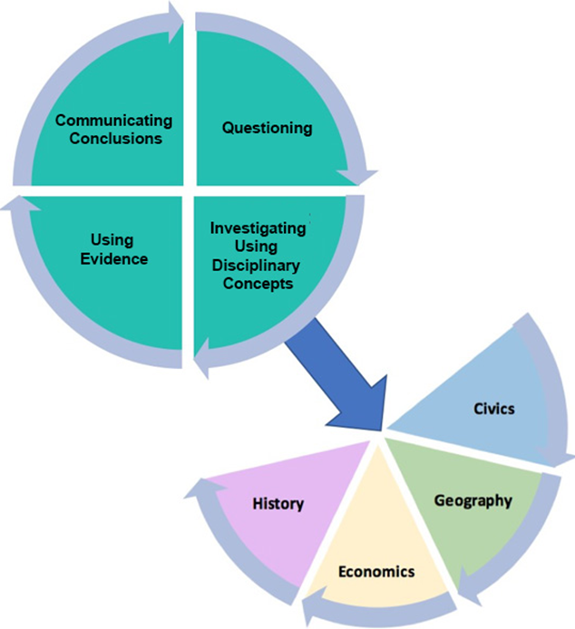
Using Evidence
All valid claims must be based on logical evidence.
For students to construct coherent arguments and explanations using their understanding of the social studies disciplines, they must understand how to substantiate those claims using evidence.
This skill requires students to collect, evaluate and synthesize evidence from primary and secondary sources to develop and support a claim.
Notes:
Guiding Notes:
In order for students to construct coherent arguments and explanations using their understanding of the social studies disciplines, they must understand how to substantiate those claims using evidence. This skill requires students to collect, evaluate and synthesize evidence from primary and secondary sources to develop and support a claim.

Slide 6
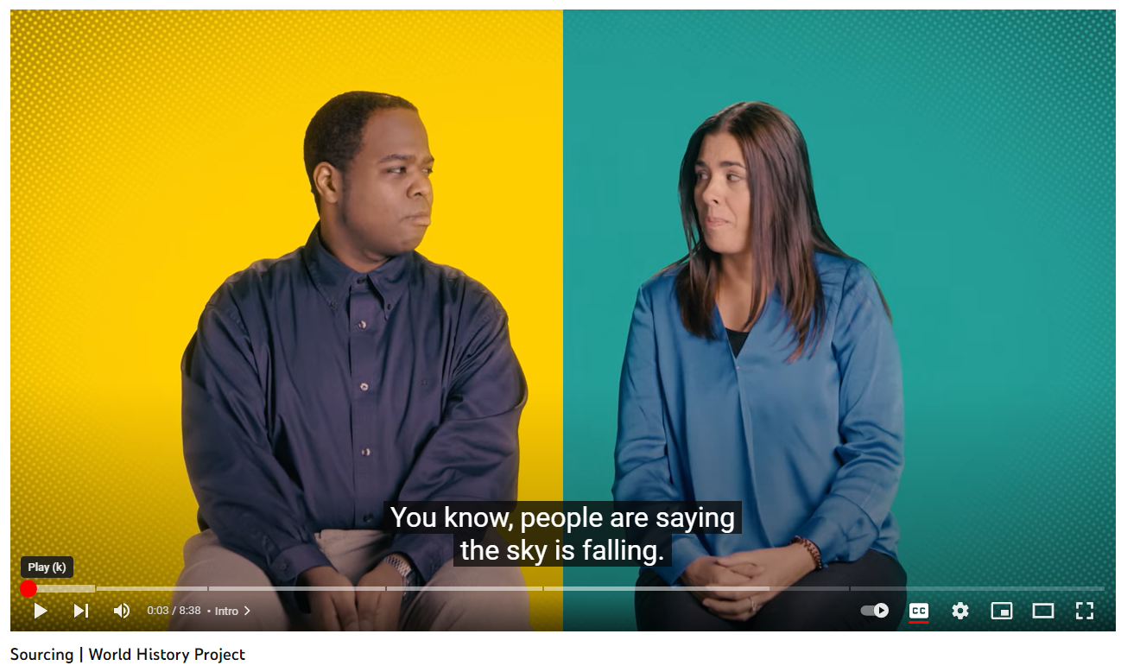
Using Evidence (2)
Substantiating claims using evidence requires sourcing. What is sourcing? Watch the following excerpt to understand sourcing.
As you watch the first 3:05 of this clip, consider the following questions:
What is sourcing?
What skills are involved when sourcing?
Why is sourcing important?
The World History Project
Notes:
Guiding Notes:
Read the slide and then watch the first 3:05 of the video. As you are watching the video, consider the following questions:
What is sourcing?
What skills are involved in sourcing?
Why is sourcing important?
Resource:
OER Project. (2021) Sourcing. The World History Project. https://www.youtube.com/watch?v=KuSecMh7BnU. Watch the first 3:05 of the video.

Slide 7
Using Evidence (3)
After you have finished the video clip, engage in a Turn and Talk to share your answers with a partner to the following questions:
What is sourcing?
What skills are involved when sourcing?
Why is sourcing important?
The World History Project
Notes:
Guiding Notes:
After watching the clip, engage in a Turn and Talk to discuss these questions with their partner, or answer individually.
What is sourcing? Something we have to do to find the truth, to evaluate history, it is a verb. Evaluating information to see if it is true.
What skills are involved in sourcing? Includes, but is not limited to, close reading, claim testing, and contextualization.
Why is sourcing important? It helps us think more critically about the information we consume.
You will now review the Using Evidence standards of the KAS for Social Studies to identify the sourcing skills students have to master at the conclusion of their grade level.
Resource:
OER Project. (2021) Sourcing. The World History Project. https://www.youtube.com/watch?v=KuSecMh7BnU.

Slide 8
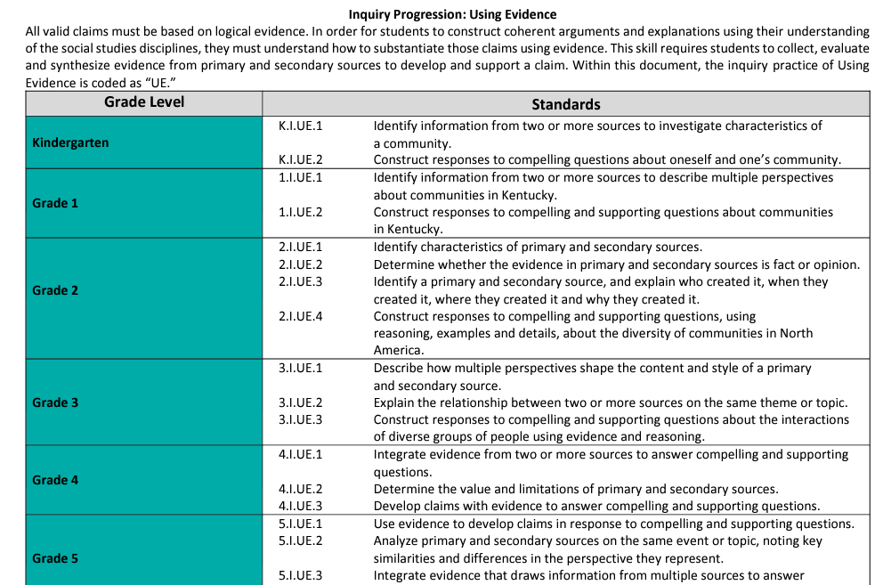
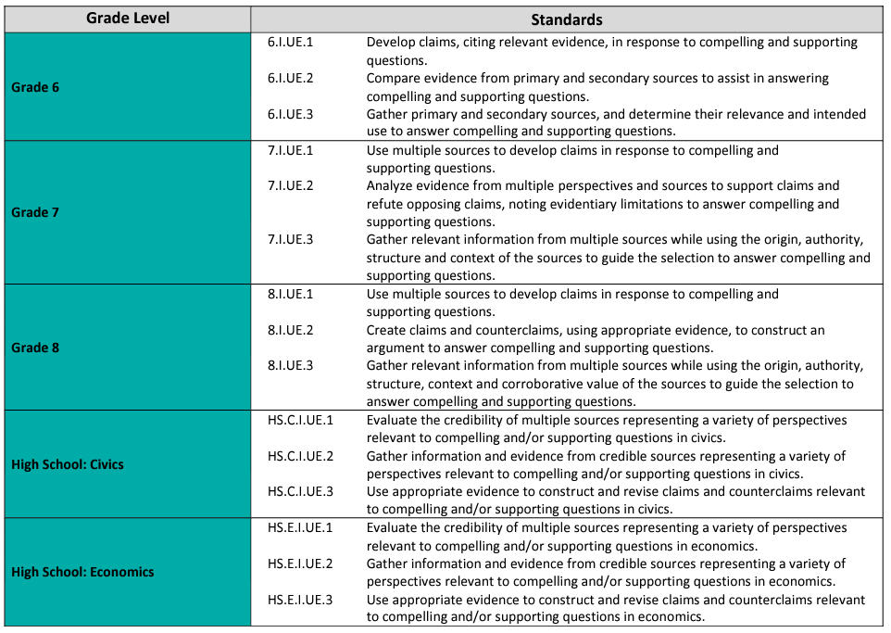
Review of the KAS for Social Studies (1)
What are the demands of the KAS for Social Studies when Using Evidence?
Access the Inquiry Progression: Using Evidence on page 157 of the KAS for Social Studies and read the progressions of the Using Evidence standards from kindergarten through high school.
As you read, annotate the sourcing skills students have to demonstrate at each grade level or grade band by highlighting or underlining the sourcing vocabulary found in the standards.
Notes:
Guiding Notes:
When annotating, circle the sourcing skills requirements students have to master at the conclusion of each grade level or grade band in the Using Evidence standards from the KAS for Social Studies. You may use additional symbols, such as question marks to identify a term you need to learn more about, or an exclamation point when you want to emphasize a skill.
For more information on annotation, visit:
Grand Valley State University- University Library (November 18, 2019). Annotating an Article. GVSU Libraries Instruction. https://www.youtube.com/watch?v=JtRGUNo2pck

Slide 9
Review of the KAS for Social Studies (2)
After you have completed your initial read, review the Using Evidence standards for your grade level(s) or grade band.
Independently, answer the following questions:
What Using Evidence skills do students need to demonstrate for your grade level or grade band?
What using evidence skills should students have demonstrated previous to your grade level or grade band?
What using evidence skills will students demonstrate after your grade level or grade band?
Notes:
Guiding Notes:
Answer these questions using the Using Evidence progression you just annotated.

Slide 10
Review of the KAS for Social Studies (3)
After you identified the progression of skills in the Using Evidence standards immediately prior to and after your grade band, answer the following question independently:
Why is it important to understand the progression of skills in the Using Evidence standards?
Once you have independently answered this question, engage in a Turn and Talk with a partner to share your thoughts and process their answer to this question together.
Notes:
Guiding Notes:
Once you have notated how students are building the skills to substantiate their claims using evidence at their grade-level, engage in a Turn and Talk with a partner to share your thoughts and process their answer to this question together. If your partner teaches a different grade-level, have participants discuss the ways that the skills in their grade-level progress to the skills in another grade-level to support students in learning how to substantiate their claims using evidence. If you do not have a partner, answer the question independently.
Then, answer the following question (as a whole group if completing the module with others): What are the demands of the KAS for Social Studies when Using Evidence? When sharing their responses, have participants cite evidence from the standards to support their statements.

Slide 11
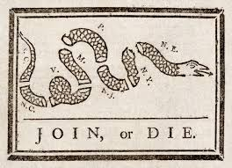
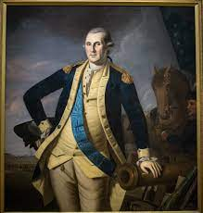
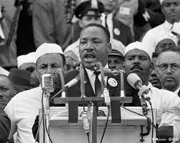
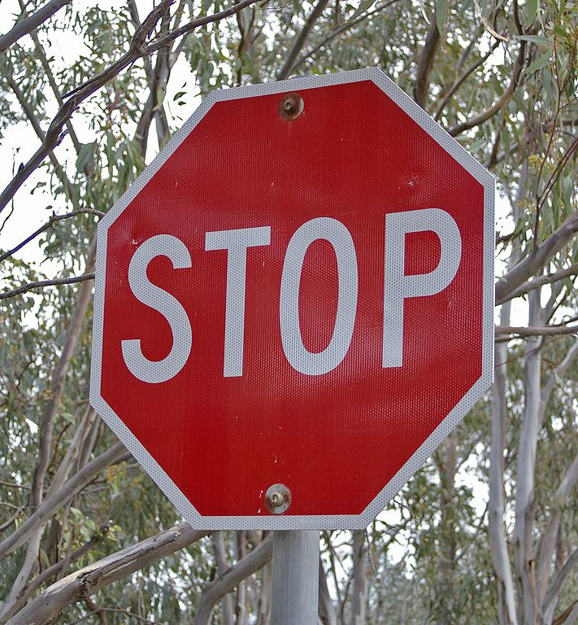
Using Evidence (4)
Anything that communicates a message can be a source!
Notes:
Guiding Notes:
It’s important to note that anything that communicates a message can be a source! Traditionally, we think of primary and secondary sources being dominated by text, but symbols, objects, photos, etc., can serve as sources to investigate compelling and supporting questions, just as the more traditional types of sources we think of. For elementary students, this provides an opportunity for students to be exposed to and engage with sources that do not require reading proficiency.
According to Interdisciplinary Literacy Practice 1 of the KAS for Reading and Writing, text is anything that communicates a message. Therefore, images that communicate a message are considered text and can serve as a source for students to investigate. The Reading and Writing standards may be accessed here: https://education.ky.gov/curriculum/standards/kyacadstand/Documents/Kentucky_Academic_Standards_Reading_and_Writing.pdf

Slide 12
Using Evidence (5)
The KAS for Social Studies asks students to engage with two types of sources:
Primary sources
Secondary sources
Notes:
Guiding Notes:
In order for students to construct coherent arguments and explanations using their understanding of the social studies disciplines, they must understand how to substantiate those claims using evidence. This skill requires students to collect, evaluate and synthesize evidence from primary and secondary sources to develop and support a claim.

Slide 13
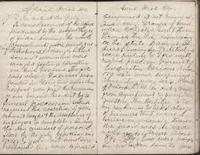
Using Evidence (6)
What is a primary source?
A primary source is an original source of information that was created at the time of the event.
Examples of primary sources:
diary/journal entry
artifact
autobiography
transcript or audio of speech
interviews
photographs
newspaper reports
Notes:
Guiding Notes:
To master the Using Evidence progression highlighted in this module, it is important that you know the meaning and characteristics of primary sources, and can identify examples of types of primary sources.

Slide 14
Using Evidence (7)
What is a secondary source?
A secondary source often uses primary sources to gather its information and is created after the time of the event.
Examples of secondary sources:
informational books
scholarly articles
biographies
documentaries
magazines
encyclopedias
Notes:
Guiding Notes:
Additionally, you should be able to explain the meaning and characteristics of secondary sources and identify examples of different types of secondary sources.

Slide 15
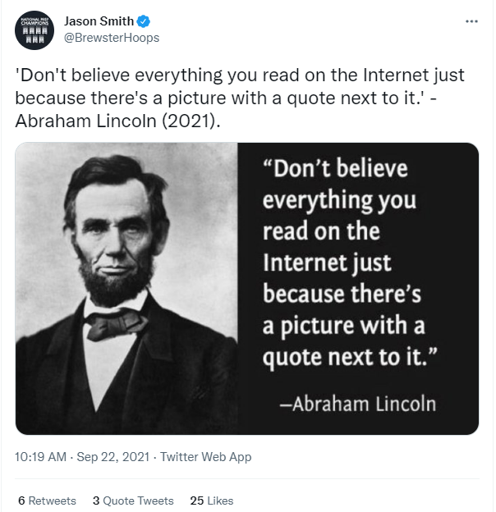
Using Evidence (8)
When engaging with sources, it is important to be aware of some misconceptions surrounding primary and secondary sources:
It is incorrect to think that primary sources are “true” or “factual,” while secondary sources are “biased” or “someone else’s opinion.”
A primary source can contain inaccurate, biased information.
A secondary source could provide a factual, unbiased account if the secondary source is drawing from multiple sources.
It is incorrect to think that primary sources are created by individuals with firsthand knowledge of the event.
Corroboration should be used when engaging with sources to determine their credibility.
Notes:
Guiding Notes:
Read the slide.

Slide 16
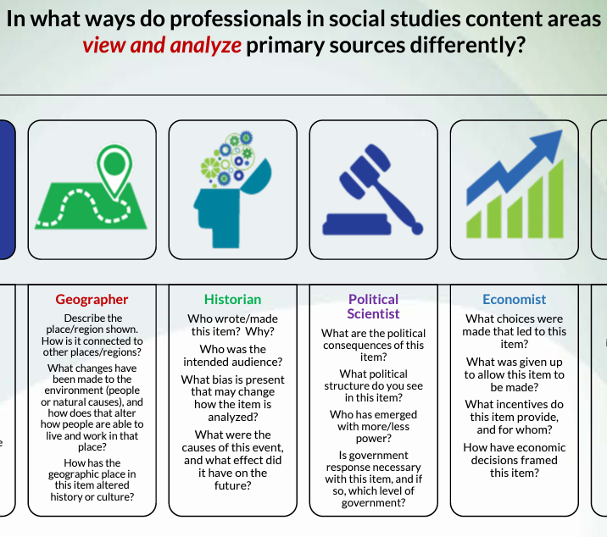
How do different disciplinary strands use evidence?
In what ways do professionals in social studies content areas view and analyse primary sources differently?
Using this informational graphic, complete a Mind Map that answers the question, "How do different disciplinary strands use evidence?”
Notes:
Guiding Notes:
Complete a Mind Map using the handout provided by completing the following directions. Note: Since the disciplinary strands of the KAS for Social Studies include civics, economics, geography and history, participants should only focus on the sections of the document entitled Geographer, Historian, Political Scientist and Economist.
To complete a Mind Map, do the following on a piece of paper or a digital document, such as a Google Doc:
Identify “How do different disciplinary strands use evidence?” as their main topic of study.
Place the main topic of study it in the center and draw a circle around it.
Identify and write down the professionals of the four disciplinary strands around the main topic of study by listing Geographer, Historian, Political Scientist and Economist.
Draw a circle around the professionals and draw a line from this circle to the circle of the main topic of study “How do different disciplinary strands use evidence?”.
Read the chart and answer the main topic of study question using information from the chart for a Geographer, Historian, Political Scientist and Economist.
Write down this information surrounding the applicable professionals circle.
For more information on Mind Mapping, visit the following links:
https://www.youtube.com/watch?v=xCyjFipytRE
https://www.mindmapping.com/
Resource:
McDaniel, Kris. (2017) In what ways do professionals in social studies content areas view and analyse primary sources differently? Wisconsin Department of Education. https://dpi.wi.gov/sites/default/files/imce/social-studies/pdf/2017%20B%20Authentic%20Analysis%20-%20TR%20San%20Juan.pdf

Slide 17
Using Evidence (9)
Sometimes the distinction between a primary and secondary source can be difficult for students to determine.
Read the article entitled Primary or secondary source? Let the research question decide. As you read, consider the following question:
How does the research question impact whether a source is a primary or secondary source?
Notes:
Guiding Notes:
When you have finished reading the article and can independently answer the question in the slide, engage in a Turn and Talk to share your responses to this question, or consider individually.
Resource:
Nice, Heather. (January 24, 2023) Primary or secondary source? Let the research question decide. OER Project Blog. https://community.oerproject.com/b/blog/posts/primary-or-secondary-source-research?_cldee=LirQ2J2QA4EnMgjM-ufHTpnlBVseU6l3q4hRufRakP-Y0nOvHjB6D-1feXCoJ9qZZDcD6oHUURsLg3rQW9V12Q&recipientid=contact-712d240dd3a1eb11b1ac00224808930e-a98ee791540045ee8653eaaea04358e7&utm_source=ClickDimensions&utm_medium=email&utm_campaign=OER%20Considerers%20Newsletter&esid=fb018b5d-359c-ed11-aad1-000d3a34390c

Slide 18
Why use evidence?
What is historical thinking?
As you watch this What is historical thinking?, think about why teachers and students should use evidence. Then, write a response that explains why sourcing is important to gaining a more complete understanding of an event, person or topic.
Notes:
Guiding Notes:
Resource:
Teachingushistory.org. (2018) What is historical thinking? Roy Rosenzweig Center for History and New Media at George Mason University. https://teachinghistory.org/historical-thinking-intro

Slide 19
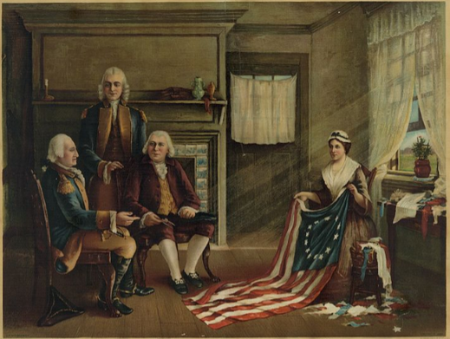
Application
In order for students to construct coherent arguments and explanations using their understanding of the social studies disciplines, they must understand how to substantiate those claims using evidence. This skill requires students to collect, evaluate and synthesize evidence from primary and secondary sources to develop and support a claim.
Investigate the primary and secondary sources provided in this Grade 5 Sourcing Example to answer the question, "Did Betsy Ross design and sew the first flag for our country?"
The Birth of Our Nation’s Flag by Charles H. Weisgerber (1893)
Notes:
Guiding Notes:
Complete the Grade 5 Sourcing Example as directed.
Resource:
O’Malley, Fran. (n.d.) Did Betsy Ross design and sew the first flag for our country? Used with permission from the author.

Slide 20
What did you learn from the activity?
Reflect on what you have learned from the sourcing activity by completing the Connect, Extend, Challenge Thinking Strategy.
Ask yourself the following questions:
How are the ideas and information I just engaged in connected to what I already know?
What new ideas did you get that broadened my thinking or extended it in different directions?
What challenges or puzzles emerge for me?
The Birth of Our Nation’s Flag by Charles H. Weisgerber (1893)
Notes:
Guiding Notes:
Complete the Connect, Extend, Challenge Thinking Strategy.
Resource:
Project Zero. (2019). Connect, Extend, Challenge Thinking Strategy. Harvard Graduate School of Education. http://www.pz.harvard.edu/sites/default/files/Connect%20Extend%20Challenge_2.pdf

Slide 21
Reflection
Thinking about the KAS for Social Studies' Using Evidence inquiry practice and what you have learned Module One, return to your KWLQ chart and respond to the questions in the last two columns.
What do I know? | What do I want to know? | What have I learned? | What questions do I still have?
Notes:
Guiding Notes:
Complete your KWLQ chart.

Slide 22
Check For Understanding
Complete the Google Form to check for understanding on what you have learned in Module One. It is important to note that this form is not scored. It is designed to support you in demonstrating your mastery of the success criteria shared at the beginning of this module. The success criteria for Module One is:
Success Criteria: I will be successful when I can develop coherent periods of learning that support students in:
Comprehending the term “source”;
Distinguishing between primary and secondary sources; and
Demonstrating mastery of the grade level or grade band Using Evidence standards of the KAS for Social Studies
Notes:
Guiding Notes:
Complete the Google Form linked on the slide to reflect on your learning in Module One. It is important to note that this form is not scored, it is merely to support a participant in demonstrating their mastery of the success criteria shared at the beginning of this section. Responses are anonymous, and submitting this form will help the KDE by providing feedback on the effectiveness of this module. As a reminder, the success criteria for Module One are:
Success Criteria: I will be successful when I can develop coherent periods of learning that support students in:
comprehending the term “source”
distinguishing between primary and secondary sources
demonstrating mastery of the grade level or grade band Using Evidence standards of the KAS for Social Studies
Once you have completed your Google Form, reflect on your learning by asking self-regulation feedback questions to ensure you are prepared to continue additional modules within the Supporting Students in Using Evidence module series. To reflect on your learning, ask yourself the following questions:
How can I reflect on my own learning?
What further doubts do I have regarding the information presented in Module One: Using Evidence and the KAS for Social Studies?
Can I now teach someone else about sources as defined by the KAS for Social Studies, the difference between a primary and a secondary source, and the sourcing skills required for the grade level that I teach?
If you identify any gaps in your understanding after answering the self-regulation feedback questions, seek additional help in clarifying any misconceptions.

Slide 23
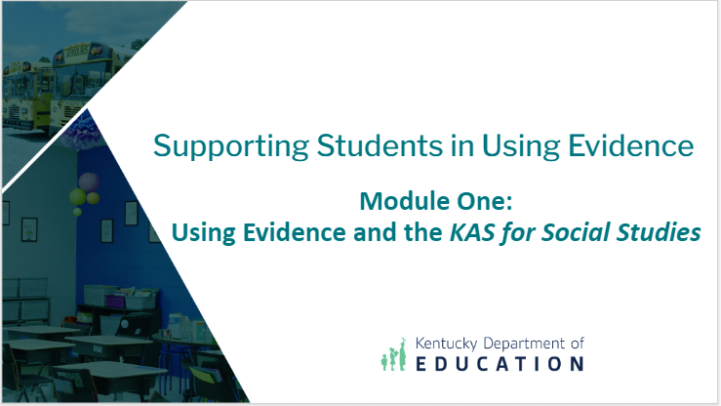
Conclusion of Module One of the Supporting Students in Using Evidence module series
This concludes Module One: Using Evidence and the KAS for Social Studies.
If you would like to continue your learning within this module series, please access Module Two: Supporting Teachers When Selecting Sources.
Notes:
Guiding Notes:
Read the slide. This concludes Module One.

Slide 24
Supporting Students in Using Evidence (3)
Module One: Using Evidence and the KAS for Social Studies
Notes:
Guiding Notes:
The KDE needs your feedback on the effectiveness of this module, the learning platform and how the consultants may best support you as you take the next steps in the implementation process. Complete a short survey to share our thinking and provide them with feedback on how the KDE can best meet our needs. Feedback from our surveys will be used by the KDE to plan and prepare future professional learning.
Post-Survey: https://docs.google.com/forms/d/e/1FAIpQLSdA4gZ6IOKn0RAxFzgbQBHvVr0pLAmZukA5zdS4dAMHppPNPQ/viewform?usp=sf_link

