Slide 1
District Health Coordinator Conference 2022
Sept. 29, 2022

Slide 2
Welcome!!!
Tell us about yourself!!
Nurse
Psychologist
Social Worker
DPP
Other
How long have you been district health coordinator?
This is my first year
Last year was my first year
Three to five years
Five years or longer

Slide 3
Beginning of the Year Reminders

Slide 4
Take advantage of free resources
Student Health Services Webpage

Slide 5
Nursing license renewal
All nursing licenses must be renewed online between Sept. 15, 2022, and Oct. 31, 2022.
Nurses must complete the annual continuing education hour requirement of 14 hours.
District Health Coordinators should verify that licenses have been renewed after Oct. 31, 2022.
Welcome to the KBN License/Credential Validation System - Kentucky Board of Nursing ​​​

Slide 6
Kentucky Board of Nursing New One Time CEU Requirement
Effective Jan. 13, 2022, per 201 KAR 20:215 all nurses must complete mandatory continuing education in suicide prevention and implicit bias.
One time requirement
Nurses holding a license of July 1, 2022, MUST complete the hours by July 1, 2023
Registered Nurses (RN) and Licensed Practical Nurses (LPN) may apply these contact hours to the annual requirement
Advanced Practice Registered Nurses (APRN) cannot apply these hours as they do not include pharmacology content
Kentucky Board of Nursing Continuing Education Competency.

Slide 7
District health coordinator distribution list
All new health coordinators should sign up at registration desk to be added to our distribution list (different from school nurse and health coordinator listservs)
Those that are watching online should email Angie McDonald at angela.mcdonald@education.ky.gov to be added

Slide 8
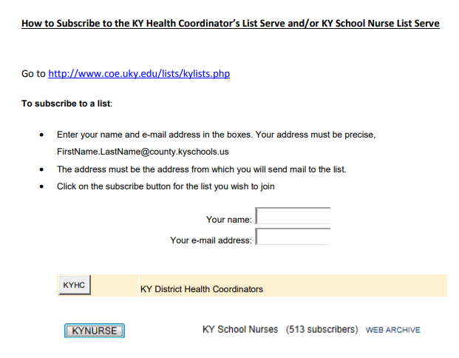
School nurse and health coordinator listservs
Hosted by the University of Kentucky
Instructions on how to join are posted on district health coordinator briefcase webpage

Slide 9
Mass screenings update
If COVID-19 cases or other illnesses are low, screening can be completed in small groups
Avoid mass screenings when high numbers of COVID-19 or other illnesses
Continue to screen as needed one on one for students with concerns, special education recerts and referrals

Slide 10
Consents for treatments and screenings
Districts should be getting yearly consent to treat students from parents/guardians
In addition, districts should not be performing routine health screenings without signed parental/guardian consent
Just because the screenings are required by law, this does not override the need for consent
Consent for both treatment and screening can be combined into one consent form

Slide 11
Guidance for Nebulizer Treatments in Schools 2022-2023
Place holder for DPH statement

Slide 12
Mental Health of School Nurses in the United States during the COVID-19 Pandemic
In March 2022, the Center for Disease Control (CDC) collaborated with the National Association of School Nurses (NASN) and the National Association of State School Nurse Consultants (NASSNC) to distribute a 121-item survey to school nurses in the U.S. Overall, 7,971 school nurses responded from all 50 states, the District of Columbia, tribal nations and U.S. territories.

Slide 13
Conditions Reported by School Nurses
Conditions Reported by School Nurses, Symptoms of:
Post-traumatic Stress Disorder (PTSD) 30%
Moderate to Severe Depression 24%
Anxiety 22%
Suicidal Ideation 4%
Almost half (45%) reported symptoms of at least one adverse mental health condition in the two weeks prior to completing the survey

Slide 14
Work-Related Stressors Reported by School Nurses Since COVID-19 Was Declared a Pandemic (March 2020)
Felt bullied, threatened or harassed 48%
Experienced stigma or discrimination 39%
Received job related threats 24%

Slide 15
School Nurses Were More Likely to Report Symptoms of Mental Health Conditions If
Worked >40 hours weekly
Reported inadequate staffing support or compensation
Experienced lack of peer, supervisor or school leadership support
Felt unappreciated
Worried about workplace exposure to COVID-19
Reported stigma, discrimination, job-related threats or harassment
Took on additional COVID-19 related job duties, such as notifying parents about COVID-19 quarantine and isolation, and caring for students and staff suspected of having COVID-19

Slide 16
What does this mean
Improving school nurse mental health is essential to creating safe environments for young people in our nation’s schools
Highlights opportunities to improve supportive policies and practices to reduce workplace stressors and increase workplace supports for school nurses
An infographic with survey findings will be posted on KDE’s student health services webpage within the next few days.

Slide 17
2021-2022 School Health Data/Infinite Campus News
Notes:
Good morning, everyone,
My name is Tonia Hickman, I have been with KDE for over 20 years, but I ‘m new to the division of district support and to the world of infinite campus. Please be patient with me, I’m nervous as a cat. I would like to ask that you hold your questions until the end of the presentation.
“

Slide 18
Nurse Counts
Very important that data be as correct as possible
This data point is asked for frequently to show the need for school nurses across the state.
Notes:
We are going to go over the beginning of the year infinite campus reminders. It’s very important that districts update this information each school year as legislatures often request this information and we want it to be as accurate as possible.

Slide 19
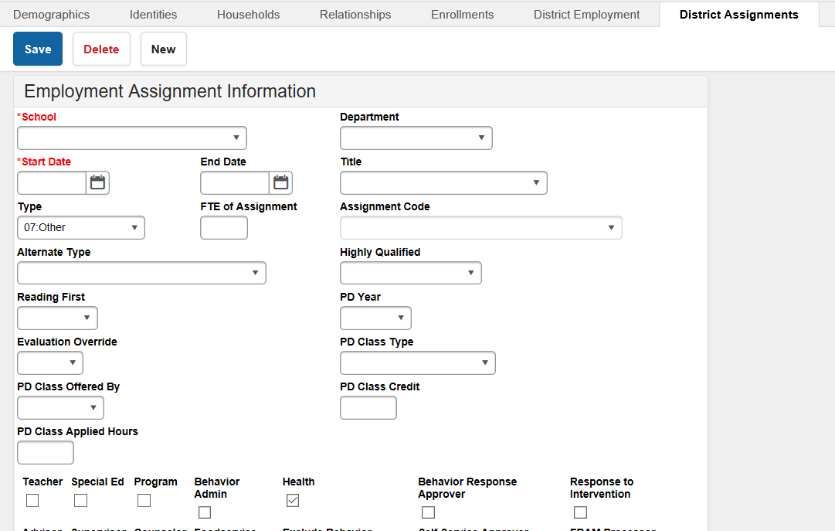
Employment Assignment: District Hired Health Staff Campus Path: Census/People/District Assignments
School - Select a school name
Date - Add employee hire date
Type - 07:Other
Alternate Type - Choose the correct type of license from the dropdown box.
LPN: Licensed Practical Nurse
RN: Registered Nurse/Advanced Practice RN
Check Health box
Save
Infinite Campus Information - Kentucky Department of Education
Notes:
This is a screen shot showing how to enter district hired nurses including the path you need to follow. Instructions can be found on our student health services IC web page.

Slide 20
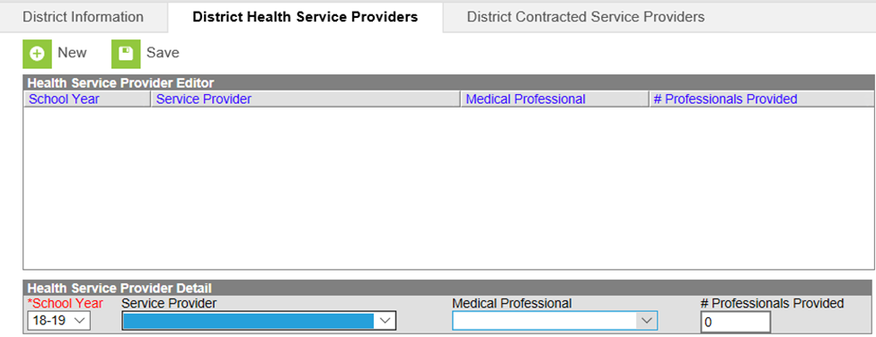
District Service Providers Campus Path: System Administration/Resources/ District Information/District Health Service Providers
School Year – Enter the correct school year (This information should be entered yearly even if the contract is longer than a one-year period)
Service Provider - Choose type of service provider from the dropdown menu.
01. Health Department
02. Hospital
03. Staffing Agency
04. Federally Qualified Health Care Center
Medical Professional: Choose type of medical professional from drop down menu
PA: Physician’s Assistant
APRN: Advanced Practice RN
RN: Registered Nurse
LPN: Licensed Practical Nurse
Number of Professionals Provided - Enter number of health provider staff (Health providers should only be listed in one of the listed categories. Also, part-time staff should be counted as one provider)
Save
Infinite Campus Information - Kentucky Department of Education
Notes:
This is a screen shot showing how to enter contract hired nurses including the path you need to follow. Instructions can be found on our student health services IC web page.

Slide 21
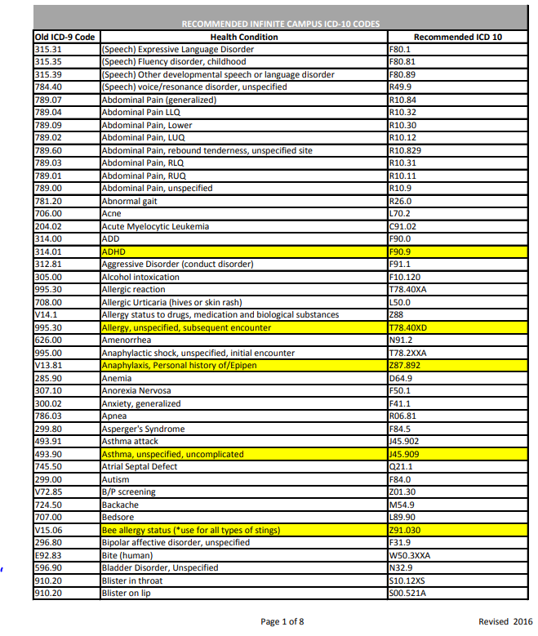
Student Health Conditions
Use this list when entering student health conditions
Top health conditions are highlighted in yellow
Students with EpiPens should have two conditions: one is the reason for EpiPen, the other Anaphylaxis personal history of Epipen.*
*This allows for tracking of students with EpiPens
Notes:
It is very important that when you enter student health conditions that you follow this chart. This allows for mor accurate and consistent health records. If you encounter a health condition that is not listed contact us and we can help you add that to your district health conditions list. This chart can also be found on student health services IC web page.

Slide 22
Communicable Disease Tab
This new tab allows school nurses to document each time that the local health department or other medical provider is notified of a reportable communicable disease in the school
To access this new tab, user access must be granted by your district system administrator
Path: Student Information/Communicable Disease
Notes:
Read slide

Slide 23
Communicable Disease Tab Information
This is tab is NOT a mandatory reporting element
Districts may continue to use the current documentation procedure if they so desire
COVID-19 was added to the list of diseases as many local health departments are still asking districts to report any positive tests that they perform
This tab is to document any point of care tests that are performed in the schools, not those performed at home and reported by parents or outside medical providers
A guidance document with instructions can be found on KDE’s Infinite Campus Information webpage.
Notes:
Read slide

Slide 24
2021-2022 School Health Data
Notes:
This data was very interesting to me. Not coming from a health background, I had no idea how much work a school nurse does and how many students you help each year. Hats off to each of you!

Slide 25
Chronic Health Conditions 2014-2022
Chronic Health Condition | 14-15 | 15-16 | 16-17 | 17-18 | 18-19 | 20-21 | 21-22
ADHD | 19,299 | 20,711 | 23,062 | 24,853 | 27,543 | 32,480 | 32,542
Allergies (Food, Stings, Unspecified) | 20,013 | 20,711 | 39,594 | 39,288 | 36,393 | 9,356 | 8,516
Asthma | 49,178 | 55,978 | 56,309 | 50,187 | 47,805 | 43,426 | 39,213
Diabetes | 2,385 | 1,278 | 2,118 | 2,112 | 1,767 | 1,804 | 1,853
Epilepsy (Seizure/Convulsion) | 5,208 | 5,259 | 5,442 | 4,224 | 4,597 | 4,277 | 4,126
Anaphylaxis (EpiPen) | N/A | 174 | 4,383 | 1,500 | 4,527 | 4,188 | 4,040
Due to COVID-19, most districts did not report during 19-20 school year.
Notes:
ADHD ( Orange) Allergies (Maroon) – Asthma – (Blue) Diabetes (Green ) Epilepsy (purple) Anaphylaxis (EpiPen) (Gold)
** Mention the note about covid 19 and the 19-20 school year

Slide 26
Chronic Health Conditions of Kentucky Students
2021-2022
school year
Chronic Health Conditions (medically diagnosed by a healthcare provider) Total:
Total Student Population Represented:
115,639
629,723
Type 1 Diabetes
Allergies
Anaphylaxis
(EpiPen)
Asthma
39,213
ADHD
32,542
1,584
8,516
4,040
Notes:
We have listed the numbers here as a reference for this year’s data count. If you would like to compare to last year’s we have them listed on our KDE web site.

Slide 27
Chronic Health Conditions
of Kentucky Students (cont.)
2021-2022
school year
Total Student Population Represented:
Chronic Health Conditions (medically diagnosed by a healthcare provider) Total:
629,723
115,639
269
Seizure Disorder
Food Allergies
Stings
Type 2 Diabetes
4,126
20,807
4,542
Notes:
Continues over to this slide – notice the total of medically diagnosed reported conditions

Slide 28
Hearing Data 2014-2022
Hearing Data | 14-15 | 15-16 | 16-17 | 17-18 | 18-19 | 20-21 | 21-22
Total Hearing Screenings | 123,661 | 80,490 | 116,637 | 121,400 | 111,516 | 20,456 | 48,059
Total Hearing Referrals | 1,981 | 2,262 | 3,541 | 3,155 | 2,883 | 207 | 1,839
Due to COVID-19, most districts did not report during 19-20 school year.
Notes:
Take note of the big drop in numbers that is due to covid and notice how the numbers are starting to come back as the kids have returned school. Looking forward to seeing the data for this next school year.

Slide 29
Vision Data 2014-2022
Vision Data | 14-15 | 15-16 | 16-17 | 17-18 | 18-19 | 20-21 | 21-22
Total Vision Exams | 35,749 | 31,771 | 29,533 | 27,008 | 29,128 | 18,664 | 21,866
Total Vision Screenings | 138,311 | 138,198 | 138,632 | 138,150 | 131,713 | 33,176 | 67,562
Total Vision Referrals | 8,611 | 5,335 | 5,181 | 4,700 | 5,271 | 419 | 3,871
Due to COVID-19, most districts did not report during 19-20 school year.
Notes:
The same thing happened for vision data covid is the reason for the bid drop in numbers. The referrals are the blue line.

Slide 30
Dental Data 2014-2022
Dental Data | 14-15 | 15-16 | 16-17 | 17-18 | 18-19 | 20-21 | 21-22
Total Dental Screening | 5,243 | 5,050 | 5,697 | 2,589 | 4,715 | 956 | 2,498
Total Dental Exam | 21,705 | 23,443 | 22,157 | 19,941 | 21,545 | 12,012 | 17,517
Total Dental Referrals | 1,003 | 432 | 432 | 324 | 261 | 72 | 102
Due to covid, most districts did not report during 19-20 school year.
Notes:
The orange line is screenings, the maroon line represents exams, and the blue line makes reference to referrals.

Slide 31
Health Office Visits of Kentucky Students
2021-2022
school year
Health Office Visits Total:
Total Student Population Represented:
2,305,713
629,723
135
Districts with HOV
Districts without HOV
Back to Class
Sent Home
36
1,427,389
145,070
Notes:
Notice the total number of Health office visits. I think its interesting of the number of students returning back to class. This just shows of what a difference it makes in having a school nurse as more students can return to class instead of being sent home.
We have 135 districts out of 171 that are charting in Infinite Campus. If your district is not charting in campus, we would love to help you make that possible! It’s even possible for districts working with Health Departments.

Slide 32
Discharges 2021-2022
Missing discharges make up < 1% of Other discharges
Discharges 2021-2022 | Percentages
Back to Class | 84%
Sent Home | 9%
Medical | 0%
EMS | 0%
Other | 7%
Notes:
9% sent home plus 0% medical and EMS= ONLY 9% of students left school for 91% back to class. Great job!!!!!
There is an ad hoc report that will show you which health office visits are missing discharges so they can easily be corrected. We recommend running this ad hoc frequently during the school year so you don’t have a lot of end of the school year clean up. We can help you walk through the process if needed.

Slide 33
Questions???
Angie McDonald, RN
angela.mcdonald@education.ky.gov
(502)564-5279 Ext. 4430
Tonia Hickman
tonia.hickman@education.ky.gov
(502) 564-5279 Ext. 4062

Slide 34
2021 High School Kentucky Youth Risk Behavior Survey (YRBS) Results
Stephanie Bunge, School Health Consultant
Kentucky Department of Education
Notes:
Hi, my name is Stephanie Bunge and I am a School Health Consultant at the Kentucky Department of Education. I am part of the Kentucky Healthy School Team and we are in the Division of District Support at KDE. Our team is funded by a federal grant from the Centers for Disease Control and Prevention to improve student academic achievement through nutrition, physical education and physical activity and the management of chronic conditions.
We have worked with wellness policies for quite a few years.

Slide 35
Background and Process
Notes:
I’m going to show a few of resources that could be helpful as you implement, review, and revise your district’s wellness policy. Our Healthy Schools Team provides professional development on most of them, as well as the Division of School and Community Nutrition.

Slide 36
Youth Risk Behavior Survey (YRBS)
Youth Risk Behavior Survey (YRBS) monitors six categories of priority health-risk behaviors among youth and young adults including:
behaviors that contribute to unintentional injuries and violence (including suicide),
tobacco use,
alcohol and drug use,
sexual behaviors that contribute to unintended pregnancy and STDs, including HIV infection,
unhealthy dietary behaviors, and
physical activity.

Slide 37
YRBS Administration
Administration is completed through a partnership with the Division of Family Resource and Youth Services Centers (FRYSC)
The YRBS is administered in the spring semester of odd-numbered years.
Approximately 50 typical public middle schools and 60-70 typical public high schools are randomly selected to participate.
The survey takes approximately 45 minutes to complete and is usually administered to three to five randomly selected 2nd-period classes in each school.
Participation in the survey is voluntary, anonymous and the data will not be reported about individual school districts, schools, or students.
Passive parental permission is obtained the selected classes.

Slide 38
2021 Survey Summary
The 2021 YRBS was completed by 2,178 students in 52 public high schools in Kentucky during the fall of 2021. The school response rate was 93%, the student response rate was 78%, and the overall response rate was 72%. The results are representative of all students in grades 9-12.

Slide 39
Demographics
Female: 48.9%
Male: 51.1%
9th grade: 26.8%
10th grade: 25.9%
11th grade: 23.9%
12th grade: 23.3%
Asian: 1.7%
Black: 10.3%
Hispanic/Latino: 7.5%
Native American: 1.3%
White: 76.3%
All other races: 0.1%
Multiple races: 2.8%

Slide 40
Limitations
Sample size
Self-reported
Fall semester administration
COVID-19

Slide 41
How Well Do You Know Kentucky’s High School Students?

Slide 42
What Percentage of Kentucky high school students attempted suicide in the past year? (1)
A. 4.2%
B. 12.8%
C. 1.6%
D. 9.5%

Slide 43
What Percentage of Kentucky high school students attempted suicide in the past year? (2)
A. 4.2%
B. 12.8%
C. 1.6%
D. 9.5% Correct Answer

Slide 44
Percentage of High School Students Who Attempted Suicide,* by Sex,† Grade† and Race/Ethnicity, 2021
Kentucky - YRBS, 2021 - QN28
*One or more times during the 12 months before the survey
†F > M; 10th > 11th (Based on t-test analysis, p < 0.05.)
All Hispanic students are included in the Hispanic category. All other races are non-Hispanic.
Missing bar indicates fewer than 30 students in the subgroup.
This graph contains weighted results.
Notes:
Data for this slide are from the 2021 Kentucky Youth Risk Behavior Survey. This slide shows the percentage of high school students who attempted suicide (one or more times during the 12 months before the survey).
The percentage for all students is 9.5. The percentage for Male students is 6.1. The percentage for Female students is 12.3. The percentage for 9th grade students is 9.4. The percentage for 10th grade students is 12.9. The percentage for 11th grade students is 7.6. The percentage for 12th grade students is 6.8. The percentage for Asian students is 6.5. The percentage for Black students is 10.6. The percentage for Hispanic/Latino students is 14.7. The percentage for White students is 8.0. All Hispanic students are included in the Hispanic category. All other races are non-Hispanic. This graph contains weighted results. Missing bar indicates fewer than 30 students in the subgroup.
For this behavior, the prevalence for female students is higher than for male students. The prevalence for 10th grade students is higher than for 11th grade students. (Based on t-test analysis, p < 0.05.)

Slide 45
What Percentage of Kentucky high school students have ever used an electronic vapor product? (1)
A. 53.7%
B. 45.1%
C. 33.6%
D. 68.4%

Slide 46
What Percentage of Kentucky high school students have ever used an electronic vapor product? (2)
A. 53.7% (2019)
B. 45.1% Correct Answer
C. 33.6%
D. 68.4%

Slide 47
Percentage of High School Students Who Ever Used an Electronic Vapor Product,* by Sex,† Grade† and Race/Ethnicity, 2021
Kentucky - YRBS, 2021 - QN34
*Including e-cigarettes, vapes, vape pens, e-cigars, e-hookahs, hookah pens, and mods [such as JUUL, SMOK, Suorin, Vuse, and blu]
†F > M; 11th > 9th, 12th > 9th, 12th > 10th, 12th > 11th (Based on t-test analysis, p < 0.05.)
All Hispanic students are included in the Hispanic category. All other races are non-Hispanic.
This graph contains weighted results.
Notes:
Data for this slide are from the 2021 Kentucky Youth Risk Behavior Survey. This slide shows the percentage of high school students who ever used an electronic vapor product (including e-cigarettes, vapes, vape pens, e-cigars, e-hookahs, hookah pens, and mods [such as JUUL, SMOK, Suorin, Vuse, and blu]).
The percentage for all students is 45.1. The percentage for Male students is 40.7. The percentage for Female students is 48.9. The percentage for 9th grade students is 36.1. The percentage for 10th grade students is 41.4. The percentage for 11th grade students is 46.7. The percentage for 12th grade students is 57.2. The percentage for Asian students is 31.1. The percentage for Black students is 40.3. The percentage for Hispanic/Latino students is 42.7. The percentage for Native American students is 51.3. The percentage for White students is 45.7. All Hispanic students are included in the Hispanic category. All other races are non-Hispanic. This graph contains weighted results.
For this behavior, the prevalence for female students is higher than for male students. The prevalence for 11th grade students is higher than for 9th grade students. The prevalence for 12th grade students is higher than for 9th grade students. The prevalence for 12th grade students is higher than for 10th grade students. The prevalence for 12th grade students is higher than for 11th grade students. (Based on t-test analysis, p < 0.05.)

Slide 48
What Percent of Kentucky high school students have ever used marijuana? (1)
A. 9.5%
B. 23.1%
C. 31.9%
D. 19.2%

Slide 49
What Percentage of Kentucky high school students have ever used marijuana? (2)
A. 9.5%
B. 23.1% Correct Answer
C. 31.9% (2019)
D. 19.2%

Slide 50
Percentage of High School Students Who Ever Used Marijuana,* by Sex, Grade† and Race/Ethnicity,† 2021
Kentucky - YRBS, 2021 - QN45
*One or more times during their life
†12th > 9th, 12th > 10th; B > A, H > A, W > A (Based on t-test analysis, p < 0.05.)
All Hispanic students are included in the Hispanic category. All other races are non-Hispanic.
This graph contains weighted results.
Notes:
Data for this slide are from the 2021 Kentucky Youth Risk Behavior Survey. This slide shows the percentage of high school students who ever used marijuana (one or more times during their life).
The percentage for all students is 23.1. The percentage for Male students is 21.3. The percentage for Female students is 24.6. The percentage for 9th grade students is 20.1. The percentage for 10th grade students is 21.5. The percentage for 11th grade students is 21.6. The percentage for 12th grade students is 29.3. The percentage for Asian students is 3.9. The percentage for Black students is 30.9. The percentage for Hispanic/Latino students is 30.4. The percentage for Native American students is 20.1. The percentage for White students is 20.9. All Hispanic students are included in the Hispanic category. All other races are non-Hispanic. This graph contains weighted results.
For this behavior, the prevalence for 12th grade students is higher than for 9th grade students. The prevalence for 12th grade students is higher than for 10th grade students. The prevalence for Black students is higher than for Asian students. The prevalence for Hispanic students is higher than for Asian students. The prevalence for White students is higher than for Asian students. (Based on t-test analysis, p < 0.05.)

Slide 51
What Percentage of Kentucky high school students have ever had sexual intercourse? (1)
A. 30.7%
B. 51.8%
C. 44.7%
D. 39.2%

Slide 52
What Percentage of Kentucky high school students have ever had sexual intercourse? (2)
A. 30.7% Correct Answer
B. 51.8% (2011)
C. 44.7% (2013)
D. 39.2% (2019)

Slide 53
Percentage of High School Students Who Ever Had Sexual Intercourse, by Sex, Grade* and Race/Ethnicity,* 2021
*10th > 9th, 11th > 9th, 12th > 9th, 12th > 10th, 12th > 11th; B > A, H > A, N > A, W > A (Based on t-test analysis, p < 0.05.)
All Hispanic students are included in the Hispanic category. All other races are non-Hispanic.
This graph contains weighted results.
Kentucky - YRBS, 2021 - QN57
Notes:
Data for this slide are from the 2021 Kentucky Youth Risk Behavior Survey. This slide shows percentages of high school students who ever had sexual intercourse.
The percentage for all students is 30.7. The percentage for Male students is 29.0. The percentage for Female students is 32.4. The percentage for 9th grade students is 16.0. The percentage for 10th grade students is 29.1. The percentage for 11th grade students is 33.6. The percentage for 12th grade students is 44.7. The percentage for Asian students is 7.4. The percentage for Black students is 23.3. The percentage for Hispanic/Latino students is 30.0. The percentage for Native American students is 34.9. The percentage for White students is 31.1. All Hispanic students are included in the Hispanic category. All other races are non-Hispanic. This graph contains weighted results.
For this behavior, the prevalence for 10th grade students is higher than for 9th grade students. The prevalence for 11th grade students is higher than for 9th grade students. The prevalence for 12th grade students is higher than for 9th grade students. The prevalence for 12th grade students is higher than for 10th grade students. The prevalence for 12th grade students is higher than for 11th grade students. The prevalence for Black students is higher than for Asian students. The prevalence for Hispanic students is higher than for Asian students. The prevalence for Native American students is higher than for Asian students. The prevalence for White students is higher than for Asian students. (Based on t-test analysis, p < 0.05.)

Slide 54
What Percentage of Kentucky high school students eat vegetables one or more times per day? (1)
A. 55.3%
B. 26.7%
C. 33.9%
D. 47.8%

Slide 55
What Percentage of Kentucky high school students eat vegetables one or more times per day? (2)
A. 55.3%
B. 26.7%
C. 33.9%
D. 47.8% Correct Answer

Slide 56
Percentage of High School Students Who Ate Vegetables One or More Times Per Day,* by Sex, Grade and Race/Ethnicity,† 2021
Kentucky - YRBS, 2021 - QNVEG1
*Green salad, potatoes [excluding french fries, fried potatoes, or potato chips], carrots, or other vegetables, during the 7 days before the survey
†H > B (Based on t-test analysis, p < 0.05.)
All Hispanic students are included in the Hispanic category. All other races are non-Hispanic.
This graph contains weighted results.
Notes:
Data for this slide are from the 2021 Kentucky Youth Risk Behavior Survey. This slide shows the percentage of high school students who ate vegetables one or more times per day (green salad, potatoes [excluding french fries, fried potatoes, or potato chips], carrots, or other vegetables, during the 7 days before the survey).
The percentage for all students is 47.8. The percentage for Male students is 47.3. The percentage for Female students is 47.8. The percentage for 9th grade students is 44.9. The percentage for 10th grade students is 46.7. The percentage for 11th grade students is 46.8. The percentage for 12th grade students is 52.8. The percentage for Asian students is 59.0. The percentage for Black students is 41.0. The percentage for Hispanic/Latino students is 51.7. The percentage for Native American students is 36.6. The percentage for White students is 47.5. All Hispanic students are included in the Hispanic category. All other races are non-Hispanic. This graph contains weighted results.
For this behavior, the prevalence for Hispanic students is higher than for Black students. (Based on t-test analysis, p < 0.05.)

Slide 57
What Percentage of Kentucky high school students were physically active at least 60 minutes on five or more days in a week? (1)
A. 52.8%
B. 36.5%
C. 44.7%
D. 60.2%

Slide 58
What Percentage of Kentucky high school students were physically active at least 60 minutes on five or more days in a week? (2)
A. 52.8% (males)
B. 36.5% (females)
C. 44.7% Correct Answer
D. 60.2%

Slide 59
Percentage of High School Students Who Were Physically Active at Least 60 Minutes Per Day on 5 or More Days,* by Sex,† Grade and Race/Ethnicity,† 2021
Kentucky - YRBS, 2021 - QN77
*In any kind of physical activity that increased their heart rate and made them breathe hard some of the time during the 7 days before the survey
†M > F; W > H (Based on t-test analysis, p < 0.05.)
All Hispanic students are included in the Hispanic category. All other races are non-Hispanic.
This graph contains weighted results.
Notes:
Data for this slide are from the 2021 Kentucky Youth Risk Behavior Survey. This slide shows the percentage of high school students who were physically active at least 60 minutes per day on 5 or more days (in any kind of physical activity that increased their heart rate and made them breathe hard some of the time during the 7 days before the survey).
The percentage for all students is 44.7. The percentage for Male students is 52.8. The percentage for Female students is 36.5. The percentage for 9th grade students is 47.9. The percentage for 10th grade students is 44.5. The percentage for 11th grade students is 41.3. The percentage for 12th grade students is 44.3. The percentage for Asian students is 56.7. The percentage for Black students is 40.0. The percentage for Hispanic/Latino students is 35.8. The percentage for Native American students is 50.3. The percentage for White students is 45.9. All Hispanic students are included in the Hispanic category. All other races are non-Hispanic. This graph contains weighted results.
For this behavior, the prevalence for male students is higher than for female students. The prevalence for White students is higher than for Hispanic students. (Based on t-test analysis, p < 0.05.)

Slide 60
What Percentage of Kentucky high school students got eight or more hours of sleep on an average school night? (1)
A. 20.0%
B. 33.3%
C. 12.6%
D. 39.5%

Slide 61
What Percentage of Kentucky high school students got eight or more hours of sleep on an average school night? (2)
A. 20.0% Correct Answer
B. 33.3%
C. 12.6%
D. 39.5%

Slide 62
Percentage of High School Students Who Got 8 or More Hours of Sleep,* by Sex, Grade, and Race/Ethnicity, 2021
*On an average school night
All Hispanic students are included in the Hispanic category. All other races are non-Hispanic.
This graph contains weighted results.
Kentucky - YRBS, 2021 - QN86
Notes:
Data for this slide are from the 2021 Kentucky Youth Risk Behavior Survey. This slide shows the percentage of high school students who got 8 or more hours of sleep (on an average school night).
The percentage for all students is 20.0. The percentage for Male students is 20.5. The percentage for Female students is 19.5. The percentage for 9th grade students is 23.0. The percentage for 10th grade students is 22.8. The percentage for 11th grade students is 16.8. The percentage for 12th grade students is 16.7. The percentage for Asian students is 11.3. The percentage for Black students is 19.4. The percentage for Hispanic/Latino students is 16.3. The percentage for Native American students is 29.0. The percentage for White students is 20.4. All Hispanic students are included in the Hispanic category. All other races are non-Hispanic. This graph contains weighted results.

Slide 63
Contact Information
Stephanie Bunge – KDE Healthy Schools Team, Division of District Support
Stephanie.bunge@education.ky.gov
(502) 564-5279 x4543
To access the data:
Visit the YRBS webpage on the KDE website.
Notes:
If you have any questions, or are interested in professional development or technical assistance on wellness policies, please reach out to me, I would love to help. I have also included Lynsey’s contact information if you would like more information on the wellness policy builder toolkit.
Thank you!

