Slide 1
Entering Immunizations Into Infinite Campus
Angie McDonald, RN
Kentucky Department of Education

Slide 2
Objective
Today we are going to discuss how to correctly enter immunizations into Infinite Campus.

Slide 3
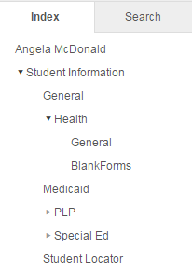
Getting Started
First:
- Select the name of the student
- Go to the Index tab
- Select Student Information
- Health
- General

Slide 4
Choose the Immunizations Tab

Slide 5
Your Screen Should Now Look Like This:

Slide 6
Dates on the Certificate
- Enter certificate date.
This is the date the certificate
was signed.
Enter certificate expiration
date
Enter the type of certificate
(provisional, standard, medical
or religious)

Slide 7
KDE Requirements
This is all that is required for submission to KDE, however, KDE recommends entering all immunization dates as well.
Not only does this give you a more complete health record for the student, but it will make completing the yearly immunization audit much easier.

Slide 8
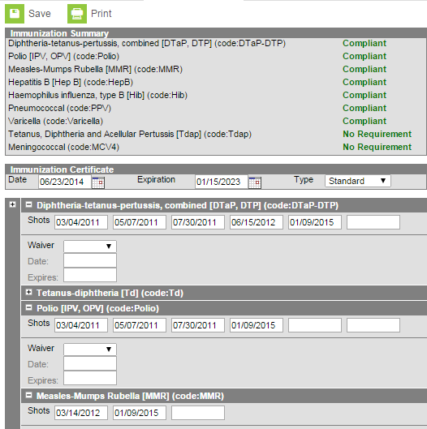
Immunization Dates
- Enter the dates
of the immunizations
listed on the
certificate.
- Click Save

Slide 9
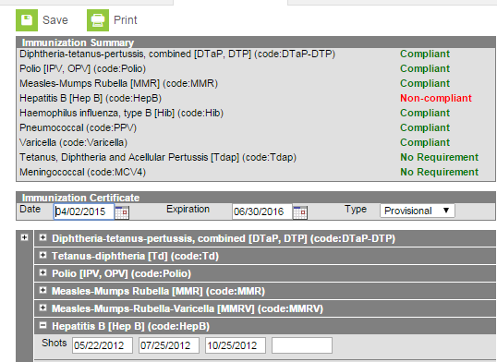
Non-Compliant Immunizations
- If you had an immunization
that is considered Non-compliant,
your screen would look like this.
- Double check the entry to make sure that
the immunization dates were
entered correctly.
- If the immunization was given at the
incorrect interval, it will show non-
compliant as well.

Slide 10
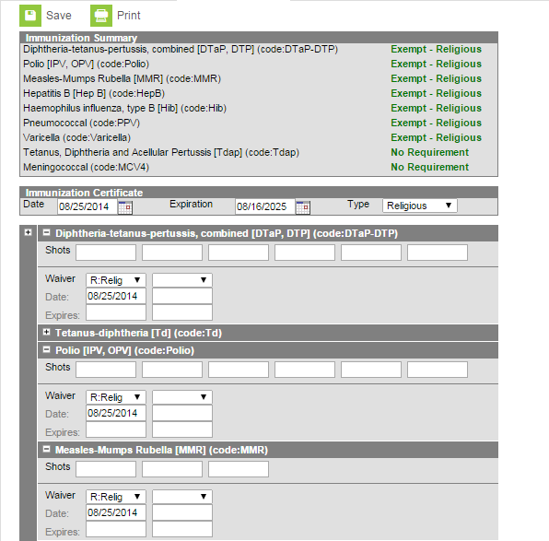
Exemptions
- In the event of a medical
or religious exemption,
enter type of exemption in
the type box.
- Under each individual immunization,
select the type of exemption
in the wavier box.
- List the certificate date in the date
box
- Click Save

Slide 11
Your Screen Should Now Look Like This:

Slide 12
Running Reports to Make Life Easier
Once you have all of your student immunizations entered into Infinite Campus, running the Immunization Certificate Report monthly will show you if you have new students who have enrolled as wellas students who have immunizations that have expired or will be expiring soon. This will help keep your data up to date.

Slide 13
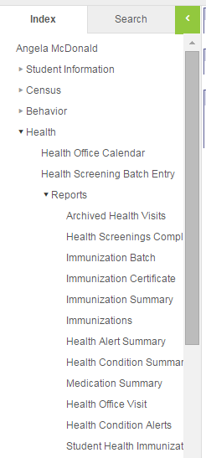
To Run an Immunization Certificate Report:
Go to Index:
Choose Health
Reports
Immunization Certificate

Slide 14
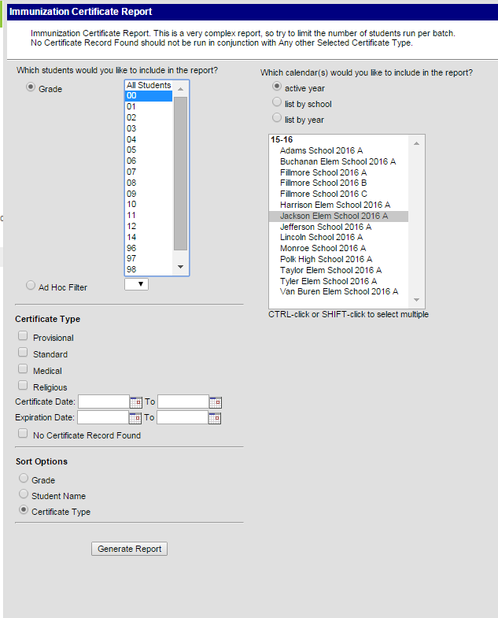
Report Screen
- First select what grade
you would like to use.
You can also choose to
use an ad hoc filter and
narrow the selection even more.
- Once the report is ready,
click the Generate Report button.

Slide 15
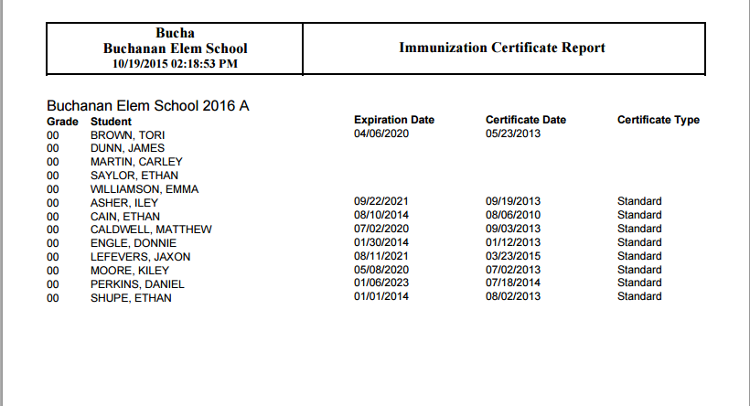
Example of Report
You will see in the red oval, student who are newly enrolled and have not had their immunization information entered into Infinite Campus.

Slide 16
Expired Immunizations
The immunization certificates circles in red have expired. This is a great tool who needs updated certificates.

Slide 17
Missing Information
When this student’s immunization information was entered, the certificate type was inadvertently omitted.
This is a great tool to find any mistakes with data entry

Slide 18
Questions
Angie McDonald, RN
Email: angela.mcdonald@education.ky.gov
Phone: (502) 564-5279 Ext. 4430

