Slide 1
KDE School Nurse End of the Year Webinar
April 27, 2023

Slide 2
Participation information
Click here to watch the KDE Media Portal
Ask questions, go to GoSoapBox, Access Code: schoolnurse
Please enter your full name and district when asking questions.
Have a technical issue? Contact your district technician.

Slide 3
Today’s Agenda
Welcome
Smart Therapy for Asthma, Dr. Bob Kuhn, University of Kentucky
Infinite Campus Updates End-of-Year Reminders
General Updates
Legislative Update – Matt Ross
Department for Public Health Updates (DPH) - Michelle Malicote
Questions and Answers
Closing Remarks and Dates to Remember

Slide 4

Pediatric Asthma Update: SMART Therapy and Beyond
Robert Kuhn, PharmD
Paige Grube, PharmD
April 27, 2023

Slide 5
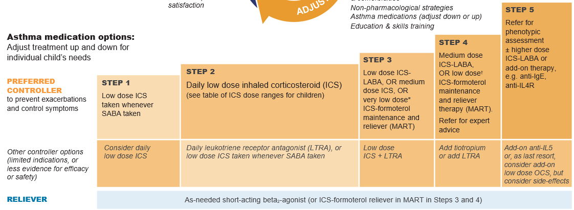
GINA 2022: Children 6-11 Years
Notes:
Dapilumab down to age 6

Slide 6
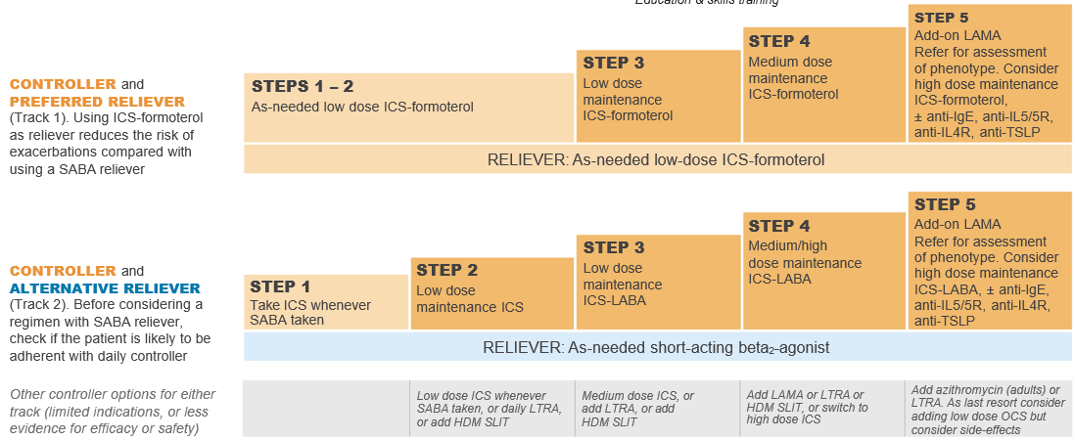
GINA 2022: Adolescents & Adults

Slide 7





SMART THERAPY
ingle
aintenance
nd
herapy
eliever
Notes:
Single co-pay!

Slide 8
ALBUTEROL: CURRENT KNOWLEDGE
Increased risk of exacerbations
Decreased lung function
Increased allergic response
Increased airway inflammation
Increased risk of SEVERE exacerbations (with ≥ 3 canisters/year)
Increased risk of asthma-related DEATH (with ≥ 12 canisters/year)
Notes:
Ironically – while we use albuterol for exacerbations it can also increase the risk of exacerbations
1 inhaler per month!
Put in terms of numbers

Slide 9
ICS: CURRENT KNOWLEDGE
Reduce hospitalizations and death
Prevent SEVERE exacerbations
Reduce symptoms
Only class of drugs that prevents remodeling (permanent change) of the airway!!!
Improve lung function
Prevent exercise-induced bronchoconstriction
Prevent need for additional therapy
Notes:
pharmacology standpoint, ICS is a winner
clinical efficacy standpoint we have also seen great benefits

Slide 10
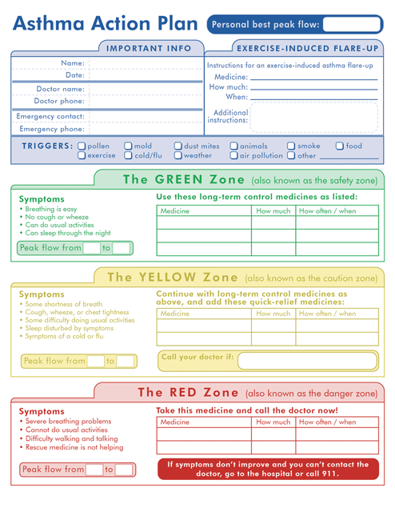
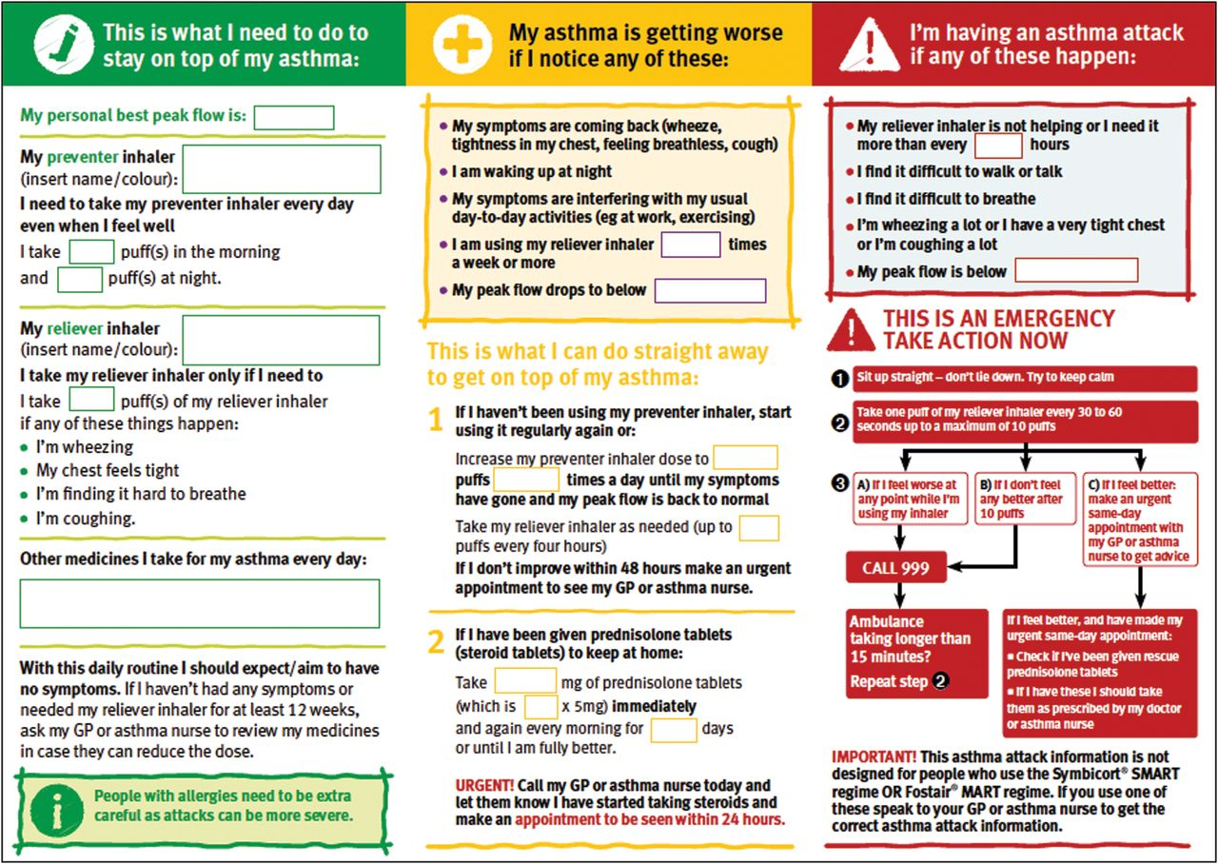
ASTHMA ACTION PLAN

Slide 11
Infinite Campus (IC) Updates and End-of-Year Reminders
Tonia Hickman
KDE Resource Management Analyst III
Notes:
Thank you Angie! Again my name is Tonia Hickman – I am still fairly new to the Office of Finance and Operations, Division of District Support and last but not least to the wonderful world of Infinite Campus
I will be reviewing what reports are due to KDE some updates and helpful hints for your reports.

Slide 12
Student Health Data Reports
The following reports will be pulled from Infinite Campus and posted on the Kentucky Department of Education’s (KDE’s) Student Health Data Page. For more information on specific data entry requirements, please review KDE’s Data Standard - Health (ky.gov)
School Nurse Counts
Health Office Visits
Chronic Health Conditions Data
Preventative Health Exam for Entry Level and Grade 6 (school physical)
Vision Data
Hearing Data
Dental
Immunization Data
Body Mass Index
Notes:
Slide 4
This is a listing of what reports are due to KDE June 1. We know most of our school nurses won’t be in school at the end of June. These reports are pulled from Infinite Campus and will be posted to our Student Health data page. For specific data entry requirements, please review KDE’s Data Standards.
We get several questions about the health office visit report. There is a ad hoc report located in the state published folder that will show any health office visits that you have not entered a discharge date for. We recommend that you run this report frequently so you may correct these data entry errors as you go. The path to find this report is under Ad hoc reporting/filter design/state published folder
Remember –rights have to be given to access the ad hoc report option in Campus. Plus, Ad hoc looks at the users overall tool rights. If there is a data element that the user does not have rights to view the ad hoc will not return the data.

Slide 13
Chronic Health Conditions
Path: Ad Hoc Reporting > Filter Designer > State Published
Chronic Health Conditions Report
Generates a list of students identified with one or more of the state's top nine health conditions with condition status of not resolved (N) or unknown (U)
This report is one of the data points pulled by KDE and reported through the Student Health Data Page on KDE’s website
  This report will ensure that you are using the correct IC codes when entering health conditions
Notes:
The Chronic Health Conditions report is also one of the data points pulled by KDE and reported through the Student Health data Page on KDE’s website. This report generates a list of students identified with one or more of the state’s top nine health conditions with conditions status of not resolved (N) or unknown (U) We recommend that you run this report and check for accuracy before June 1. This report will ensure that you are using the correct IC codes when entering health conditions. There is ad hoc report that you can run on this one as well and that path is Ad Hoc Reporting/Filter Designer/State Published folder.

Slide 14

Reminder - Communicable Disease Tab
Path: Student Information/Communicable Disease
This new tab allows school nurses to document each time that the local health department or other medical provider is notified of a reportable communicable disease in the school
To access this new tab, user access must be granted by your district system administrator
This is not a requirement to use
Notes:
Still new is the Communicable Disease Tab that was added just this year. This tab can only be used if the district grants access to it. This tab allows school nurses to document each time that the local health department or other medical provider is notified of a reportable communicable disease in the school. For example – this can be used for measles etc.. we had several cases reported this year. The path to this report is shown here. This tab is not a requirement to use

Slide 15
School/District Health Data
School nurse counts should be entered before June 1st, 2023
  District-hired nurses tracked on District Assignments tab
  Contract-hired nurses tracked on District Service Providers tab
  Data checks can be done using the Nurse Count report located under KDE Reports
  Information should be reviewed and entered each school year.
  Detailed instructions can be found here How to document district health providers
.
Notes:
School/District Health Data refers to our Nurse Count report. School nurse counts should be entered before June 1. Please note that the district point of contact is responsible for entering this information for district hired nurses. District hired nurses are tracked on the District Assignments tab and Contract Hired nurses are tracked on the District Services Providers tab. Data checks can be done using the nurse count report located under KDE Reports

Slide 16
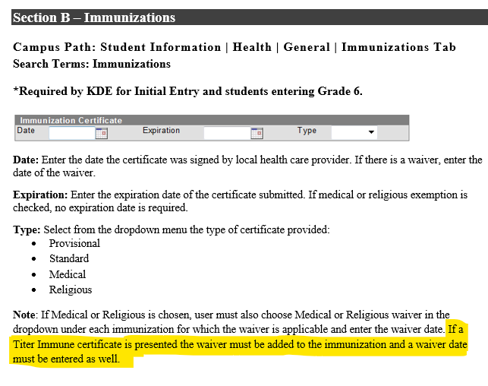
Titer Immune
New to Immunizations Tab in Infinite Campus– Titer Immune which is an additional exemption option if titers are drawn instead of additional vaccine given.
Notes:
Titer Immune – this is a new immunization Tab in infinite campus. Titer Immune which is an additional exemption option if titers are drawn instead of additional vaccine given. How to enter this information has recently been added to our data standards. The campus path: Students Information|Health|General|Immunization Tab since this is new I’m going to walk you through it.
Date: enter the date the certificate was signed by local health care provider. If there is a waiver, enter the date of the waiver.
Expiration – enter the expiration date of th4e certificate submitted. If medical or religious exemption is checked, no expiration date is required.
Type: Select form the dropdown menu type of certificate provided:
Provisional, standard medical or religious
Important note – if Medical or Religious is chosen, you must all choose Medial or Religious waiver in the drop down under each immunization for which the waiver is applicable and enter the waiver date. If a Titer Immune certificate is presented the waiver must be added to the immunization and a waiver date must be entered as well.

Slide 17
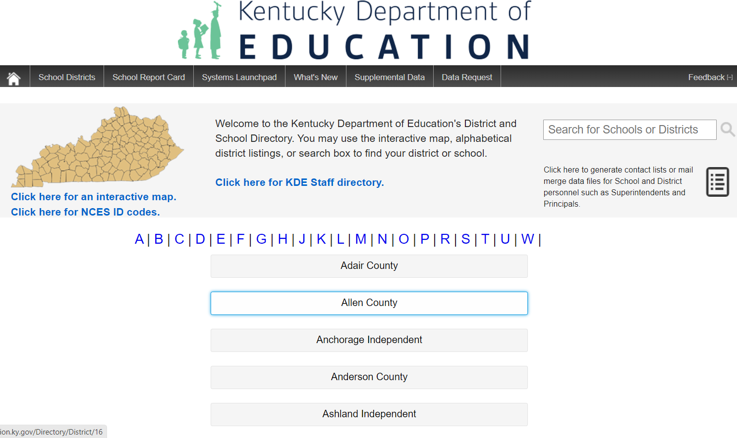

Open House - Kentucky Student Information System - Point of Contacts
Directory - Open House (ky.gov)
A great tool to find administrative staff for each district can be found in the District and School Directory on KDE’s Open House from the KDE Public Website
Notes:
Slide 9 – a helpful hint – we get questions regarding how to find out who the KSIS is point of contact for the district. A great tool to use to find that information is the District and School directory located on KDE’s Public Website. (education.ky.gov). Be sure to scroll to the bottom of the page and look for a red house icon.
Thank you so much. If you have questions, please contact me or Angie we will be glad to help in any way. We can set up a TEAMS meeting or visit your district. Our contacts will be shown at the end of presentation. Also remember you can find a lot of this information such as how to enter the information on our webpage…education.ky.gov/districts/SHS/Pages/School-Health-Services-Infinite-Campus-Information.aspx

Slide 18
General Updates
Medication Administration Training for 22-23 school year MAY continue through summer programing as it is a continuation of the current school year
NO changes in training materials for 23-24 school year
Updated Effective Instructional Leadership Act (EILA) certificates available July 1, email tonia.hickman@education.ky.gov to request certificates
KDE needs school nurse in action photos for our archive
  Email photos to angela.mcdonald@education.ky.gov to submit
  Must have signed photo release on file for student with district

Slide 19
New Family Educational Rights and Privacy Act (FERPA) Guidance
The U.S. Department of Education’s Student Privacy Policy Office has issued two guidance documents to school officials to remind them of their obligations to protect student privacy under the Family Educational Rights and Privacy Act (FERPA). The guidance documents focus on student health records and encourage school officials to consider the importance of student privacy, including health privacy, before disclosing information from education records.

Slide 20
Document Links/Details
Family Educational Rights and Privacy Act: Guidance for School Officials on Student Health Records
Know Your Rights: FERPA Protections for Student Health Records
Notes:
This first document provides school officials with general information about FERPA, with a particular focus on student health records maintained by educational agencies and institutions and by third parties acting on their behalf.
The second, one-page document, provides a brief overview of parents’ and eligible students’ rights FERPA, with a particular focus on student health records.

Slide 21

Field Trip Concerns/Questions
Students who require health services may not be excluded or denied access to activities
Federal laws mandate schools provide ALL students equal opportunity to participate in academic, nonacademic and extracurricular activities (including school-sponsored field trips), even after regular school hours
Schools must assure that medications administered to students are done so in a way that assures safety and compliance with the school policies and procedures and each state’s laws
Notes:
There were several questions submitted regarding field trips, both instate and out of state, so I thought it would be easier to talk about field trips as it will hopefully answer everyone’s questions

Slide 22

More Field Trip Concerns/Questions
Scope of practice varies from state to state
Be especially aware of the scope of licensed practical nursing practice as it varies across the country
Nurse is responsible for knowing the scope of practice for nurses in the state they will be traveling through as well as the state where the field trip will take place
List of Nurse Compact states
Individual boards of nursing
State school nurse consultants list and contact information
Areas of importance are:
  Is delegation allowed?
  Laws regarding medication administration
  Emergency care and medication
For more information, see Providing Health Services on Out of State Field Trips
Notes:
If delegation is not permitted in the state, there are a few options, 1. Self administration if the student is old enough and competent to self administer. Staff just has to observe and document that the student self administered the medication. 2. Parent or other family member goes with student, allow to ride of bus, etc. that will perform care. 3. School nurse goes on field trip with student. 4. District contracts to provide nursing service in the state on the field trip

Slide 23

Tennessee
Tennessee does allow for delegation to unlicensed school personnel to assist with medication administration and administer emergency rescue meds. Here’s a link to our Guidelines for Health Care in a School Setting that contains additional information and guidance
Tennessee Code Annotated 49-50-1602 speaks to assistance in self-administration of medications, administration of glucagon, epinephrine and anti-seizure medications by volunteers and diabetes care tasks
Amanda Johnson, MPH, RN
School Nurse Consultant, Tennessee
amanda.johnson@tn.gov

Slide 24
Exams, Screening Compliance and Transfers
School Health Requirements
Notes:
Summary can be found at the link above

Slide 25

Physical Exams
Initial entry exam (includes preschool) – Can be completed up to one year prior to the first day of PS (if within the district), K or 6th grade. Must be on file by October 15th of the year of enrollment or 6th grade, exams turned in after that date will be considered non-compliant in Infinite Campus
Notes:
Students are still

Slide 26

Vision Exams
Performed at initial entry (ages 3,4,5 or 6) – Can be completed up to one year prior to the first day of enrollment. Must be on file by January 1st to be considered valid, any exams performed after that date will be considered non-compliant in Infinite Campus

Slide 27

Dental Exams/Screenings
Must be completed the calendar year that the student starts kindergarten (Between Jan 1 and December 31), any exams/screenings performed after outside this timeline is considered non-compliant.
Notes:
As winter break nears, run report of student missing dental exams/screenings and complete screenings before leaving for Christmas break.
*** Remember, retained students do not need to repeat screenings.
**** Is it up to the district to determine which grades get routine hearing and vision screening. BMI’s are not mandatory, however some districts do them and we report those that are completed

Slide 28

Transferring Students
If student transfers from out of state in their initial entry year, all requirements are the same as any other student (immunizations, physical, vision and dental)
If the student transfers in any other grade, only immunizations and physical are required
Districts should may every effort to get the required screenings and exams completed in a timely manner, however there is no penalty to districts if not completed

Slide 29
Upcoming Training Opportunities
Kentucky School Nurse Association Summer Conference (In Person)
  July 5-7, 2023
  Watch Listserv for upcoming registration information
KDE District Health Coordinator Conference
  Sept. 7, 2023
  KDE, 300 Sower Blvd., Frankfort, KY 40601
  Watch Listserv in August for registration and agenda

Slide 30
In Other News…
Medication Administration Training for 22-23 school year MAY continue through summer programing as it is a continuation of the current school year
KDE needs school nurse in action photos for our archive
  Email photos to angela.mcdonald@education.ky.gov to submit
  Must have signed photo release on file for student with district

Slide 31
2023 Legislative Update
School Health
April 27, 2023

Slide 32
SB 150
2023 Legislative Guidance
On enrollment and annually district must provide comprehensive notice of the health services and mental health services available to students and right of parents to refuse consent for services.
Must notify parents when school personnel make referral to a student for health or mental health services
General parental consent may not be given for well-being surveys and questionnaires. Parental consent is required for each.
Impacts grade 5 health standard and human sexuality instruction
Restricts bathrooms and locker rooms. Provides for accommodation.
Prohibits administration of certain drugs to alter appearance of minor’s sex.

Slide 33
HB 331 (AEDs)
District emergency plan required to include written cardiac emergency response plan
  Include location of AEDs
  Provided to all school staff
  Reviewed annually by school nurse, school council, principal and first responders
Cardiac response plan rehearsed by simulation prior to the beginning of each athletic season by:
  Licensed athletic trainers, school nurses and athletic directors
  Interscholastic coaches and volunteer coaches

Slide 34
HB 331 Cont. 1
AED required in every middle and high school building
As funds are available AEDs at school-sanctioned middle and high school athletic practices and competitions
Adopt procedures for use, training and maintenance
Minimum 3 school employees and all coaches trained on AED
All athletic coaches maintain CPR certification
Develop event-specific emergency action plan for school-sanctioned nonathletic events held off-campus
  Roles of staff, emergency personnel and may include AED
  Distributed to staff

Slide 35
HB 331 Cont. 2
By August 1 of each year, District to report to KDE # of AEDs
By October 1 of each year, KDE to publish # of AEDs on website and report to IJCE and IJC on Health, Welfare and Family Services
Creates an AED fund in CHFS to help pay for and maintain AEDs as well as for CPR training
KHSAA required to adopt rules requiring:
  AED at athletic practices and competitions
  Venue specific emergency plans
  Annual rehearsal
  Certify to KHSAA that plan has been reviewed and rehearsed

Slide 36
SB 47 (Medicinal Cannabis)
Provides for the legalization of medicinal cannabis for certain qualifying conditions. Most sections not effective till 1/1/2025.
Establishes framework for oversight, administration and licensing
Prohibits patients under 18 from possessing/acquiring cannabis; requires minor’s guardian to consent and control administration
Prohibits dispensing products intended to be consumed by vaporization for cardholders under 21 years old
Prohibits schools from refusing to enroll a cardholder
Requires local boards to establish policies to permit students that are registered qualified patients to consume medicinal

Slide 37
SB 47 Cont. 1
Each local board of education…, no later than July 1, 2024, establish policies to permit a pupil who is a registered qualified patient to consume medicinal cannabis on school property as deemed necessary by the pupil's parent or legal guardian. Policies enacted pursuant to this paragraph shall require medicinal cannabis be administered by a school nurse or under the supervision of appropriate school staff

Slide 38
HB 538 (Student Discipline)
Requires districts to adopt policy requiring expulsion for at least 12 mos. if student is determined by clear and convincing evidence to have made threats that pose a danger to students and staff.
Requires policy requiring disciplinary actions for physical assaults or students and staff off school property if incident is likely to disrupt the educational process.
Clarifies that a board may expel a student for longer than 12 mos.
Review expulsion 30 days prior to end to determine whether it should be extended.

Slide 39
HB 538 Cont. 1
In lieu of expulsion, student may be placed in an alternative program or setting;
No alternative placement until guardian provided the opportunity to have a hearing before the board or appeals committee;
Students in alternative placement shall be subject to compulsory attendance and included in attendance for funding purposes;
Placement reviewed at least once per year

Slide 40
HB 538 Cont. 2
Principal may establish procedures for removal and reentry for disruptive students.
Student considered “chronically disruptive” if removed 3 times in 30 days from same classroom and may be suspended.
Any time a student is removed, principal may require meeting and review with guardians and determine a course of action for student to continue in that classroom.
May permanently remove chronically disruptive student from classroom and place in another class or alternative setting.
Opportunity to appeal permanent removal decisions.

Slide 41
Questions:
Matt Ross, Policy Advisor
Office of Finance and Operations
Matt.Ross@education.ky.gov

Slide 42


Slide 43
Back to School Outreach Tool-Kit
Contents:
Relevant KRS/KAR (may not be all inclusive)
KDPH Immunization Branch Resources
CDC Resources
Immunization Action Coalition Immunization Action Coalition (IAC): Vaccine Information for Health Care Professionals (immunize.org)
Immunize Kentucky Coalition Health | Immunize Kentucky Coalition (immunizeky.org)
Sample outreach call scripts
  Kindergarten/Sixth grade entry
  No records
  Students turning 16 /Meningitis Requirement
Helpful Outreach Hints
Sample Notice of Incomplete Health Records

Slide 44


Slide 45


Slide 46


Slide 47
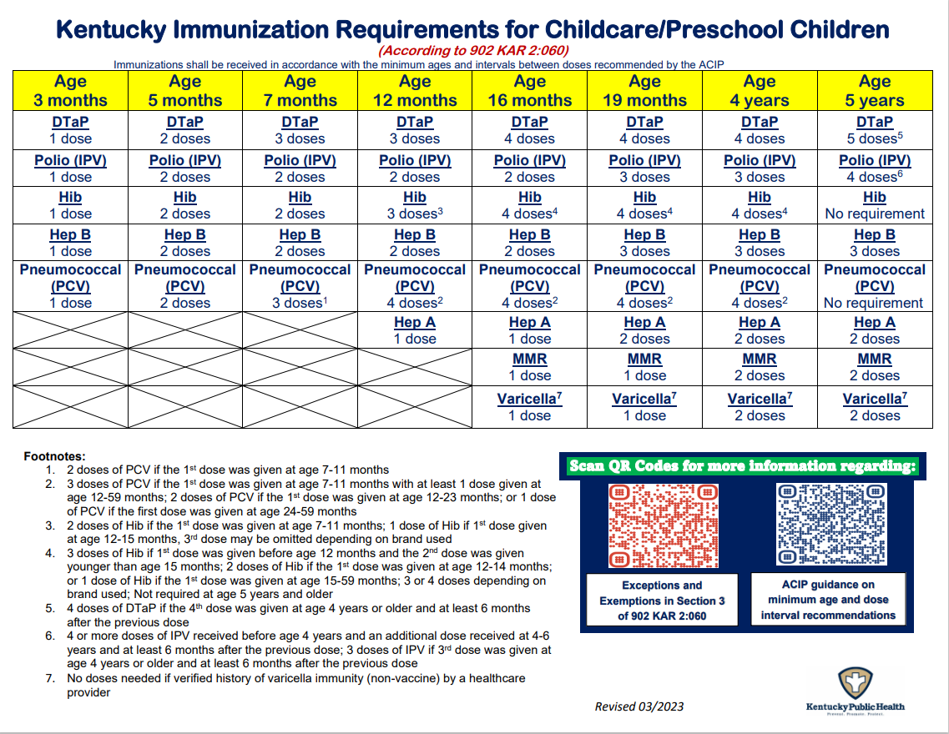

Slide 48
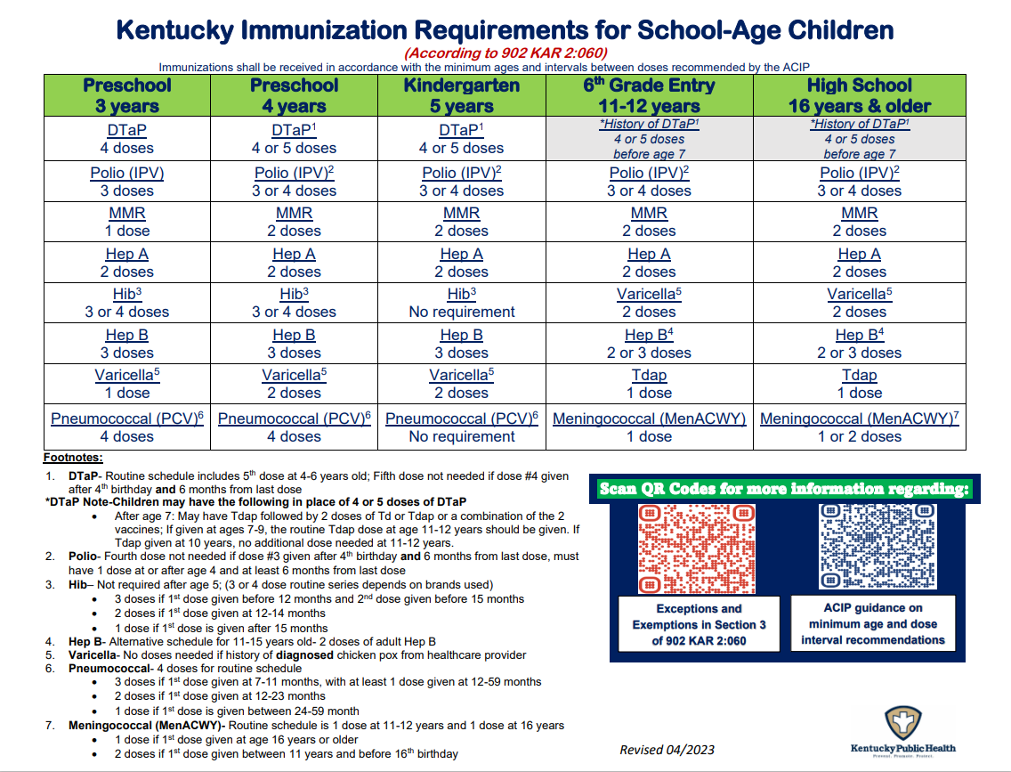

Slide 49
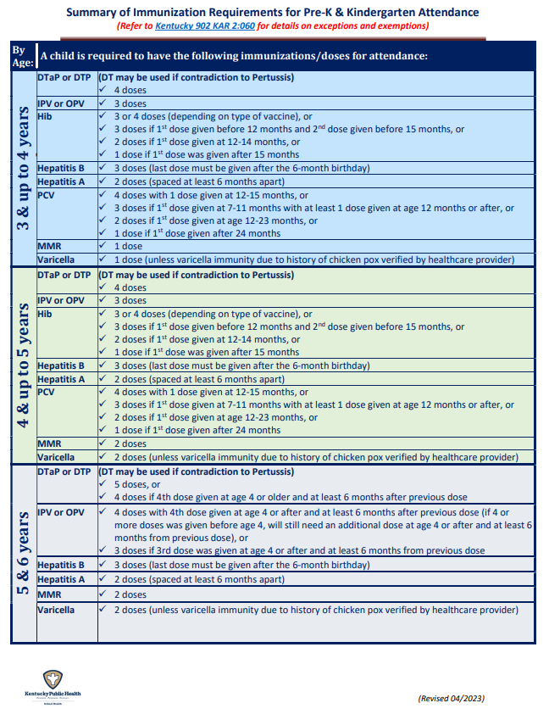
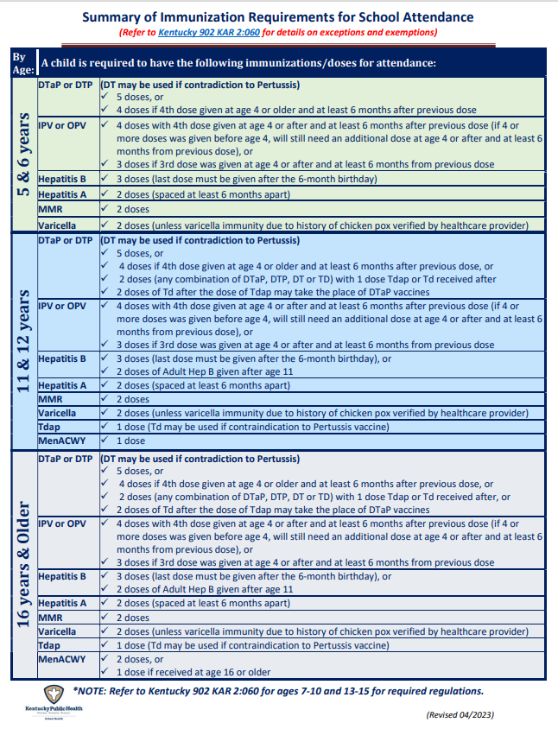
Quick Guides to
Kentucky Immunization requirements

Slide 50
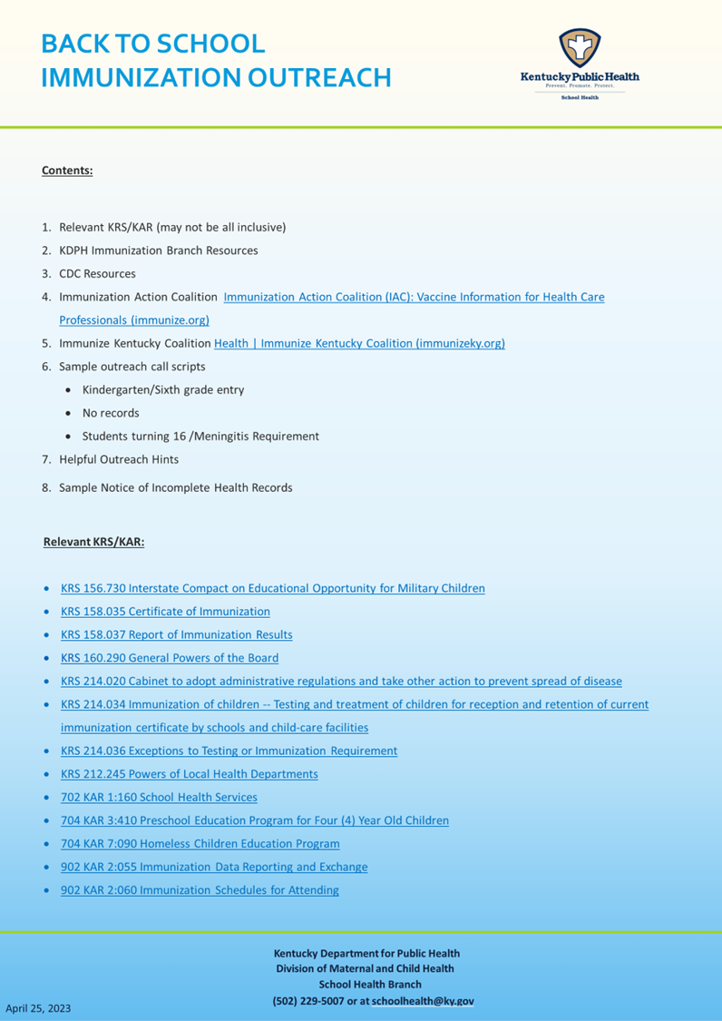


Slide 51
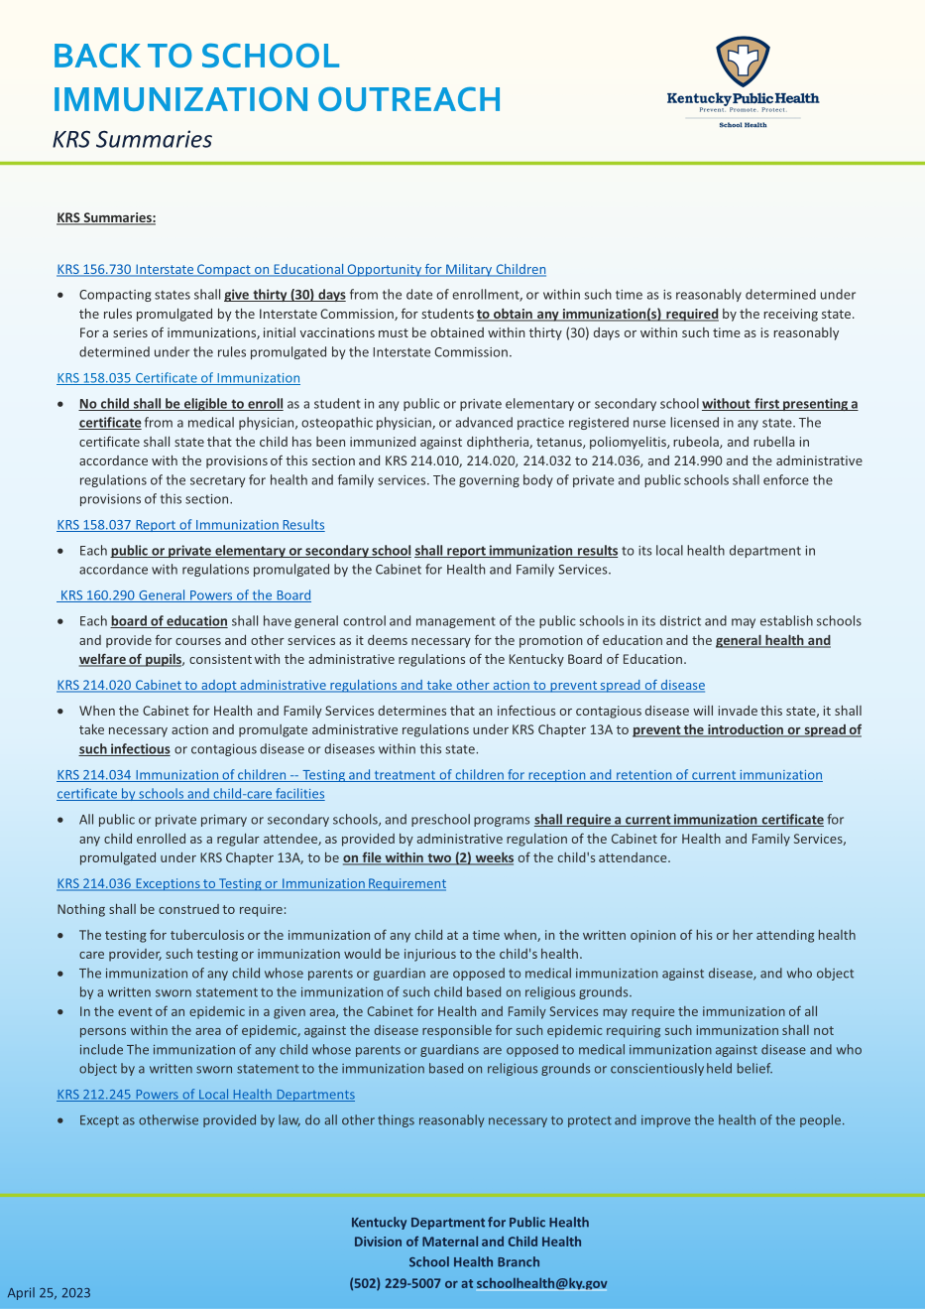


Slide 52
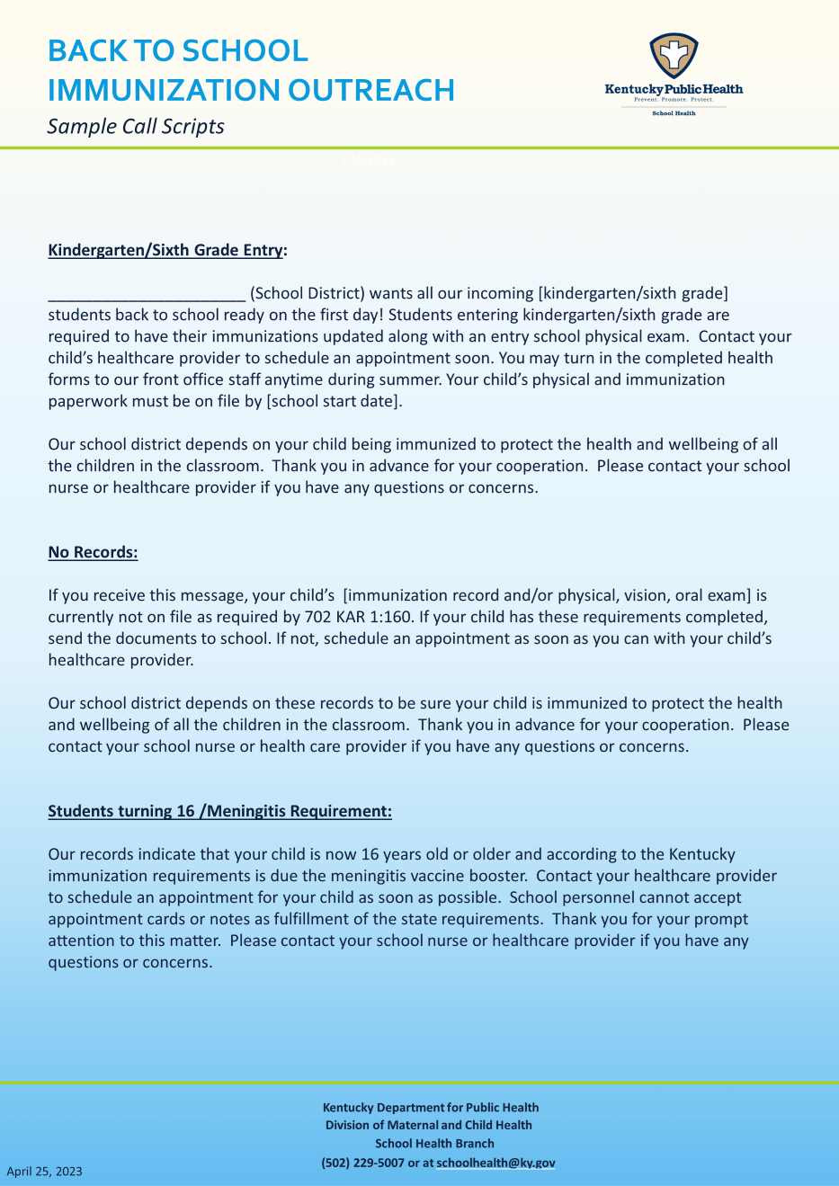
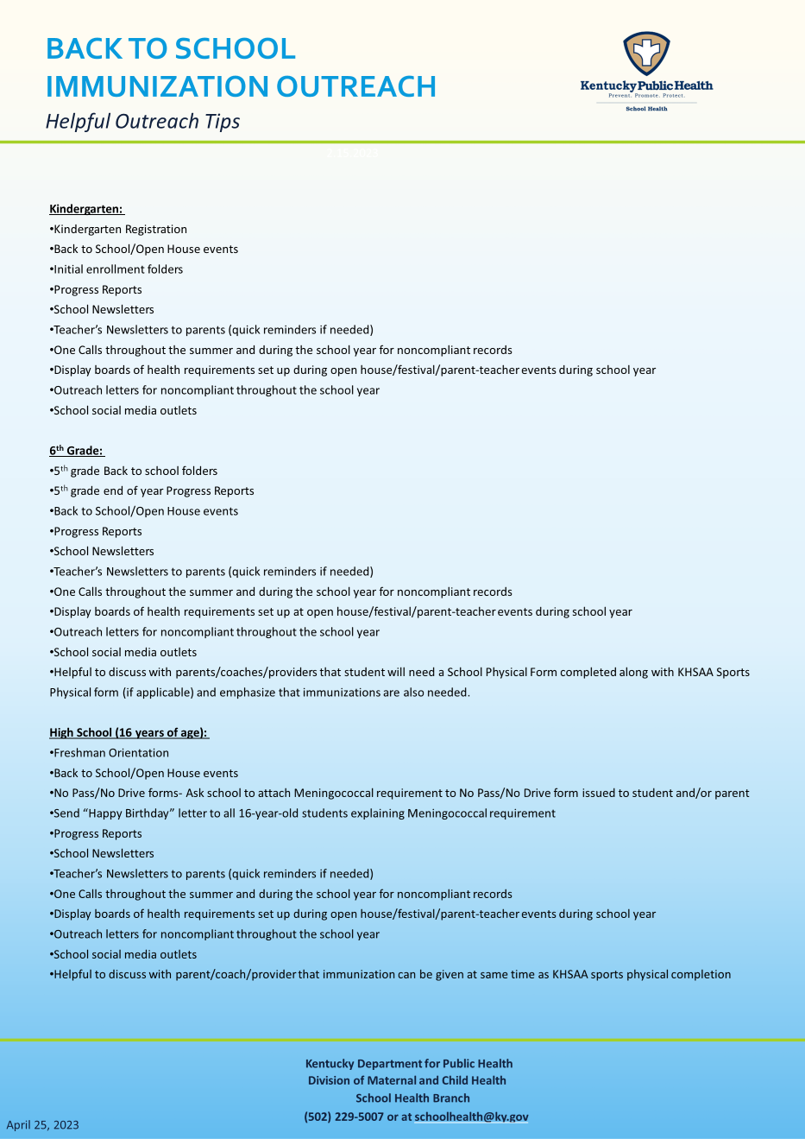

Slide 53
Incomplete
Health Requirements Outreach Letter

Slide 54
HEPA UNITS AVAILABLE FOR K-12 SCHOOLS

Slide 55
Questions
Please put any questions
in the GoSoapBox app and
they will be answered in
live time or in a
follow-up email.
?

Slide 56
Beth Thomas, BSN, RN
School Health Branch
Kentucky Department for Public Health
Division of Maternal and Child Health
School Health Branch
Office: 502-564-9919
Candace Carpenter BSW, MS (she/her)
School Health Branch
Kentucky Department for Public Health
Division of Maternal and Child Health
School Health Branch
Office: 502-564-2075

Slide 57
Beth Thomas, BSN, RN
School Health Branch
Kentucky Department for Public Health
Division of Maternal and Child Health
School Health Branch
Office: 502-564-9919
Candace Carpenter BSW, MS (she/her)
School Health Branch
Kentucky Department for Public Health
Division of Maternal and Child Health
School Health Branch
Office: 502-564-2075

Slide 58

Contact
Angie Spaw McDonald, RN Education State School Nurse Consultant Office of Finance and Operations Division of District Support Student Health Branch Phone: (502) 564-5279 Ext. 4430 Email: angela.mcdonald@education.ky.gov | Tonia Hickman Resource Management Analyst II Office of Finance and Operations Division of District Support Student Health Branch Phone: (502) 564-5279 ext. 4062 Email tonia.hickman@education.ky.gov

Slide 59

Thank you!!

