Slide 2
KY Academic Standards (KAS) Implementation Professional Learning (PL) Mini Grant
Grant Technical Assistance

Slide 3
KDE Competitive Grants Page
KDE competitive grants page

Slide 4
Questions
You may ask questions by typing in the chat box or unmuting your mic during the questions period
You may submit written questions to KDERFP@education.ky.gov
Questions asked but not answered today will be included on the FAQ
Questions deadline is 10/7/19
Notes:
Expect FAQ to be posted on or around 10/10.

Slide 5
Purpose of the PL Mini Grant
Engage educators in professional learning to address new KY Academic Standards (KAS)
Build a plan for KAS implementation that shows
Who will be targeted for professional learning
When implementation items will occur
How it will be scaled and sustained for continuous improvement

Slide 6
Eligibility
KY Public School Districts
No special considerations for enrollment, academic performance or demographics

Slide 7
Conditions of Application
Applications will be submitted from the district only
District may apply on the behalf of the entire district, a single school or other configuration
Such as (but not limited to): selected teachers, content areas, grade levels, positions (instructional coaches, math teachers, principals, middle school teachers)

Slide 8
Funding
Total award all combined: $520,000
Total award per mini grant: $10,000
Estimated 52 individual awards

Slide 9
Requirements for Funded Districts
Create a KAS Implementation Professional Learning (PL) plan based on needs assessment
Plan must be approved by KDE
Awardees will engage in PL provided by KDE plus additional learning
Budget Summary will be included
Appropriate signatures must be collected
Notes:
Webcasts, book studies, virtual workshops have to be included in the plan along with the specified PL chosen in this plan.

Slide 10
KAS Implementation Professional Learning Mini Grant Timeline
Date | Event | Location | Participation
9/25/19 | RFA released | Online | N/A
10/04/19 | Technical assistance | Online | Attending or watching this TA session is recommended
10/07/19 | Questions deadline | Email | N/A
10/28/19 | Proposal deadline | Send to KDE | Required
TBD | Proposal peer review | Frankfort | N/A
On or around 12/01/2019 | Awardees are posted to KDE website | Online | N/A
TBD | MOA process (KDE & LEA) | N/A | Districts
TBD | District plans reviewed | N/A | N/A
01/01/2020 | Funding available to LEA | N/A | Districts

Slide 11
KAS Implementation Professional Learning 30-60-90-180 Day Plan
Year 1: January – September 2020
Year 2 & 3
How will the plan be sustained?
How will the plan/results scale across schools and district?
Notes:
How do you begin starting in January? Big push in the summer. Beginning of school year.

Slide 12
KAS Implementation Professional Learning 30-60-90-180 Day Plan
Use template for response
100 points possible
Needs assessment: 20 pts
Year 1 plan: 50 pts
Description of plan to scale and sustain the work: 30 pts
Notes:
How do you begin starting in January? Big push in the summer. Beginning of school year.

Slide 13
KAS Implementation Professional Learning 30-60-90-180 Day Plan
At grants webpage: download RFA, 30-60-90-180 Day Template, Budget Summary
Template
Type directly in the template (Word)
10 page limit for plan
Arial 11 point font, single space
Budget Summary: itemized expenses with MUNIS codes
Notes:
How do you begin starting in January? Big push in the summer. Beginning of school year.
Notice on the grants webpage the 3 pieces you should download: RFA, plan template, budget summary

Slide 14
KAS Implementation Professional Learning Plan Response Question 1
Needs Assessment

Slide 15
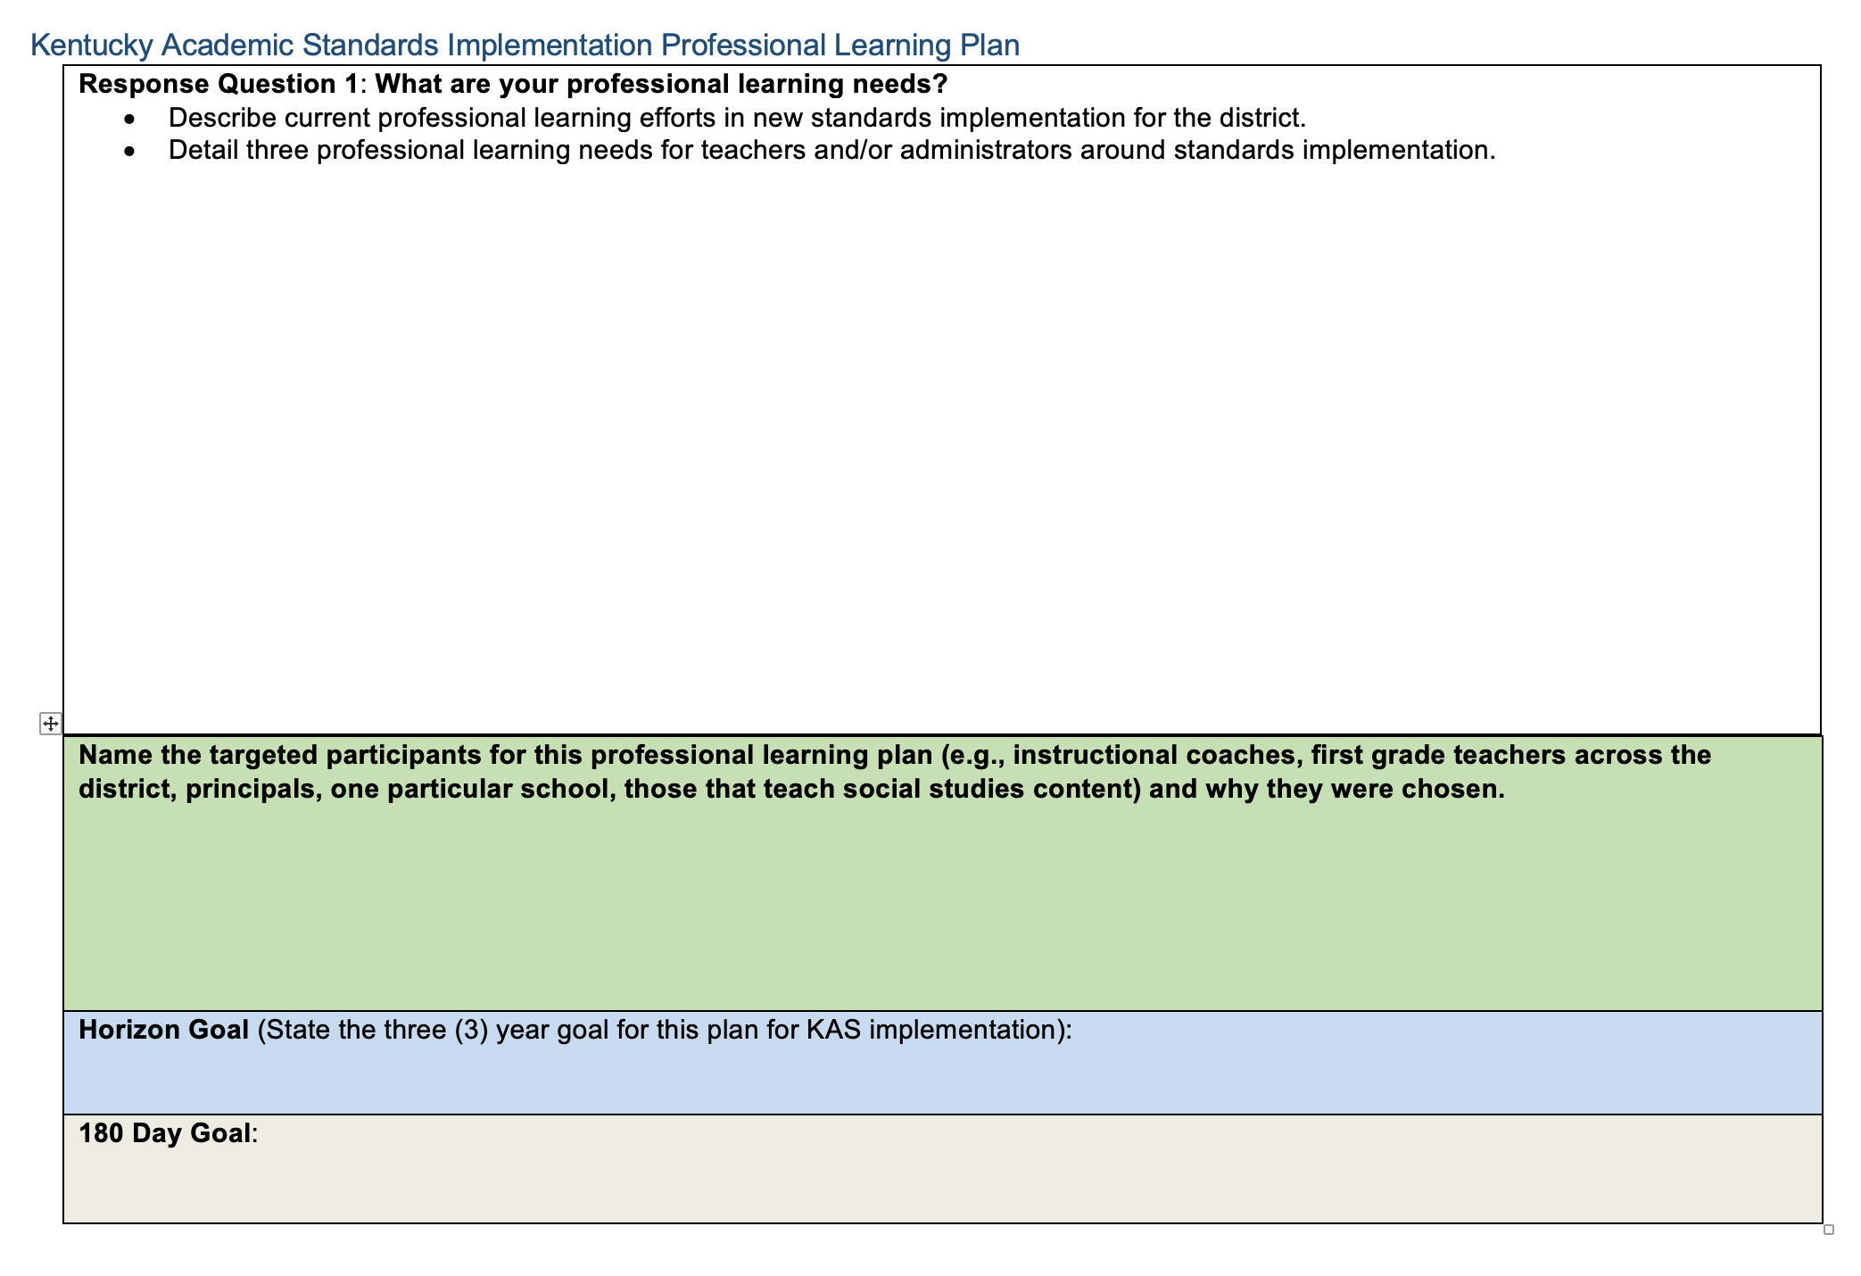
KAS Implementation Professional Learning 30-60-90-180 Day Plan
Notes:
There is no formal needs assessment that we are requesting, just a response to this question that summarizes your assessment of needs. Notice the size of the box. This is an expandable box. It can be made smaller or larger as you need. Remember the page limit and use these spaces accordingly.

Slide 16
KAS Implementation Professional Learning Plan Response Question 1: Needs Assessment
20
points
Describe current professional learning efforts in new standards implementation for the district.
Explain the professional learning needs for teachers and/or administrators around standards implementation in the district
Notes:
Answering directly in the box in the template is response question 1 that asks about current PL and what is needed for standards implementation. You’re building your case for your plan.

Slide 17
KAS Implementation Professional Learning Plan Response 2
Year 1 Plan: 50 Pts

Slide 18
KAS Implementation Professional Learning 30-60-90-180 Day Plan
Name the targeted participants for this PL Plan
Explain why they were chosen
Notes:
The template will guide. This box asks for you to consider who will be the targeted group for participation in this grant and why.

Slide 19
KAS Implementation Professional Learning 30-60-90-180 Day Plan
Name the targeted participants for this plan
Examples include but are not limited to: instructional coaches, first grade teachers, principals, high school math teachers, social studies teachers, one particular school
Explain why this is the targeted group
This group was chosen for a reason. Explain.
Notes:
What’s the plan for Y1…specifically. The template will guide these responses.

Slide 20
KAS Implementation Professional Learning 30-60-90-180 Day Plan
Horizon Goal: states 3 year goal for KAS implementation
180 Day Goal: measurable goal for the end of the first year (January to September)

Slide 21
Horizon Goal
“For this grant, a horizon goal is a strategic, overall goal that defines an outcome at the end of a three (3) year period once the 30-60-90-180 Day plan is implemented. It is the vision for the plan.” (RFA p. 3)
Notes:
Envision what you expect to see at the end of three years BECAUSE you executed a PL plan to help implement the standards.

Slide 22
180 Day Goal
Goal for the end of the first year
September 2020
Measurable goal
Tangible
Can view progress through established criteria of success
Notes:
This is about teaching and learning. Think of how this impacts teachers and students.

Slide 23
Breaking 180 Day Goal into Measurable Elements
Using the template, break down the 180 Day goal into 30 day increments
Be specific in details in the template
Alignment of teacher instructional tasks/assignments to grade-level standards
Use of formative assessment to guide instruction
Use of PLCs to engage in the learning

Slide 24
30 Day Increment Planning
Name & detail the following
Success criteria “We will know we are successful when…”
Listing the measures/evidence that will be used to monitor success
Naming action strategies
Who’s on point for that strategy?
When will it be communicated?
How will it be communicated?
Naming actions if goal is not successful

Slide 25
30 Day Increment Planning
Repeat this break down for each 30 day period
30-60-90-180 Day Plan
January 2020 – September 2020

Slide 26
Sustaining and Scaling Response Question 3
30
points
Describe plan for scaling the work from year 1
Explain how the district will know the impact on initial group
How will capacity be built from the initial group to a larger number of staff in year 2 & 3?
Discuss how PLCs will be included in years 2 & 3

Slide 27
Scalability & Sustainability Defined (Key Terms & Definitions, RFA p. 3)
Scalability: the capacity of a district to increase the number and effectiveness of the initial plan to impact an increasing broader number of educators and ultimately students.
Sustainability: the ability of a district to continue the work initiated by the grant beyond the funding period.

Slide 28
Submission Requirements
Responses all within the 30-60-90-180 Day Template on the Grants website
Proposals must be received by 4:00 pm ET, October 28, 2019
(KDERFP@education.ky.gov)
Arial 11 point font, single spaced
10 pages maximum
Does not include signatures page
Does not include budget summary

Slide 29
Submission Process
RFA pp. 5 & 6
Scan completed application in its entirety
Template, cover page, principal signatures, budget summary
Save in this manner
PDF format
KASMINIGRANT_20_DistrictName
KASMINIGRANT_20_FranklinCounty

Slide 30
Where do I find all parts of the application?
KDE Competitive Grants webpage
Application Cover Page: RFA p. 8
Print to Sign
Superintendent
Notary
Principal Signature Page: RFA p. 9
Print to sign

Slide 31
Where do I find all parts of the application?
KDE Competitive Grants webpage
30-60-90-180 Day Template
Budget summary
Download both from grants page
Both are Word documents
Type directly into the templates

Slide 32
Submission Process cont.
Email PDF of full application
KDERFP@education.ky.gov
Subject: KASMINIGRANT/name of District
Time stamp be on or before 4:00 pm ET, October 28, 2019
Remember incoming mail is routed for security purposes and may delay the process

Slide 33
Submission Process cont.
Application not received by the deadline will not be reviewed or considered for award.
October 28, 2019
On or before 4:00 pm ET
KDERFP@education.ky.gov

Slide 34
Award Notifications
Districts will receive preliminary notice of award on or around December 1, 2019

Slide 35
Evaluation of Proposal RFA p. 6
Independent peer-review process
Conducted through the KDE Grants Branch
Based on the scores of reviewers, proposals will be ranked and awarded as funding allows

Slide 36
Questions?
KAS Implementation Professional Learning Mini Grant

