Slide 1
Entering Immunizations Into Infinite Campus
Angie McDonald, ADN, RN, NASSNC
KDE State School Nurse Consultant
Michelle Malicote, BSN, RN, NASSNC
KDPH School Health Branch Manager
2022

Slide 2
Objectives:
Understand how to correctly enter immunizations into Infinite Campus
Define compliant vs. non-compliant
Identify what an immunization screen entry looks like
Can enter immunization certificate data and recognize incomplete or incorrect entries
Can create immunization data reports to support compliance

Slide 3
Getting Started:

Slide 4
Choose the Immunizations Tab:

Slide 5
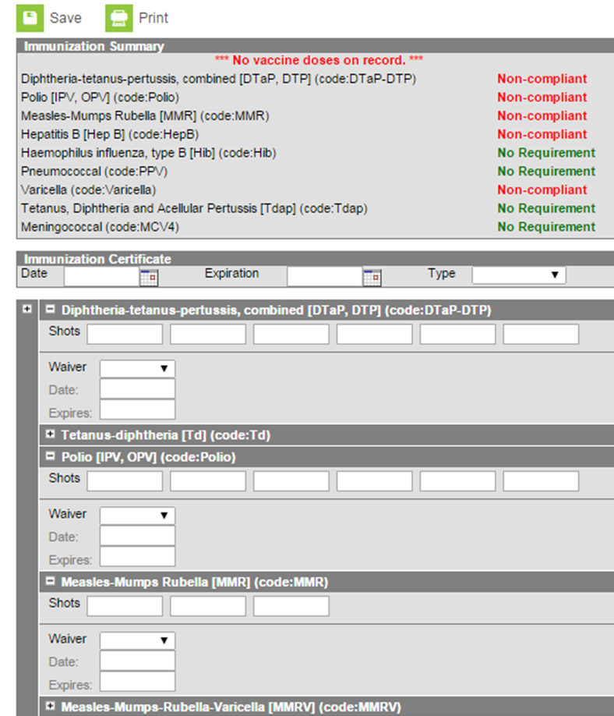
Your Screen Should Now Look Like This:

Slide 6
Dates on the Certificate:
Enter certificate date:
(This is the date the certificate was signed
or the date you entered into Infinite Campus (IC))
Enter certificate expiration date
Enter the type of certificate:
(provisional, standard, medical or religious)

Slide 7
KDE Requirements:
This is all that is required for submission to the Kentucky Department of Education (KDE), however, KDE recommends entering all immunization dates as well
Not only does this give you a more complete health record for the student, but it will make completing the yearly immunization audit much easier

Slide 8
Immunization Dates:
Enter the dates of the immunizations listed on the certificate
Click Save

Slide 9
Non-Compliant Immunizations:
If you have an immunization that is considered Non-compliant, your screen will look like this
Double check the entry to make sure that the immunization dates were entered correctly
If the immunization was given at the incorrect interval, it will show non-compliant

Slide 10
Exemptions:
In the event of a medical or religious exemption, enter type of exemption in the type box
Under each individual immunization, select the type of exemption in the wavier box
List the certificate date in the date box
Click Save

Slide 11
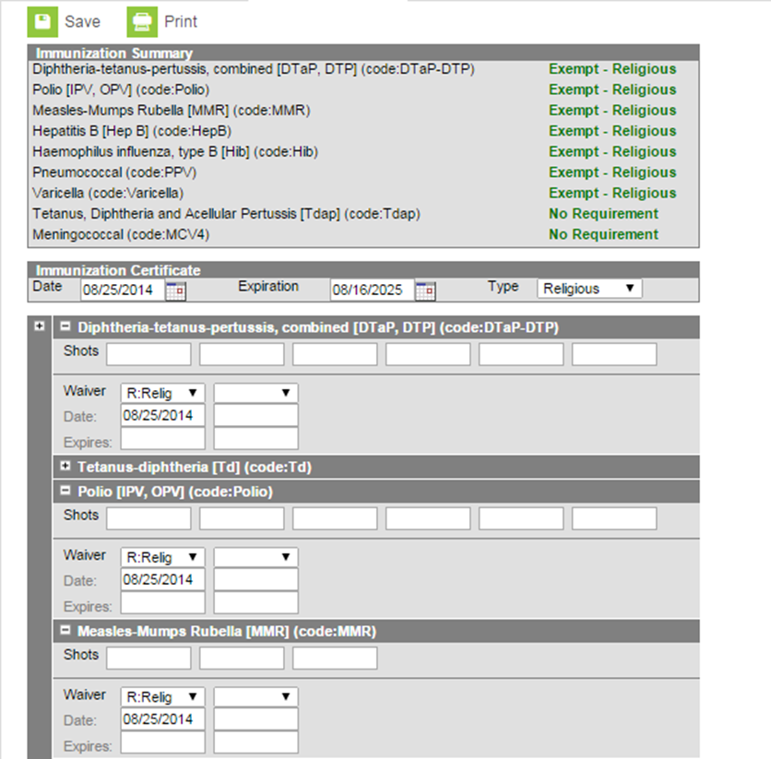
Religious Exempt Example

Slide 12
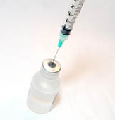
Running Immunization Compliance Reports:
Once you have all your student immunizations entered in Infinite Campus, running the Immunization Certificate Report monthly will show you if you have new students who have enrolled, as well as students who have immunizations that have expired or will be expiring soon
This will help keep your data up to date

Slide 13
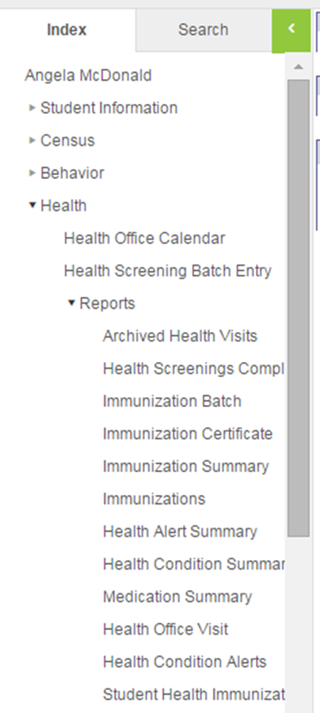
How to Run an Immunization Certificate Report
Go to Index:
Health
Reports
Immunization Certificate

Slide 14
How to Run Immunization Certificate Report:
First select what grade you would like to use
You can also choose to use an ad hoc filter and narrow the selection even more
Once the report is ready, click the Generate Report button

Slide 15
Example of Report:
This is an example of where the CERTIFICATE information has NOT been entered
Because these entries are EXPIRED, they should be changed to PROVISIONAL and need UPDATED CERTIFICATES

Slide 16
Missing Information:
When this student’s immunization information was entered, the certificate type was inadvertently omitted.
This is a great tool to find any mistakes with data entry

Slide 17
Contact Information:​
​
Angie McDonald, ADN, RN, NASSNC​
KDE State School Nurse Consultant​
Angela.Mcdonald@education.ky.gov​
​
Michelle Malicote, BSN, RN, NASSNC​
KDPH School Health Branch Manager
Michelle.Malicote@ky.gov

