Slide 2
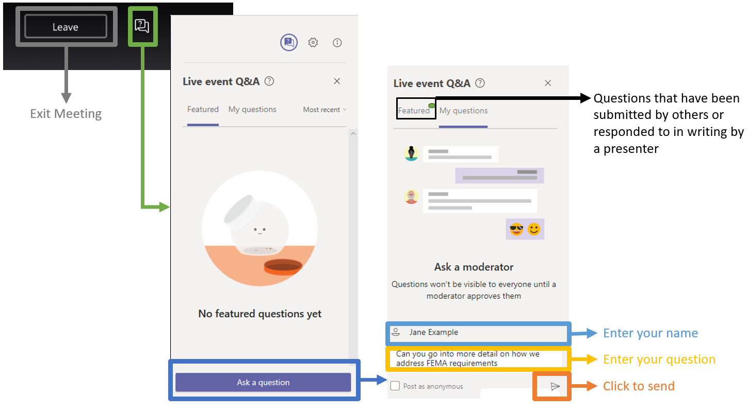
Questions & Answers Feature

Slide 3
Kentucky Department of Education
Office of Finance and Operations Division of District Support District Facilities Branch
May 15, 2020

Slide 4
District Planning
Based on 702 KAR 4:180
Incorporates by reference the Kentucky School Facilities Planning Manual.
Used by KDE and Districts to prepare District Facility Plans.
Districts organize the Local Planning Committee (LPC) to manage the process.
Existing facilities are assessed by A/E for condition and educational suitability.
-Facility assessments will be integrated with the Kentucky Facility Inventory and Classification System (KFICS).

Slide 5
District Planning
LPC reviews District finances with Fiscal Agent.
LPC develops draft plan and submits to KDE Facilities. Plan is prioritized based on facility assessment and fiscal ability.
Priorities 1-4 are eligible for restricted funding; Priority 5 is eligible for unrestricted funds only.
Upon KDE approval, both LPC and School Board approve the plan.
Following Board approval, Plan is presented in a Public Hearing.
Plan is presented to the Kentucky Board of Education for final approval and implementation.
Regulation and process will be revised to account for KFICS
and revisions to 702 KAR 4:170.

Slide 6
District Financing
Funding for District construction comes from several sources and include local and state matching nickels, SEEK, and ADA (Average Daily Attendance) appropriations.
Funding comes in two broad categories: Restricted and Unrestricted.
Restricted funds include SFCC, FSPK, Capital Outlay, and Building Fund.
General Funds are unrestricted.

Slide 7
KDE reporting impacting financing:
Unmet Needs Report
Based on total DFP Priorities 1-4, statewide.
Provides the state “Need” for the “Unmet Needs Report”.
Unmet Needs report due to SFCC in October of odd numbered years, based on current DFPs as of June 30 of that year.
Ranked Report
Based on the Kentucky Facility and Inventory Classification System (KFICS).
Reports school physical condition and educational suitability.
Presented to LRC in October of each year.

Slide 8
Construction
Capital Construction Process
Based on 702 KAR 4:160.
BG-1 Project Application is the starting point.
BG-1s are split into tiers at KDE approval to streamline required KDE reviews.
Regulation needs revision to account for FACPAC and revised documents incorporated by reference.
Facility Programming and Construction Criteria Planning Guide used to guide construction document development.
Regulation needs revision to update for current educational and construction practices.

Slide 9
FACPAC Facility Planning and Construction
Provides a Document Management System for:
BG-1,4 and 5
Owner Contractor Agreements including Design - Build Agreements
Purchase Orders
Change Orders
The above documents can all be submitted and approved within FACPAC.
FACPAC integrates the District Facility Plan priorities into the BG-1.

Slide 10
FACPAC Facility Planning and Construction
These documents are uploaded in FACPAC but approved by separate correspondence:
Owner - Architect and Owner - Construction Manager Agreements.
BG-2 & 3.
All construction documents.
KDE reviews projects in anticipation of the summer construction season and completion before the start of school in the fall and coordinates reviews with OCTE, Pupil Transportation, and KYTC.

Slide 11
Property
Building Sites, Inspection & Approval
Sets out minimum standards for new school sites.
Approval required for all site purchases for all uses.
Property Disposal, Leases and Easements
Regulation currently being revised.
Property Insurance Replacement Costs
Sets out standard Square Foot costs for new facilities.
Revised every spring.

Slide 12
Additional KDE duties:
Efficient School Design Report
Based on BG-2 Outline Specifications Energy Design Criteria.
Presented to LRC in November of each year.
Respond to inquiries from legislators, LRC and KDE management. Respond to KDE Commissioner correspondence, Open Records requests and District inquiries.
Issue memoranda regarding compliance with statutory changes, AIA document revisions, workflow, etc.

Slide 13
Questions?
Planning/District Facility Plans
Financing
Construction
FACPAC
Property
Reports

Slide 14
KFICS 2020 Virtual Training Schedule
 | Tuesday May 19th & May 26th | Wednesday May 20th & May 27th | Thursday May 21st & May 28th
Morning Session 11 AM EST | Introduction | Condition Audits | Reporting & Executive Summary
Afternoon Session 1 PM EST | __ | Space Audits | Questions & Answers Software Enhancements
Oxana Lopetegui – Pineda
oxana.lopetegui-pineda@education.ky.gov

Slide 15
Credits
Office of Finance & Operations
Associate Commissioner
Robin Kinney
robin.kinney@education.ky.gov
District Support
Division Director
Donna Duncan
donna.duncan@education.ky.gov

Slide 16
District Facilities Branch
Branch Manager
Greg Dunbar, AIA greg.dunbar@education.ky.gov
Project Administration/District Liaison
James Bauman, RA james.bauman@education.ky.gov
John Gilbert, AIA john.gilbert@education.ky.gov
Marcus Highland, AIA marcus.highland@education.ky.gov
Gary Leist, AIA gary.leist@education.ky.gov
Resource Management Analyst II
Denise Hartsfield denise.hartsfield@education.ky.gov

