Slide 1
2022 Stilwell Awardees Kentucky Board of Education KSB and KSD
Notes:
2022 Stilwell Awardees – Kentucky Board of Education, KSB and KSD

Slide 2
Notes:
KBE Board Chair, Lu Young with Associate Commissioner David Couch

Slide 3
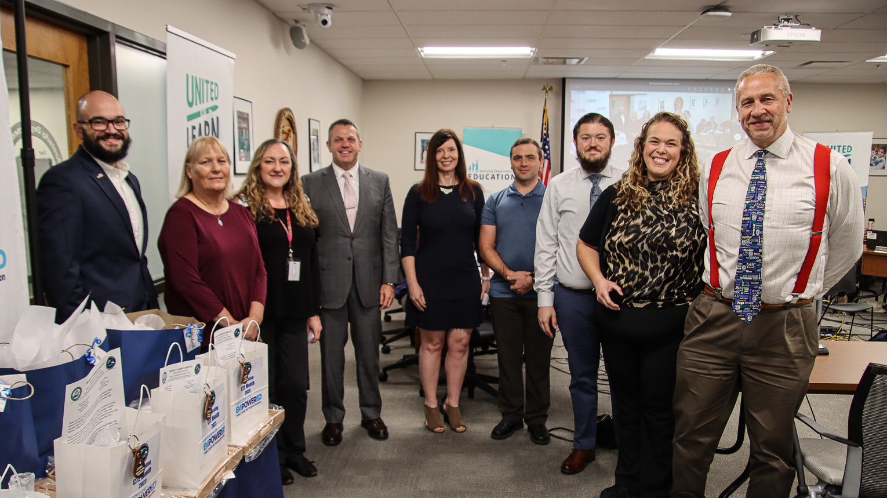
Notes:
2022 Stilwell Awardees from KSB and KSD with Commissioner Jason Glass and Associate Commissioner David Couch: Connie Hill, Linda Spiglemire, Jason Harmon, Leanne Edlelen, Jarod Mills, Johnathan Woodall and Renee Combs

