Slide 1
Professional Standards For School Food Service Professionals
Professional Standards Learning Code: 3400
Katie Embree-Cleveland
Kentucky Department of Education
Division of School and Community Nutrition
December 19, 2016

Slide 2
Today’s Objectives
Provide a brief overview of the new Professional Standards for All School Nutrition Program Employees;
Describe Kentucky ONE Certification Requirements per 702 KAR 6:045; and
Highlight new Resource Materials that are available for Kentucky ONE Certification and Professional Standards.

Slide 3
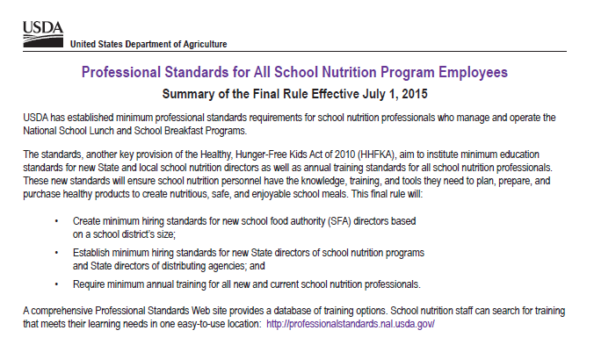
Professional Standards Are Here!
USDA established minimum professional standards requirements for school nutrition professionals who manage and operate the National School Lunch and School Breakfast Programs.
The new standards will ensure school nutrition personnel have the knowledge, training and tools they need to plan, prepare, and purchase products to create nutritious, safe and enjoyable meals.

Slide 4
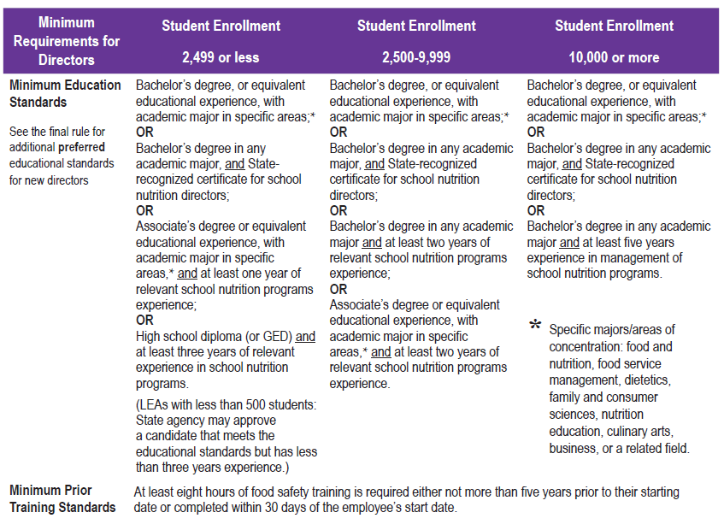
Professional Standards: Minimum Requirements Directors
The final rule:
Creates minimum hiring standards for new School Food Authority Directors based on the school district’s size.
New directors must have 8 hours of food safety training completed within 30 days of hire date.

Slide 5
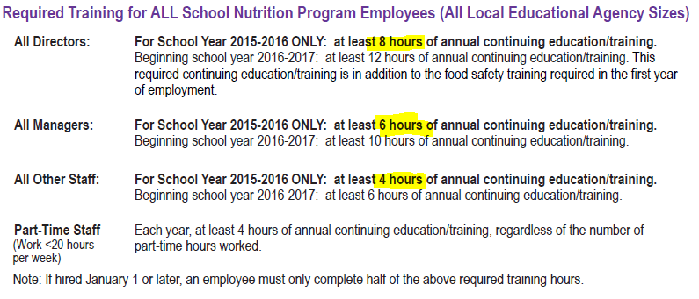
Professional Standards: Required Training for All School Nutrition Program Employees
The Final Rule: -Requires minimum annual training for all new and current school nutrition professionals.

Slide 6
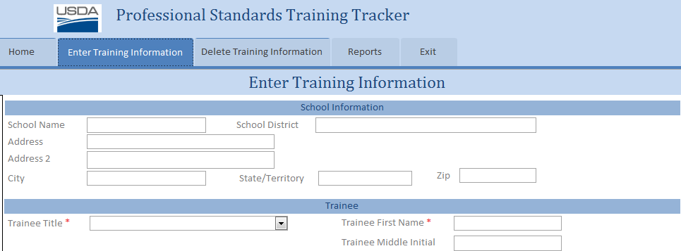
Professional Standards- Questions?
Professional Standards will be monitored for compliance during the Administrative Review Process.
All Directors employed prior to July 1, 2015 are “grandfathered” into their position at their current district or one of a similar size.
Resources are available:
USDA Professional Standards Website: http://professionalstandards.nal.usda.gov/
USDA Professional Standards Tracking Tool:

Slide 7
Kentucky ONE Certification
Kentucky state regulations (702 KAR 6:045) require:
All new food service employees must successfully complete the Kentucky ONE (Orientation for New Employees) Certification course either upon hire or within 40 days of hire.
Substitutes are required to only take Areas 3 and 4 of the course.
Initial Kentucky ONE Certification training must be conducted by the Kentucky ONE Certified Trainer and is district specific.

Slide 8
Professional Standards & Kentucky ONE Certification
All Kentucky ONE Training hours count for Professional Standards requirements.

Slide 9
Kentucky ONE Train the Trainer Training Sessions
SCN will conduct future sessions for districts in need of Kentucky ONE Certified Trainers.
Please contact SCN if you need additional dates or trainers.

Slide 10
New Resources Available Now!

Slide 11
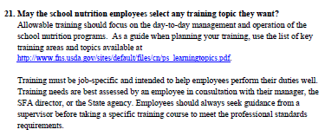
Frequently Asked Questions and Answers
1. How do we establish enrollment to determine SFA size?
Use October 31st data.
2.

Slide 12
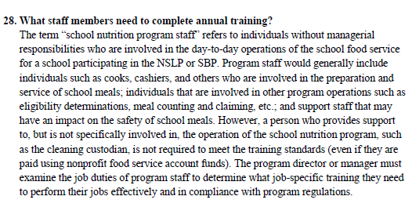
Frequently Asked Questions and Answers

Slide 13
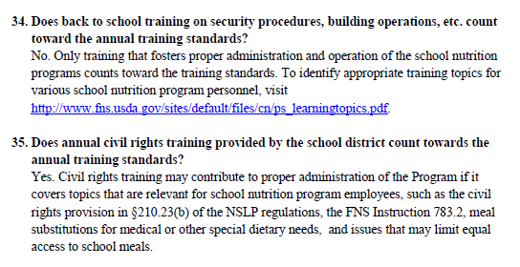
Frequently Asked Questions and Answers

Slide 14
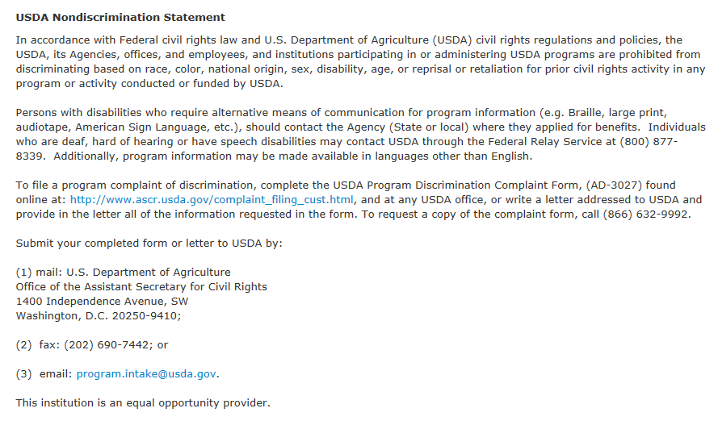

Slide 15
Thank you!
Questions or For More Information
Please Contact:
Katie Embree-Cleveland
Kathryn.Embree-Cleveland@education.ky.gov

