Slide 1
Student Data Review and Rosters (SDRR)
ACCESS For ELLs ® (ACCESS and Alternate Rosters)
Chris Williams, Program Consultant
Office of Assessment and Accountability

Slide 2
Agenda
ACCESS for ELLs Reminders
Secure Web Application-SDRR
Resources and Reminders

Slide 3
ACCESS for ELLs Reminders
SDRR

Slide 4
ACCESS for ELLs in SDRR
Rosters to submit nonparticipations for ACCESS for ELLs will open on Jan. 5 and close on Mar. 7 at noon ET for new tickets.
The student listing will be blank initially.
Do not add students to the roster who are participating in ACCESS or WIDA Alternate ACCESS.
Only add students to the student listing for the following reasons:
Medical Nonparticipation
Withdrew After the Testing Window Began
Expelled Without Services
IFEP-Initially Fully English Proficient on the WIDA Online Screener (Grades 1-12)
RFEP-Redesignated Fully English Proficient on ACCESS (Grades K-12)
Upload scanned copies of the Medical nonparticipation form(s) in SDRR.
Keep a copy of the ACCESS for ELLs Roster nonparticipation changes made by the district prior to closing on Mar. 7.
Notes:
There will be a text box to provide additional relevant information about the student from the school/educational perspective, in addition to what is on the form itself. You don't need to retype the information from the form.
Submissions of nonparticipations are not automatic, they must go through the approval process.

Slide 5
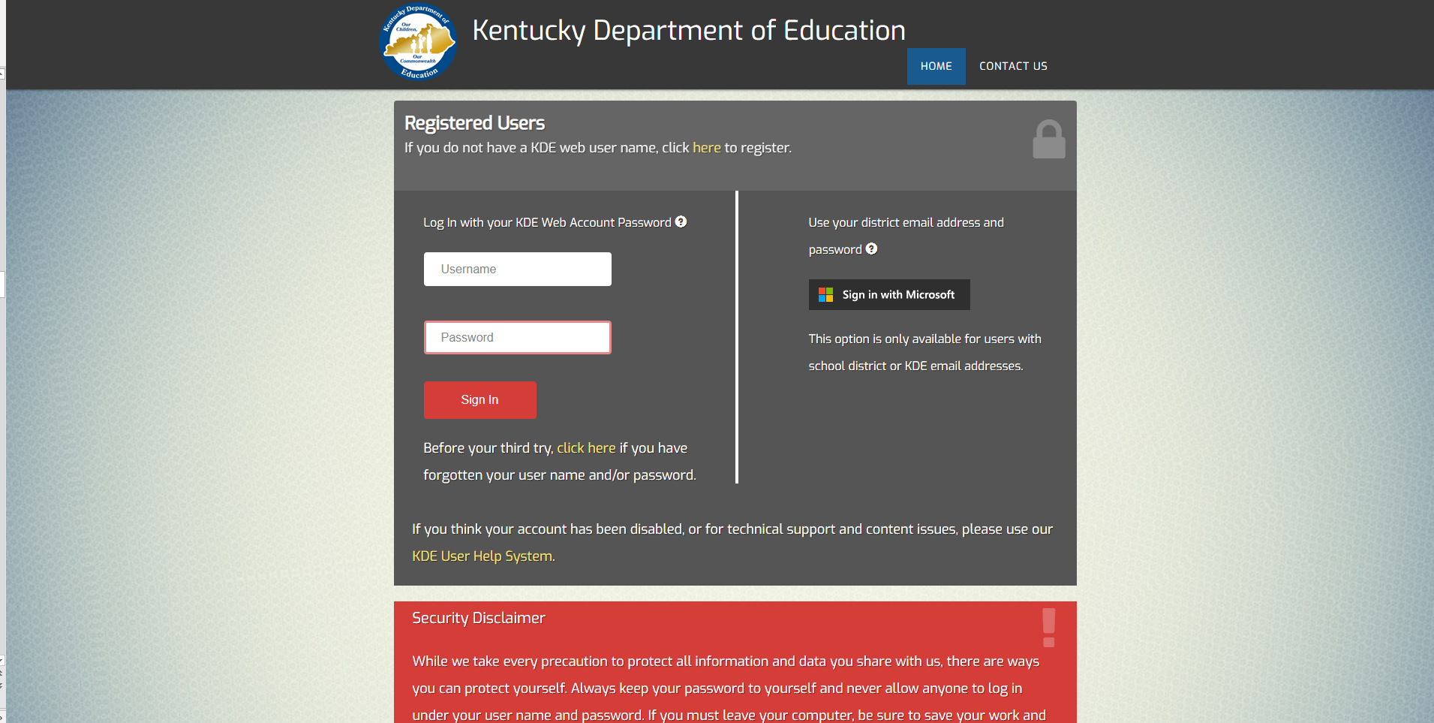
Secure Web Applications Login Page
https://applications.education.ky.gov/login/default.aspx

Slide 6
Secure Web Application-SDRR
Application - Login (ky.gov)
Notes:
SDRR URL
https://oaa-adc.education.ky.gov/

Slide 7
Welcome/Home Page

Slide 8
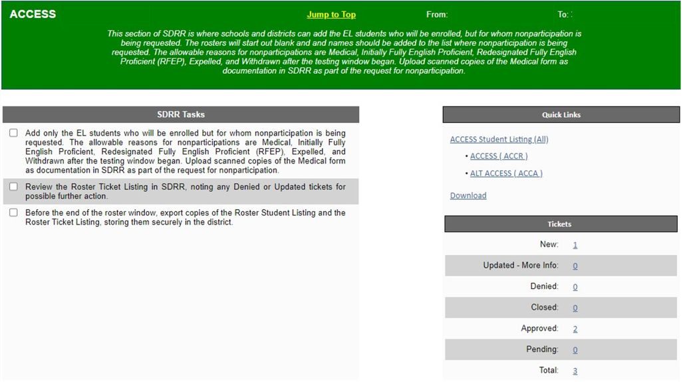
ACCESS- SDRR Tasks, Quick Links and Tickets

Slide 9
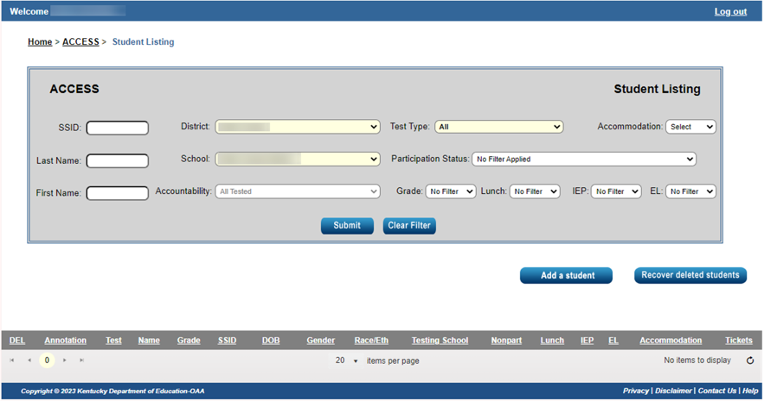
Student Listing Page- will be blank until students who need a nonparticipation for ACCESS/Alternate ACCESS are added

Slide 10
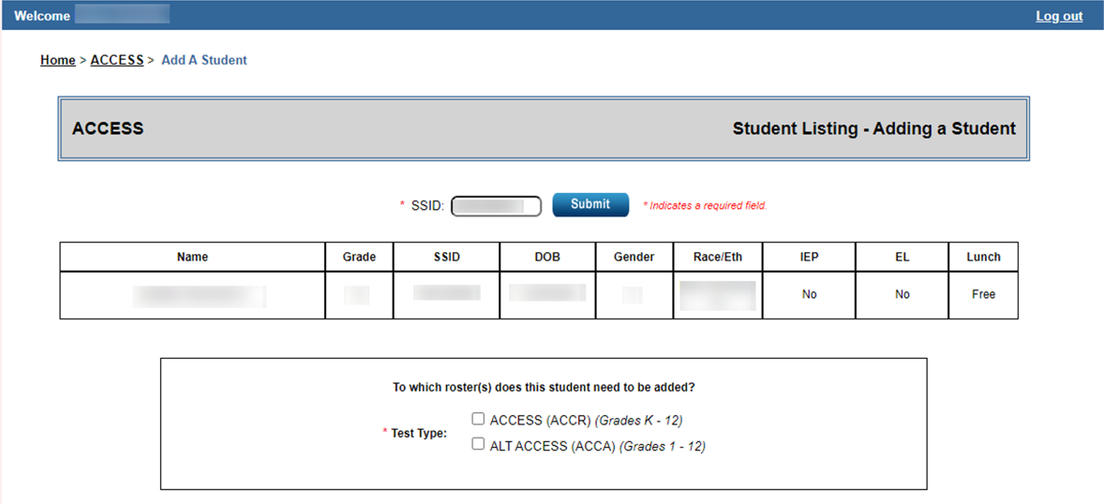
Adding a Student - Need SSID
Notes:
Districts will need the SSID when adding the student to the roster in SDRR for filing a nonparticipation only.

Slide 11
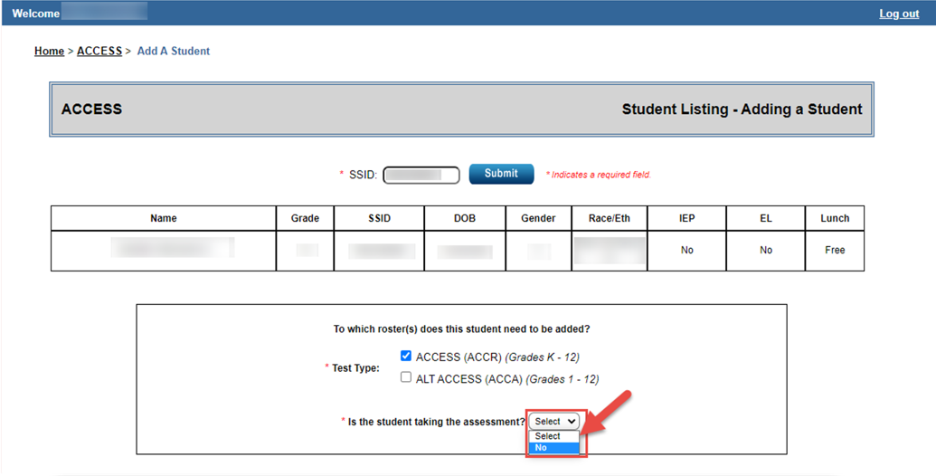
Adding a Student - Not Taking the Assessment

Slide 12
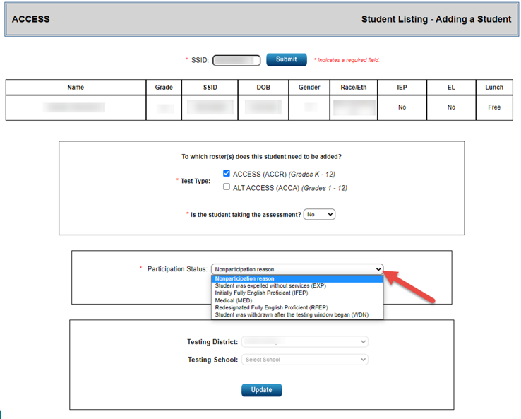
Adding a Student - Nonparticipation
Notes:
Extraordinary Circumstance (EC) is no longer available for any state assessment as a nonparticipation.

Slide 13
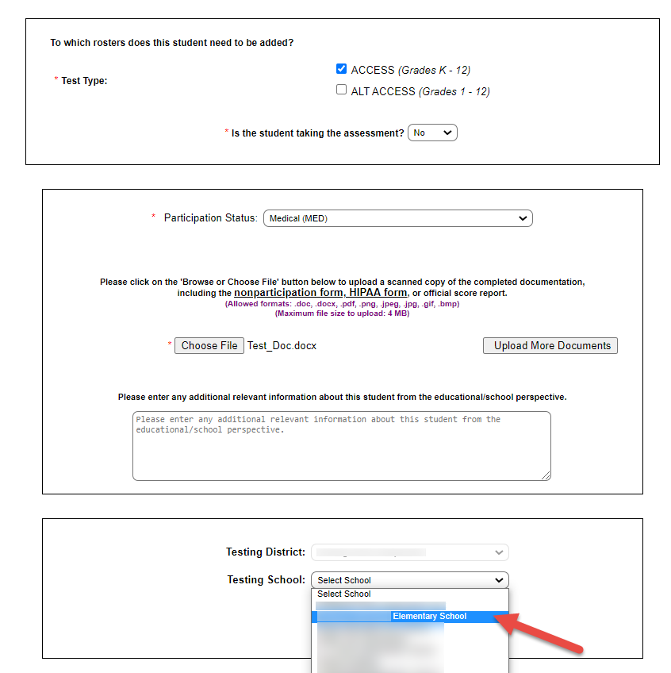
Adding a Student-Testing School and Update
Notes:
School level users will have the Testing School filled in automatically, because they will be adding students to their own school's roster. District level users will need to indicate the school, since they could be adding the student to the roster for any school in their district that serves Kindergarten.

Slide 14
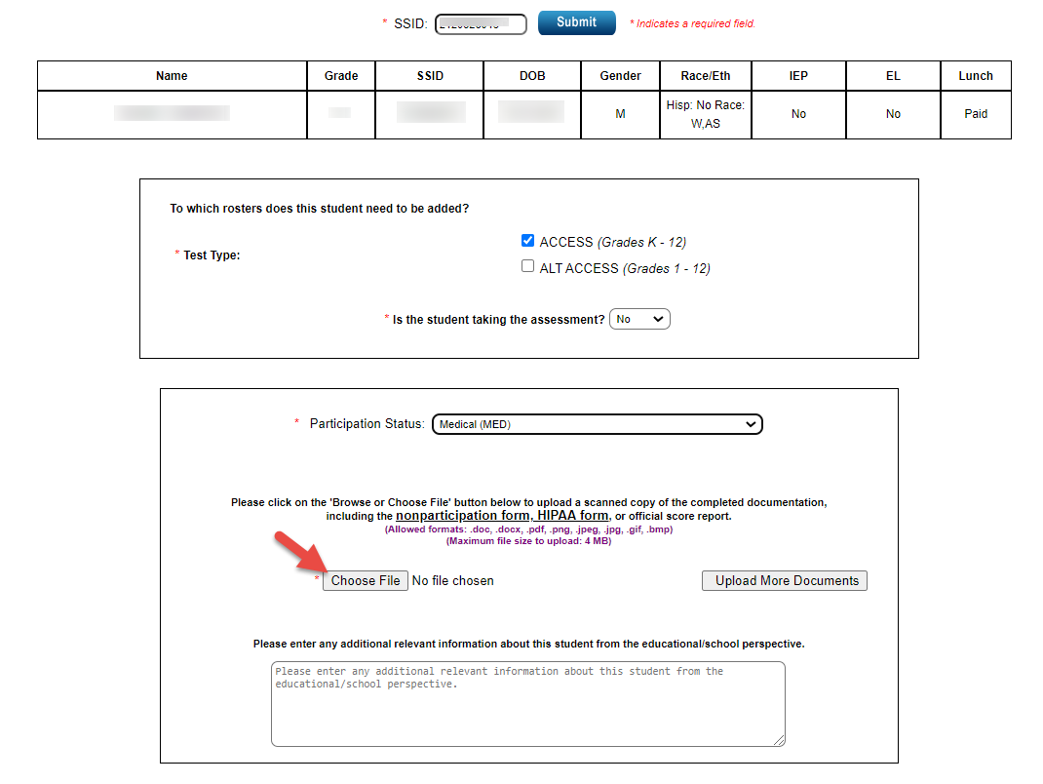
Adding a Student-Uploading the Nonparticipation Document

Slide 15
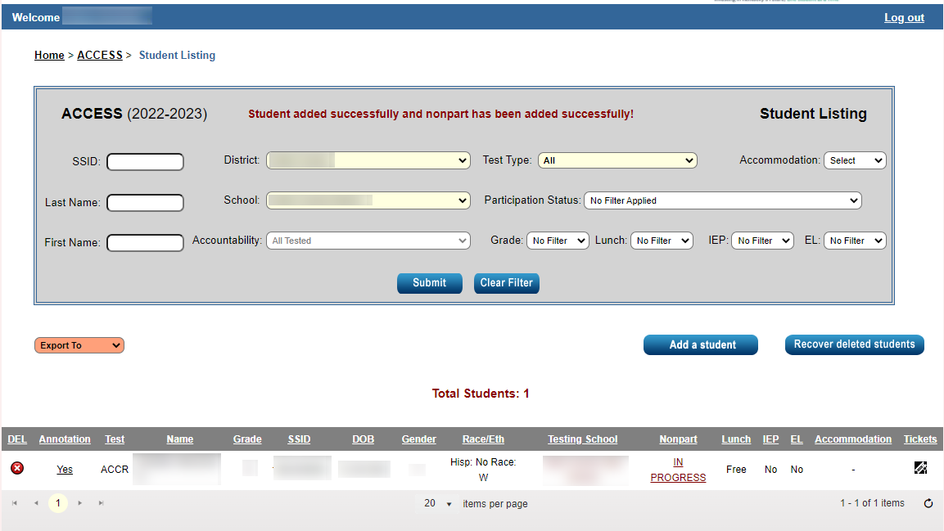
Student Listing with Nonparticipations
Notes:
When the nonparticipation is in progress, districts can still go in and edit any changes if needed.

Slide 16
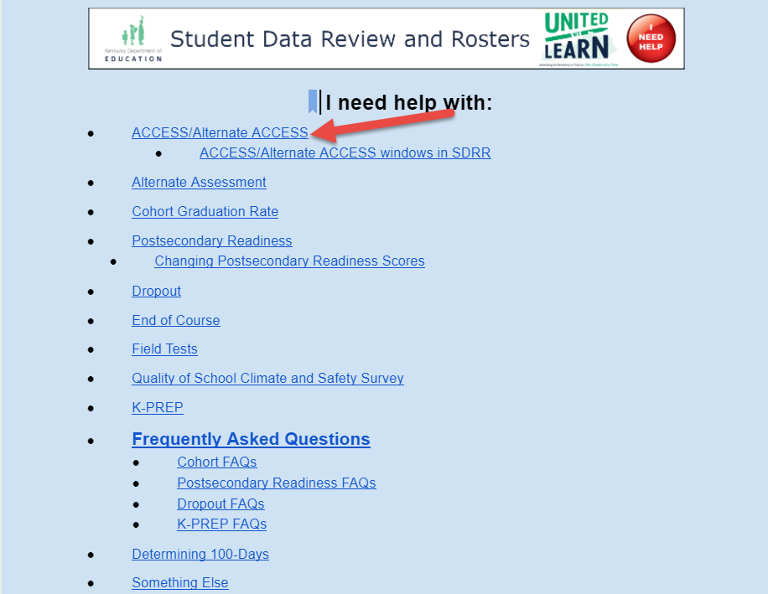
Resources for ACCESS for ELLs: (Online Help Button)
Notes:
Once a user logs into SDRR, the I Need Help button will be available in the top right hand corner of every screen if you need assistance with the functions, tools, the assessments and accountability.

Slide 17
Resources and Reminders
SDRR

Slide 18
Student Transfers Out of State Before Testing Window
Annotate where the student transferred and date of withdrawal; then delete the student from the ACCESS roster in the spring if the student shows up.
Do not assign the student a test booklet or put the student in a test registration in WIDA Assessment Management System (AMS).
If a pre-id label was applied to the test booklet, affix a “Do Not Process” label over top of the pre-id label and send back with non-scorable materials.

Slide 19
SDRR Resources
Local WAAPOC for access to SDRR
100-Day Tool
https://bit.ly/100-Day Tool
Help Button
100-Day Quiz/Scenarios http://bit.ly/100-Day-Quiz.
Notes:
Applications - Login (ky.gov)- login for SDRR and to get to the Help Button on each screen once a user is logged in for support.

Slide 20
2023-2024 ACCESS for ELLs (ACCESS-Kindergarten, Online, Paper) Tentative Testing Schedule
 | Start Date | End Date
Online Test Setup for Registrations | 11/30/2023 | 2/16/2024
Districts Receive Test Material | 12/5/2023 | 12/5/2023
Additional Test Material Window | 12/5/2023 | 2/9/2024
Test Window | 1/4/2024 | 2/16/2023
All Test Material Received at DRC | 3/1/2024 | 3/1/2024
Pre-Reporting Data Validation Window | 3/20/2024 | 4/3/2024
Districts Receive Reports | 4/26/2024 (online) | 5/08/2024 (printed)
Score Correction Window | 5/7/2024 | 5/21/2024
Notes:
The ACCESS testing window is scheduled to begin on Jan. 4 and will end on Feb. 16 this year. KDE will be monitoring the health crisis and will let the DACs know if there are any
change to the schedule in a Monday DAC email.
12/1/22-2/17/23 WIDA AMS test setup available for test sessions
Data Recognition Corporation (DRC) prints, scores, houses the online system and ships the test materials and reports to the districts.
DRC opens a data validation window for districts to have one last look at the demographic data before the reports are printed and sent to the districts.
Kindergarten, Alternate ACCESS and Accommodated (Braille and Large print) are paper/pencil assessments.

Slide 21
2023-2024 WIDA Alternate ACCESS Tentative Testing Schedule
 | Start Date | End Date
Online Test Setup for Registrations | 11/30/2023 | 2/16/2024
Districts Receive Test Material | 12/5/2023 | 12/5/2023
Additional Test Material Window | 12/5/2023 | 2/9/2024
Test Window | 1/4/2024 | 2/16/2023
All Test Material Received at DRC | 3/1/2024 | 3/1/2024
Pre-Reporting Data Validation Window | 3/20/2024 | 4/3/2024
Districts Receive Reports | 9/11/2024 (online)-WIDA Alternate ACCESS | 9/26/2024 (printed)-WIDA Alternate ACCESS
Notes:
The Alternate ACCESS testing window is scheduled to begin on Jan. 4 and will end on Feb. 16 this year. KDE will be monitoring the health crisis and will let the DACs know if there are any
change to the schedule in a Monday DAC email. The WIDA Alternate ACCESS Reports will be delayed due to WIDA standard setting that is happening this summer.
12/1/22-2/17/23 WIDA AMS test setup available for test sessions
Data Recognition Corporation (DRC) prints, scores, houses the online system and ships the test materials and reports to the districts.
DRC opens a data validation window for districts to have one last look at the demographic data before the reports are printed and sent to the districts.
Kindergarten, Alternate ACCESS and Accommodated (Braille and Large print) are paper/pencil assessments.

Slide 22
Kentucky ACCESS Trainings on KDE Website
User Accounts
Materials Ordering
Test Setup
Writing Tier Placement
Overview
ACCESS Roster Training in SDRR
Notes:
Each of the Kentucky ACCESS trainings are required along with the WIDA online training and quizzes.

Slide 23
ACCESS for ELLs® Exit Criteria
ACCESS
Overall composite of a 4.5 on a Tier B/C.
Kindergarten ACCESS
Overall composite of a 4.5.
Alternate ACCESS
Overall composite of a proficiency level of P2.
Notes:
EL students must meet the criteria to exit from EL program.

Slide 24
ACCESS for ELLs Questions
Contact Information
Chris Williams
(502) 564-4394

