Slide 1
ACCESS for ELLs
Writing Tier Placement and Testing Writing Online
Chris Williams, Program Consultant
Division of Assessment and Accountability Support
KDE:OAA:DAAS:hj 1/27/2021

Slide 2
Writing Tier Placement
After students have completed Reading and Listening domain tests online, test administrators or designated staff should go to the Tier Placement Report in WIDA Assessment Management System (AMS) for students needing to take the Writing domain.
Use the Tier Placement Report to identify the Writing tier level for students who will be handwriting their responses in grades 1-3.
Please see slide #6 for step-by-step instructions for accessing the Tier Placement Report in WIDA AMS.

Slide 3
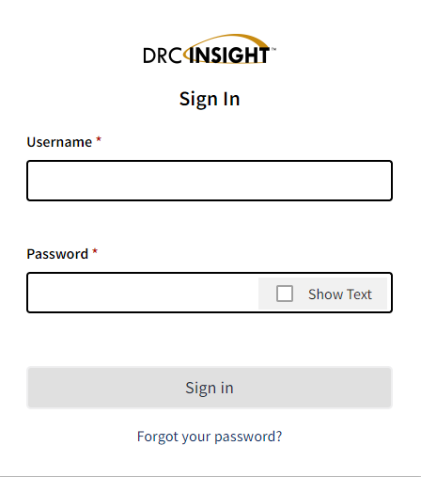
Login to WIDA AMS
If District Assessment Coordinators (DACs) and District Technology Coordinators (DTCs) need an account, contact Chris Williams.
If school personnel need an account, contact the DAC
3

Slide 4
WIDA AMS
Welcome to the WIDA Assessment Management System (AMS)
WIDA AMS supports the administration of the ACCESS for ELLs suite of assessments and WIDA Screener Online.
  Find technical and test administration materials in the WIDA AMS Library (login not required).
Logging in to WIDA AMS
  To access WIDA AMS, log in using your username (email address) and password.
If you do not have a WIDA AMS login, go to the 'Logging in' section of your WIDA member/state page. Find your member/state page by going to the WIDA website and using the drop down in the upper right corner. If you can't find what you're looking for, contact the WIDA Client Services Center.
Check the DRC System Status Indicator to see if all systems are operating normally or if there is an outage that could be affecting your work.
Public Test Resources
  View the Test Demo to demonstrate test features to students. The Test Demo is a series of videos that explain to students how they will take the online test and interact with the test platform.
  Use the Test Practice items to help students understand how to respond to ACCESS for ELLs Online and WIDA Screener Online items on the test platform. While using the test practice items, students can familiarize themselves with the features available to them during the actual assessment. To access and view the Test Practice Items on Windows, macOS, ChromeOS, or Linux devices, you must use the Chrome browser. If you are on an iPad, you must use the Safari Browser.
  Use the Sample Items to help students, educators, and families get a better understanding of ACCESS for ELLs Online. None of the sample items appear on the operational test; however, they are similar to items that students will see on the test. To access and view the Sample Items on Windows, macOS, ChromeOS, or Linux devices, you must use the Chrome browser. If you are on an iPad, you must use the Safari Browser.
  ACCESS for ELLs and WIDA are trademarks of Board of Regents of the University of Wisconsin System.
Notes:
Need to use Chrome for the test practice and the test demo. For everything else in WIDA AMS, you can use any browser.

Slide 5
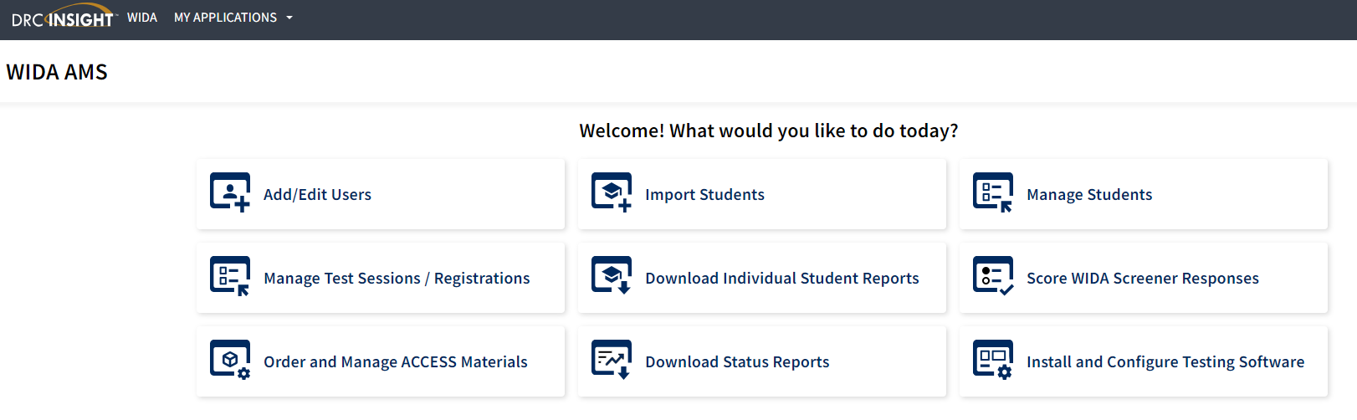
WIDA AMS Enhanced Landing Page
5

Slide 6
Tier Placement Report
To access the Tier Placement report:
Click on Manage Test Sessions/Registrations after logged into WIDA AMS.
Confirm or enter your site criteria in the upper right corner. Click Save.
Confirm or enter your Registration Window in the drop-down menu.
Select the View Registration(s) tab.
Apply one or more filter criteria such as State Student ID, Student Name, Domain, Registration Name, and/or Assessments to refine your search. Or, to view the tier placement of multiple registrations, leave the filters blank.
Select the checkboxes next to the registration(s) and click Export Details. The resulting .csv file will contain columns for Writing Tier and Speaking Tier, providing you with the necessary tier placement details for one or more registrations.
6

Slide 7

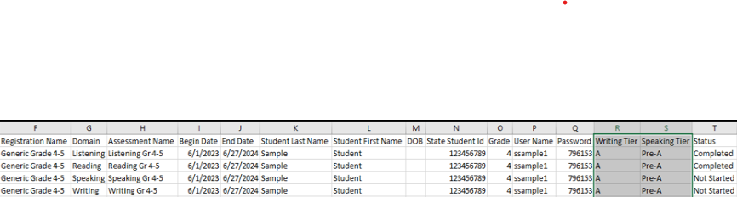
Tier Placement Report Examples
There will be no tier level for the student if the student has not completed testing in the domains of reading and listening first for ACCESS- It will show “In Progress” or “Not Started”.
  Before Listening and Reading are completed online
This is what the report will look like when the student has completed testing in the domains of reading and listening for ACCESS.
  Once Listening and Reading are completed online
7

Slide 8
ACCESS Writing Online
Writing is the only domain, when testing ACCESS for ELLs online, that has a writing test booklet for grades 1-3.
Reading, Listening and Speaking domains are all tested online.
Data Recognition (DRC) will only ship a certain amount of Tier A or Tier B/C level booklets based off the initial order placed in Oct.
If districts need more tier level booklets, order during the Additional Materials Window (12/5/2023- 2/9/2024) for ACCESS in WIDA AMS.

Slide 9
Writing Grades 1-3 Online
Grades 1-3 test writing in a test booklet only.
There are no writing test registrations assigned in WIDA AMS.

Slide 10
Writing Grades 4-12 Online
Grades 4-12 test writing all online and are assigned a test registrations in WIDA AMS.
No writing test booklets are used.
Notes:
Should a student in grades 4-12 require a handwriting booklet rather than keyboarding their response, test coordinators will need to order these as Additional Materials in WIDA AMS. Please refer to the District and School Test Coordinator Manual for more information on this process.

Slide 11
Resource in WIDA AMS
WIDA AMS
WIDA AMS User Guide - a guide for how to use WIDA AMS to complete administrative functions for testing with DRC INSIGHT
  Log into WIDA AMS
  Click on View Documentation
  Under Document Type-Select Manuals from the drop-down menu
  Open or Save WIDA AMS
  Tier Placement Report- see p. 80 of the WIDA AMS User Guide for assistance
WIDA AMS Knowledge Articles- assist with all the functions in WIDA AMS
  Login into WIDA AMS
  Click on My Application at the top of the screen
  Under Other Links- click on DRC Customer Service

Slide 12
Kentucky ACCESS Trainings on KDE Website
ACCESS Trainings
User Accounts
Materials Ordering
Test Setup
Writing Tier Placement
Overview
ACCESS Roster Training in SDRR (coming soon)
Notes:
Each of the Kentucky ACCESS trainings are required along with the WIDA online training and quizzes.

Slide 13
Contact Information:
KDE:
Chris Williams
502-564-4394 ext. 4750
DRC:
WIDA DRC Customer Service
Data Recognition Corporation
855-787-9615

