Slide 1
Kentucky’s Common Kindergarten Entry Screener
BRIGANCE K Screen III and Online Management System Refresher Training
Lisa Jett, Program Consultant
Division of Assessment and Accountability Support
Notes:
Hello and thank you for joining me today. My name is Lisa Jett. I am a program consultant from the Division of Assessment and Accountability Support, working with the K Screen program. Today we will be conducting our refresh K Screen training including Infinite Campus and OMS. Let’s get started, here are the objectives for today.

Slide 2
Objectives
Provide updates and procedures for district Kindergarten Screen contacts
Provide Kindergarten Screen training content for experienced staff

Slide 3
Agenda
Purpose of the Common Kindergarten Entry Screener
Ordering Process and Timeline
Screening Timeline
Training Requirements
Infinite Campus Reminders
Online Management System (OMS) Updates and Reminders
Resources

Slide 4
Purpose of the Common Kindergarten Entry Screener
The Common Kindergarten Entry Screener is a data screening tool used to help districts quickly and effectively identify children's strengths and needs, plan individualized instruction and identify children who might need tiered instruction.
Notes:
The Common Kindergarten Entry Screener is designed to produce point-in-time student-level results that indicate the level of school readiness in the five domains: adaptive, cognitive, communication, motor, and social and emotional. The common kindergarten entry screener data may be used as a system of measurement to inform stakeholders about early learning in order to close school readiness gaps, make informed policy decisions at the local level to support early learning experiences prior to school entry, establish local goals for program improvement in order to achieve early learning outcomes, and to include data as evidence in kindergarten through the third-grade Program Evaluation.
K Screen results cannot be used to determine eligibility for enrollment or be utilized as part of the school’s or district’s overall score to determine recognition or support contained in any administration regulation.

Slide 5
Ordering Process

Slide 6
Ordering K Screen Materials
The K Screen Materials ordering window closes on March 29
Curriculum Associates (CA) recommends each school has one copy of Spanish directions
Orders will begin shipping the week of May 13
Supplemental, late orders or ordering questions may be sent to lisa.jett@education.ky.gov or dacinfo@education.ky.gov
Notes:
The K Screen ordering window closes on March 29. Initial orders will begin shipping the week of May 13. The Office of Assessment and Accountability (OAA) recommends having the materials shipped to a central location or the district’s board of education if this delivery window is during the district’s summer vacation. Supplemental or late orders may still be placed by contacting me, Lisa Jett or DAC info at DACinfo@education.ky.gov. The OAA and Curriculum Associates cannot guarantee that supplemental or late shipments will arrive before the screening window.
If any schools within the district are in need of replacement kits or pieces, please contact the OAA through DAC info or by emailing me at Lisa.Jett@education.ky.gov. I will place you in contact with Curriculum Associates personnel who will help you with this process.

Slide 7
Timeline

Slide 8
Timeline 2024-2025
Week of March 25 Refresh Training Video (virtual)
March 29 Deadline for K Screen Orders
Week of April 8 Refresh Training Office Hours
April 24 Train the Trainer (TtT) Session (virtual)
Week of May 13 K Screen materials start shipping
July 8 Deadline for staff file revisions
July 11 TtT Session (in-person)
June - Aug. In-person Staff training:
OMS Training Videos
Prior Setting Video
Mid-July - Sept. District screening windows open
Aug. 1 OMS accounts available *tentative
Aug. 28 & 29 TtT Session (virtual)
Aug. - Oct. 15 OMS and IC data entry
Fall of 2024 Fall Release of 2023 State Assessment Data
Jan. 2025 District Reporting
Notes:
The projected shipping date for K Screen materials is the week of May 13, allowing trainings to begin in June. Please take note of the August 1 date. This is a projected date of when OMS accounts will be available. Please refer to DAC Emails to ensure that this date has or has not changed. You will also notice that districts will have access to K Screen data reporting in January. The scores will then be released in the fall with the Fall Release of State Assessment Data.

Slide 9
Training Requirements

Slide 10
K Screen Training Requirements
New District Train the Trainer (TtT) administrators must attend a 6-hour TtT module presented by CA and KDE.
New teachers administering the screen must attend a 3-hour session provided by the District TtT trainer.
EXPERIENCED district TtT trainers must watch the Refresh Webcast
EXPERIENCED teachers administering the screen must receive a one-hour refresher provided by the district trainer.
NEW and EXPERIENCED data entry staff must annually review the training materials hosted on the BRIGANCE Kentucky website.
Notes:
New District Trainers must attend the 6-hour Train the Trainers module presented by Curriculum Associates. If you look back at the Timeline, you will notice that we have one scheduled for July 11. This will be an in-person training at the Sower Building in Frankfort. If you can not attend the July 11 training, OAA and Curriculum Associates will also have a second virtual option on August 28 and 29. New teachers administering the screen need to attend a 3-hour training provided by the district trainer. It is acceptable to provide these virtually. Experienced district trainers are required to watch this refresh training video that you are currently viewing. Experienced teachers administering this screen must receive a one-hour refresher session that is provided by their district trainer. Lastly, all new and experienced data entry staff must view the training materials posted on the common kindergarten entry screener website.
Experienced district trainers, please remember that you may use the K Screen Refresh or portions of it in your district trainings.

Slide 11
Training Reminders
District/schools keep training sign-in sheets and agendas on file
Collect and file signed implementation agreements (Implementation Guide, Appendix A)
Notes:
Each year, anyone who administers, manages, or enters data is required to take some form of training. It is required that you keep sign in sheets and agendas of each training on file for one year, or from one training until the next. There is an implementation agreement that also must be signed by each person trained. This is located on our website and in the implementation guide (Appendix A).

Slide 12
BRIGANCE Office Hours
The OAA and CA will be hosting office hours this fall during the K Screen Window.
Dates and times will be communicated in K Screen updates and Monday DAC emails as the time approaches.
Notes:
OAA and Curriculum Associates will once again be hosting Office Hours this fall to assist educators with topics such as the BRIGANCE screener, the Online Management System, data collection, and more. Details will be communicated in K Screen Updates and Monday DAC Emails

Slide 13
BRIGANCE Screener

Slide 14
Determine Your Screening Window
Screening may begin 15 calendar days before the first day of school
If the BRIGANCE Screener was used for early kindergarten registration in the spring, the student must be screened again during the window and those new results are to be entered in the Online Management System.
Screening must not take place after the 30th instructional day
Online Management System (OMS) and Infinite Campus (IC) data must be entered within 15 instructional days after the screening window closes, no later than October 15th
Notes:
Let’s move into the screen itself.
First, you need to determine your screening window. As you start to order materials, it is also important to plan your screening window. The window begins NO earlier than 15 calendar days before the first day of school and cannot exceed the 30th instructional day. Keep in mind that all data must be entered into the OMS and IC within 15 days after the window closes, but no later than October 15, regardless. As you start to order materials, it is also important to plan your screening window. The window begins NO earlier than 15 calendar days before the first day of school and cannot exceed the 30th instructional day. Keep in mind that all data must be entered into the OMS and IC within 15 days after the window closes, but no later than October 15.
If you used the Brigance to pre-screen students in early registration, those results cannot be used, as the screen was not administered during the official window. You will have to rescreen.
It is important to ensure that if you screen students before school begins, you are within this window, as this is regulated by law. Be sure not to plan screening that conflicts with district or school professional development days.

Slide 15
Your Screening Window
My district’s screening window is:
______________________________
My district’s data entry window ends on:
______________________________
Notes:
Take a moment and write down notes about your screening window and when your data entry window would close.

Slide 16
Collect Prior Setting Data
This form is located on the Kentucky Common Kindergarten Screener webpage or in the Implementation Guide, Appendix D.
Provide the form to parents/guardians at registration, open house, or Kindergarten camps
Preschool and Head Start rosters can supplement the prior settings form
The new Prior Settings training video is located on the Kentucky Common Kindergarten Screener webpage.
Notes:
Now, let’s look at collecting Prior Setting data. This is something schools could be doing now or in the spring, but regardless, it should be on your radar. If not, make sure to collect prior setting data during kindergarten kickoff events, open house, etc.
A letter and form (located on our K screen website or in the implementation guide) asks parents or guardians to let us know what setting the enrolling student(s) were in for the year prior to Kindergarten. That may be home, private sitter, daycare, preschool, Head Start or Kindergarten.
If you are not receiving parent input, pull rosters from preschool and Head Start to use in conjunction with parent form.
This information can be collected at any time.
Only students who are actively enrolled need to have Prior Settings data entered in IC. Kindergarten screening results are derived from both Prior Settings Data in IC and screener data entered into the Online Management System. If there is Prior Settings Data in IC for a student, they will be listed in the kindergarten screening results.

Slide 17
Repeating Kindergarten Students
Reminder, screen all students that repeat Kindergarten
Prior settings data for repeating Kindergarten students will be “Kindergarten” in IC
Notes:
Continuing from previous years, repeating kindergarten students will be screened again, just as all other students. Their prior setting data will be recorded as “Kindergarten” in IC. Repeating kindergarten students will ultimately have 2 entries for prior settings, 1 for last year, and one marked “kindergarten” for this year.

Slide 18
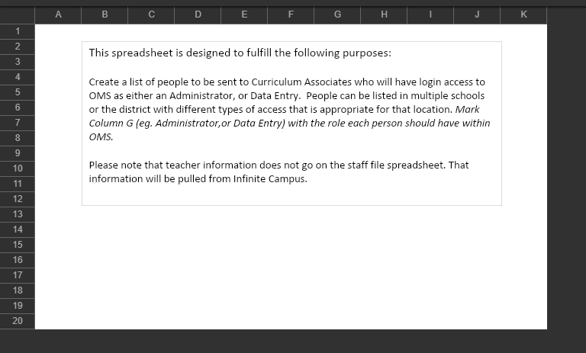
Submit Staff File
Review prior year staff file and submit changes only
Directions will be included in the May K Screen Update
Must be submitted to KDE by Monday, July 8
Example of Staff File Name:
SD25districtnumber_K_Screen_DistrictName_XXXXX.xlsx
Notes:
Let’s move on to the Staff File. The District Assessment Coordinator (DAC) will access the spreadsheet from the KDE secure web applications site. Choose Student Data Detail (Excel and PDF). The staff file is included in one zip file, “SD25districtnumber_K_Screen_DistrictName_XXXXX.xlsx”.
If you are unable to access the KDE secure application site, check with your WAAPOC and/or the KDE Help Desk. The KDE Help Desk can be reached at (502) 564-2002.
Your district’s spreadsheet will be pre-populated with the information submitted for the 2023-2024 school year. Please review and make any corrections or additions as needed. Then, upload the updated staff file to the 2024-2025 K Screen Staff File Submission Google Form. This must be completed by July 8th. Missing district staff files will be reverted to including only the District Assessment Coordinator. More information will be provided in the May K Screen Update.

Slide 19
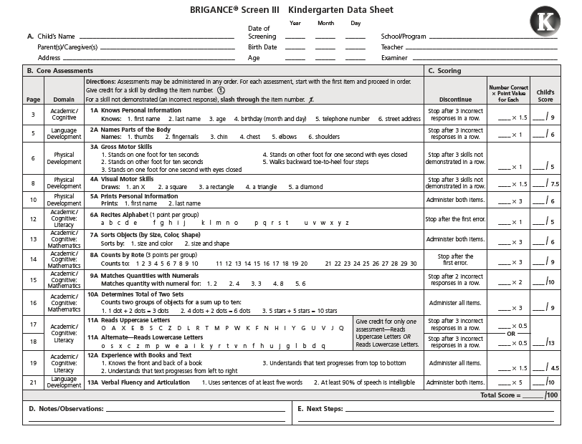
Gather Materials
Implementation Guide
Screen Manual
Data Sheets
Counting & sorting items
Other items such as pencil and paper
Picture book(s)
Photocopies of certain forms
Student demographics
Notes:
Once you have ordered materials, you have completed the trainings, and the staff files are submitted, you are ready to screen.
This is a list of items each individual screening student needs.

Slide 20
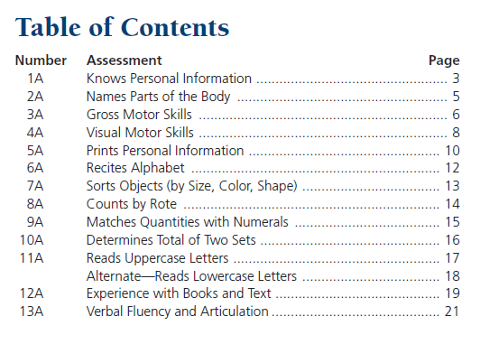
Kindergarten Core Assessments
Review notes on kindergarten core assessments – page 28 of the Implementation Guide

Slide 21
Core Assessments
Abide by directions as written in the manual
Maintain consistency
Adhere to the discontinue point
Tab places in the screen for quick reference
Review the Implementation Guide for detailed notes
Notes:
Remember that it is crucial to abide by the directions exactly as written in the manual.
Maintain consistency, screen all students exactly the same way, and adhere to the discontinue points.
It may be helpful to place post-its as tabs on the places in the screen for quick reference.
Make sure you review the Implementation Guide before beginning, and you may want to keep it handy as a quick point of reference when administering the screener, scoring the screener, and entering data into IC.

Slide 22
Self-Help and Social Emotional Scales
Distribute during screening window only
Monitor rate of return
Teacher completes only if unable to obtain from family
Every item must be completed
Notes:
You can provide the Self-Help and Social-Emotional form to parents, or you can complete the Self-Help and Social-Emotional scales through an interview if you think that will be more productive. The script is in your training manual.
Carefully monitor your return rate to complete during the screening window. Keep a list of those students that haven’t returned this, as it is important to administer this during the window. If after multiple attempts to collect, you still don’t have this, the teacher may complete it.
Please ensure that each item must have a response.

Slide 23
Screening Using iPads
Alternative method to student data sheets
Record student results directly into OMS Student assessment results must be printed and placed in permanent record
Self-Help and Social-Emotional Scales must be entered
Screening may not begin until OMS is open, typically early August
Notes:
This is a method some may use to enter scores directly into the OMS—this would only be an option after mid-August when the OMS is live. OAA will let districts know when the OMS is live and operational. Teachers would need to have a backup tablet or iPad on hand in the event of technical difficulty.
The results are entered as the student is screened. If this method is used, the student results must be printed and placed in the student’s permanent record. This is a vital part of the screen, and the data must be entered during the testing window. Teachers also need to be ready and trained in the paper format should the internet connection fail.

Slide 24
Nonparticipation Students
OAA does not collect nonparticipations for the K Screen in the Student Data Review and Rosters (SDRR) application.
Note: Please keep documentation at the school/district level for any student that is not screened.
Notes:
The Office of Assessment and Accountability will not accept nonparticipation requests for the K Screen. The K Screen is a screening tool designed to help districts quickly and effectively identify children’s strengths and needs. Thus, allowing educators to plan individualized instruction and identify students who might need tiered instruction through the use of the Kentucky System of Intervention. It is not a summative assessment.
We often have questions regarding nonverbal students. When considering nonverbal students, it is important to remember that this is a screener and not an assessment with accountability. It is ok if students cannot respond “correctly” to every prompt. Teachers can still gain valuable information during the screen. After consultation with our accommodations specialist and consulting the Brigance manual, our guidance is to at least attempt the test, possibly enlisting the assistance of someone familiar with the child’s communication methods. If a student cannot answer something, mark the data sheet appropriately and move to the next item.

Slide 25
Infinite Campus
Notes:
Now that we’ve reviewed the K Screener itself, let’s look at Infinite Campus.

Slide 26
Infinite Campus (IC) Preparations
Collaborate with district IC administrator and data entry staff
Check resource 2024-2025 K Screen Implementation Guide: Appendix M
Homerooms scheduled in IC by July 26 with this state code:
703001 Elementary Homeroom
Homeroom associated with the teacher with the CORRECT district email address in IC
At least one student assigned to each class by July 26 for kindergarten teachers to be automatically set up as OMS users
Proper setup in Infinite Campus is crucial for Online Management System (OMS) efficiency
Notes:
In order for the Brigance data to be entered into the online management system, IC information must be set up correctly. Data files are extracted from IC, and files are created in the OMS for student assignment and assessment data.
It is very important for communication and collaboration to happen between your district IC contact, the person who will enter the new kindergarten data into IC, and you to ensure things are set up correctly from the beginning. This will save a lot of time and stress during the screening window.

Slide 27
Entering Prior Setting Data in IC
Staff must view an instructional video on KDE’s Media Portal
Plan for entering prior setting data into Infinite Campus (IC)
Make sure start date is one year prior to first day of kindergarten
Double check students who attended state-funded preschool, Head Start or kindergarten
Schedule a time for district contracts to check progress using the ad-hoc report available in IC
Notes:
Prior setting data should be collected prior to the screening process. It is important to collect this information during kick off events, kindergarten open houses/camps, and can be placed in registration packets.
This information is entered into IC. Data entry clerks must watch the videos associated with prior setting; these are located on the KDE’s Common Kindergarten Entry Screener webpage.
When entering the data, it is important to only account for the setting one year prior. Repeating Kindergarten students will have a prior setting of “kindergarten.”

Slide 28
Online Management System (OMS)

Slide 29
OMS Preparations
Check the User list.
Are all teachers listed?
Are other staff listed?
Are all email addresses correct?
School/Class lists.
Are all schools listed?
Are all kindergarten teachers at each school listed?
Notes:
The online management system or OMS is the online tool for entering BRIGANCE data. Both core assessment data and Self-Help and Social-Emotional scales will be entered into the OMS. The OMS “resets” each year and all data will be pulled from IC into the OMS. The staff file that is due July 1 is the first step in Curriculum associates setting up the OMS accounts for your district and schools. Once Curriculum Associates receives that file, they will set up the school and class lists as well as the user list and teacher list. It is important to check 1. Are all schools listed and teachers at each school? 2. Are all teachers listed and are the email addresses correct?
Please make sure that the district email address is listed and not a personal email address.

Slide 30
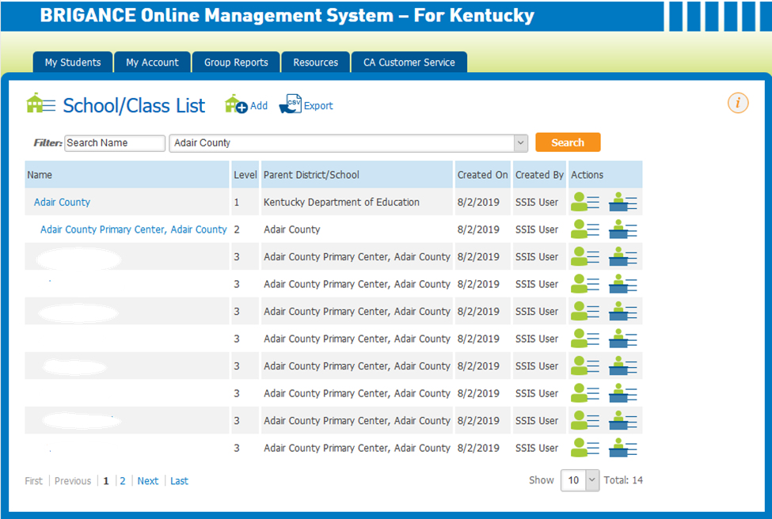
Check School/Class List
Notes:
This is a sample school/class list.
Here, you will see Adair County, the district, is listed as a level 1.
Adair Co primary is the school, and it is listed as a level 2.
Level 3 would be each teacher that belongs to the building. (The names are blank.)

Slide 31
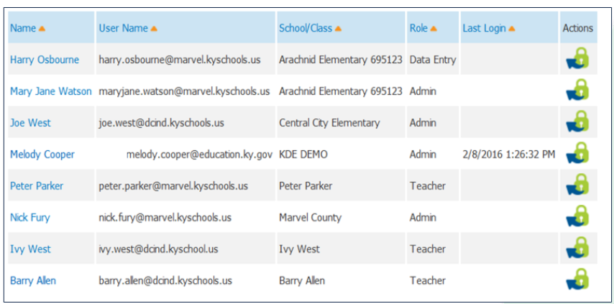
Check User List
Notes:
It is also important to check the user list.
These users are the teachers, data entry clerks, and administrators that need access to the OMS.
It is important that the email addresses are the correct district email as well .

Slide 32
OMS Data
There is a weekly data pull from IC into OMS
Changes are generally visible mid-week
Changes made in IC could be delayed from being visible in the OMS by a week or more
Updates to student information must be made in IC
Changes to teacher information and creation of new classes must be made directly in the OMS by a district administrator
Notes:
IC feeds data to OMS. The staff file is pulled from IC to populate the class and user lists in the OMS. Every week during the screening “season,” a new student file from IC will be uploaded into the OMS. Due to the one-week lag between synching district and state editions of IC, the changes made are not usually seen for up to two weeks. That’s why it’s critical for schools to communicate with you about missing or incorrect students in the OMS immediately.
The weekly refresh doesn’t work for users and classes – only students.
This is also the ONLY way students are uploaded into the OMS.
KDE cannot add or delete students from the OMS, before contacting me, please check Appendix M in the implementation guide to troubleshoot entering data into IC and OMS.

Slide 33
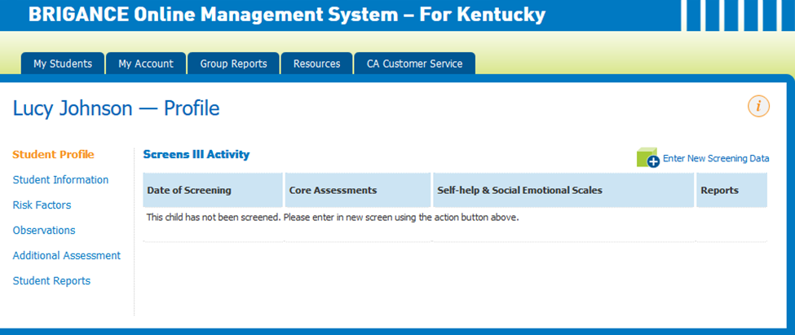
OMS Data Entry
Notes:
Let’s review what a student profile looks like in the OMS.
Here is a fictional student, Lucy Johnson. To begin entering data for Lucy, users will click the Enter New Screening Data on the right side of the screen, middle of the page.
This is the only time you will choose this feature- only when no screening information is entered.

Slide 34
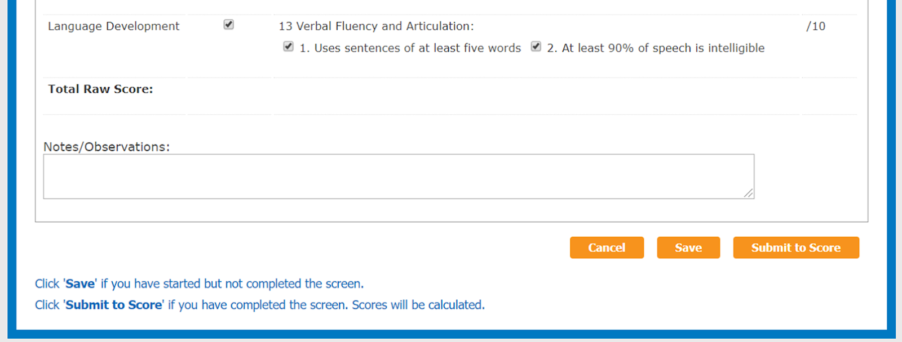
Submit Core Assessment Data
Notes:
The core assessment data page will come up and users will enter the student results from the student data sheet OR if you are screening with tablets, you will enter data as you assess. You have a cancel, save and submit to score button. It is important to save your information as you go along. Remember, only press “submit to score” if the student has both the core data and the Self-Help and Social-Emotional data fully entered. If duplicate data is created, there is guidance on how to clean this up on our website.

Slide 35
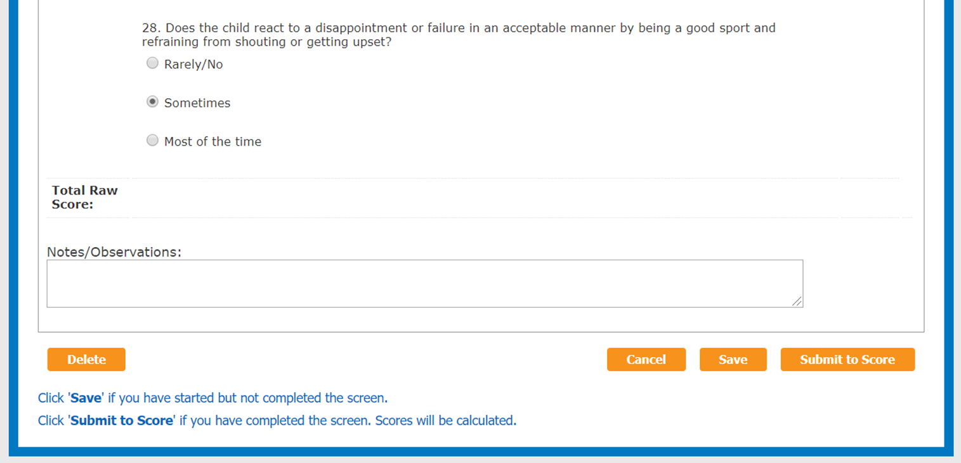
Submit Self-Help & Social-Emotional Data
Notes:
The same applies for the Self-Help and Social-Emotional scales. After entering that data, you will hit save. Once all data is entered, submit must be clicked on Core Assessment tab AND the Self-Help and Social-Emotional tab.

Slide 36
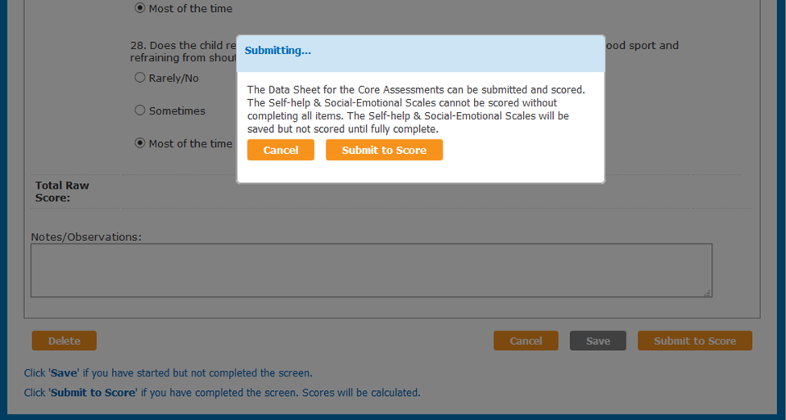
Save vs. Submit
Notes:
Many times, those entering the screening data fail to finish entering all data, or they enter everything and forget to hit the Submit To Score. It is important to know that the Submit turns to Submit To Score once all information is entered for each part – the core assessment and the Self-Help and Social-Emotional scales. Make sure users click Submit To Score – otherwise, it appears that the student has not been screened. Please keep last year's update, in mind in order to avoid data inaccuracies; districts should not submit the Self Help and Social-Emotional Skills Data (SH/SE) in OMS if there is no Core Screen data being entered for the student. You will need to enter and save the Self Help and Social Emotional Skills data, but unless you have the core data do not submit it.

Slide 37
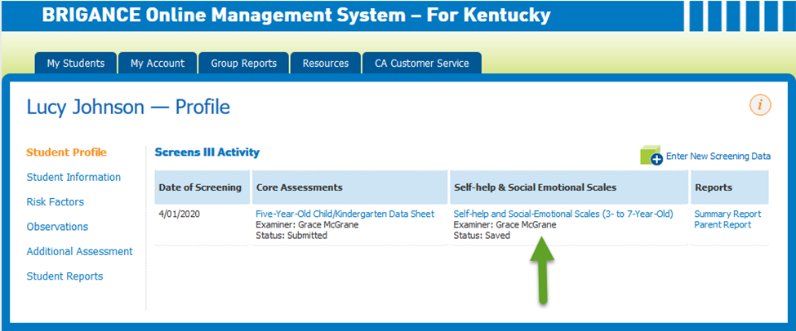
Continuing Data Entry
Notes:
Now let’s look closely at Lucy’s profile. When I look at this, I can see that Lucy’s core assessments are completely entered because the status is “submitted.” I also see that the Self-Help and Social-Emotional scales are not complete. I can tell that because the status is “saved.” If you want to continue entering data, you will not click enter new screening data. This is crossed out on the screen. Instead, you will click into the assessment as the green arrow points to and continue entering data, OR it may be that it was simply not submitted to score.

Slide 38
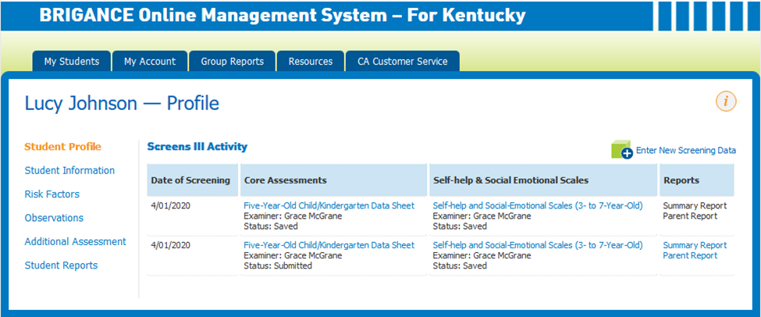
Avoid Duplicate Entries
Updating/Removing Duplicate Screen Entries in OMS
Notes:
A common error is duplicate entries. Duplicate entries must be removed from the OMS in order for the data to be accurate. Not removing duplicate entries impacts the results of group screening data. You can follow the link on the bottom of this slide or visit our K Screen webpage to find guidance on how to remove duplicate entries.

Slide 39
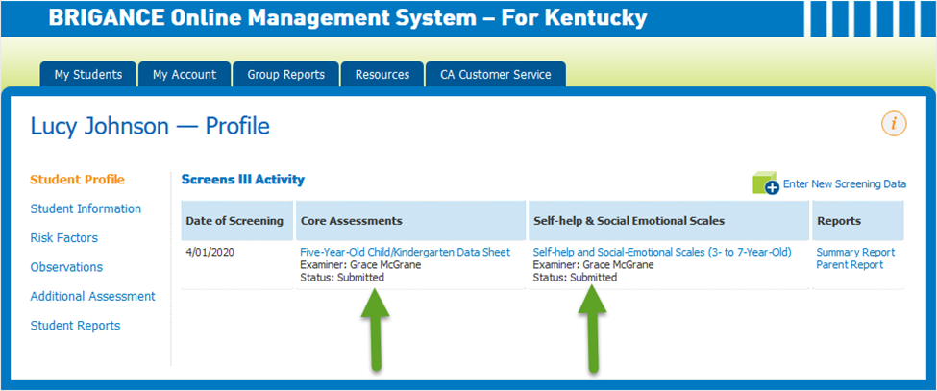
Complete Profile
Notes:
This is the ultimate end result for each student profile. “Submitted” on each section indicates the data is complete – nothing is missing, and each one has been submitted .

Slide 40
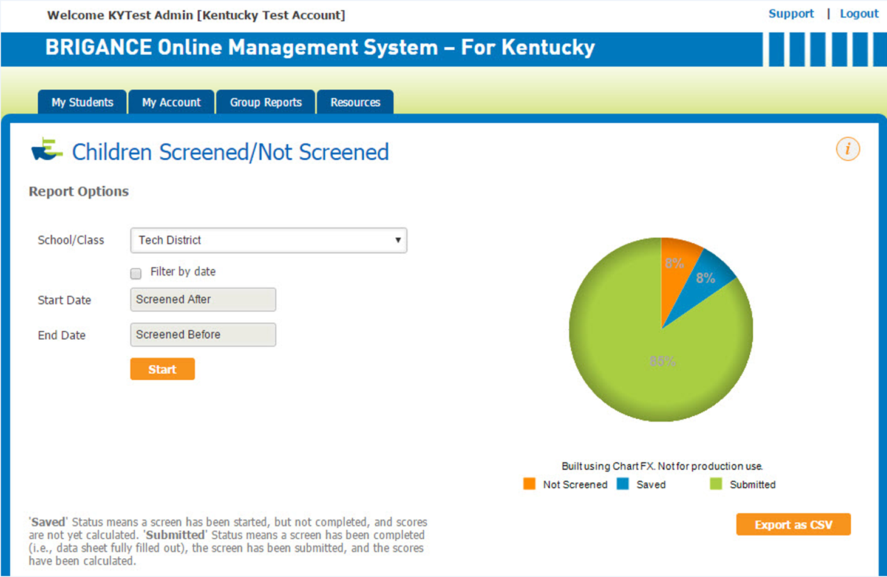
OMS Reports
Notes:
Screened/Not Screened Report is perfect for checking whether a child has saved data that hasn’t been submitted but be aware that it will say “submitted” even if SH/SE data is missing. This looks at the Core Assessment data only.

Slide 41
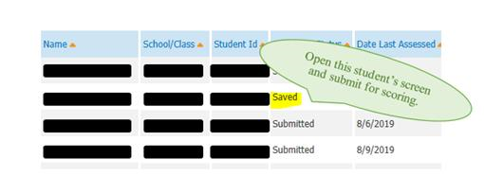
Children Screened/Not Screened Report
Notes:
We talked about the importance of clicking “Submit To Score.”
You want the pie chart to be all green. You should not have any blue unless you are still entering data. At the end of your data entry window, there should be no blue (saved).
If you do have data that is Saved but not Submitted, you can look for specific students by exporting the report as a CSV file and filtering the ‘Screening Status’ column for Saved, or you can scroll through the list provided under the pie chart.
As you can see, the saved will be included in the list. Simply open that student’s screen and submit for scoring.

Slide 42
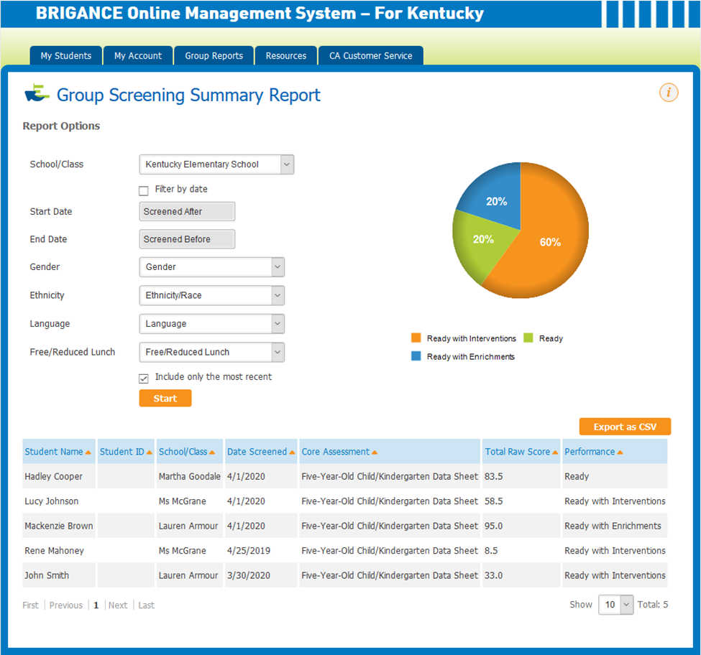
OMS Reports – Check Data
Notes:
It is important to utilize the CSV file. Exporting this group screening summary report as a CSV is the only way to check for:
1. Duplicate entries: When running the report, uncheck the box that says to include only the most recent, sort the SSID column numerically, and set a rule to highlight duplicates.
2. Missing Self-Help/Social-Emotional data: When running the report, make sure the box is checked to include only the most recent, set filters, and check for blanks in the column where Self-Help/Social-Emotional scores should be.

Slide 43
OMS Reminders
No iPad screening until OMS is live
Don’t assign students to a pretend class or one teacher in IC
Students cannot be manually entered
In an effort to avoid data inaccuracies, districts should not submit the Self Help and Social-Emotional (SH/SE) Skills Data in OMS if there is no Core Screen data being entered for the student.
Notes:
Please communicate this to schools:
Your OMS account might look perfect in early August, but I wouldn’t count on it being operational. There are often issues that need to be resolved before student data can be entered. KDE will communicate when the OMS is ready to be used. This is important to know if you are screening with tablets or iPads.
Also, in the past, some schools have tried to “get ahead” by setting up a homeroom under a school administrator’s name so they could screen on iPads and sort the kids into homerooms later. The kids didn’t move automatically, and they had to manually move the students to the correct classes.

Slide 44
Data Entry Reminders
Enter only one new screening session
Be sure all items on the Self-Help and Social-Emotional Scales are completed
Make sure you click “Submit to Score” after entering both the K Core Assessment and SH/SE Scales
View the Group Report and Export as CSV to sort information by domains
Notes:
Please communicate this to schools:
Avoid duplicate entries by only clicking a new screening session one time.
Run reports to ensure all data is entered and SUBMITTED.
Make sure that Submit To Score is clicked when ALL data is entered in order for the assessment to be considered complete.
CSV files allow for filtering reports.

Slide 45
OMS Updates
Notes:
The Office of Assessment and Accountability and Curriculum Associates has listened to your suggestions and are pleased to announce several new features that have been added to the Online Management System for this screening window.

Slide 46
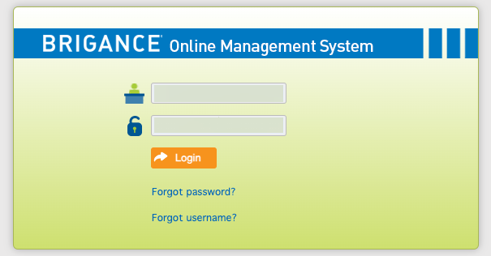
Forgot Username
Notes:
The first updates you will see are the “Forgot username” and “Forgot password” options on the login page.

Slide 47
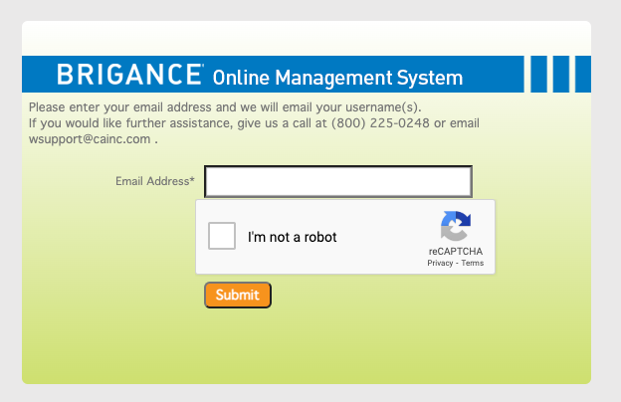
Forgot Password/Username Feature
Notes:
When you click on this option you will be directed to enter you district email as well as clicking the reCAPTCHA security feature.

Slide 48
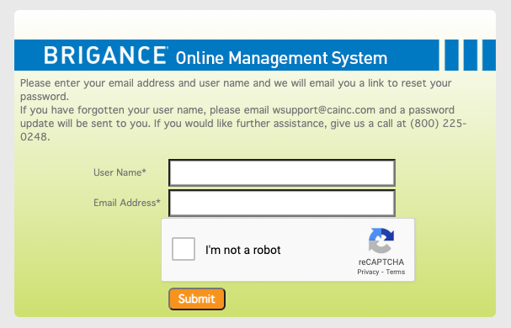
Forgot Password/Username Feature Continued
Notes:
When resetting your password, you will need to enter your username and district email before marking the reCAPTCHA security feature. After completing either of the above-mentioned options, an email will be sent to the district email account that was entered.

Slide 49
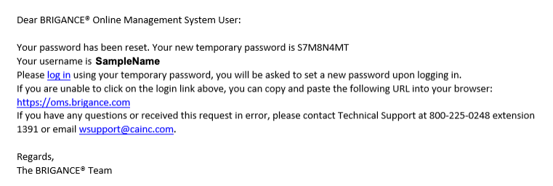
Email Update
Notes:
Here is a screenshot of an email one would receive when resetting their OMS password. You will notice contact information that can be utilized if further assistance is required.

Slide 50
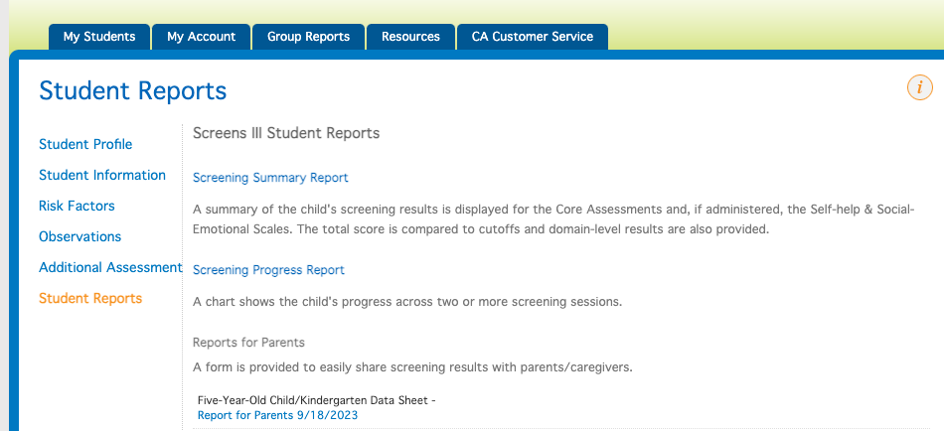
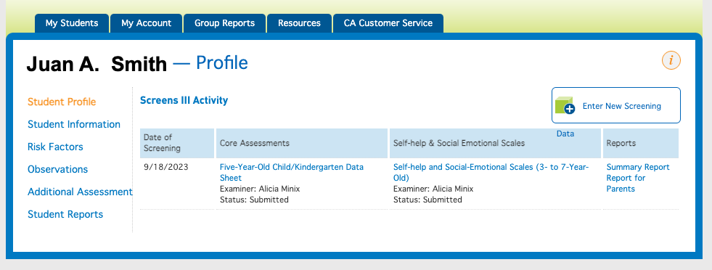
Updated Label for Parent Reports Link
Notes:
Once screening is completed, districts are required to provide parent reports, providing individual results of the screener to parents and or guardians. CA has updated the label for the Parent Reports. Using the Student Reports option, you will see a link to the Report for Parents link located in the bottom red box. You can navigate to the Parent Report by looking at the student profile page as well. On this page, the Parent Report is located on the far right.

Slide 51
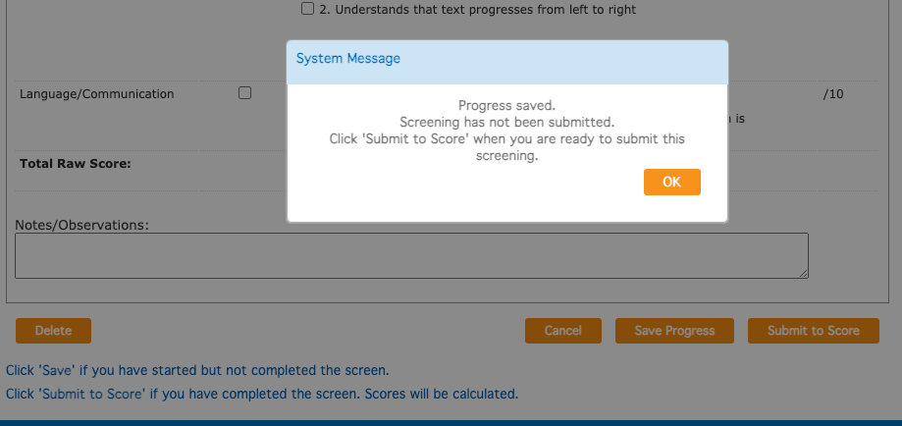
New System Message
Notes:
OMS now has a reminder message when one saves BRIGANCE K Screen data as opposed to pressing the ‘Submit To Score’ button.

Slide 52
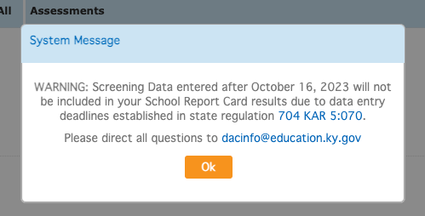
New System Warning
Notes:
Last season, CA implemented a new system warning, reminding districts of the deadline to enter BRIGANCE data into the OMS. This message will be updated with the correct deadline of October 15 and reimplemented to notify districts of the deadline.

Slide 53
Active/Inactive Filter
Notes:
When searching for students in OMS, educators can now choose to show all, show only active students, or show inactive students by using the drop-down menu below the field “Search Name”.

Slide 54
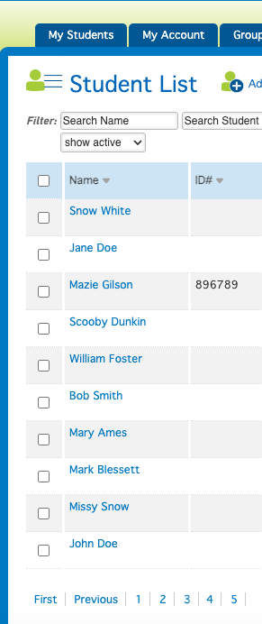
Multi-select Option
Users now have the option to select more than one student or select all students.
Notes:
Another new feature this screening season is the ability to multi-select students by using the check boxes to the left of student names.

Slide 55
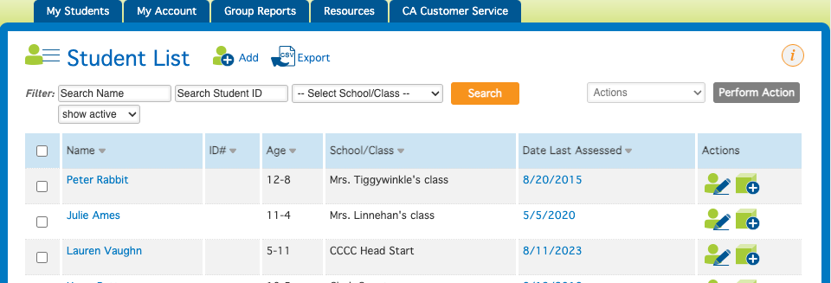
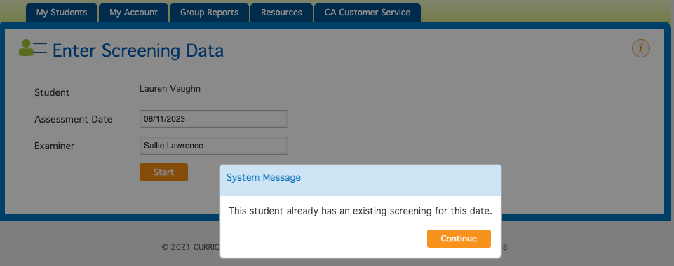
Prevent Screening on the Same Date
Notes:
In an effort to assist in preventing duplicate screens, OMS now features a system message, alerting data entry staff if the student has an existing screen in the system.

Slide 56
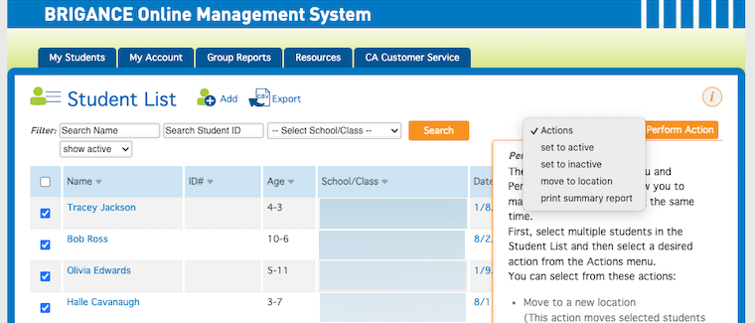
Ability to Batch Print Reports
Notes:
OMS Administrators now have the option to “batch print” reports.

Slide 57
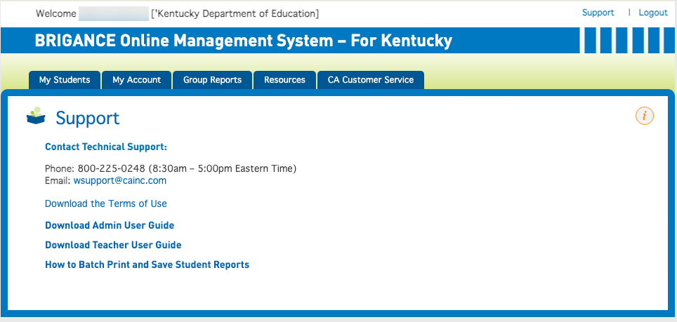
Online Resource
Notes:
To assist with batch printing and other topics, OMS has a “support” tab; at the bottom you will find assistance with batch printing.

Slide 58
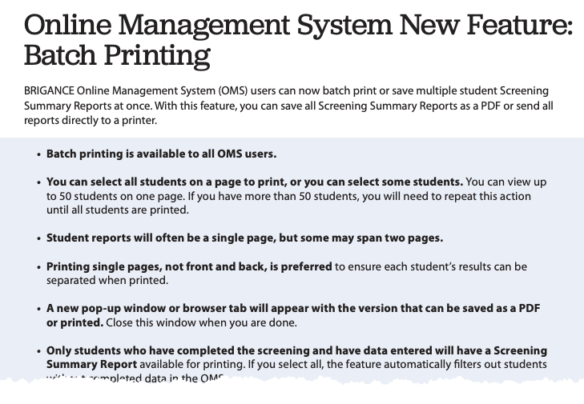
Online Resource: Batch Printing

Slide 59
Resources

Slide 60
Kindergarten Screen Resources
K Screen Updates
Implementation Guide
K Screen Webcasts
Refresher TtT Webcast
Prior Settings Video
Curriculum Associates Kentucky BRIGANCE Video Series
Common Kindergarten Entry Screener website
Notes:
These are important resources for the district K screen contact/administrator to review often and communicate with the appropriate people such as those administering screens in the classroom (teachers and support staff, interventionists), principals, IC district contact, data entry staff (secretaries, IC building person, attendance clerks) and DACS/BACS.

Slide 61
Kentucky OMS Training Videos
Part 1: Introduction and Overview
Part 2: Accessing the KY OMS
Part 3: Entering Required Screen data: Core Assessments
Part 4: Entering Required Screen data: Self-help and Social-Emotional Scales
Part 5: Viewing the Screening Summary Report and Online Data Sheet
Part 6: Group Reports
Part 7: Recommended Screen Data
Part 8: Sharing Screening Results with Families
Part 9: Resource Tab
Part 10: Tips to Avoid Common Pitfalls when Entering OMS Data
Part 11: Administrator Features
Notes:
These videos are important for viewing in order to familiarize yourselves with the OMS. They go beyond the highlights I have provided. Remember these slides can be used in full or in part for the 3-hour new screen training and the refresher you provide to trained staff.
All are great for district training, but the Common Pitfalls video – Part 10 is required.
For the 3-hour district training, I recommend part 3, part 4, part 6 and 10 (required).

Slide 62
Training Videos
Curriculum Associates Kentucky Brigance Website
Notes:
You can find Training Videos on the Kentucky Brigance webpage BRIGANCE.com/Kentucky

Slide 63
Possible Topics for Experienced Teacher and/or Data Entry Training
Timelines
Review Implementation Guide
Review Infinite Campus K Screen Reference Guide
Sign Implementation agreement
Common pitfalls video from CA
Collecting prior settings data
If SH/SE scale is unavailable from family, complete the teacher survey during your screening window
OMS videos
Log into new OMS accounts early August
District specific procedures and timelines
Notes:
This is a slide to help guide you in developing your own trainings for the upcoming school year.

Slide 64
What should I be doing now?
Review Implementation Guide
Determine Screening Window
Order Materials
Plan Training
Prepare for Data Entry
Revise Staff File
Collect Prior Setting Data
Notes:
K screen implementation has several requirements at different times of the year, different places to enter data, etc. While it’s not a difficult process, there’s a lot to it.
So, that said, I have broken it down into what needs to be completed in the upcoming weeks. Take a moment to review this information.

Slide 65
Next Steps
Provide Training
Access and check OMS account
Monitor data entry in IC and OMS
(districts/school admins)
Gather screening materials
Administer Screen
Collect Self-Help and Social-Emotional Scales
Enter data in IC and OMS
Share results with families
Notes:
Once you have completed what is on the previous slide, use this slide as a resource for what comes next. Again, use all the resources that are available to help you navigate the year. I think it is important to know that you should share the results with families. We pull the data to report school readiness, and it is included in your district open house data found on the KDE website.

Slide 66
Thank you for your time and attention today!
Feel free to reach out to me with any questions concerning the K Screen
Lisa.jett@education.ky.gov
(502) 564-4394. ext. 4755

Slide 67
Division of Assessment and Accountability Support
Lisa Jett, Program Consultant
OAA/DAAS (502) 564-4394 lisa.jett@education.ky.gov

