Slide 1
ALTERNATE ASSESSMENT & ACCOUNTABILITY FOLDER
AAAF

Slide 2
IMPORTANT
The Kentucky Department of Education no longer requires the AAAF to be kept as a requirement of the state. The decision to use the AAAF beginning in the fall 2020 will be a district decision only.
The AAAF should not be considered a student working folder; as it will require some student work within, but not all daily assignments should be included.
This PowerPoint will provide additional information to the specific contents of the AAAF.

Slide 3
Components of the AAAF
Student Information Page (required)
Teacher Code of Ethics (Found in Alternate K- PREP Resources)
Teacher Qualification Quiz(s) (quizzes provided with Alternate Assessment Online Trainings):
Overview/Attainment Tasks
Transition Attainment Record- applies to teachers of students in grade 11, if a grade 12 or 14 student will be administered the TAR, those teachers should also be trained

Slide 4
Components of the AAAF
ATTAINMENT TASKS:
Section 1-Work Samples (Test Window 1)
Section 2- Work Samples (Test Window 2)
Section 3- Attainment Task Scores from Test Window 1 and Supports Sheet (if one was required)

Slide 5
Components of the AAAF
Section 4- Attainment Task Scores from Test Window 2 and Supports Sheet (if one was required)
Section 5- Anecdotal Notes (supporting notes regarding specific student information on either of the Attainment Task test windows)

Slide 6
Components of the AAAF
TRANSITION ATTAINMENT RECORD (TAR)
Required for students in grade 11.
Optional for students in grades 12 or 14 if benchmark not met at grade 11.
Section 6-
Location where the supporting documentation is stored (e.g., Individualized Education Program (IEP) data in Due Process Folder)
Original completed Transition Attainment Record document.
All participating members listed on original document.

Slide 7
Student Information Page for AAAF & CRAAF
Provides the following:
Student Name
School
District
Grade
SSID (Student Identification Number)
New Student Placement or Enrollment
Accommodations (List all accommodations identified on the students IEP
Teachers name and signature

Slide 8
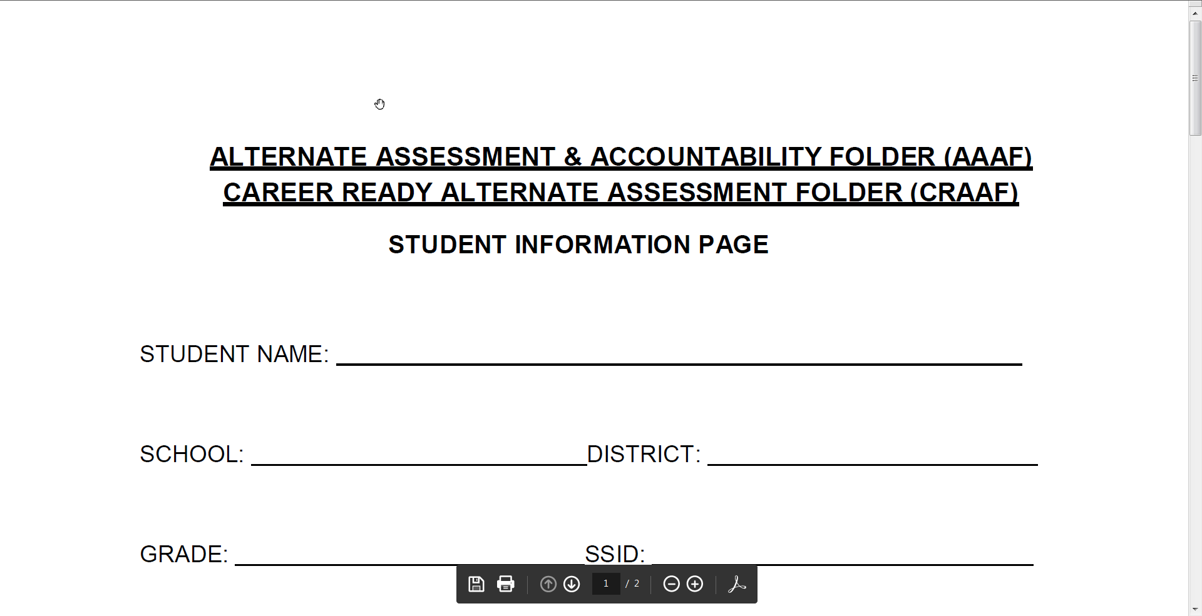
Combined AAAF and CRAAF Student Information Page

Slide 9
Code of Ethics
Identifies specific assessment policies such as:
Professional Ethics
Educational Defensibility
Student Ownership
Accommodations
Student Performance
Teachers may sign one Code of Ethics and provide copies to multiple student AAAF folders. An original is not required for every student.

Slide 10
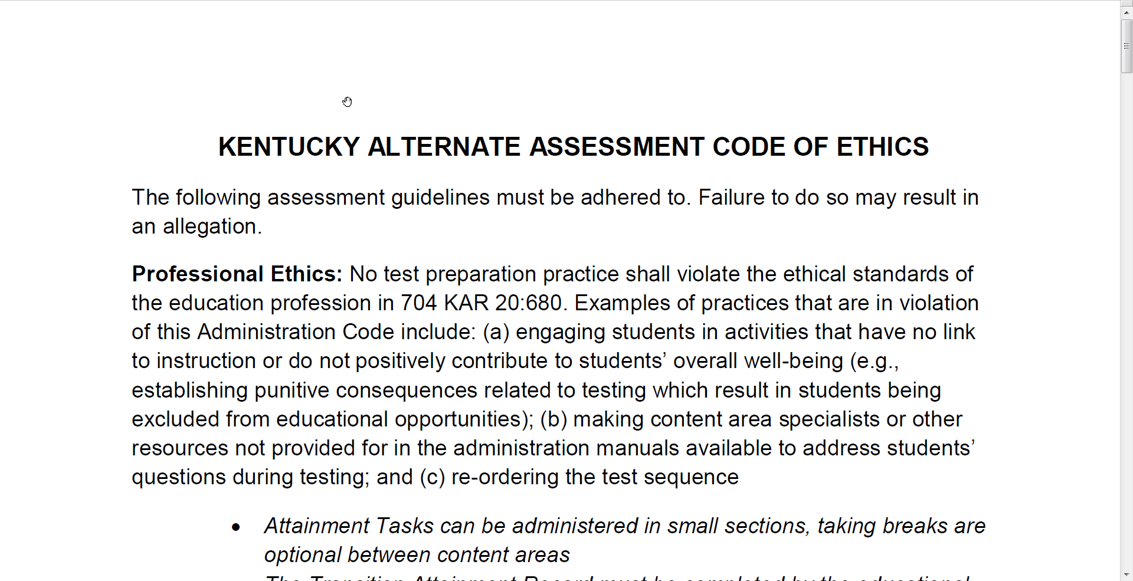
Kentucky Alternate Assessment Code of Ethics document

Slide 11
Teacher Qualifications
Complete required online training and quiz conducted for each part of the Alternate Assessment.
After successfully completing and passing the online quiz, print the certificate verifying its completion. Provide a copy of the certificate in the AAAF, the other to your BAC or DAC before materials are received.
Alternate Assessment Quizzes: Combined Overview/ Attainment Tasks Quiz and Transition Attainment Record Quiz.

Slide 12
Section 1 (Test Window 1)
Work Samples:
1 per standard
Aligned to the content standard
Score identified
Must include the following:
Name Date
Grade Content Area
Standard Score (%)
(ex: 4.1 Grade 4 standard 1)

Slide 13
Section 2 (Test Window 2)
Work Samples:
1 per standard
Aligned to the content standard
Score identified
Must include the following:
Name Date
Grade Content Area
Standard Score (%)
(ex: 4.1 Grade 4 standard 1)

Slide 14
Section 3
Attainment Task score sheet from Test Window 1
Supports sheet(s) for any adjustments made to any of the task items from Test Window 1. (If no additional supports were required then a support sheet does not need to be completed)
See next slide for example of Supports Sheet

Slide 15
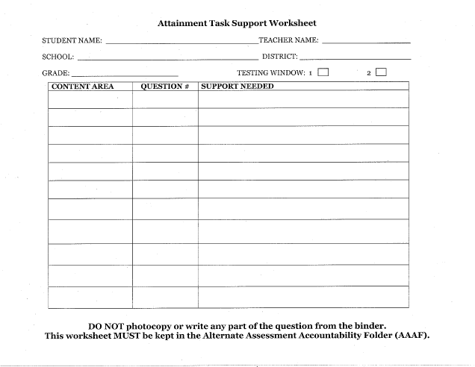
Attainment Tasks Support Worksheet

Slide 16
Section 4
Attainment Task score sheet from Test Window 2
Supports sheet(s) for any adjustments made to any of the task items from Test Window 2. (If no additional supports were required then a support sheet does not need to be submitted)

Slide 17
Section 5
Anecdotal Notes:
Supporting notes regarding specific student information that could impact either of the Attainment Task test windows.
An example might be that a student was hospitalized for two weeks during the mathematics assessment. Another may be that a restraint occurred during testing. Hopes are neither of these happen, but unfortunately they do occur.

Slide 18
Section 6
TRANSITION ATTAINMENT RECORD (TAR)
Required for students in grade 11.
Optional at grades 12 and 14 if benchmark not met at grade11.
Documentation concerning meeting held to complete the record (i.e., who, where, and when).
Original completed Transition Attainment Record document .
List all participating members on the original document.

Slide 19
AAAF Review Form
This review is not part of accountability but instead focuses on classroom instruction provided to students participating in the Kentucky Alternate Assessment.
The Kentucky Department of Education no longer requires the AAAF to be kept as a requirement of the state. The decision to use the AAAF beginning in the fall 2020 will be a district decision only.

