Slide 1
Accountability Indicator Training:
Quality of School Climate and Safety Indicator
Krista Mullins
Program Consultant
Office of Assessment and Accountability
Notes:
Hello! My name is Krista Mullins and I am a program consultant in the Office of Assessment and Accountability. I am pleased to be talking with you today about the Quality of School Climate and Safety Indicator.

Slide 2
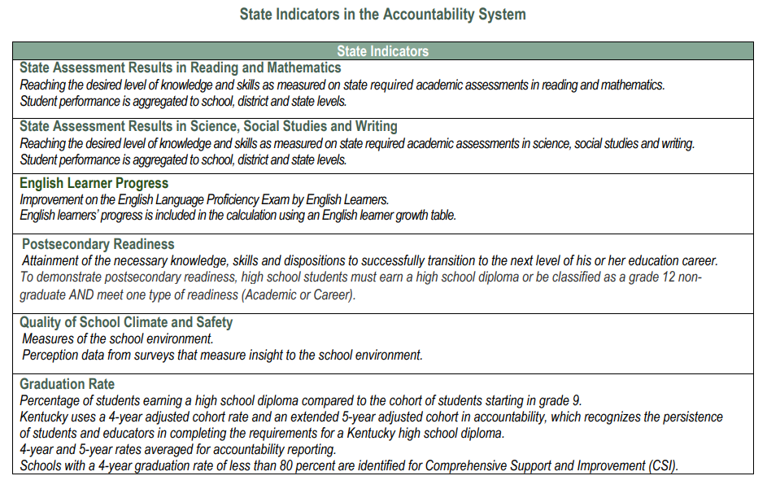
State Indicators in the Accountability System
Notes:
Quality of School Climate and Safety or QSCS is one of 6 state indicators in the accountability system.

Slide 3
Agenda
Rationale/History
QSCS Survey Construction
Scoring
Accountability Weights/Impact on Overall Performance
Where to Find Data
Next Steps with Data
Notes:
Today we are going to discuss the rationale behind the Quality of School Climate and Safety survey, how it is constructed, scoring, accountability weight, where to find the data, and how that data might be used.

Slide 4
Rationale
Notes:
Let’s look at the rationale for the QSCS.

Slide 5
Rationale
Senate Bill 158 (2020) amended the accountability system to include multiple meaningful measures to describe the overall performance of each district, school, and student demographic group.
The Quality of School Climate and Safety (QSCS) indicator is a state indicator for accountability that uses student perceptions from a survey to provide insight into the school environment.
Notes:
In 2020, Senate Bill 158 amended the accountability system to include multiple meaningful measures for performance. The QSCS indicator uses perceptions from a survey to provide insight into the school environment.

Slide 6
History of the QSCS
Notes:
The history of the QSCS survey involved many stakeholders.

Slide 7
History
Human Resources Research Organization (HumRRO), an industry expert in survey development and analysis, created the survey and tested it for validity and reliability.
Students participated in survey development and a field test.
Notes:
The survey was created by HumRRO with the assistance of students and other stakeholders, and it was tested for validity and reliability and field tested before implementation.

Slide 8
QSCS Survey Construction
Notes:
How was the QSCS Survey constructed?

Slide 9
Survey Construction
Two forms (Gr. 3-5 and Gr. 6-High School)
Modified survey for students on Alternate KSA
Climate and Safety Items (two constructs used for accountability)
QSCS Survey questions for both forms are available on the KDE Quality of School Climate and Safety webpage.
Students indicate agreement to statements using a Likert response scale
Notes:
There are 2 forms- one for grades 3-5 and one for grades 6- High School. Students in Grade 9 and 12 do not take the survey. There is a modified version available for students on the Alternate assessment. There are two constructs related to climate and safety, and students use a Likert response scale to indicate their agreement to statements. Copies of the survey questions for all forms and versions are available on the KDE Quality of School Climate and Safety Webpage.

Slide 10
Scoring the QSCS
Notes:
How is the QSCS scored?

Slide 11
Scoring
0.00
33.33
66.66
100.00
Student responses are assigned scores of 0.00, 33.33, 66.66, and 100.00 based on the student’s response being least favorable to most favorable.
The scores are averaged for each question to get a question score.
The Climate and Safety indexes are calculated by averaging the question scores that are associated with either Climate or Safety.
Notes:
Students are assigned scores of 0.00 for Strongly Disagree, 33.33 for Disagree, 66.66 for Agree, and 100.00 for Strongly Agree. They are averaged for each question to get a question score. The questions are then categorized into either Climate or Safety and the scores are averaged into an index.

Slide 12
Status Scores
The Status Score is the numerical value for the current year for a given indicator.
Indicator | State Assessment Results in Reading and Mathematics | State Assessment Results in Science, Social Studies, and Writing | English Learner Progress | Quality of School Climate and Safety | Postsecondary Readiness (HS only) | Graduation Rate (HS only)
Metric | Weighted performance index based on student assessment performance levels | Weighted performance index based on student assessment performance levels | Points assigned based on student-level growth as measured by a value table | Average of student scores for applicable questions in the QSCS survey | Percent of 12th grade students demonstrating academic or career readiness | Average 4- and 5-year graduation rates
Notes:
The status score is the numerical value for the current year for a given indicator. Here you can see how the status score is calculated for each indicator. As previously stated, the status score for the QSCS is calculated by averaging the average score of the safety construct with the average score of the climate construct. Finding the status score is the first part of the process to find the overall score.

Slide 13
Status Score
Safety Construct Score
Climate Construct Score
Climate and Safety Status Score
Notes:
As mentioned in the last slide, the two constructs that go into the status score are the safety construct score and the climate construct score. The average student scores for questions associated with Safety are averaged again to create one Safety Construct Score. The average student scores for questions associated with Climate are averaged again to create one Climate Construct Score. Together, they are averaged to yield the Climate and Safety Status Score. For example, if the safety construct average score was 52 and the climate construct average score was 60, the climate and safety status score would be 56. 52 (safety) + 60 (climate) =112. 112 divided by 2 (safety and climate) equals 56.

Slide 14
Status Levels
There are five Status Levels.
Status | Very Low | Low | Medium | High | Very High
Notes:
Here you can see the five status levels; very low, low, medium, high, and very high.

Slide 15
Change Score
Change Scores are a simple subtraction of Prior Year Status Scores from Current Year Status Scores.
They are calculated the same way for every Indicator.
Current Year Status Score – Prior Year Status Score = Change Score
Prior Year Scores are used to calculate Change Scores. They are not used to influence Indicator Performance Ratings.
Prior Year Status Score
Change
Score
Current Year Status Score
Notes:
When looking to determine the change scores, you will use the prior year’s score as well as the status score from the current year. For example, if the 2022-2023 (current status) score is 62 and the prior status score (2021-2022) was 52, you would take 62 minus 52 which would equal 10 (change score).

Slide 16
Change Levels
There are five Change Levels:
Change | Declined Significantly | Declined | Maintained | Increased | Increased Significantly
Notes:
There are five levels of change; declined significantly, declined, maintained, increased, and increased significantly.

Slide 17
Indicator Scores
Indicator Scores are a simple combination of Status Score and Change Score.
They are calculated the same way for every Indicator.
Current Year Status Score + Change Score = Indicator Score
Indicator Scores are used to calculate Overall Scores. They do not influence Indicator Performance Ratings.
Current Year Status Score
Change Score
Indicator Score
Notes:
Now that we know the status score and the change score, we can determine the indicator score which is used to determine the overall score. By using our previous example, we will take the current year status score of 62 and add that to the change score of 10 which will give us the indicator score of 72.

Slide 18
Indicator Performance Ratings
Table: Indicator Performance Ratings based on combined Change and Status Levels
 | Change Declined Significantly | Change Declined | Change Maintained | Change Increased | Change Increased Significantly
Very High Status in current year | Yellow | Green | Blue | Blue | Blue
High Status in current year | Yellow | Yellow | Green | Green | Blue
Medium Status in current year | Orange | Orange | Yellow | Green | Green
Low Status in current year | Red | Orange | Orange | Yellow | Yellow
Very Low Status in current year | Red | Red | Red | Orange | Yellow
Notes:
While this table does not have the specific cut scores, it can give you an idea of what the indicator performance levels will look like.

Slide 19
Overall Accountability Weights
 | State Assessment Results - Reading and Math | Other State Assessment Results -Science (SC), Social Studies (SS) and Combined Writing (CW) | English Learner Progress | Quality of School Climate and Safety (QSCS) | Postsecondary Readiness | Graduation Rate
Elementary | 51 | 40 | 5 | 4
Middle | 46 | 45 | 5 | 4
High | 45 | 20 | 5 | 4 | 20 | 6
If any indicator is not available, weights will be redistributed proportionally to remaining indicators.
Notes:
At the elementary, middle, and high school level, the Quality of School Climate and Safety indicator is given a 4% weight. If for some reason a school does not have scores in a category (such as English Learner progress), that percentage is proportionally redistributed among the other indicators, so the QSCS indicator would hold a little more weight than 4%.

Slide 20
Overall Score – Elementary
Overall Scores represent the combined outcomes across all applicable Indicators, with appropriate weights applied.
Elementary Overall Score Calculation
State Assessment Results in Reading and Mathematics Indicator Score * .51
State Assessment Results in SC, SS and CW Indicator Score * .40
Overall Score
English Learner Progress Indicator Score *.05
QSCS Indicator Score
* .04
Notes:
Using this example from elementary school, we can see how the overall score is calculated. The QSCS indicator portion of the formula is shown on this slide with the red oval. You can see that we will take the QSCS indicator score of 72 that we calculated earlier and will now multiply that by the weight of 0.04 or 4%. The weight came from the weight table that was shown earlier. The QSCS portion of the overall score formula after multiplying 72 by 0.04 would equal 2.88. Once you have calculated the other indicator scores and multiplied them by their weights, you can add each of these together to determine your overall score. For the QSCS indicator, the weight of 4% is the same at elementary, middle, and high school. Weights will be different for other indicators depending on the grade level.

Slide 21
Overall Designations
An overall performance score combines performance on the exclusive state indicators for elementary, middle and high schools.
The ratings will be reported using a color rating system to communicate performance of schools, with Red being the lowest rating and Blue being the highest rating.
Color ratings include five performance levels from highest to lowest, Blue, Green, Yellow, Orange and Red.
Blue
Green
Yellow
Orange
Red
21
Notes:
Ratings will be reported using a color rated system from highest to lowest, Blue, Green, Yellow, Orange, and Red. These ratings are based on weights approved by the Kentucky Board of Education (KBE).

Slide 22
Impact on Accountability
Notes:
How does this impact accountability?

Slide 23
Accountability
The QSCS Survey results are more than a participation rate.
Positively affiliated scores will generate a higher score for this indicator; negatively affiliated scores will generate a lower score for this indicator.
That score will then calculate into 4% of a school's overall performance rating for accountability.
Notes:
A common misconception is that the survey is for participation only- that if students just “take the survey” the school automatically gets their 4%. However- survey responses matter! Positively affiliated scores generate a higher score for this indicator, and negatively affiliated scores will generate a lower score for this indicator. The scores then calculate into that 4% weight toward the overall performance rating.

Slide 24
Where to Find Data
Notes:
Where can I find the QSCS data?

Slide 25
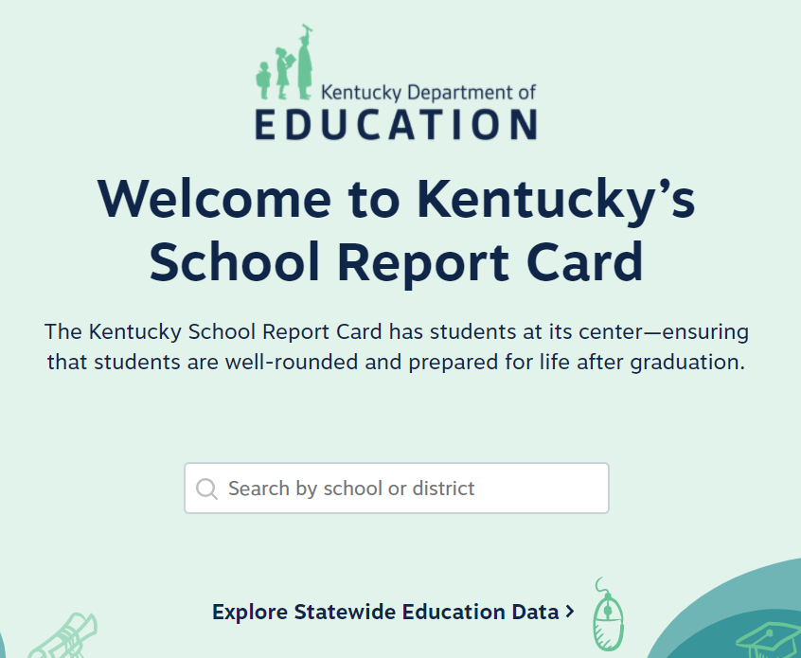
Where to Find QSCS Data
Data is released publicly in the School Report Card
Search by school or district or explore Statewide Data
Notes:
QSCS data can be found in the School Report Card, which is released publicly every fall. Once you are on this page, you can explore statewide data, or search for your district or school.

Slide 26
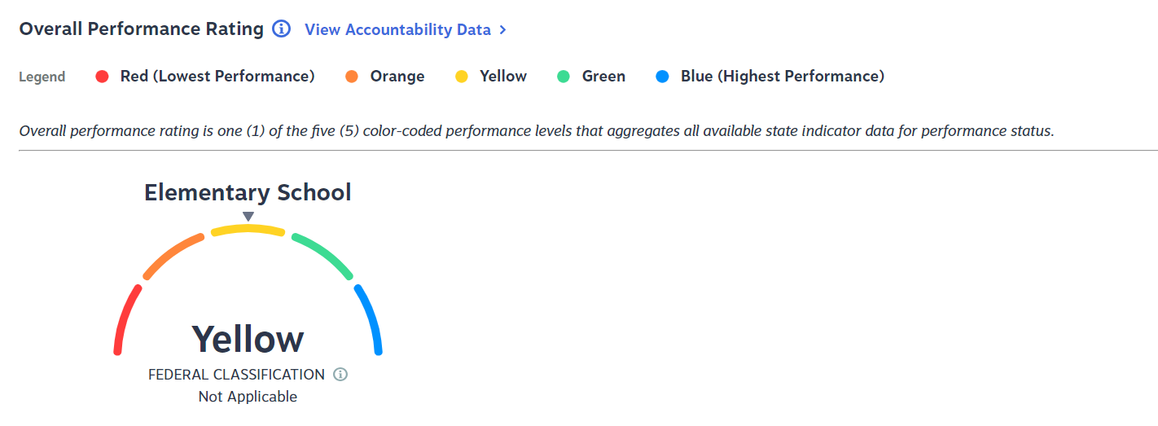
Locating QSCS Data
Notes:
Once you have searched for your school, your page will look like this. Next, you will click on “View Accountability Data” as indicated by the red oval on this slide.

Slide 27
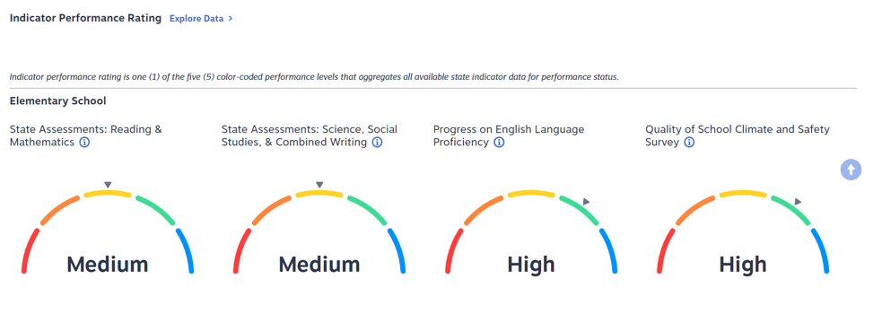
Locating QSCS Data (continued)
Notes:
After clicking “View Accountability Data”, you will see ratings for each area. Now click on “Explore Data” as indicated by a red oval on this slide.

Slide 28
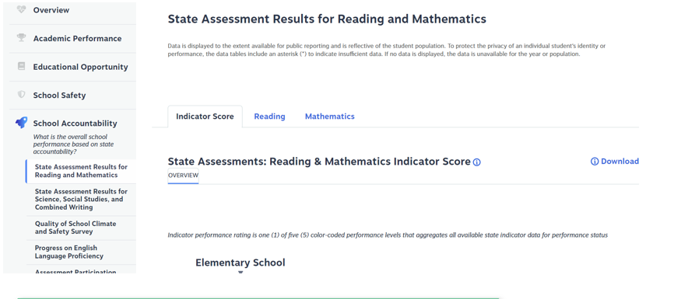
Locating QSCS Data (2)
Notes:
Once you have clicked “Explore Data”, it will bring you to this page. In the column on the left side, you will see “Quality of School Climate and Safety Survey” as indicated by the red oval.

Slide 29
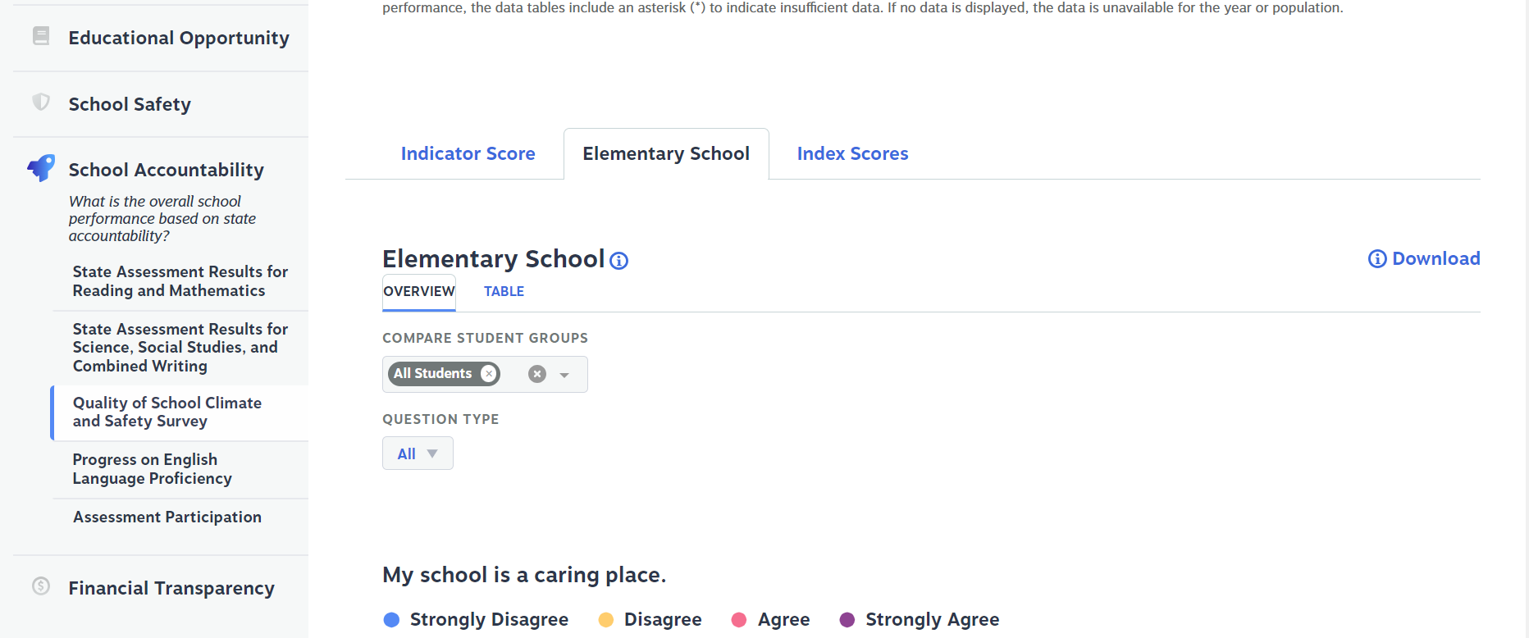
Locating QSCS Data (3)
Notes:
Once you have clicked on the “Quality of School Climate and Safety Survey”, you will be taken to a page that shows the indicator score. You can see the break down of responses by question by clicking on “Elementary School” as seen by the red oval. If your school is middle or high, then you would click on the tab that correlates to your school.

Slide 30
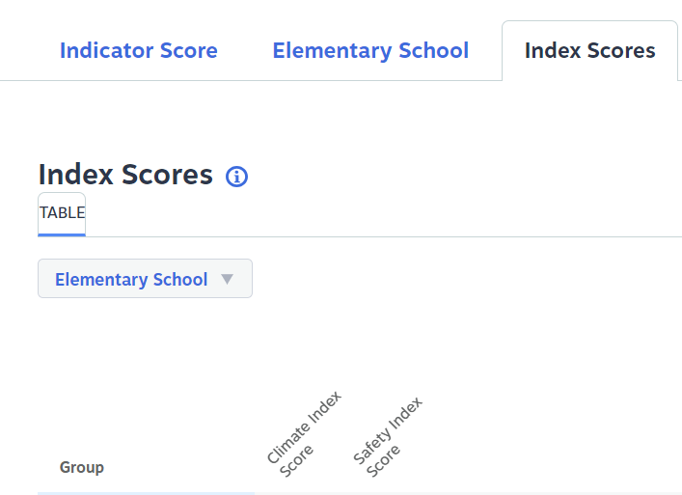
Locating QSCS Data (4)
Notes:
By clicking on “Index Scores” you can see the results for the climate index scores and safety index scores by demographics, gender, all students, etc.

Slide 31
Next Steps
Notes:
The data are planned to be included in the spreadsheets for Quality Control Day and released to the public in the school report card. How can this data be used?

Slide 32
Next Steps: How Can Schools Use Data?
Schools only receive aggregate data, which can be used to:
Identify areas of needed growth
Implement school climate interventions
Notes:
The QSCS survey scores weigh into accountability, but the data provided from survey responses can also be a valuable tool for districts and schools. This data, which correlates to student perception of school and learning environment, can help a school or district identify areas of needed growth, or to implement school climate interventions. Maslow’s hierarchy of needs has safety as the second priority of the base—if students don’t feel safe, accepted, or included, it is more difficult for them to learn. Much like the way schools use academic data to plan interventions and next steps, the aggregate data from the QSCS survey can be used to create a more supportive learning environment.

Slide 33
Division of Assessment and Accountability Support
Krista Mullins, Program Consultant
krista.mullins@education.ky.gov
OAA/DAAS (502) 564-4394 dacinfo@education.ky.gov
Notes:
This concludes the Quality of School Climate and Safety portion of the State Accountability Trainings. If you have any questions, please feel free to contact us at 502-564-4394 or at dacinfo@education.ky.gov or you can email me directly at krista.mullins@education.ky.gov

Slide 34
Ending Slide
Notes:
Thank you for your time.

