Slide 1
OTL:NGP:EA:1217

Slide 2
Objectives
Identify how reflection and growth planning is connected to improved educator effectiveness
Understand the process for self-reflection and professional growth planning

Slide 3
Self-Reflection
A process by which certified personnel assess the effectiveness and adequacy of their professional knowledge and performance for the purpose of identifying areas for professional learning and growth
Notes:
Discuss informal ways educators reflect on their professional practice.

Slide 4
Professional Growth Plan
An individualized plan that is:
focused on improving professional practice and leadership skills
aligned with educator and student performance standards
built using a variety of sources such as student data, educator data, and school/district data
produced in consultation with the evaluator

Slide 5
“Advocates of professional development for teachers are not arguing that teaching is of poor quality and must be fixed. Their advocacy for professional development for teachers reflects the recognition that teaching is so hard that it is never perfect; no matter how good a lesson is, it could always be improved.” Danielson, Talk About Teaching (2009).
Notes:
Advocates of professional development for teachers are not arguing that teaching is of poor quality and must be fixed. Their advocacy for professional development for teachers reflects the recognition that teaching is so hard that it is never perfect; no matter how good a lesson is, it could always be improved. ( Danielson, Talk About Teaching (2009).

Slide 6
Connecting Self-Reflection to Effective Teaching
Effective teachers may reflect on their work formally or informally; for example they may review a day’s work mentally, keep a journal, meet regularly with a mentor or with colleagues, or assess a videotaped recording of their teaching.
Good & Brophy, 1997; NBPTS, n.d.
Notes:
Reflection may be formal or informal as it is integrated into every aspect of a teacher’s professional life.

Slide 7
Connecting Self-Reflection to Effective Teaching (continued)
When teachers use data to reflect on what worked, what did not work, and what types of changes they might make to be more successful, the likelihood of knowing how to improve increases dramatically.
Airason & Gullickson, 2006; Tucker, Stronge, & Gareis, 2002.

Slide 8
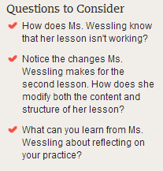
practice
Notes:
What can you learn from this teacher about reflecting on your practice?
https://www.teachingchannel.org/videos/when-lesson-plans-fail
Video is 16 minutes

Slide 9
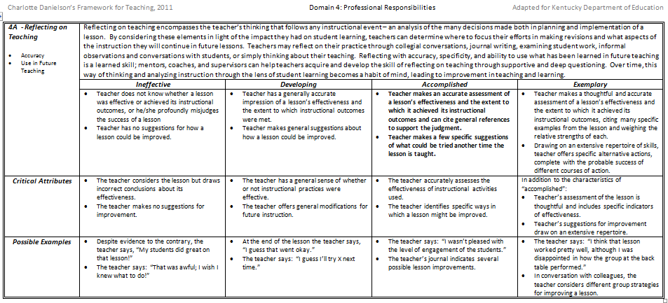
Handout: Framework for Teaching
Notes:
Handout needed: framework for teaching.
Ask participants to turn to domain 4 of the FfT.
Point out components 4A and 4E specifically address reflection and professional growth. (Note: Charlotte Danielson uses the term “reflective practice” instead of self-reflection. ).
Have participants read through these two components and the performance levels associated with each.
4.A explicitly addresses reflection on a lesson
4.E explicitly addresses growing and developing professionally
Review this sample of component 4A: Reflecting on Teaching: this component encompasses the teacher’s thinking that follows any instructional event-an analysis of the many decisions made both in planning and implementation of a lesson.
By considering these three elements (accuracy, use in future, and teaching), in light of the impact they had on student learning, teachers can determine where to focus their efforts in making revisions.
Over time, this way of thinking and analyzing instruction through the lens of student learning becomes a habit of mind, leading to improvements in teaching and learning.

Slide 10
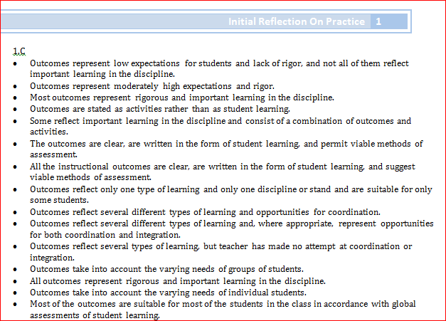
Reflection on Practice Process
Handout
Step 1: Highlight or circle the descriptors in each of the four domains that best describe your teaching practice.
Step 2: Find your highlighted descriptors in the KY Framework for Teaching.
Step 3: Determine your performance level in each of the components.
Step 4: identify your area of need to be used for the professional growth goal.
Notes:
Using the Initial Reflection on Practice document, an educator reflects on their teaching choosing the descriptors that best describe their teaching practices.

Slide 11
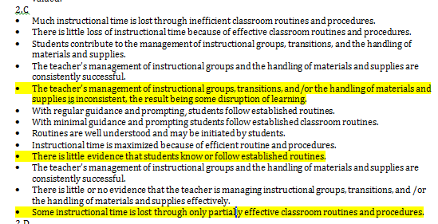
Example
Initial Reflection on Practice
Notes:
After a teacher has chosen the descriptors that best describe their teaching practice, they then refer to the KY Framework for Teaching and find the descriptors within the performance levels. Using this process, a teacher determines their performance level in each of the components in the framework.
It is this data that helps determine the professional growth need.
Educators record their self reflection ratings on the self assessment document.

Slide 12
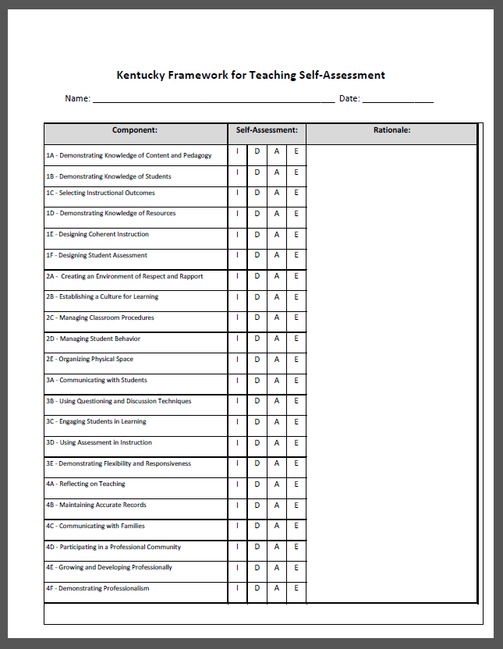
Handout: Self-Assessment
Identify your level of performance using the initial self reflection tool and/ or the self assessment document.
Provide rational or evidence to support your rating
Determine your area of need to be used in developing a professional growth goal
Notes:
As a group or individually, complete the self assessment and determine the main area of need for the professional growth goal

Slide 13
Places for Self-Reflection
Content standards and skills
Student Voice results
Professional Learning experiences
Recent developments in pedagogical research
An unfamiliar instructional approach
Demographic changes
Student Work
Student engagement during a recent lesson
Notes:
As content standards are evolving, teachers may want to self-assess their knowledge of content and content-specific skills.
Additionally, instructional strategies that support Kentucky’s Academic Standards (KAS) such as LDC and MDC may be new to some teachers; however, self-reflection of practice might focus on instructional approaches.

Slide 14
Goal setting for Professional Growth
Answer the following to develop a PG goal:
What do I want to change about my practice that will effectively impact student learning?
How can I develop a plan of action to address my professional learning?
How will I know if I accomplished my objective?
*You should be able to articulate what sources of evidence are informing your decisions when writing your goal.*
Notes:
After reflection, teachers consider these three questions to help write their professional growth goal (PGG).
The PGG is produced by a teacher in consultation with a principal or PLC.

Slide 15
Considerations for professional growth planning
Reflection on Kentucky Framework for Teaching (KyFfT)
Student growth goal
Content standards and content-specific skills
Student Voice results
Reflection on instructional practice and student outcomes
Other sources identified in the district CEP
Notes:
Before an educator writes their professional growth goal, they would certainly reflect on their teaching performance using the Kentucky Framework for Teaching.
However, teachers can consider other information as they make decisions about their professional growth.
Using sources such as student voice, or observation notes, or student growth progress or goals can help inform the professional growth need.
All or any of these can be considered as a teacher decides his or her professional growth goal.

Slide 16
Professional Growth Process
Educator shares goal with principal
Educator drafts goal
Principal approves goal or asks for revision
On going
Educator reflects on progress; then discusses progress with Principal
Educator implements learning strategies for attaining PG goal

Slide 17
Sample Professional Growth Goal
Any content area –
Area of focus/ growth need: formative assessment
During this school year, I want to embed formative assessment practices in my daily instruction. I will study Classroom Assessment for Student Learning, by Rick Stiggins, with my PLC team and begin to implement Keys to Quality Assessments. Indicators of success will include: lesson/unit plans with CASL elements (formative assessment cycle, learning targets, students monitoring their own learning); observational data; reflections after implementation; student data review and future instruction plans devised during PLC meetings.
Notes:
Notice how the goal addresses all three questions even if briefly. A teacher will decide the learning that will help him or her attain the goal.

Slide 18
Sample Professional Growth Goal (continued)
Any content area –
Focus area/ growth need: questioning & discussion techniques
During the school year, I will improve my questioning and discussion techniques. I will incorporate the Q-Chart for daily classroom discussions so that students can take ownership of classroom conversations. I will read and implement strategies from Classroom Discussions. Growth will be evidenced through lesson/unit plans that include strategies from the text, observational data, self-reflection after implementation, and student reflections after Socratic Seminars.
Notes:
Notice how the goal addresses all three questions even if briefly.
A teacher will decide the learning that will help him or her attain the goal.

Slide 19
Writing a Professional Growth Goal

Slide 20
Does it …
Articulate what I want to change about my practice that will effectively impact student learning?
Include a plan of action to address my professional learning?
Include sources of evidence that would serve as success criteria for meeting my objective?

Slide 21
What does the district CEP say?
What sources of evidence inform the PGP?
What forms will you use for the PGP?
How will you document progress throughout the year as you work towards your goal?
How many goals will you write each year?
When are reflections due?
How many?

Slide 22
Implement PGP and Action Plan
Are you consistently implementing the action plan as agreed in collaboration with your principal?
Notes:
Our past experiences with Professional Growth Planning has taught us that the action plan must be consistently implemented as agreed upon during the collaboration between principal and teacher. Teacher reflects on each phase of implementation making adjustments and revisions as needed.
22

Slide 23
Regularly Reflect on PGP Progress
Are you consistently using multiple data sources to reflect on your professional growth goal(s) status?
Notes:
As the teacher reviews, analyzes and reflects upon student work samples, test data and naturally occurring data generated in teaching and learning, she/he monitors his/her progress towards goal(s) and determining their goal status.

Slide 24
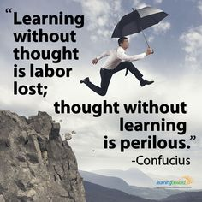
Questions? Contact: Christine Meisberger Manager, Teacher and Leader Effectiveness Branch 502-564-1479 ext. 4510 Christine.Meisberger@education.ky.gov

